Slide 1
CSE 574 Lecture 7:
Value Iteration and Policy Iteration for MDPs
Professor: Stephanie Gil
Email: sgil@asu.edu (Office hours M 12-1pm BYENG 386)
TAs: Sushmita Bhattacharya sbhatt55@asu.edu (Office hours M 5-6 BYENG 392)
Weiying Wang wwang239@asu.edu (Office hours Th 2:30-3:30 BYENG 392)

Slide 2
Last Time:
HW 2 due this Friday– any questions?
  Office hours tomorrow 2:30-3:30 with Weiying in BYENG 395
Midterm moved to Oct 3rd in class
Last time: Markov Models and Markov Decision Processes
  Reading Sutton and Barto text “Reinforcement Learning, An Introduction” Second Edition (2017), chapter 3 (available online)
Next time: Dynamic Programming and Optimal Control Vol 1
  Provided by Dimitri Bertsekas on our Blackboard site!
  Please note that this material is copyrighted and not authorized for sharing or posting outside of this class

Slide 3
Example: A Maze
States S={1,2,…,18}
Actions A={N,E,S,W}
Partially expanded state space?
Why is the reward negative?
How to solve for the best path?
  BFS?
  A*?
  Dynamic Programming!

Slide 4
Solving the Maze
What are good states? What are good actions?
This is defined in terms of expected reward – this is estimated via value functions
Policy – A mapping from states to probabilities of selecting each possible action. You can think of this as a strategy…
What about state 7?
Is state 3 a good state?
Does the value of a state depend on the subsequent action? Or policy?

Slide 5
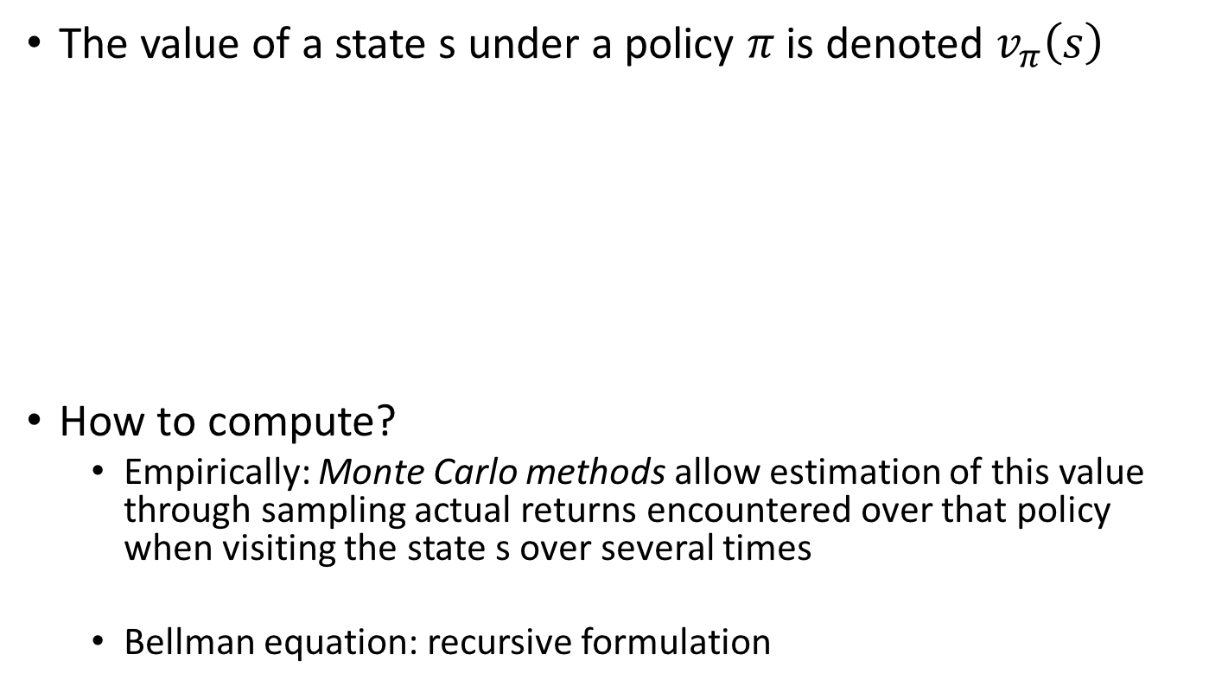
Policies and the Value of a State
Defines the probability of choosing action a given the state

Slide 6

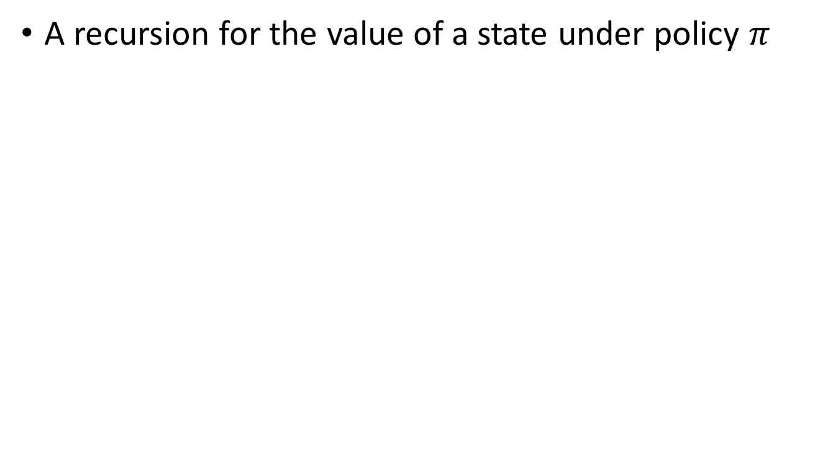
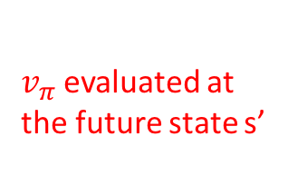
Bellman Equation for
A recursion for the value of a state under policy
evaluated at the future state s’

Slide 7
Q-Values
Q-value is the expected return of starting from a state s, taking action a, and following policy from that point forward
This is different from v since here we are committed to taking action a from state s
s
a
Choice of action
(agent)
stochasticity
s,a
Q-state
Stochastic state selection (environment)
s’

Slide 8
Example: Gridworld
Rules:
  Actions ={N,S,E,W}
  Rewards: -1 for moves off the grid, +10 for state A with teleportation to A’, +5 for state B with teleportation to B’, 0 for all other state-action pairs
  Discount
Policy: all four actions equally probable
Figure 3.3 Sutton and Barto text

Slide 9
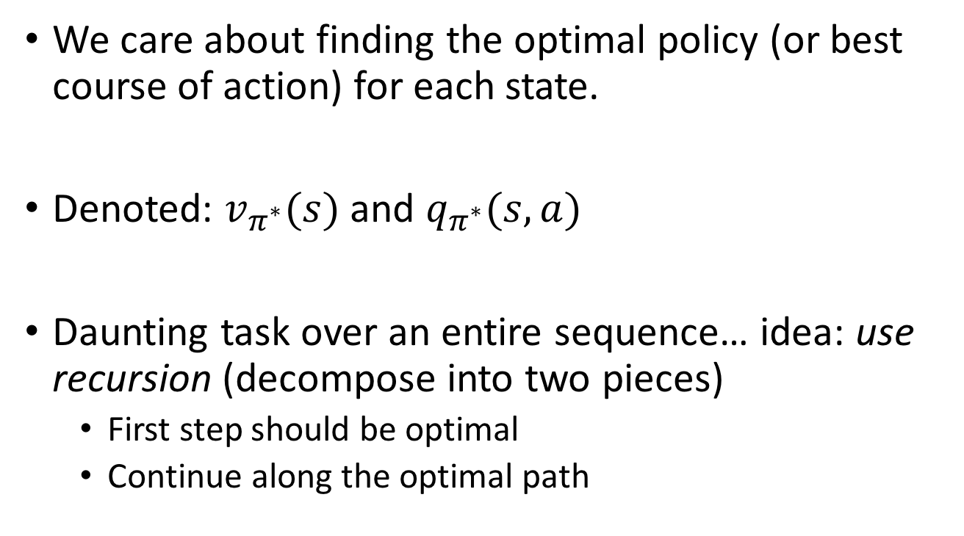
Optimal Policies

Slide 10
Example: Another Gridworld
Non-deterministic actions (80% success)
“Living” negative reward of -0.04 for every action
Terminal (absorbing) states have rewards +1, -1
Figure 17.1 in Russell and Norvig text

Slide 11
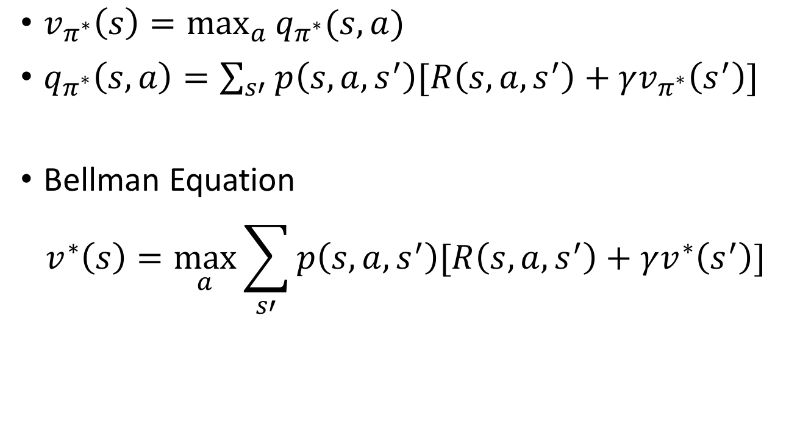
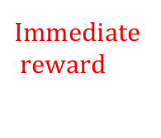

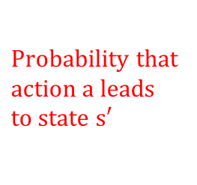
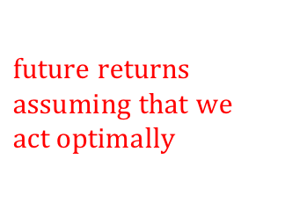

Bellman Equations

Slide 12
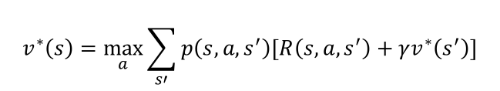
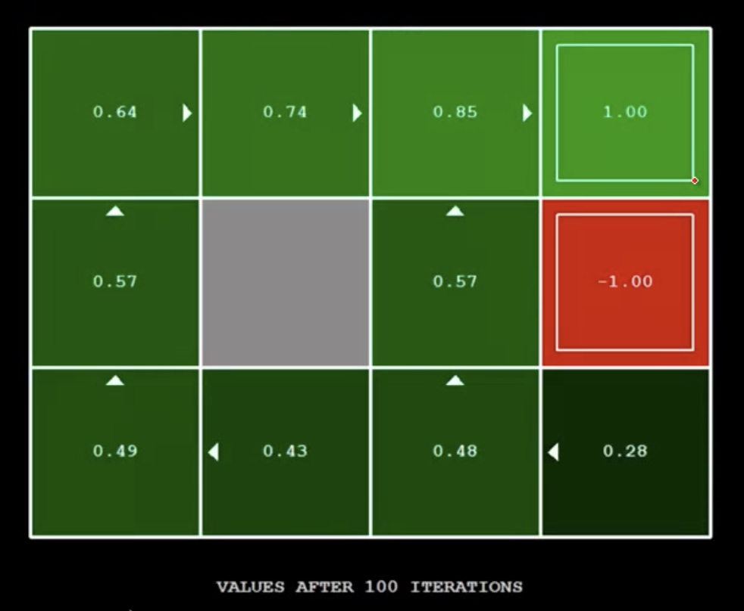
Simple Gridworld V-values
Figure 17.1 in Russell and Norvig text
CS188 Spring 2014 Berkeley AI Lectures

Slide 13
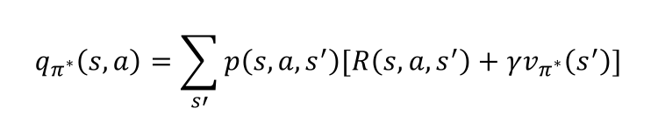
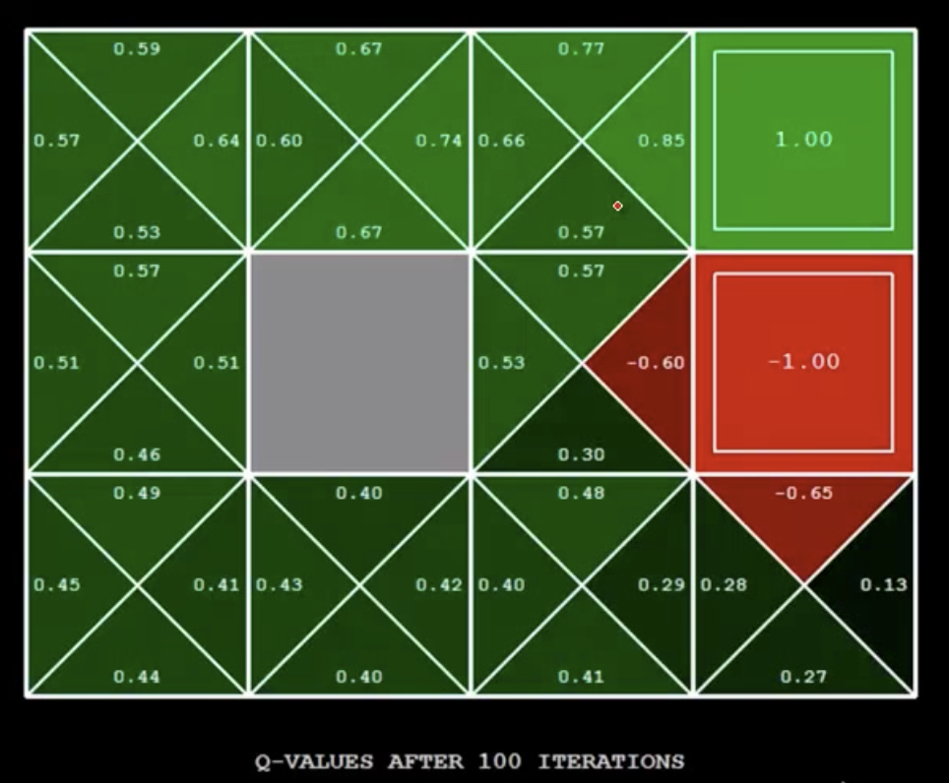
Simple Gridworld Q-values
Figure 17.1 in Russell and Norvig text
CS188 Spring 2014 Berkeley AI Lectures

Slide 14
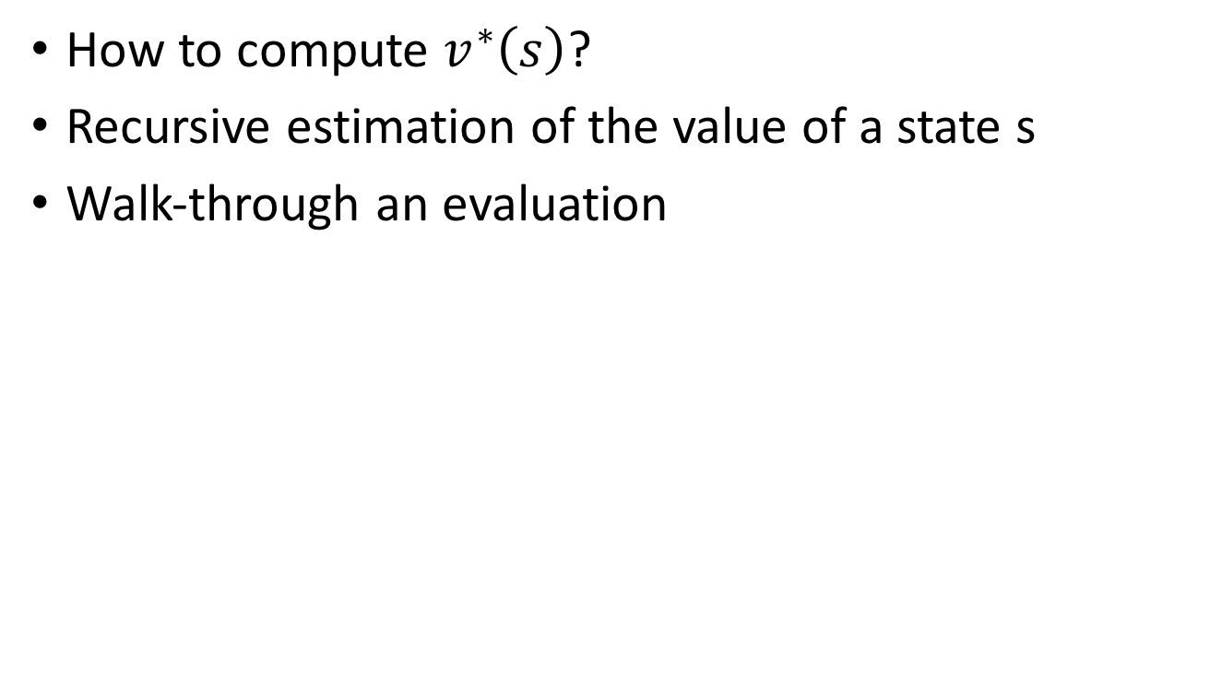

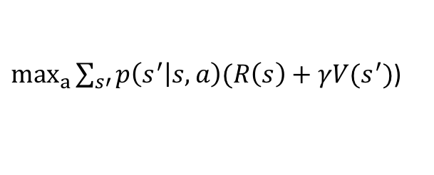
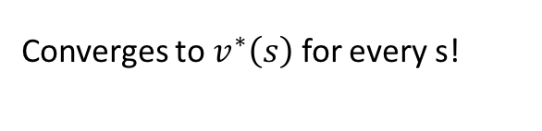
Value Iteration
If s is a terminal state
Converges to for every s!

Slide 15
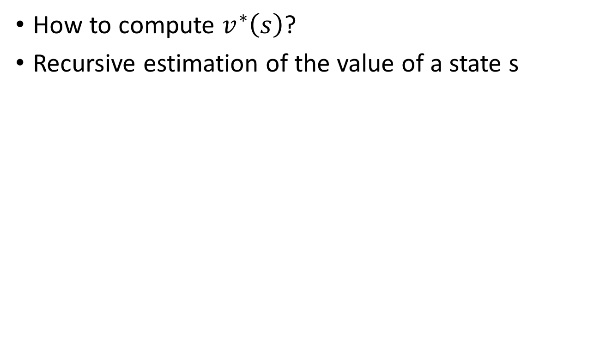

Value Iteration
The number of iterations k is like the depth of your search tree (how many actions you can take)
If s is a terminal state
Converges to for every s!
CS188 Spring 2014 Berkeley AI Lectures

Slide 16

Policy Evaluation
Question: how to compare different policies? How to determine which is the better policy?
Optimal policy
Fixed policy
s
Choice of action
(agent)
s
a
Fixed action
stochasticity
s,a
Stochastic state selection (environment)
Stochastic state selection (environment)
s’
s’

Slide 17
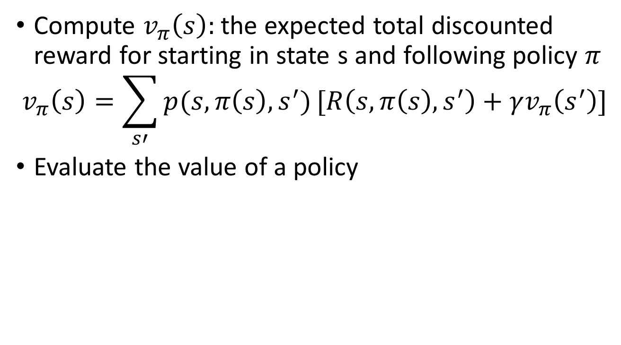
Policy Evaluation

Slide 18
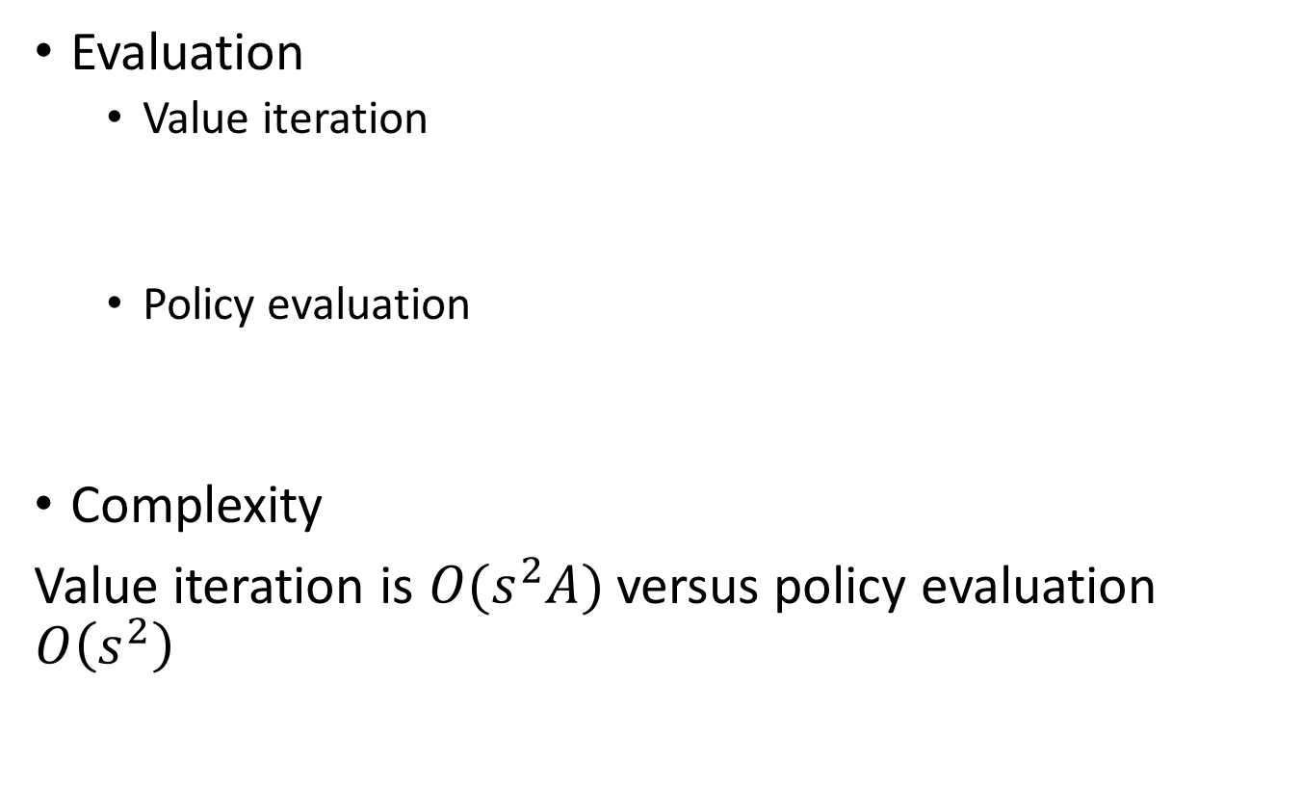
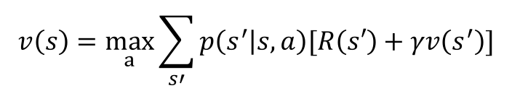
Value Iteration vs. Policy Evaluation

Slide 19
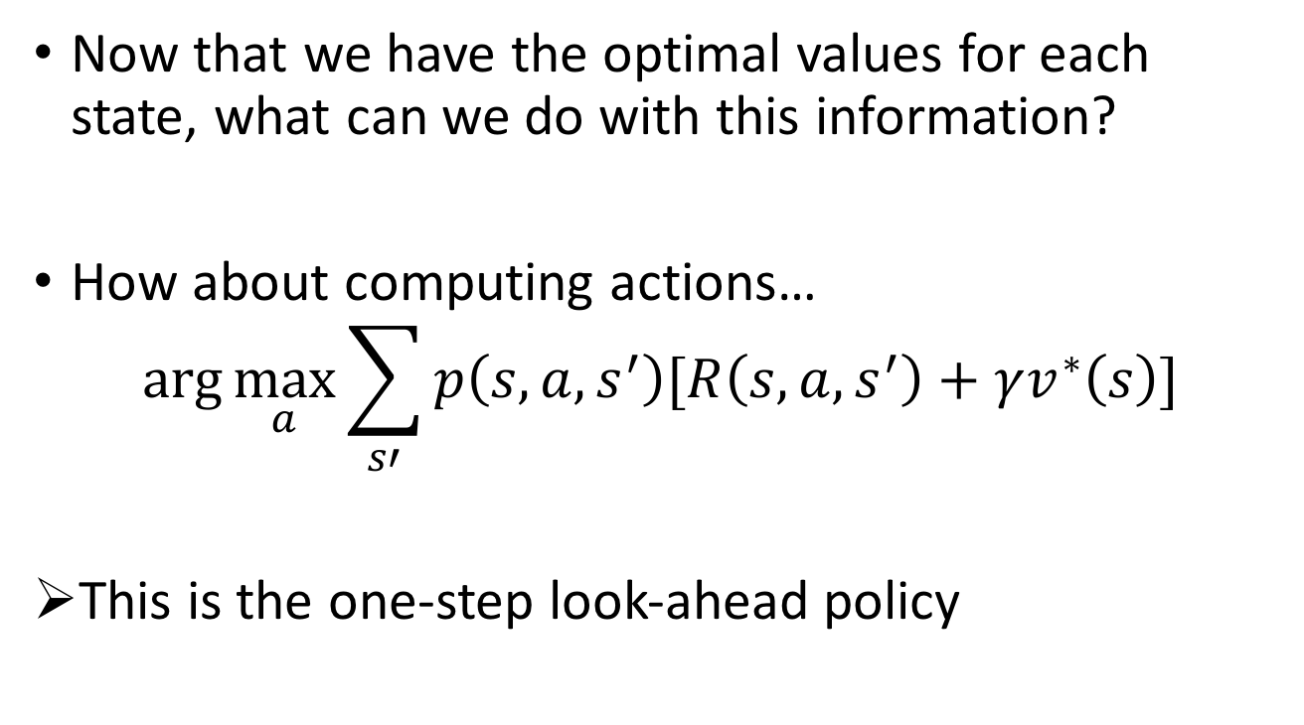
Computing Actions from Values

Slide 20
Policy Iteration
Another way to solve MDPs:
Step 1: Policy Evaluation – calculate utilities for some fixed policy (not the optimal one) until convergence
Step 2: Policy Improvement – update policy using one-step look-ahead with resulting converged (but not optimal) utilities as future values
Repeat until convergence
Policy iteration is still optimal!

Slide 21
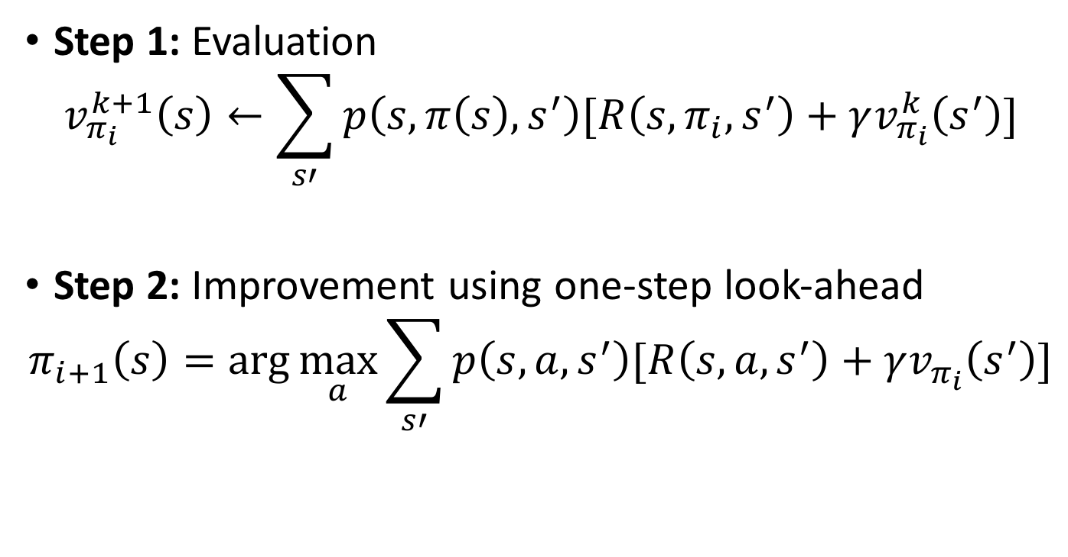
Policy Iteration Equations
Improvement one step at a time – only change the policy in a way that is guaranteed to be better (because of the max)

Slide 22
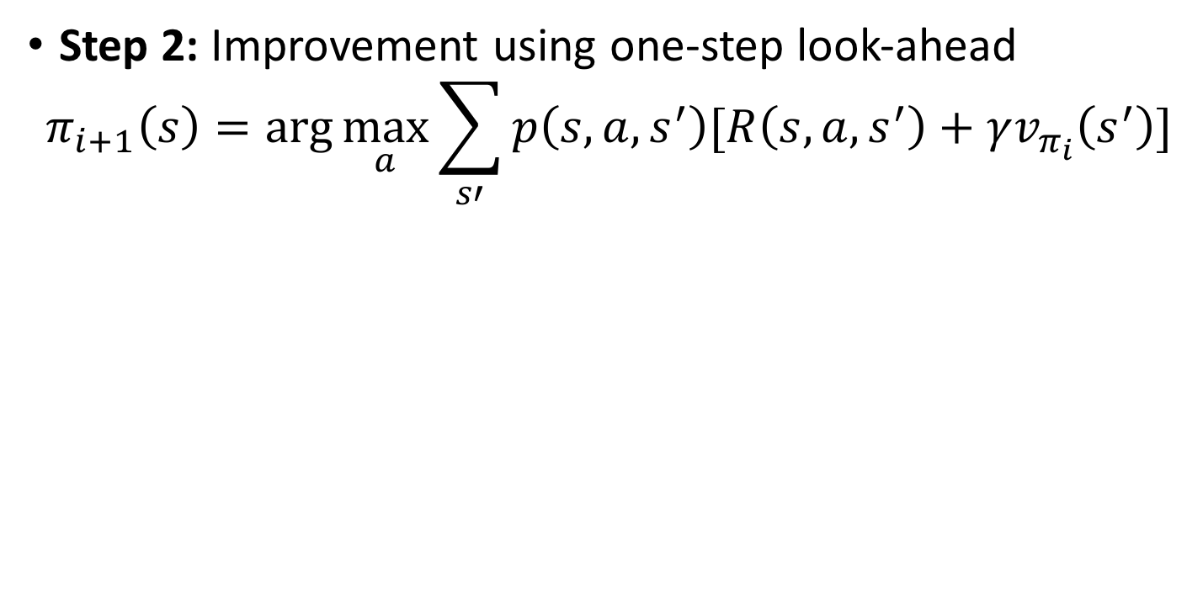

Policy Iteration
Step 2: Improvement using one-step look-ahead

Slide 23
Using these tools you want to…
Compute optimal values using value iteration or policy iteration
Compute values for a particular policy using policy evaluation
Turn your values into a policy using policy extraction or one-step look-ahead

Slide 24
Relation to Dynamic Programming
First example of dynamic programming
Dynamic programming applicable to general class of problems
We will explore this in the next lectures

Slide 25
Final Project Review
Final project 35%
Final project breakdown:
  Proposal (P/F)
  Literature Review 5%
  Report (8 pages IEEE format) 15%
  Presentation 15%

Slide 26
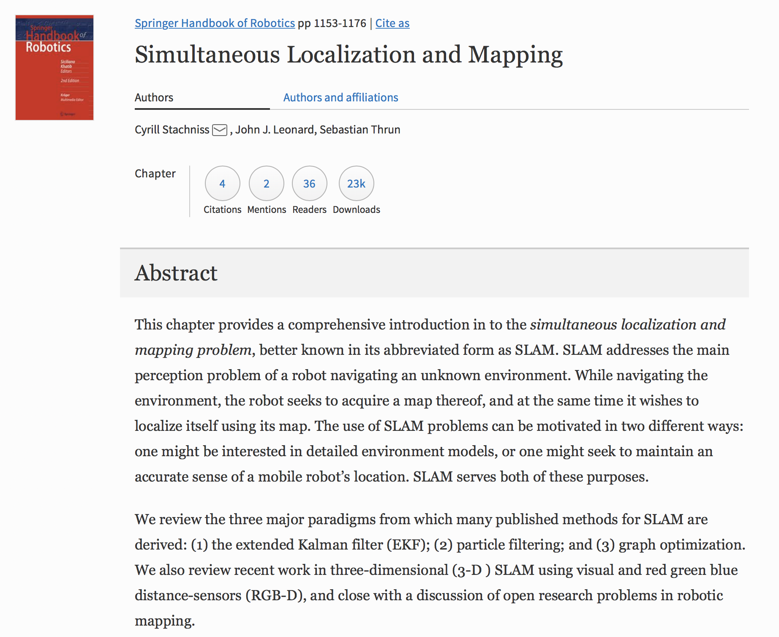
How to Pick a Final Project Topic
Problem Representation and Search
  State space and how to model problems
  SAT/CSP/IP based planning and graph search
  Adversarial search
Markov Processes
  Markov models
  Markov decision processes
  Online planning
Intro to Dynamic Programming
  Shortest path problems
  Optimal control
  Minimax problems
Hidden Markov Models
  Modeling using HMMs
  Partially Observable Markov Decision Processes (POMDPs)
Multi-agent Planning
Motion Planning
  Bug Algorithms
  Potential Field Methods
  Sampling Based Motion Planning
Localization and Mapping
  Robot Localization
  Intro to Simultaneous Localization and Mapping (SLAM)
Reinforcement Learning (Approximate Dynamic Programming)

Slide 27
Final Project Review
Final project 35%
Final project breakdown:
  Proposal (P/F)
  Literature Review 5%
  Report (8 pages IEEE format) 15%
  Presentation 15%
Discuss the strengths and limitations of your paper’s this method. Compare to other papers in the field (minimum of 5). Include preliminary simulation data for your implementation.

Slide 28
Final Project Review
Final project 35%
Final project breakdown:
  Proposal (P/F)
  Literature Review 5%
  Report (8 pages IEEE format) 15%
  Presentation 15%
Your report should include:
Simulation plots of your benchmark algorithm
Your extension of the work. This can be addressing limitations or exposing limitations

Slide 29
Final Project Review
Final project 35%
Final project breakdown:
  Proposal (P/F)
  Literature Review 5%
  Report (8 pages IEEE format) 15%
  Presentation 15%
Your presentation should include:
Comparison of your paper to the state of the art
Your benchmark simulation results
Your extended results beyond what exists in the paper
An explanation of how your results are different and what their significance is

Slide 30
Next Time…
HW 2 due Friday (Sept 14th at 5pm)
Introduction to Dynamic Programming
  Readings will be posted on Blackboard → special access made possible by Prof. Dimitri Bertsekas to his Dynamic Programming and Optimal Control text!

