Slide 1
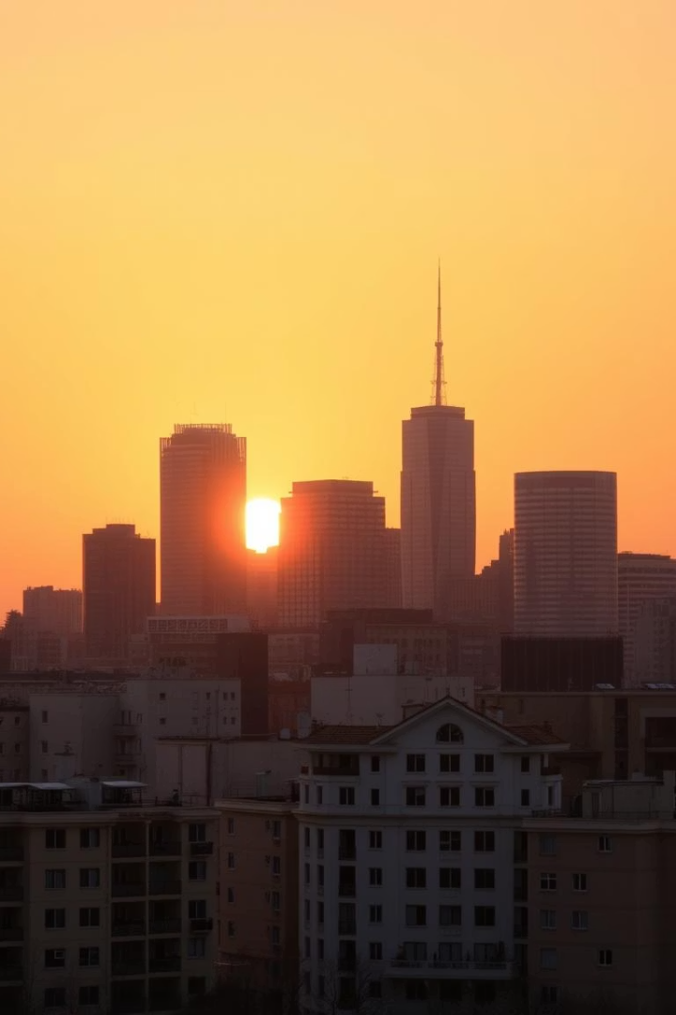
CityFix: Report, Resolve, Restore
Making Cities Cleaner, Safer, and More Livable
Tagline: Be the Change You Want to See

Slide 2
The Problem: Urban Blight is Everywhere
Littering
Spitting
Loitering
The US spends $11.5 billion annually on cleanup.
Spreading diseases and a social nuisance.
Reduces public safety and obstructs businesses.
Current reporting methods are slow and inefficient.

Slide 3

CityFix: The Solution
Photo Capture
Description
Document incidents with visual proof.
Add details for clearer understanding.
Auto-Location
Pinpoint the exact location.

Slide 4




How CityFix Works: 3 Easy Steps
Snap
Describe
Report
Take a photo of the incident.
Add a brief description and category.
Submit the report with location.

Slide 5
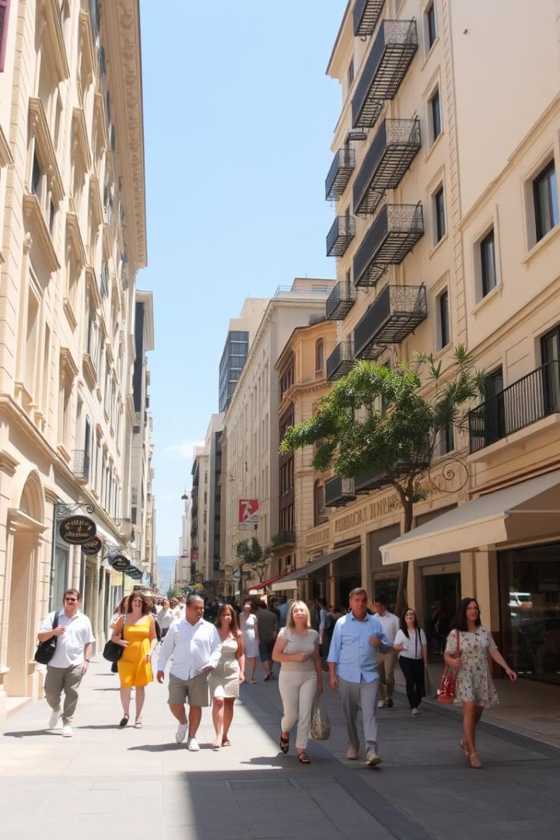
Vision & Impact
Transforming cities into cleaner, safer, and more livable spaces.
Empowering citizens to take ownership of their communities.
"CityFix is revolutionizing how we address public misconduct." - Local City Official

