Slide 1
Introduction to Data Science
Lecture 05; February 7th, 2013
Ernst Henle
ErnstHe@UW.edu
Skype: ernst.predixion
Notes:
http://uweoconnect.extn.washington.edu/r7lng0be1uw/

Slide 2
Agenda
Social Interactions
  LinkedIn (UW – Data Science)
  I request more collaboration on homework assignments
    What do you think about pairing of students to do homework?
Homework and Review
  K-means
  MATLAB (GNU-Octave)
    Normalization
  AWS
Scripting Exercises
  Data Clean up in R (MPG data)
  Clustering of MPG data in MATLAB
  Clustering of MPG data in Predixion Insight
Time permitting: Mid Course Review
Time permitting: Classification in Predixion Insight

Slide 3
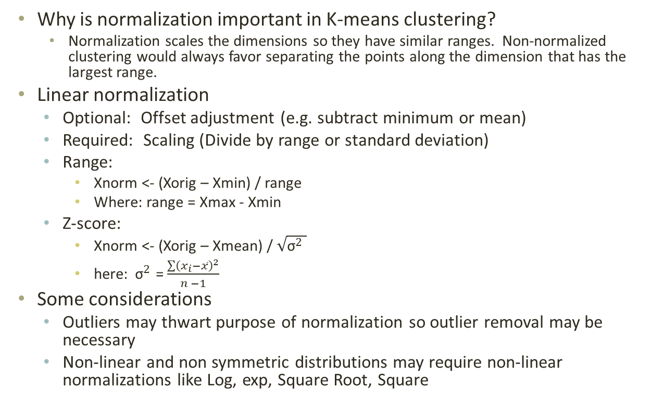
Homework: Normalization
Why is normalization important in K-means clustering?
    Normalization scales the dimensions so they have similar ranges. Non-normalized clustering would always favor separating the points along the dimension that has the largest range.
Linear normalization
  Optional: Offset adjustment (e.g. subtract minimum or mean)
  Required: Scaling (Divide by range or standard deviation)
  Range:
    Xnorm <- (Xorig – Xmin) / range
    Where: range = Xmax - Xmin
  Z-score:
    Xnorm <- (Xorig – Xmean) / $\sqrt{{\text{σ}}^{2} }$
    here:${ \text{σ}}^{2}$ = $\frac{\sum{{\left(x_{i}−\overline{x}\right)}^{2}}}{n −1}$
Some considerations
  Outliers may thwart purpose of normalization so outlier removal may be necessary
  Non-linear and non symmetric distributions may require non-linear normalizations like Log, exp, Square Root, Square

Slide 4
Homework: Category → Binary (1)
Binary Categories
ID
IQ
Parent Income
Moral Support
Gender
College Plans
835
107
40,000
Yes
Female
Applied
016
99
53,000
Yes
Male
Applied
490
105
60,000
No
Male
Did not
apply
Notes:
No need to encode because categories are already binary. Only encode in case processing code cannot recognize that these last three columns are binary.

Slide 5
Homework: Category → Binary (2)
Category
ID
Location
835
San Mateo
016
Bellevue
490
Bellevue
835
Tacoma
016
Capitol Hill
490
Tacoma

Slide 6
Homework: Category → Binary (3)
Category Binary
ID
Location
ID
Bellevue
Capitol Hill
Tacoma
San Mateo
835
San Mateo
835
0
0
0
1
016
Bellevue
→
016
1
0
0
0
490
Bellevue
490
1
0
0
0
835
Tacoma
835
0
0
1
0
016
Capitol Hill
016
0
1
0
0
490
Tacoma
490
0
0
1
0

Slide 7
Homework: (Un)-Supervised
Training explains the difference between supervised and non-supervised learning. Supervised learning derives patterns from a training set where the answers are given. Unsupervised learning does not need to be trained. There are deterministic and non-deterministic examples of both supervised and unsupervised learning.

Slide 8
Homework: MATLAB
% Parameters for normalization and denormalization
minPoint = min(points);
maxPoint = max(points);
range = maxPoint - minPoint;
% Normalize points
numberOfPoints = size(points, 1);
% for each point:
% subtract away its minimum and then divide by the range
for (pointNo = 1:numberOfPoints)
points(pointNo, :) = (points(pointNo, :) - minPoint)./range;
% y = (x - m) / r
end
See: SimpleKmeans.m

Slide 9
Scripting Exercise
R
  IntroductionToR4.R
  Clean up data from:
    http://archive.ics.uci.edu/ml/machine-learning-databases/auto-mpg/auto-mpg.data-original
  Relabel Column Values
  Binarize Categories
  Write out modified file with predictive columns
MATLAB
  KMeansDemo3
  Read cleaned data file
  Cluster Data
    Original space
    Normalized Space
View Data in Excel
Read Data and Cluster using Predixion Insight

Slide 10
Mid Course Review
Data Flow (DFD)
Scripting Languages
  R
  MATLAB
Data Preparation
  Data typing
  Data coercion
  Missing Data (Incomplete cases)
  Outlier recognition and removal
  Relabeling
  Normalization
  Replacing Categories with Boolean columns
Machine Learning
  Predictive Analytics Overview
  K-means in depth
Social Interactions

Slide 11
Assignment
Lab 3a and 3b for Predixion Insight. Use AWS and Office 2010 Pro trial version if you need a compatible machine.
    Make Screen shot of final cost comparison for all methods: Logistic Regression, Neural Net, Naïve Bayes, and Decision Trees. Submit the completed assignment to Catalyst by Monday evening.
Review terminology in slide titled: “Assignment Terminology”
Review Relational Model, Relational Algebra, and Calculus
  http://sentences.com/docs/amd.pdf (Pages 35 to 48 only)
  http://en.wikipedia.org/wiki/Relational_model
  http://www.youtube.com/watch?v=NvrpuBAMddw

Slide 12
Assignment: Terminology
Algorithm
Anomaly detection
Association
Attribute
Binarize Categories
Binary Column
Case
Category Column
Character Column
Classification
Clustering
Coercion
Column
Column Header
Data
Data Dimensionality
Data Frame
Data Type
Dataset
DFD
Estimation
Field
Hypothesis
Key Column
Machine Learning
Market-basket analysis
MATLAB
Matrix
Missing Data
Model
Multinomial Column
Normalization
Numeric Column
Observation
Outcome
Outlier Removal
Predictive Analytics
R
Rectangular Data
Relabeling
Row
Sparse Multi-Dimensional Matrix
Standard Deviation
States
String
Supervised Learning
Supervised Learning
Support
Table
Target Column
Text Column
Theory
Un-structured Data
Unsupervised Learning
Z-score

