Slide 2

Classification of Malware Behavior Based on Known Malware Samples

Slide 3
Members
Đinh Phương Mai – 202417162
Nguyễn Thành Công - 202416783

Slide 4
Table of Contents
0. Background
1. Theoretical Background (Rules)
2. System Architecture
3. Evaluation
4. Conclusion

Slide 5
0. Background
Malicious software (malware) continues to grow in volume and sophistication. Malware families such as Trojans, Botnets, Ransomware, Spyware, Worms, and Remote Access Trojans (RATs),… pose severe security risks to enterprise networks and end-user hosts.

Slide 6
0. Background - Objective
To design and implement a static analysis tool
To implement Finite State Machines (FSMs) capable of identifying anti-analysis behavior and unpacking sequences.
To construct a weight-based heuristic scoring engine that aggregates structural anomaly markers to classify fles as benign or malware.
To evaluate the engine’s capability against a curated dataset of benign files and wild malware samples

Slide 7
0. Background - Scope
Target:
Windows executable files (PE files)
x86/x64 assembly source text (.asm) fles
The program extracts static features from either the PE structural headers, the disassemblable code segment (.text), or directly from the raw assembly statements in source fles.
The system does not execute any file, ensuring malware is analyzed inside a secure sandbox containment

Slide 8
0. Background – Environment and Tools
Environment (For testing): Oracle Window VM – Windows 10 x64 (Isolated offline)
Language: Python
Dataset:
Malware: MalwareBazaar
Benign: System32 of original Window OS
Library: pefile, capstone, pyzipper, requests
Principle:
Heuristic evaluation: Detecting malware based on suspicious or abnormal indicators
Behavioral FSM: A specific sequence or order of API calls or Opcodes can form a distinct malicious behavior pattern

Slide 9
1. Theoretical Background – PE Format & Disassembly
Headers:
DOS MZ Header
Responsible for backward compatibility
PE Signature
Indicates PE file
COFF File Header
Specify machine types and number of sections
Optional Header
Contains entry point virtual address, image base, and directories

Slide 10
1. Theoretical Background – PE Format & Disassembly
Sections:
.text or .code: Contains executable machine instructions
.data: Holds initialized global variables.
.rdata: Contains read-only variables, debug directories, and the Import Address Table (IAT).
.rsrc: Contains application resources (icons, menus, versions).

Slide 11
1. Theoretical Background – PE Format & Diassembly
Import Address Table (IAT): Records the dynamic link libraries (DLLs) and functions imported from the system API (LoadLibrary, GetProcAddress, …)
Disassembly: Reversing raw binary bytes in .text into x86 assembly mnemonics (mov, xor, cmp, etc.) for opcode analysis.

Slide 12
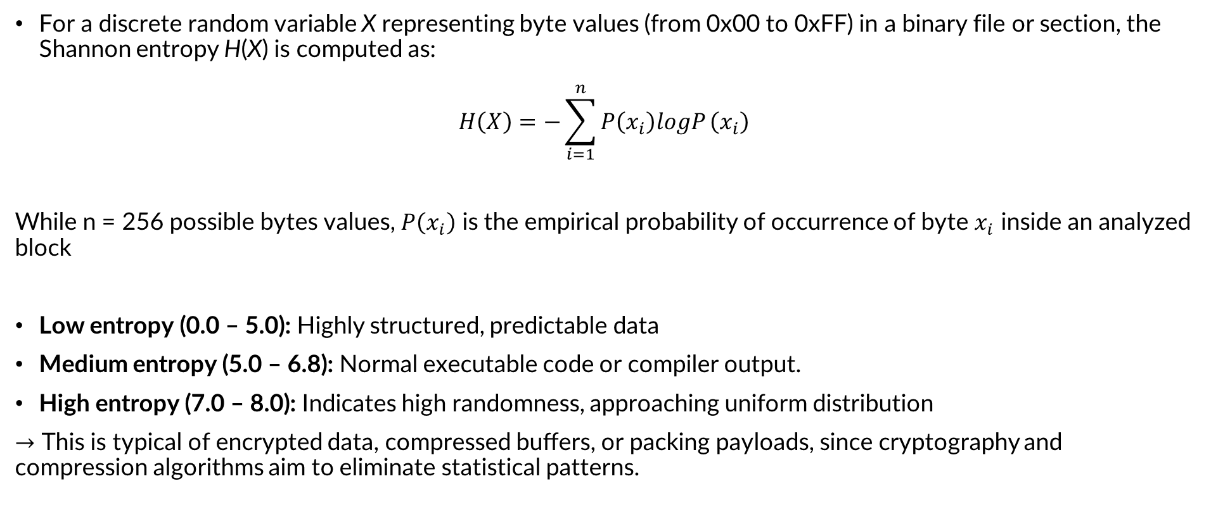
1. Theoretical Background – Shannon Entropy
For a discrete random variable X representing byte values (from 0x00 to 0xFF) in a binary file or section, the Shannon entropy H(X) is computed as:
$$H\left(X\right)=−\sum_{i=1}^{n}{P\left(x_{i}\right)logP}\left(x_{i}\right)$$
While n = 256 possible bytes values, $P\left(x_{i}\right)$ is the empirical probability of occurrence of byte $x_{i}$ inside an analyzed block
Low entropy (0.0 – 5.0): Highly structured, predictable data
Medium entropy (5.0 – 6.8): Normal executable code or compiler output.
High entropy (7.0 – 8.0): Indicates high randomness, approaching uniform distribution
$→$ This is typical of encrypted data, compressed buﬀers, or packing payloads, since cryptography and compression algorithms aim to eliminate statistical patterns.

Slide 13
1. Theoretical Background – Packing & Obfuscation
W^X Permission Violation: Sections that are simultaneously Writable and Executable. Standard compilers separate these, but packers break this rule to decrypt code directly into memory.
Virtual vs. Raw Size Mismatch: When the virtual size of a section in memory is significantly larger than its size on disk. This points to an expansion container for an unpacked payload.
Low/Zero Import Counts: Packed files often hide their IAT, importing only baseline functions like LoadLibraryA and GetProcAddress to dynamically load APIs at runtime.
Suspicious Section Names: Section headers named .upx0, .aspack, or containing unexpected characters like /.

Slide 14
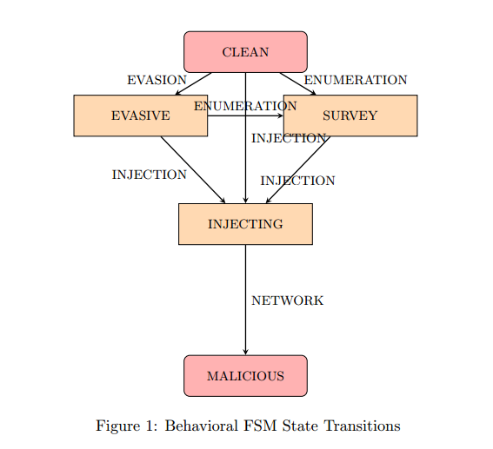
1. Theoretical Background – Behavioral FSM: API Chain Tracking
Score Impact:
CLEAN / EVASIVE: +0 pts
SURVEY: +5 pts
INJECTING: +15 pts
MALICIOUS: +35 pts

Slide 15
1. Theoretical Background – Decryption Loop FSM
State 1: START → Scans disassembled assembly opcodes. If a decryption operation (xor, rol, ror) is detected, transition to XOR_FOUND.
State 2: XOR_FOUND → If the subsequent instruction updates loop pointers (cmp, test, dec, inc, add, sub), transition to LOOP_FOUND. Otherwise, reset.
State 3: LOOP_FOUND → If the next instruction is a conditional jump or loop back (jnz, jne, loop, jmp), transition to DECRYPTOR. Otherwise, reset.
Result: Reaching the DECRYPTOR state signals a decryption stub, adding +25 points to the heuristic score.

Slide 16
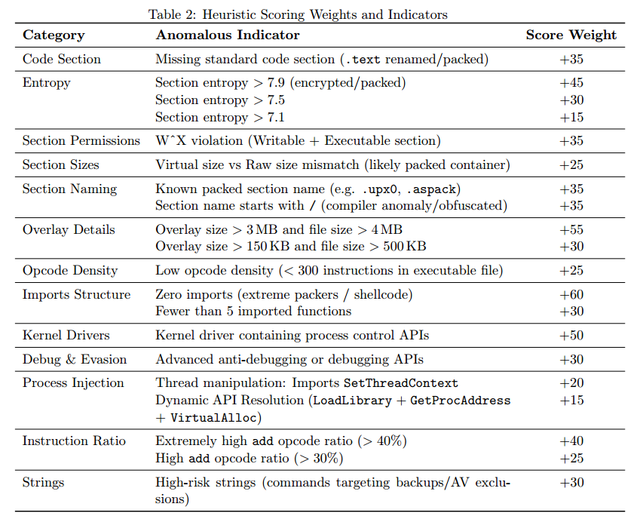
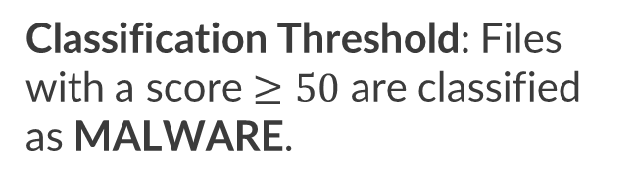
1. Theoretical Background – Weighted Heuristic Scoring Model
Dynamic Discounts (FP Mitigation):
Export count > 50 | -35
High DLL import count (>12) | -20
Windows API-Set DLL imports (> 4 api-ms-win* libraries) | -20
Classification Threshold: Files with a score $≥50$ are classified as MALWARE.

Slide 17
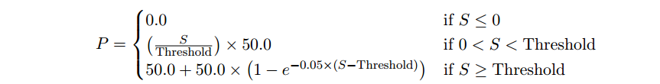
1. Theoretical Background – Heuristic Probability Curve
To express threat likelihood as a percentage rather than a raw score, the engine computes a Malware Probability P using an exponential curve:
While S is the heuristic score, Threshold = 50
Scores that are far above the threshold asymptotically approach 100% malware probability.

Slide 18
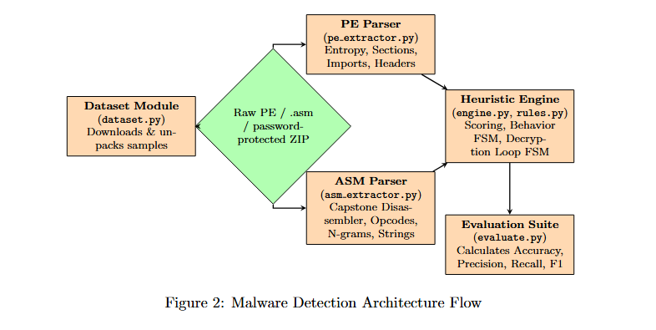
2. System Architecture

Slide 19
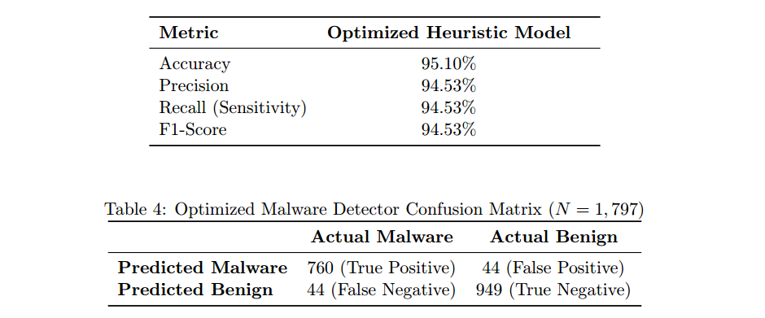
3. Evaluation
The performance of the heuristic engine was validated against a large-scale static features database containing 1,797 samples: • Benign Samples: 993 legitimate Windows executables, DLLs, and system drivers. • Malware Samples: 804 wild malware binaries collected securely from MalwareBazaar.

Slide 20
4. Conclusion
Core strength:
Safety & Speed: Evaluates files statically in milliseconds with zero threat execution risk.
Robust Obfuscation Heuristics: Catches packer stubs using entropy triggers and a custom 3-gram assembly FSM.
Drawbacks:
API Obfuscation Blindspot: Unable to map API calls if resolved dynamically using custom hashes.
Payload Encryption Limits: Static analysis cannot parse hidden instructions before they are loaded into RAM.
Dual-Use Tool Overlaps: Legitimate debuggers and command engines naturally trigger injection rule

Slide 21
THANK YOU !

