Slide 1

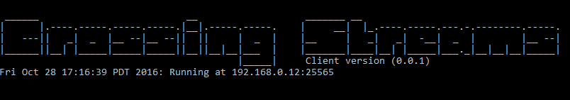
Sprint 2 (Nov 2 - Nov 15) Project Report
Project: Crossing Streams
Ben Ward Marc-Andrew Dunwell
Corey Frank Dan Atkinson Billy Spelchan
Okanagan College, Kelowna, BC
Nov 16th, 2016

Slide 2
Report Content
Project Summary
Sprint 2 (November 2 - November 15, 2016) Project Report
Demo
Conclusion
Notes:
Project Summary
Sprint 1 (October 20 - November 1, 2016) Project Report
Demo
Conclusion

Slide 3
Project Summary
Crossing Streams is a two-phase project conducted by students of Okanagan College and their client Ben Heggie. The first phase began in 2016 as a project for COSC 470. It’s main results are:
The design and implementation of an Multiplayer Online Rogue-like Top-Down Shooter (MORTDS) done in the style of Binding of Isaac, Enter the Gungeon and Gauntlet.
An integrated web platform that includes payment and hosting abilities for multiple future games.
A low latency environment to allow for smooth online gameplay with friends
Notes:
Crossing Streams is a two-phase project conducted by students of Okanagan College and their client Ben Heggie. The first phase began in 2016 as a project for COSC 470. It’s main results are:
The design and implementation of an Multiplayer Online Rogue-like Top-Down Shooter (MORTDS) done in the style of Binding of Isaac, Enter the Gungeon and Gauntlet.
An integrated web platform that includes payment and hosting abilities for multiple future games.
A low latency environment to allow for smooth online gameplay with friends

Slide 4
Project Goals
Infrastructure to play games Online
This project utilizes infrastructure created entirely from students.
It should allow 2-4 players to play together online
By using golang we can innovatively spin up new processes on a server to encase a user's game.
Unity allows the developers to not worry about the boilerplate and go right to developing the features.
Notes:
Infrastructure to play games Online
This project utilizes infrastructure created entirely from students.
It should allow 2-4 players to play together online
By using golang we can innovatively spin up new processes on a server to encase a user's game.
Unity allows the developers to not worry about the boilerplate and go right to developing the features.

Slide 5
Theme - The Crossing
The Crossing. Building on the system built in the first sprint, our focus now is to add support for multiple players to exist in the same world. To make the world compelling for multiple players we are fleshing out the experience by adding power ups, more monsters, more rooms, and an expanded website.
Notes:
Joining the streams. The system we are developing is made up of a number of interconnected components so we wish to get all the components working at the most basic level possible. The client will be able to download the patcher from the game site, update to the current (first) build of the game, and run through a very simplified version of the game with just rudimentary server connections.

Slide 6
Happy Path

Slide 7
System Architecture Layout (old)

Slide 8
System
Architecture
Layout
(Shiney New)

Slide 9
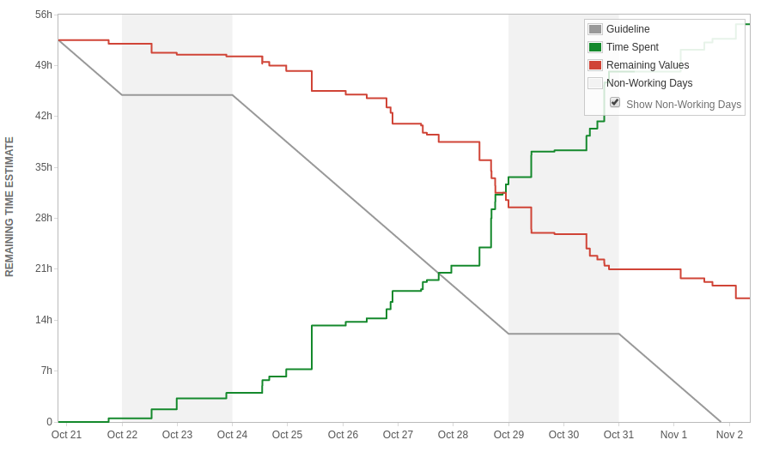
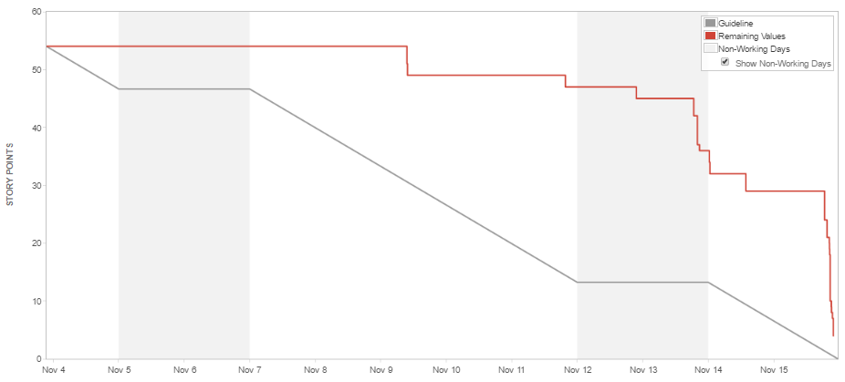
Burndown and workload (In Story points)
Notes:
Burndown chart shows a stagnant workflow and a rush at the very end. Many of us had other commitments to classes, exams and projects which relates to the beginning stagnant workflow as well many of the tasks could have been further broken down into smaller pieces.

Slide 10
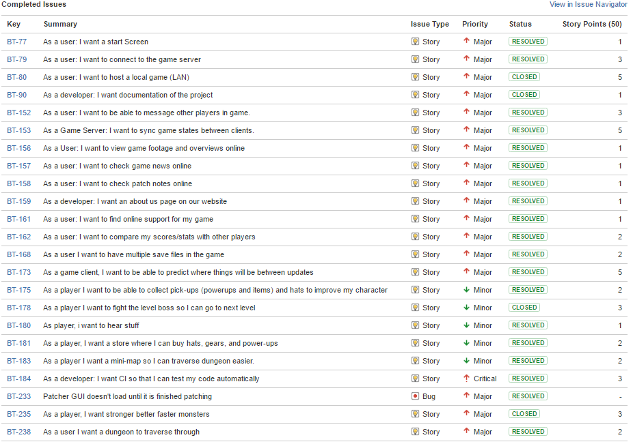
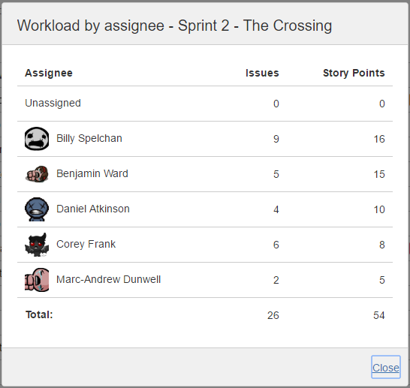
Sprint Backlog
Notes:
There was a total of 26 user stories with 54 points. The story points were mostly distributed evenly across all five team members.

Slide 11
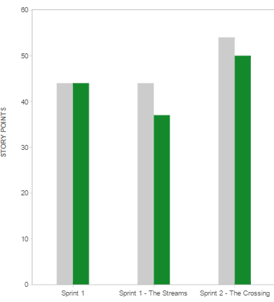
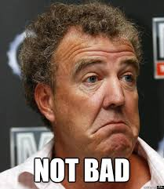
Velocity so far
Committed: 54
Completed: 50
Notes:
We committed to a lot of work and we were able to finish the mass majority of it. The tasks which were unfortunatly not finished were of lower value to the project as an overall. The overall feel is that we bit off too much this sprint and will lower our work load to the levels of sprint 1 for this upcoming sprint 3.

Slide 12
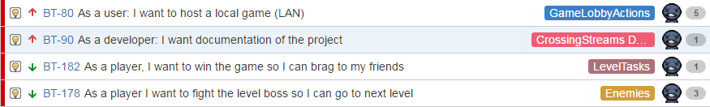
Sprint 2 (Daniel Atkinson)

Slide 13

Task breakdown (Daniel Atkinson)

Slide 14
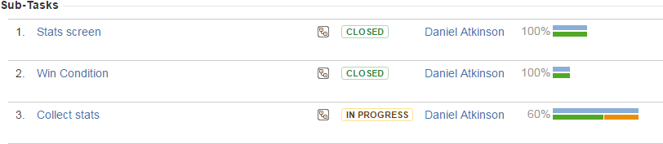

Task breakdown (Daniel Atkinson)

Slide 15
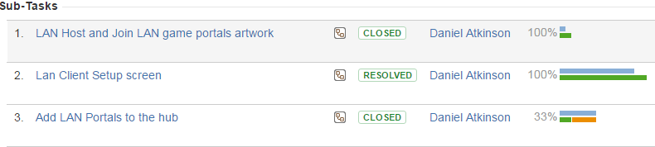

Task breakdown (Daniel Atkinson)

Slide 16
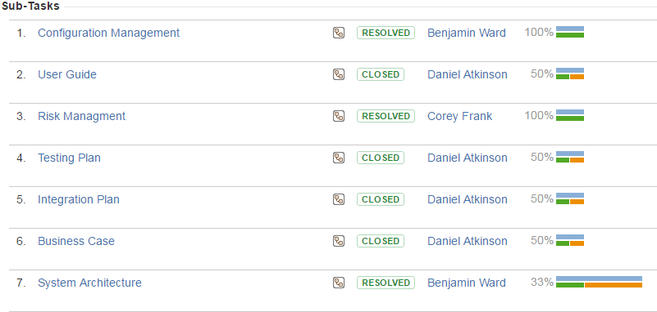
Task breakdown (Daniel Atkinson)

Slide 17
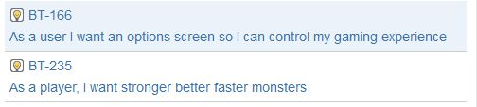
Sprint 2 (Marc-Andrew Dunwell)

Slide 18
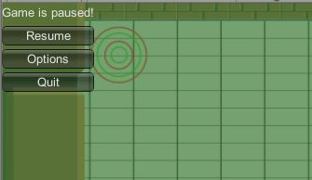

Options Screen - Task breakdown
BT-166: As a user I want an options screen so I can control my gaming experience
⇒

Slide 19


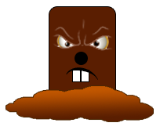


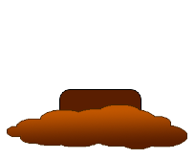


Enemies - Task breakdown
BT-235: As a player, I want stronger better faster monsters
Boomer
Burrower
Poizon
Canoon

Slide 20
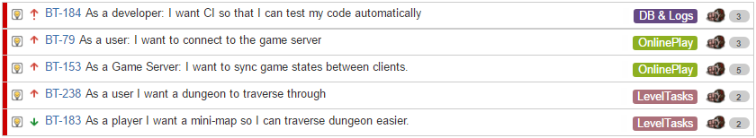
Sprint 2 (Ben Ward)
Notes:
Server Installation:
Acquired servers from Youry
Installed developer tools (apache, postgresql, golang, php, webmin)
Golang Server Application:
Can connect to the postgresql database to obtain information
Can Receive and send seed information to clients
Database:
Created database, schema, relational tables

Slide 21

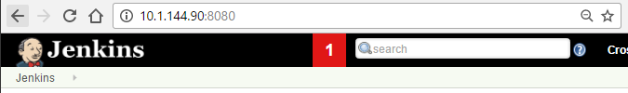
Jenkins - Task breakdown (Ben Ward)
Notes:
Installed Jenkins, github plugin, configured it to poll our repos and it runs a script that tests, builds and deploys from our master repo.

Slide 22

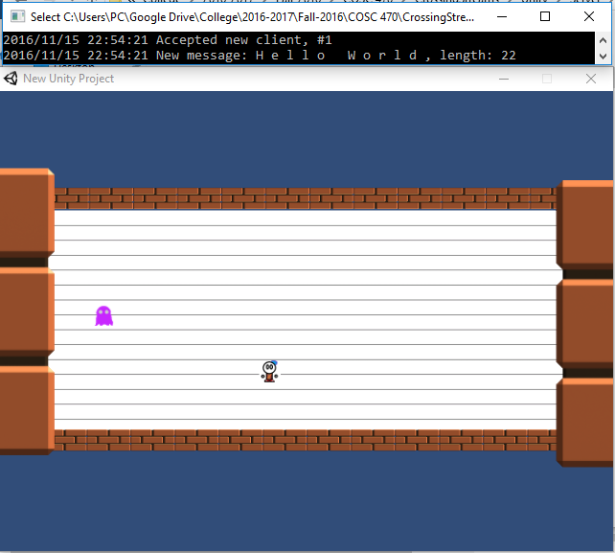
Connections - Task breakdown (Ben Ward)

Slide 23
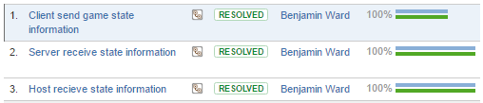
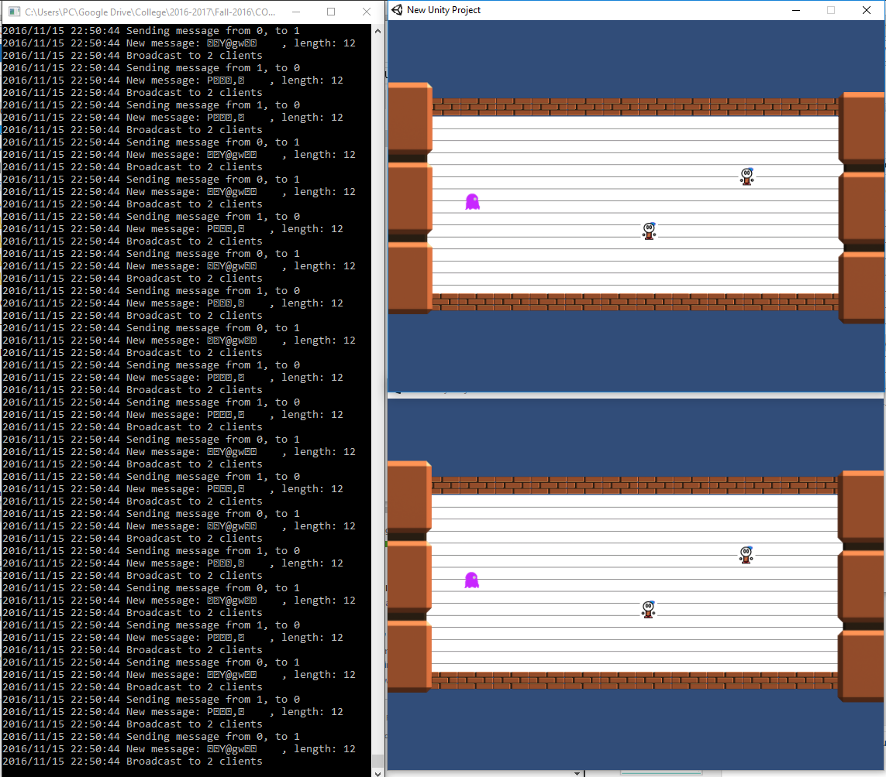
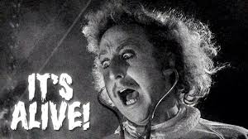
Sync State - Task breakdown (Ben Ward)

Slide 24
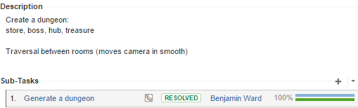
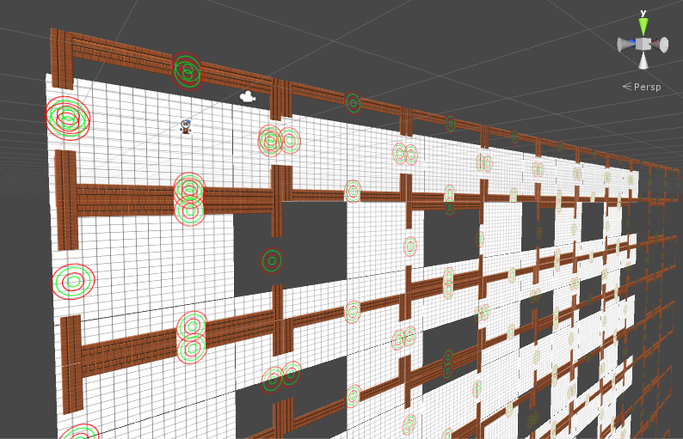
Map Generation - Task breakdown (Ben Ward)

Slide 25

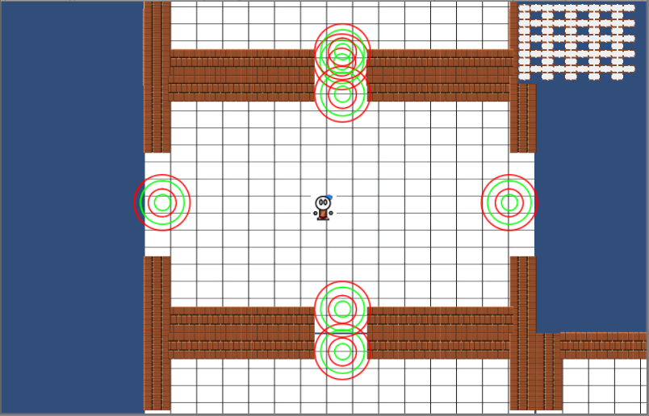
Mini Map - Task breakdown (Ben Ward)
Mini-Map!
Mini-Map!

Slide 26
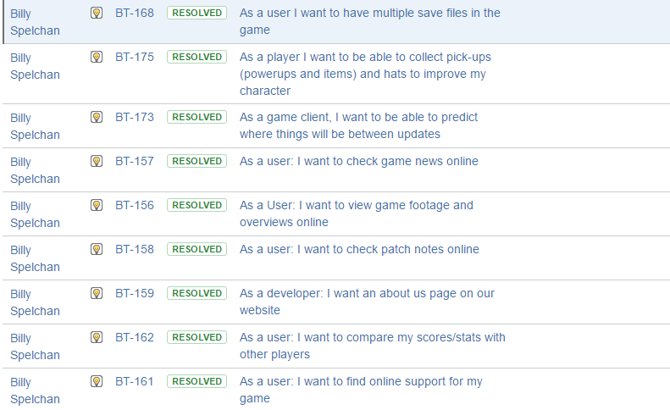
Sprint 2 (Billy Spelchan)
Notes:
Website where player gets game. Accounts have unique user names and emails. Password protected in database using a salted
SHA384 hash. Simple AI built up using Unity behaviors. Currently using Unity’s physics but issues with determinism will require our
own.

Slide 27
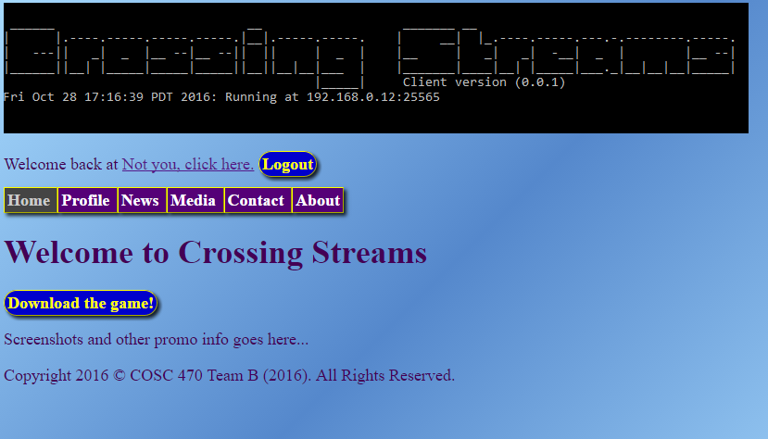
Website Pages (Billy Spelchan)
· BT-157As a user: I want to check game news online (1 point)
o BT-195 News update web page
o BT-205 game news database table
· BT-158As a user: I want to check patch notes online (1 point)
o BT-196 Web patch notes page
o BT-204 patch note database table
· BT-156As a User: I want to view game footage and overviews online (1 point)
o BT-197 Media page
· BT-159As a developer: I want an about us page on our website (1 point)
o BT-198 About us page
· BT-161As a user: I want to find online support for my game (1 point)
o BT-199 Web support page
· BT-162As a user: I want to compare my scores/stats with other players 2 points)
o BT-200 Stats page
o BT-201 Stats database table

Slide 28
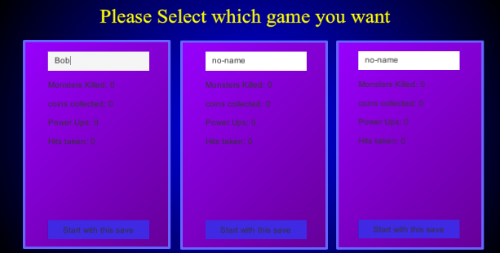
Saves (Billy Spelchan)
· BT-168As a user I want to have multiple save files in the game ( 2 points)
o BT-216 Create save game object
o BT-217 Store saved game objects locally
o BT-218 Display game save object
o BT-219 load game save information

Slide 29

Basic Prediction (Billy Spelchan)
· BT-173 As a game client, I want to be able to predict where things will be between updates (Billy Spelchan, 5 points)
o BT-210 Client side prediction

Slide 30




Power Ups (Billy Spelchan)
· BT-175 As a player I want to be able to collect pick-ups (power-ups and items) and hats to improve my character ( 2 points)
o BT-221 Create 5 - 10 Objects
Heart Container
Damage Multiplier
Speed Boost
Coins
Health

Slide 31
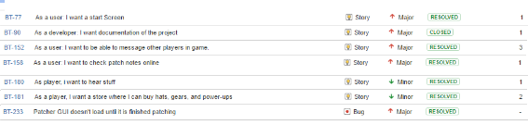
Sprint 2 (Corey Frank)

Slide 32
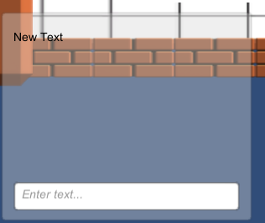
Task breakdown (Corey Frank)
Start Screen, simple start / quit, linked to save screen (will see in demo)
Game Audio: Added for power-ups, damage taken, bullets fired, general sound effects
Sending Messages: Completed half, set-up and client side programmed, need to finish server side programming

Slide 33
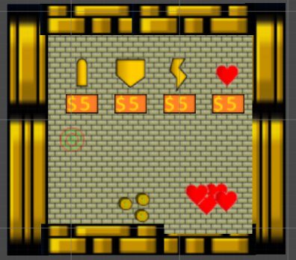
Task breakdown (Corey Frank)
Online Patch Notes: INCOMPLETE
Game Store: Added for power-ups, and items to store, Game money system Implemented.
EXTRA TASK: Setting up player HUD to display player variables

Slide 34
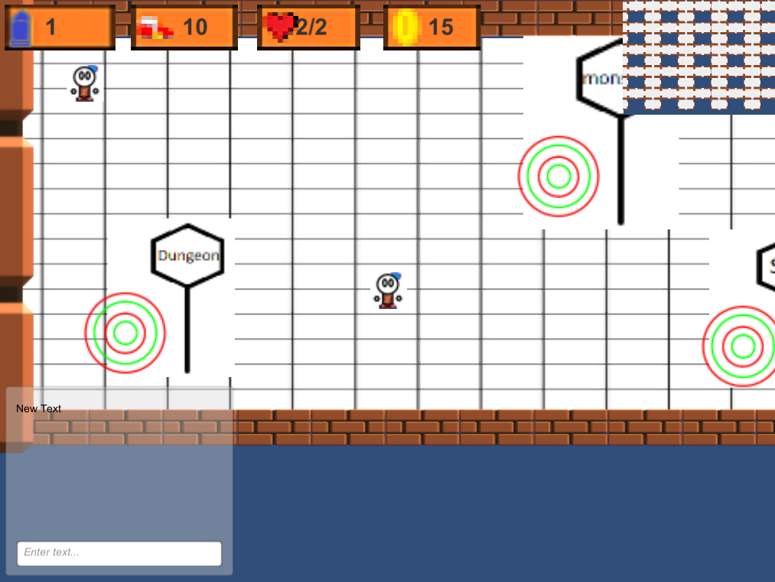
Task breakdown (Corey Frank)
HUD Display

Slide 35
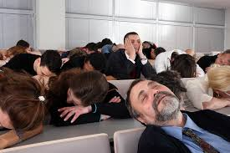
Demonstration
Let’s Play - Part Two
Sprint 2 - What many lost hours of sleep get you
Notes:
Server IP 10.1.144.91:25565

Slide 36
Any Questions?

