Slide 1
FIM basics
Rainer Bleck, Shan Sun, Tanya Smirnova
(and a host of other contributors too numerous to mention)
NOAA Earth System Research Laboratory, Boulder, Colorado
July 2012

Slide 2
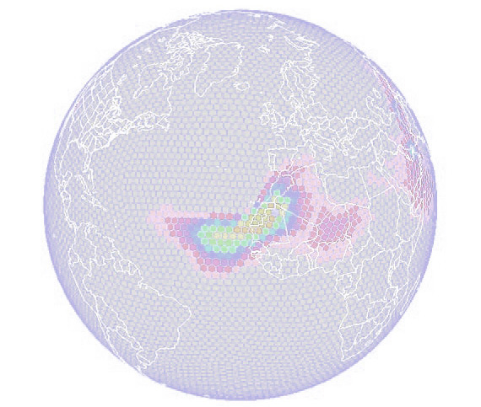
FIM
short for FFFVIM
Flow-following
Finite-volume
Icosahedral

Slide 3
Overriding goal: add genetic diversity to atmo and oceanic dycores
Unique combination of two (not quite so unique) grid types:
Icosahedral horizontal grid
Adaptive (terrain-following/isentropic) vertical grid
Tradeoffs:
Some drawbacks in traditional grids are avoided
must learn to cope with a few new problems

Slide 4
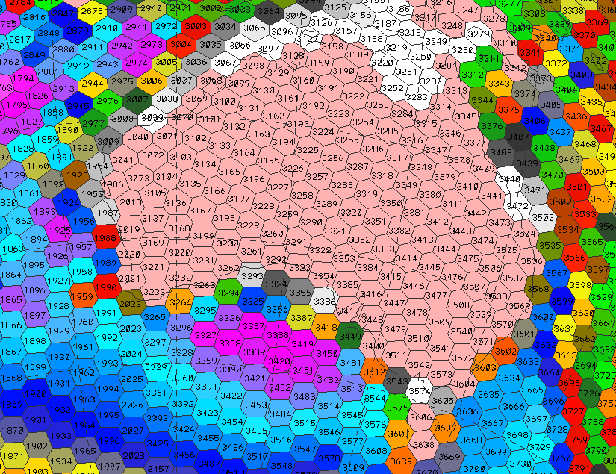
FIM grid layout (G5 resolution)

Slide 5
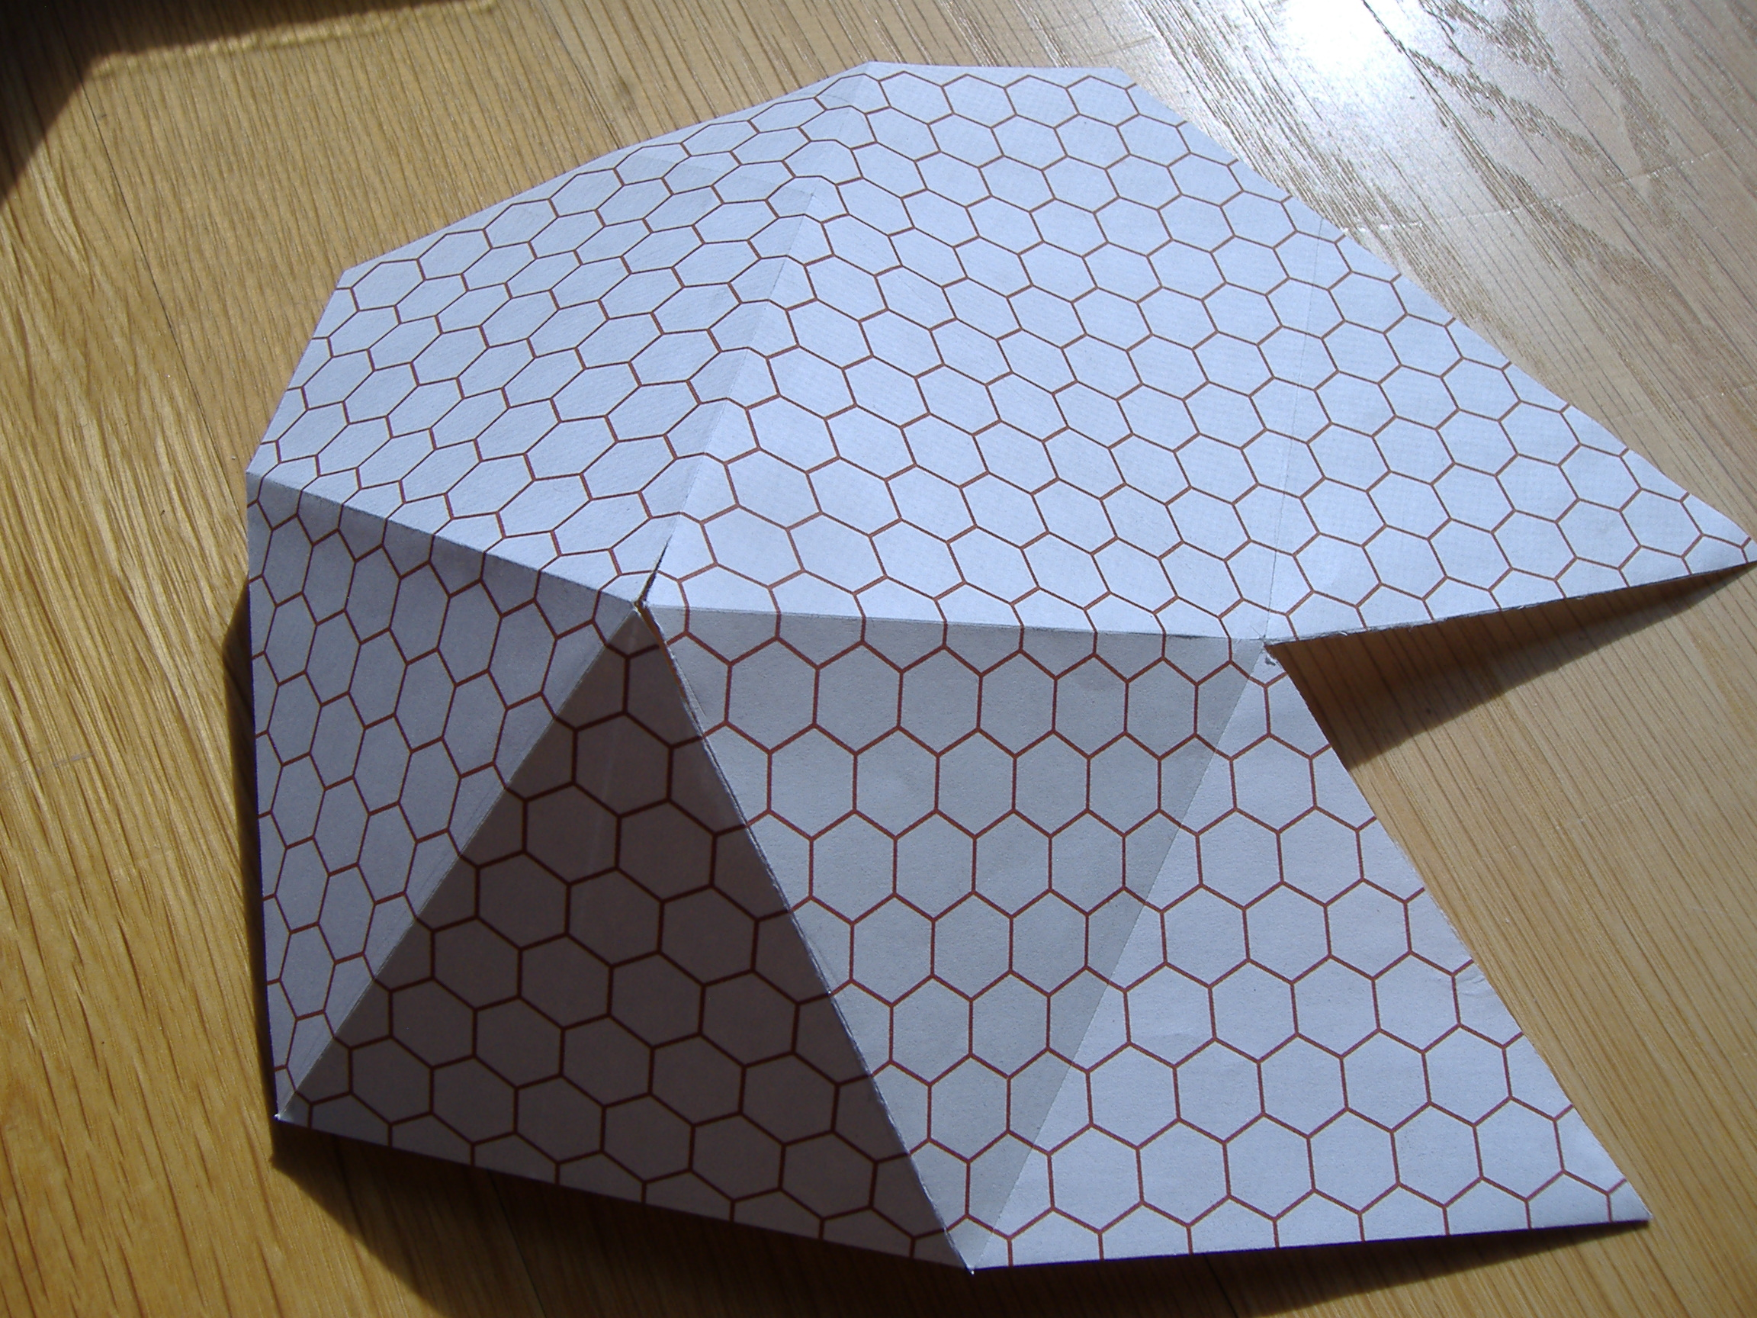
Perfectly shaped hexagons on the icosahedron

Slide 6
Horizontal grid: Pros and Cons
Pros:
No pole problems
Fairly uniform mesh size & cell shape on sphere
Cons:
Indirect addressing (an efficiency issue)
Wavenumber 5 zonal grid irregularity
Line-integral based discretizations hard to manipulate
Minor annoyances:
Model diagnostics, graphics display more complex

Slide 7
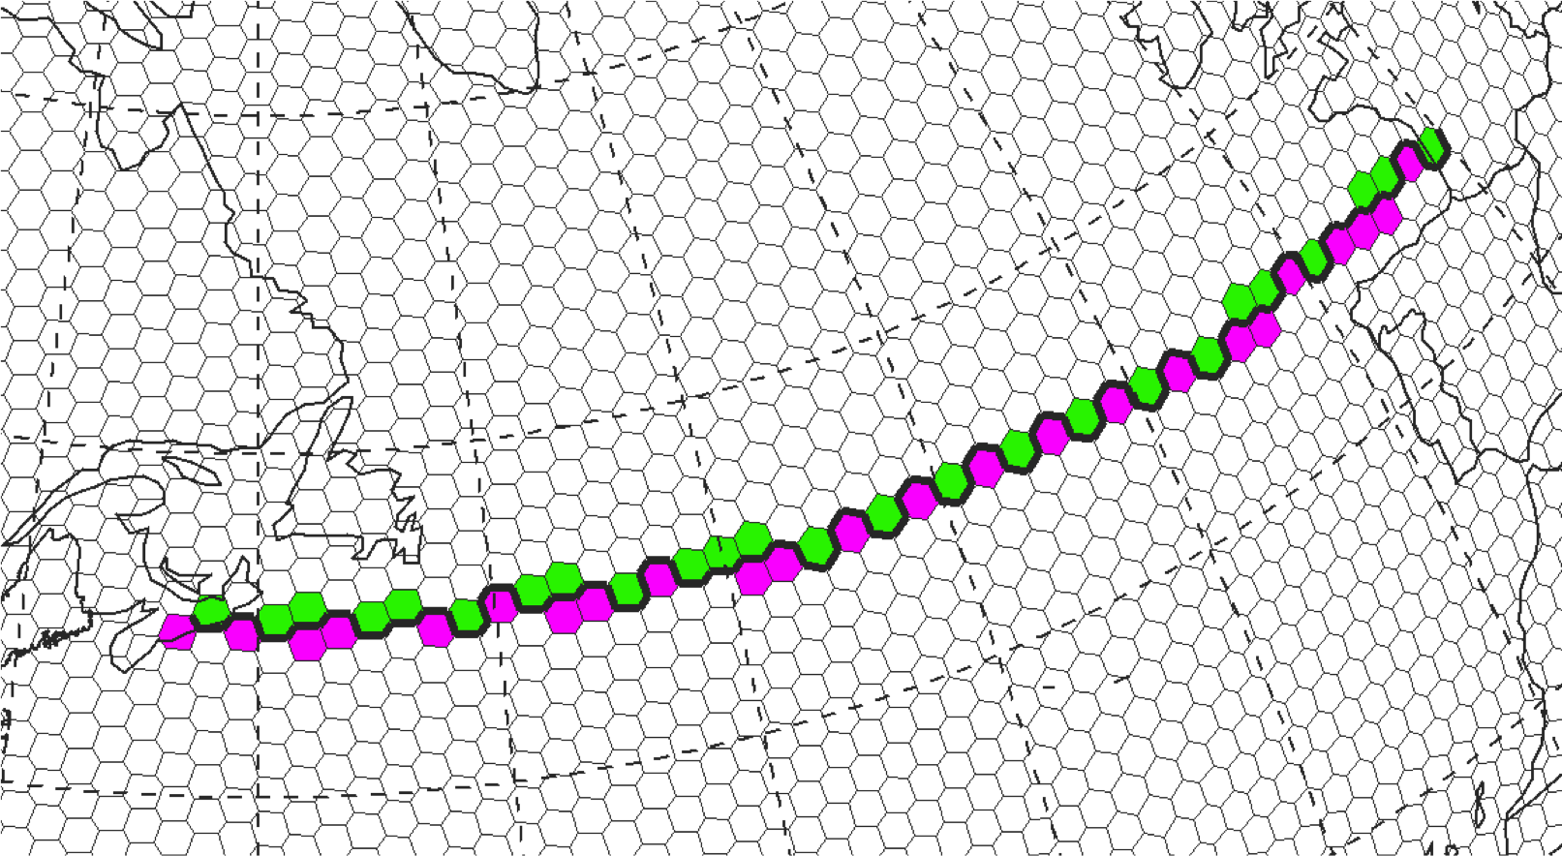

Slide 8
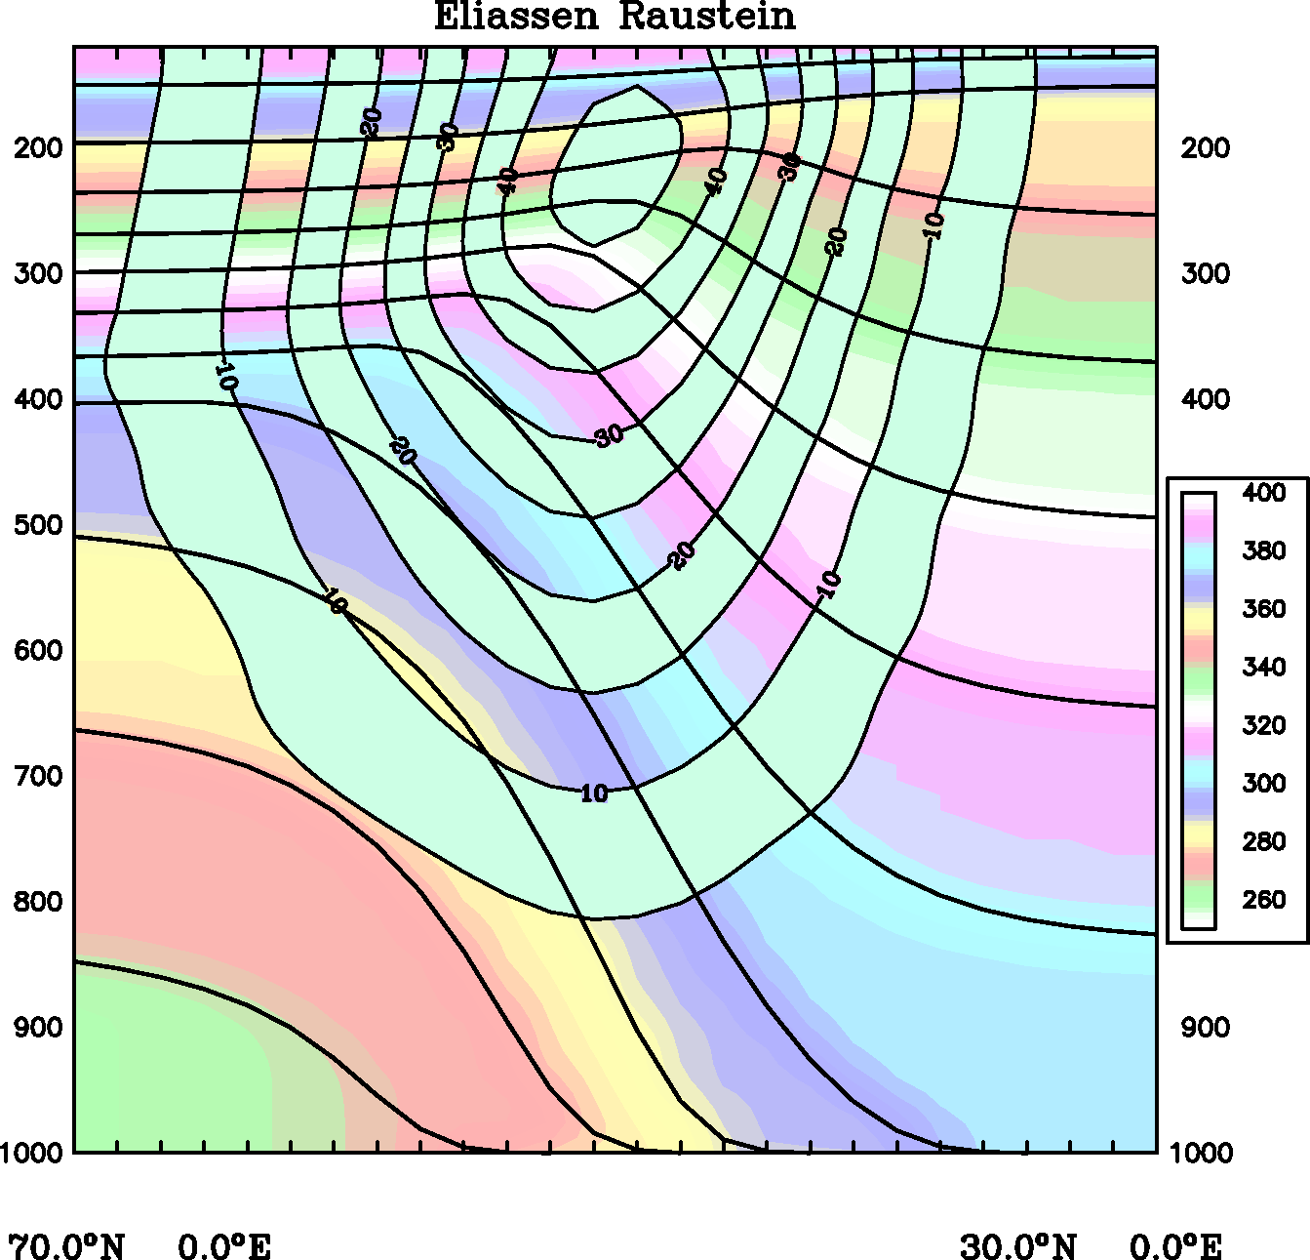
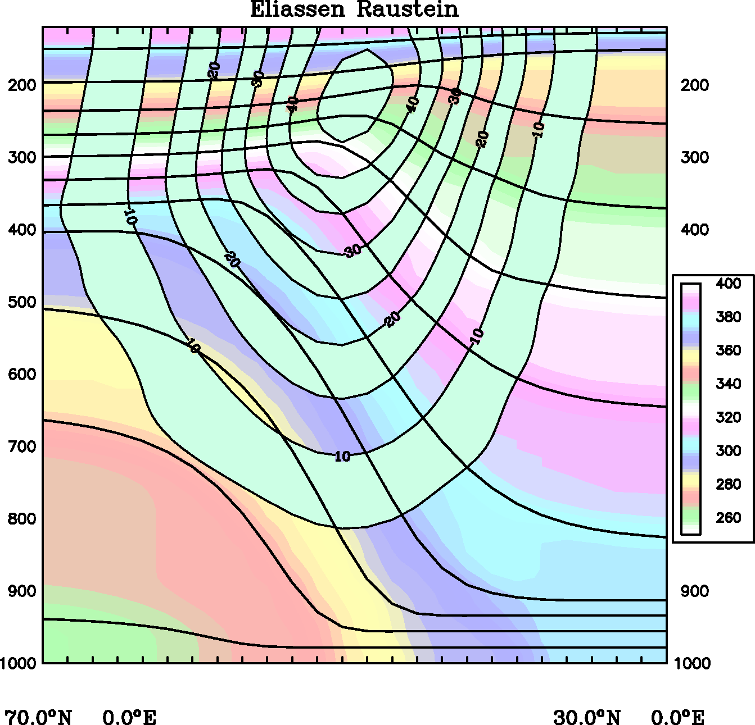
Adaptive vertical grid (primarily isentropic)
Coordinate surfaces and isotachs: solid. Pot.temperature: color

Slide 9
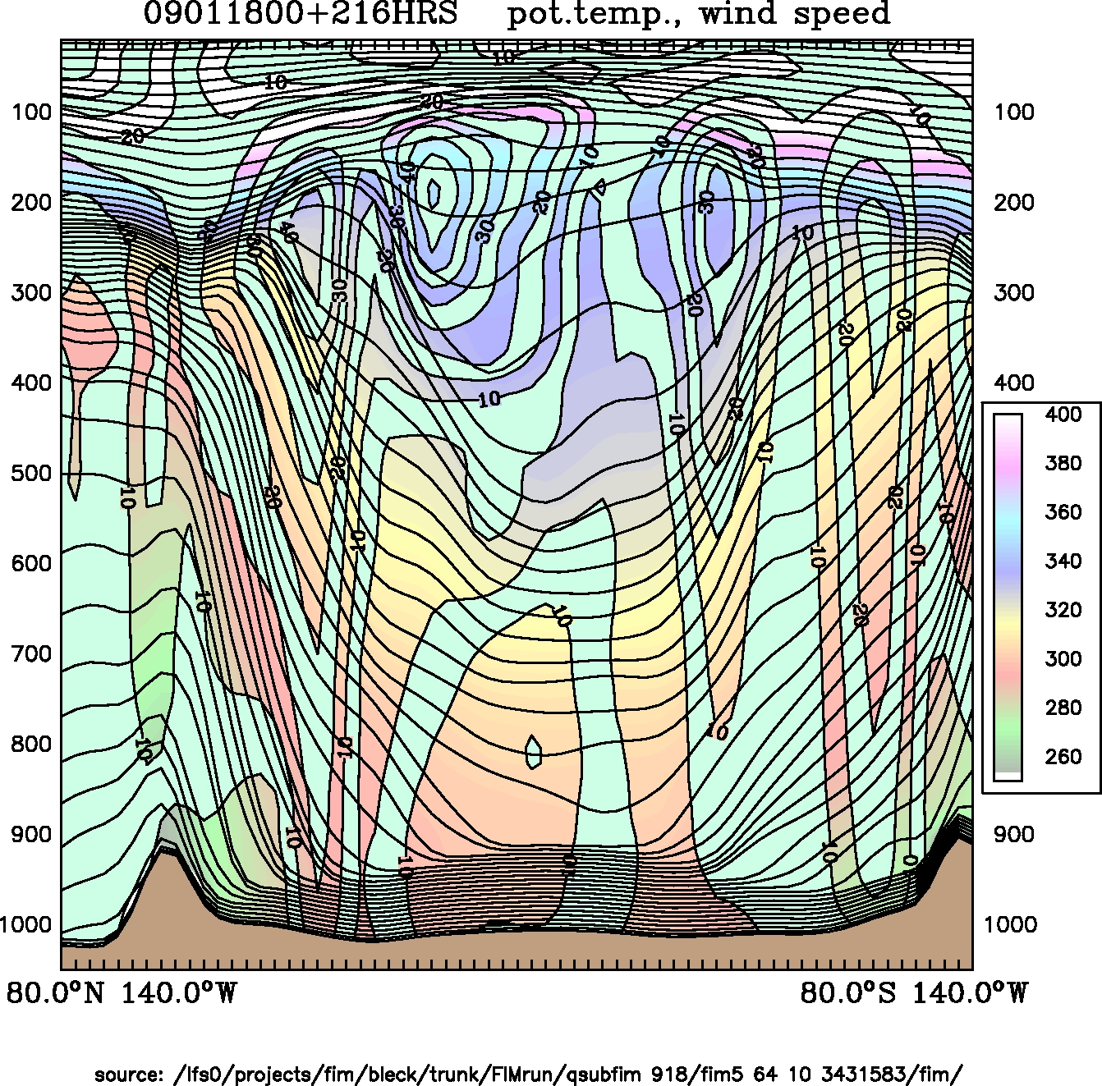
FIM hybrid-isentropic vertical coordinate

Slide 10
How we maintain the vertical grid: Continuity Equation in generalized (“s”) coordinates
(zero in fixed grids)
(zero in material coord.)
(known)

Slide 11
Vertical grid: Pros and Cons
Pros (in θ domain):
Numerical dispersion acts along isentropes
Optimal resolution of fronts and associated shear zones
Cons (in θ domain):
Poor resolution in unstratified columns
Positive side effect of hybrid design:
Weak stratification due to surface heating leads to deep sigma domain (=> more uniform grid spacing at low latitudes)

Slide 12
FIM
Hydrostatic; primitive eqns (solved explicitly)
Arakawa A-grid (i.e. no staggering)
3-level Adams-Bashforth time differencing
Finite-volume discretization; no explicit mixing terms required to suppress grid-scale noise
Variable vertical grid spacing requires transport eqns in flux form for conservation
Use FCT for pos-definiteness, monotonicity
Divergence, vorticity, gradients expressed as line integrals along grid cell perimeter
GFS column physics
Horiz/vert. resolution specified at runtime
highest resolution regularly used: ~15km (2.6M cells)

Slide 13
See http://fim.noaa.gov for FIM documentation, skill scores, and twice-daily 10-day forecasts based on GFS initial conditions

