Slide 1
ICON Test 3 - Supercell
Ted Letcher and Thomas Rackow

Slide 2
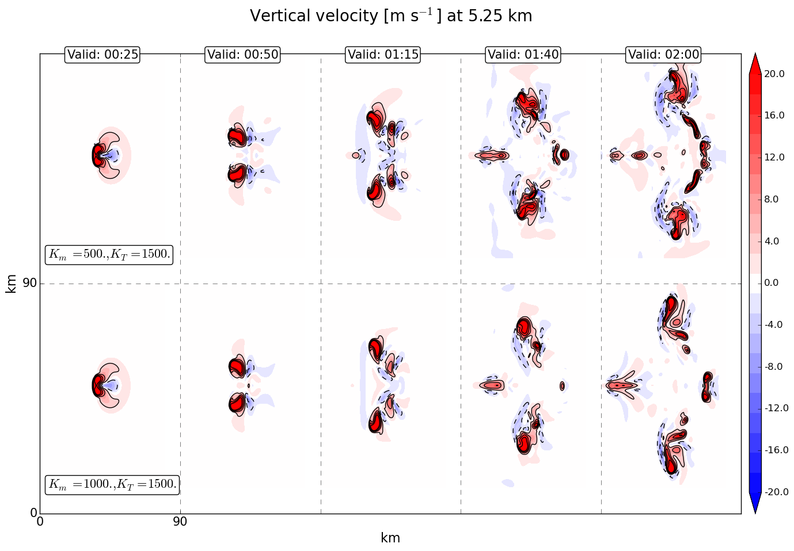
ICON test 3: initial and default (reference) run
dx=0.5km
(dt=240s)
60 levels (top 30 km)
INITIAL
DEFAULT (doubled momentum diffusion)
TIME
Notes:
K_m is doubled to resolve/cure some stability issues and ‚under-diffusion‘

Slide 3
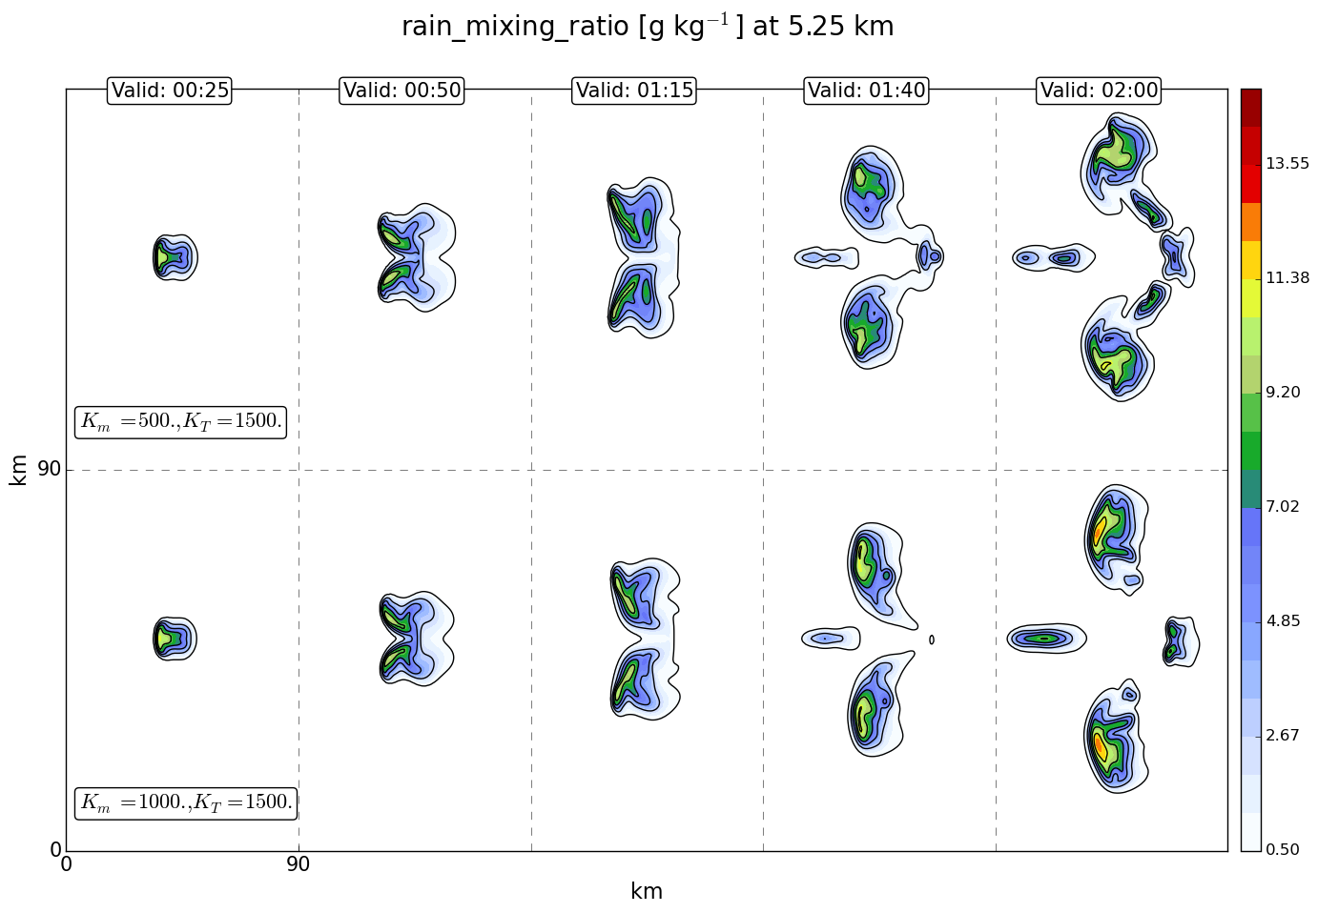
ICON test 3: initial and default (reference) run
dx=0.5km
(dt=240s)
60 levels (top 30 km)
INITIAL
DEFAULT (doubled momentum diffusion)
TIME
Notes:
Doubling K_m decreases total precipitation
Less noise after doubling

Slide 4
ICON test 3: sensitivity studies
spatial resolution dependence of results
diffusion dependence of results

Slide 5
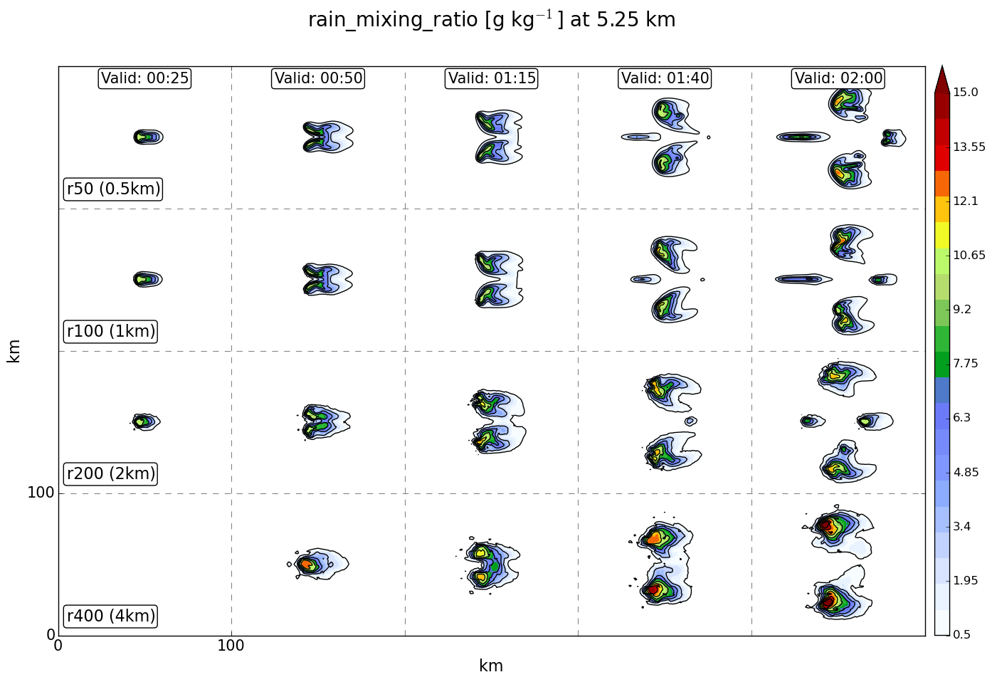
1. Precipitation: spatial resolution dependence
DEFAULT
(0.5 km)
1km (r100)
2km (r200)
4km (r400)
TIME
Notes:
The supercell is not yet developing after 25 minutes and not yet splitting after 50 minutes!

Slide 6
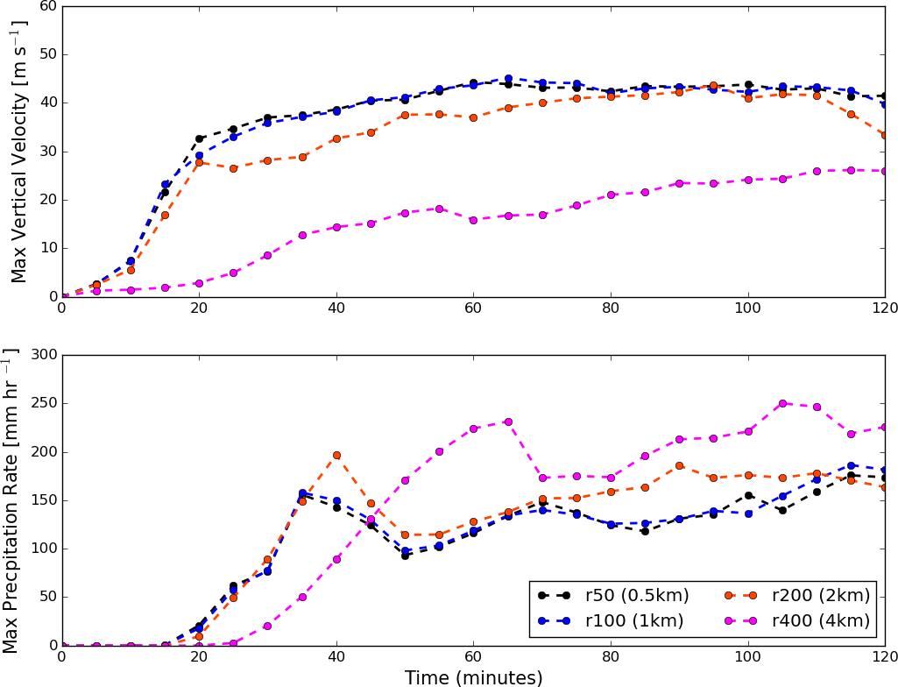
1. Max. precip & max. w: spatial resolution dependence
r400 vastly different
r50 and r100 close to convergence

Slide 7
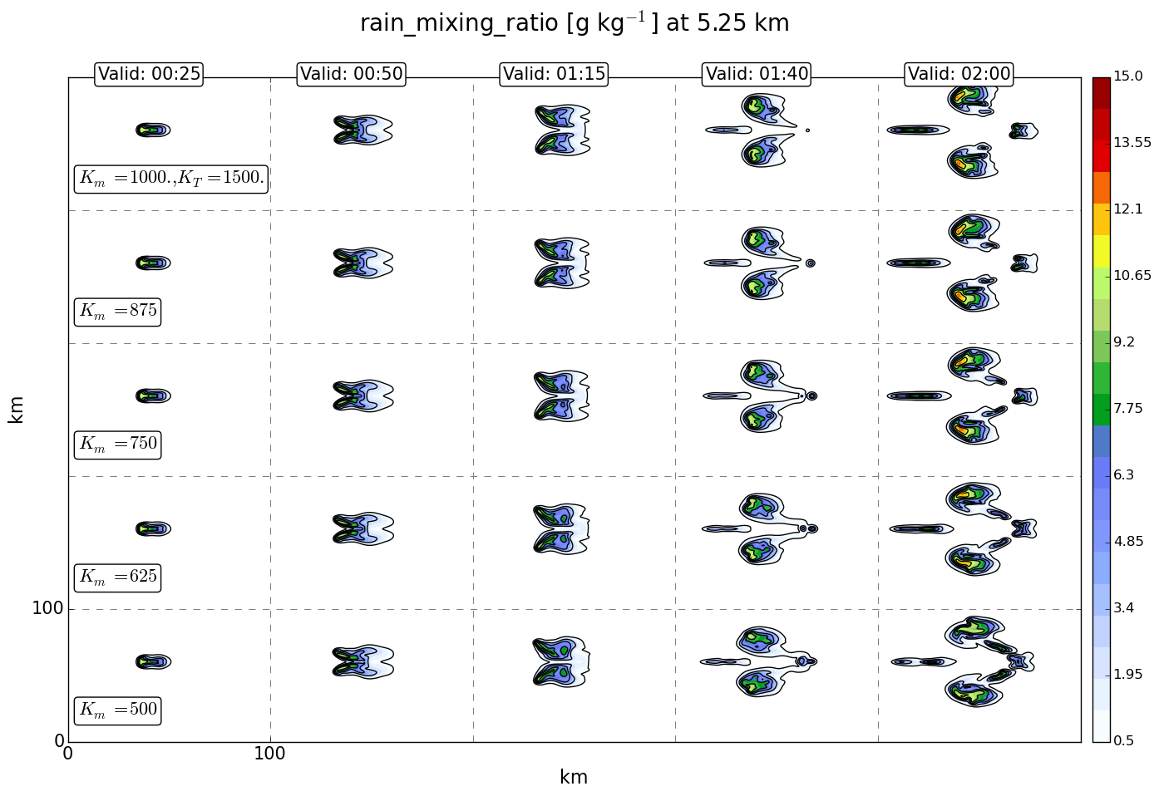
2. Precipitation: momentum diffusion dependence
DEFAULT
LESS DIFFUSION
TIME

Slide 8
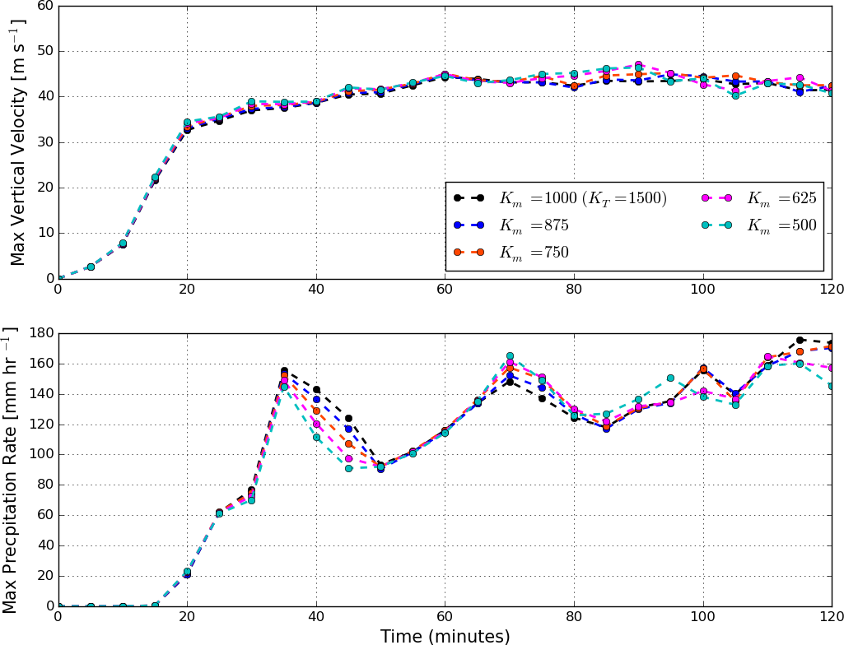
2. Max. precip & max. w: momentum diffusion dependence
Generally minor differences

Slide 9
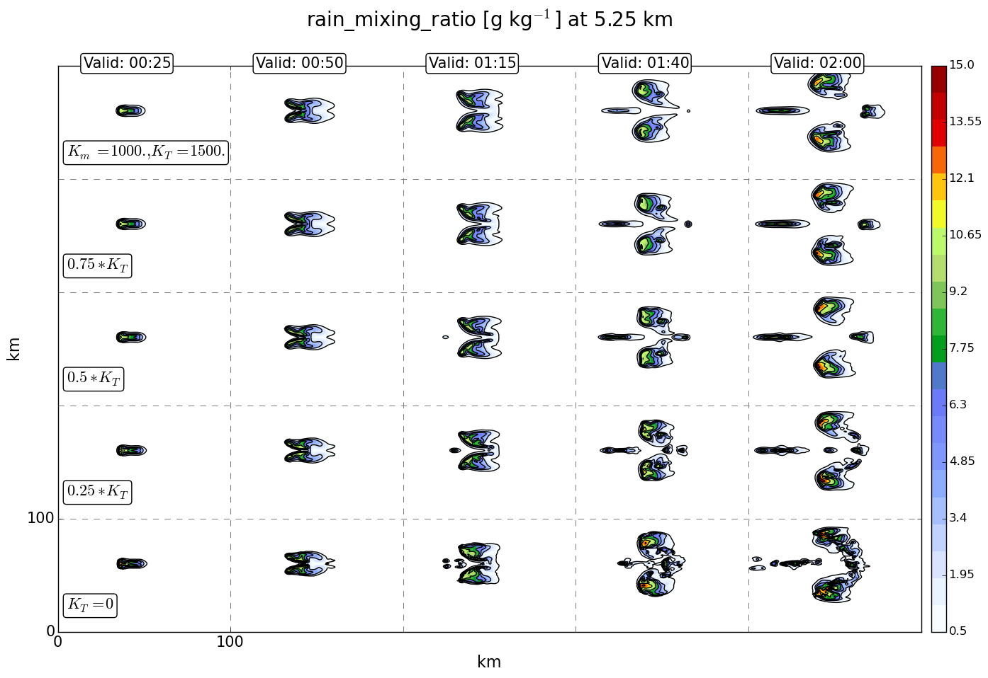
2. Precipitation: tracer diffusion dependence
DEFAULT
LESS DIFFUSION
TIME

Slide 10
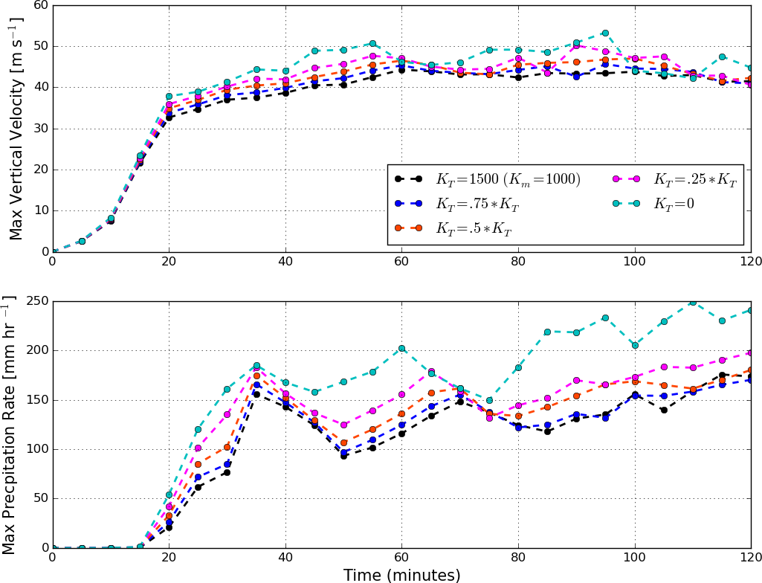
2. Max. precip & max. w: tracer diffusion dependence
Stronger sensitivity of results to change in K_{T} than K_{m}

