Slide 1
Subjugation
A game of strategy and warfare
By Pádraig Crotty
20085012
BSc(Hons) in Applied Computing (Games Development)
Supervisor: Dr Denis Flynn

Slide 2

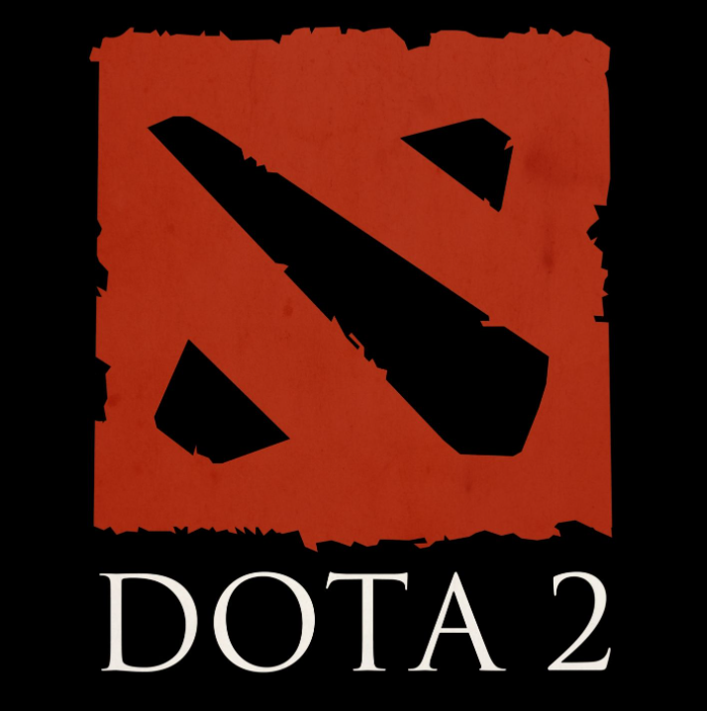
Overview
Subjugation
3rd person 1 vs 1 Multiplayer Online Battle Arena (MOBA)
MOBA :
Competitive
5 vs 5
Large Arena
Character Selection
Destroy enemy base

Slide 3
What am I Developing?
A fresh new take on the 1 vs 1 experience
Prioritise the players
Simple to learn, difficult to master
Replay-ability
Large amounts of random generation
Some Players like experimenting
1 Conqueror and 4 minion types
5 Conquerors and 12 minion types on release, that’s 59,400 combos!

Slide 4
What Motivates this Project?
Unique but not niche
Gap in the market
For me personally
I like making games
I like working with randomness
As a developer
People enjoying your game
Bulking my skills

Slide 5

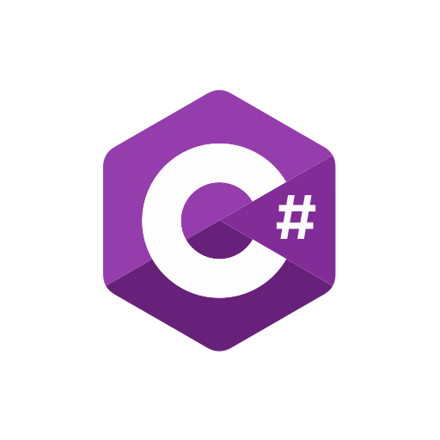

How is the Project being Created?
Developed in the Unity Engine
Created in C#
Using Mirror Networking Library

Slide 6



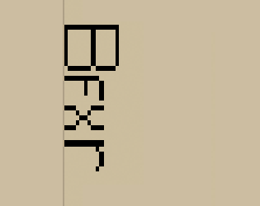

All Assets are being made by me!
3D Assets >> Blender
2D Assets >> GIMP (GNU Image Manipulation Program)
Audio Assets >> Recordings, BFXR, Bosca Ceoil & Audacity

Slide 7
Where is the project and where is it going?
It’s still early stages, let me show you my progress!
6 Releases planned for Semester 2
Additional game Systems and features
1 Conqueror, 2 Minions, 4 Structures & Several Props

Slide 8
My Findings from Semester 1
Networking is difficult and slow
It is difficult to predict time
Creating Assets can be time consuming
All time related issues.

Slide 9

Thank you for your time! Any Questions?

