Slide 1

Labyrinth rush
A game by Oisín Ivory , Pádraig Crotty and Cillín Ivory

Slide 2
A competitive 3 player strategic exploration game

Slide 3
What are you doing?
You are exploring the Labyrinth to find and defeat the Minotaur before anyone else.

Slide 4
Why are you doing it?
Necromancers have risen the Minotaur. You are a mercenary who is trying to claim the sizeable bounty on the Minotaur

Slide 5
How are you doing it?
Finding and collecting powerful items and equipment, aiding you in defeating the Minotaur.

Slide 6
Summary of Key facts
Boardgame- Amazon, Boardgamer.ie
Genre- Indirect PvPvE, Exploration
Release Date- TBA

Slide 7
Summary of Key facts
Monetization- One-time purchase of €19.99
3 player game
20-30 minutes

Slide 8
Summary of Key facts
Key Creatives
Cillín Ivory- Marketing and Human Resources
Pádraig Crotty- Resource and Accounting
Oisín Ivory- Graphic Designer

Slide 9
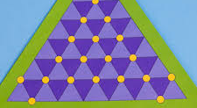
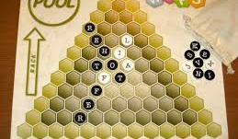
Gameplay
Players get 2 mobility points and 2 action points. Action points are used for attacking, using items and switching gear.

Slide 10

Combat
Turn based combat, armour and weapons determine resistance and damage dealt. Enemies do fixed amounts of damage.
All actions cost one ability point.

Slide 11
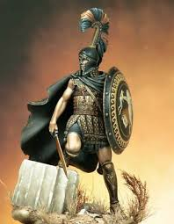
Main Characters
Necromancers have got into the Labyrinth and have risen the Minotaur to cause havoc.
Three rival mercenaries rush to be the first to defeat the Minotaur and claim his bounty.

Slide 12
Storyline
You play as a mercenary who has taken up the offer on a high-risk high reward bounty on a risen Minotaur within the Labyrinth.

Slide 13
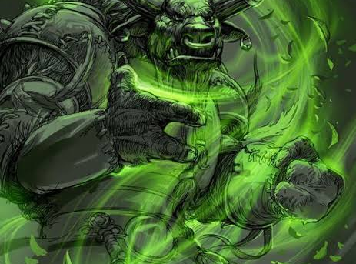
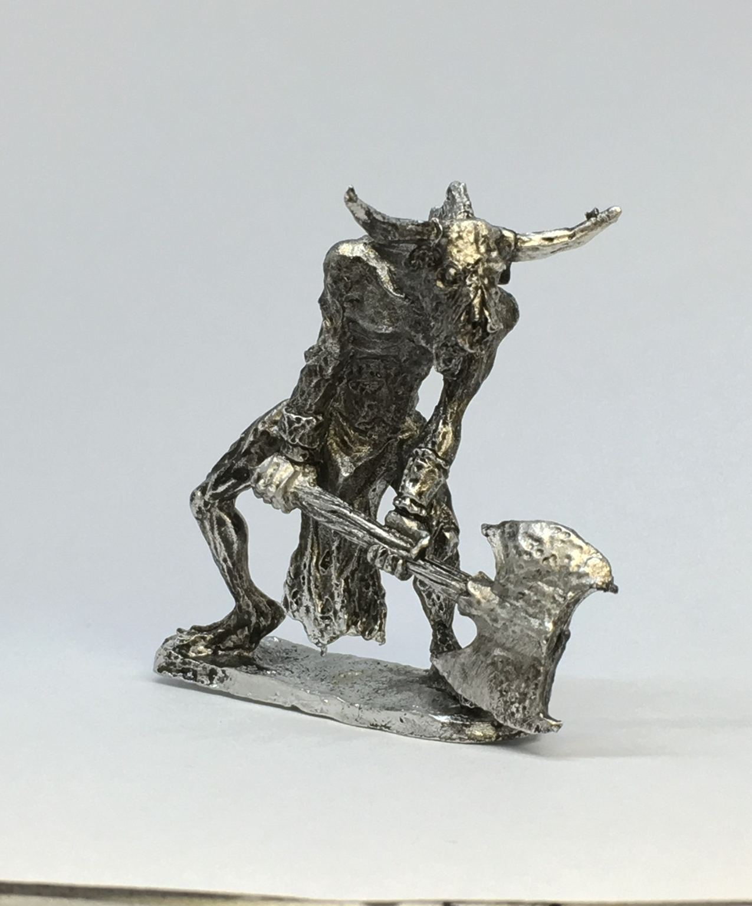
[Insert Artwork]
Concept Art for undead Minotaur

