Slide 1
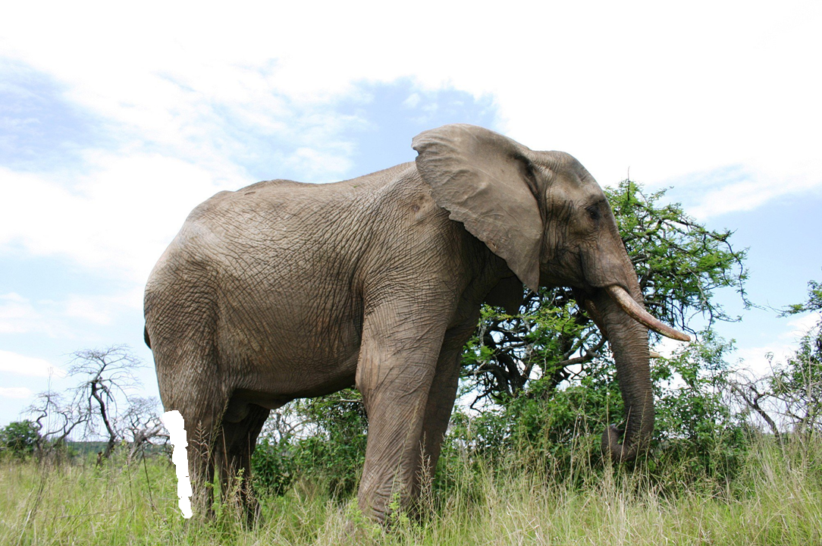

Slide 2


Bites of the Elephant
Smile and high posture while I* remain in a state of confusion for 45 minutes.
Smile and breathe while I* work on my tasks--including Anki, the rest of Lecture 5 reading, and probably the start of Problem Set #2
(Continued)
(Continued)
(Continued on 10/02/2017)
LEARNING < - Finish developing my prioritizer while paying attention to my breathing until 13:27

