Slide 1

Agilité par le code grâce à CQRS et EventSourcing
Workshop – #MixIT15
Forent @florentpellet
Clément @clem_bouillier
Jean @jeanhelou
Emilien @ouarzy

Slide 2
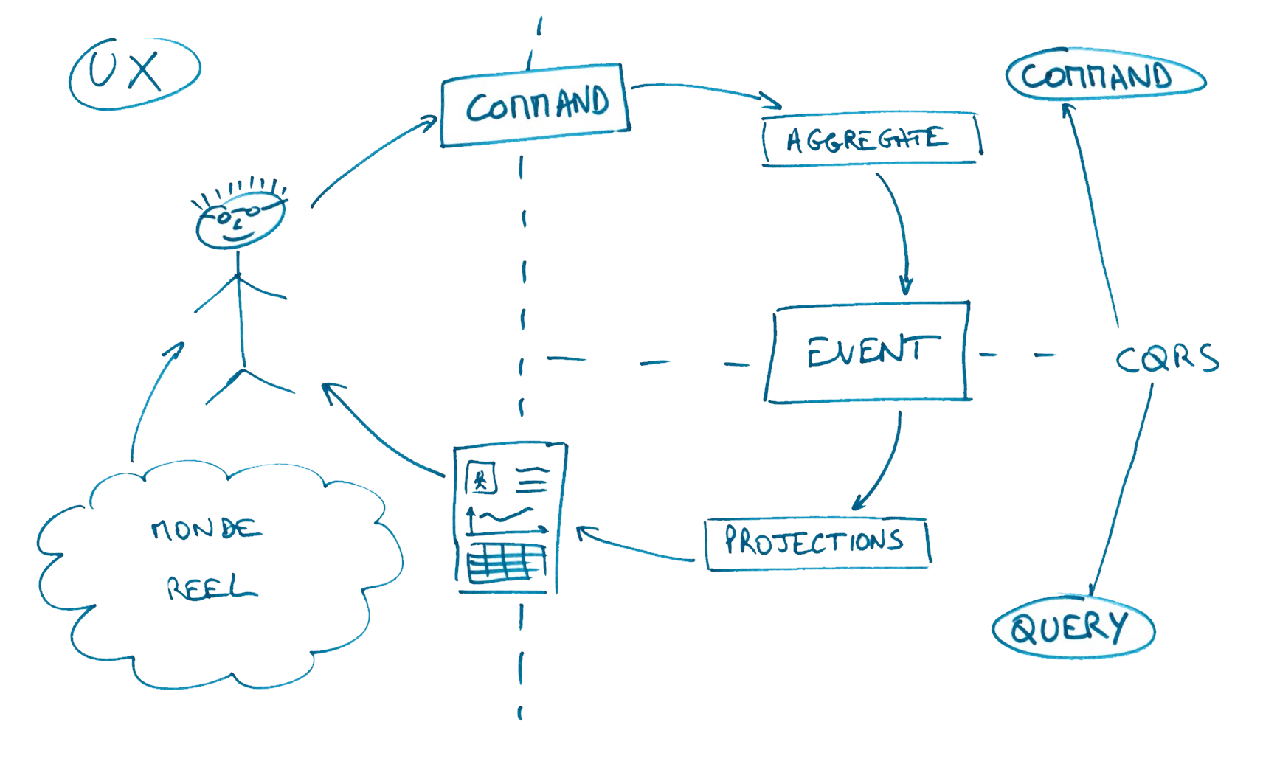
CQRS Concept
Ref. "Conceptual CQRS" - Alberto Brandolini

Slide 3
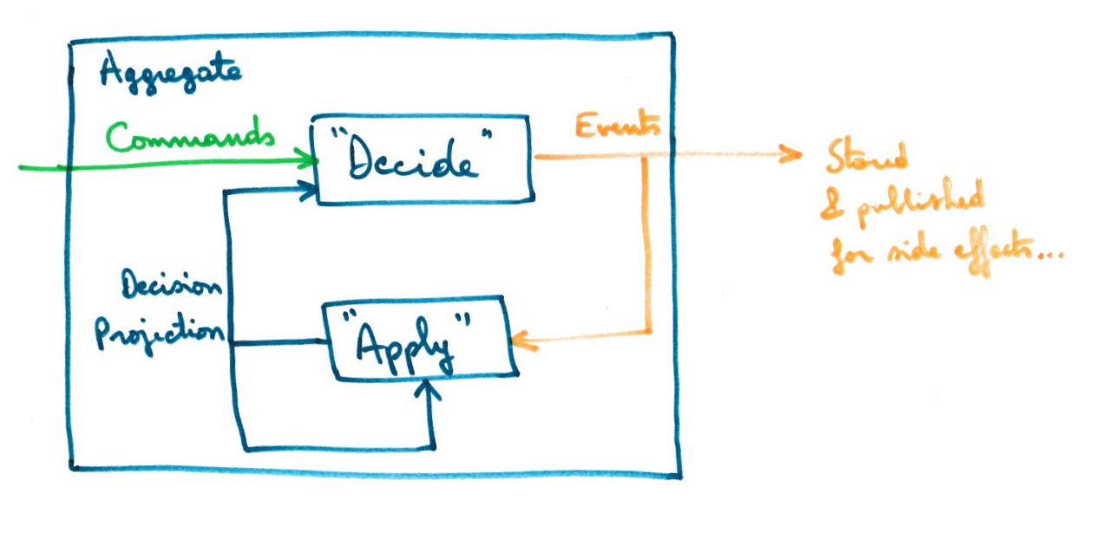
Event Sourcing Concept
NB : DecisionProjection is also called State
Ref. Jérémie Chassaing

Slide 4
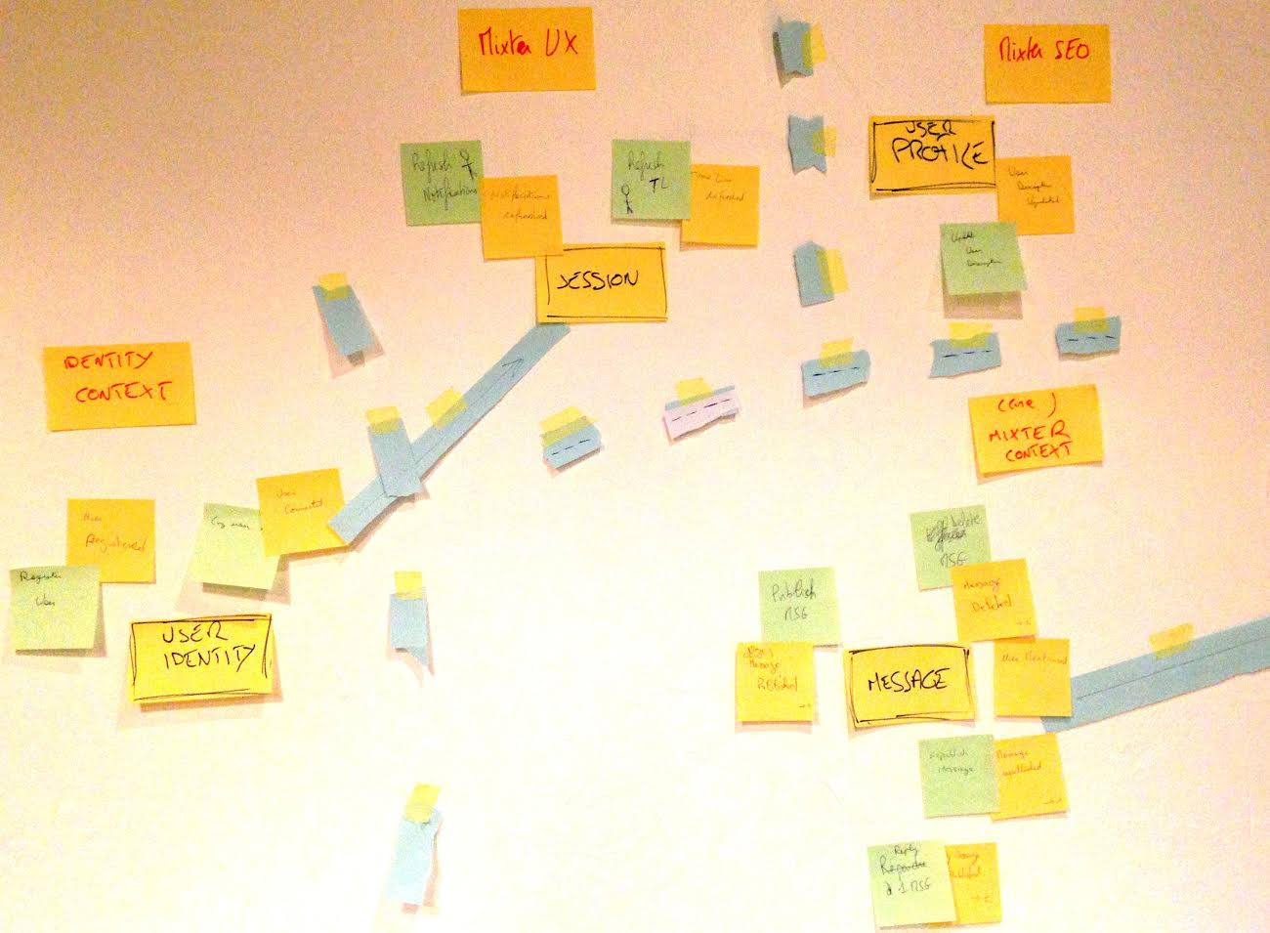
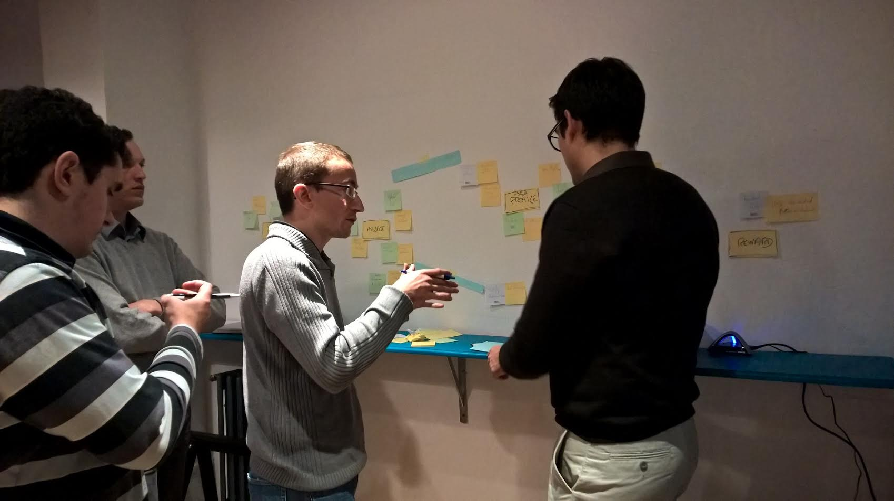
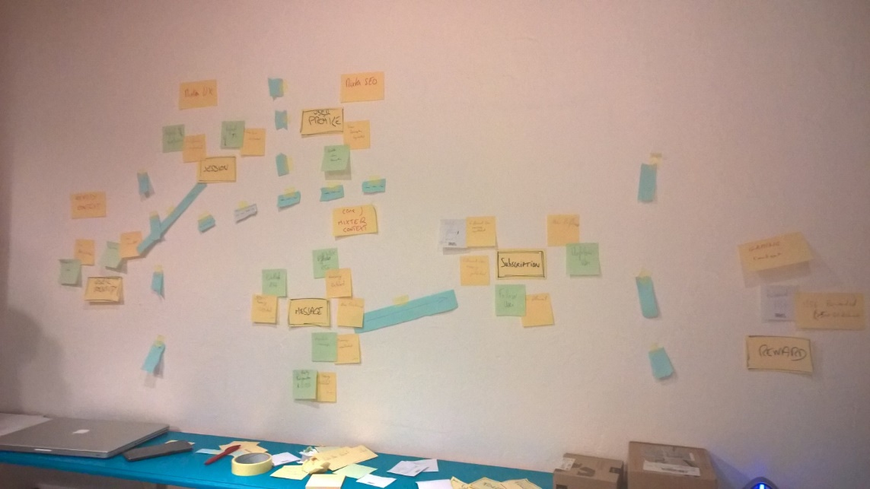
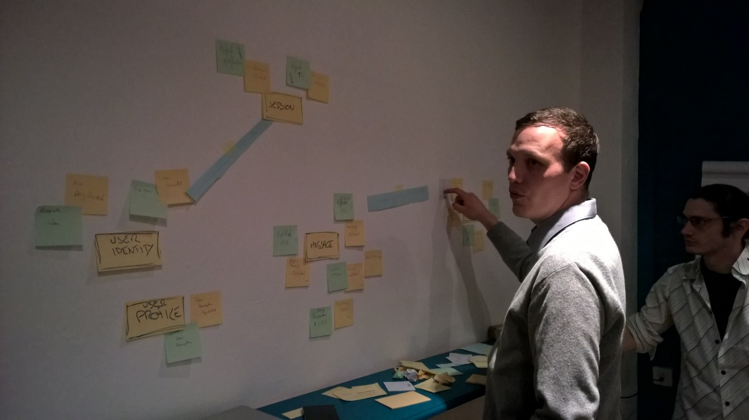
Event Storming Mixter
Ref. "Event Storming" - Alberto Brandolini

Slide 5

Identity context
User description updated
Mixter SEO
User Connected
Log user
Update user description
Session
User Profile
User Disconnected
User Identity
Logout user
Register User
User registered
Followee Message Published
Timeline messages
Notify follower
User unfollowed
Unfollow user
Subscription
Message deleted
Message published
Followers
Delete message
Follow user
Publish message
User followed
Message
User mentionned
(core)
Mixter context
Reply message
Republish message
Gaming context
Reply Message Published
Message republished
Message rewarded
(>500 republished)
Reward
Reward message

Slide 6
Identity context
User description updated
Mixter SEO
User Connected
Log user
Update user description
Session
User Profile
User Disconnected
User Identity
Logout user
Register User
User registered
Followee Message Published
Timeline messages
Notify follower
User unfollowed
Unfollow user
Subscription
Message deleted
Message published
Followers
Delete message
Follow user
Publish message
User followed
Message
User mentionned
(core)
Mixter context
Reply message
Republish message
Gaming context
Reply Message Published
Message republished
Message rewarded
(>500 republished)
Reward
Reward message

Slide 7
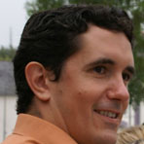

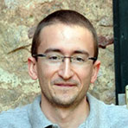

Only 1h30!
It’s short !
4 facilitators
Any questions => signal us
Clément
Emilien
Florent
Jean

Slide 8
Test Driven Workshop
Working in pairs
Red test => Green test
1 git TAG by test (commit if green)
=> git merge [language]-x.y where x and y are incremented to follow workshop (commit your previous solution before merge !)
NB : this is based on 2 branches :
one with test only (one by commit with tag)
one with our solution (only if you are late)
3 steps (+2 bonus)
Command DeleteMessage
Query Timeline Message
Events in aggregate

Slide 9
Repository git
git clone https://github.com/jeantil/mixter.git
Branches:
csharp-workshop (.NET 4.5.1, VS 2013)
java-workshop (SDK8, Maven)
js-workshop (Node.js)
php-workshop (5.5, Composer)
Slide : https://raw.githubusercontent.com/jeantil/mixter/slide/slide.pdf

Slide 10
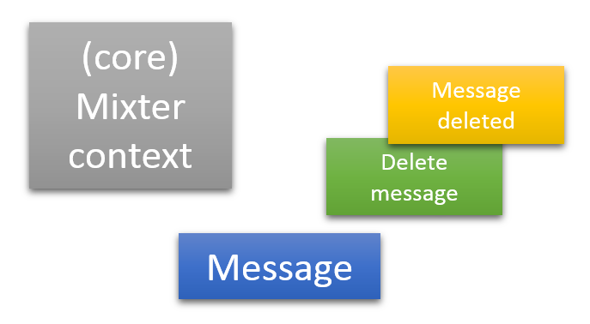
1. Delete Command
What we will learn
publish events from aggregate,
use projection for decision inside aggregate (contains only "state" for future decision, DO NOT keep all state like in an entity)
Implement "business rules" that insure aggregate consistency (based on decision projection and command=method parameters)
In brief : the C of CQRS
Notes:
Additional messages:
Avoid primitive obsession with UserId, MessageId...
A decision leads to events raised => "state" is maintained in DecisionProjection, but just when needed (i.e for future decisions)
For error cases, we can have several strategies : 1) ignore/do nothing, 2) raise an event, 3) throw an exception (not really the best choice)
Tests (and associated tags)
[1.1] message can be deleted​
[1.2] message cannot be deleted by someone else​
[1.3] cannot delete a deleted message​
[1.4] cannot reply to a deleted message​
[1.5] cannot republish a deleted message

Slide 11
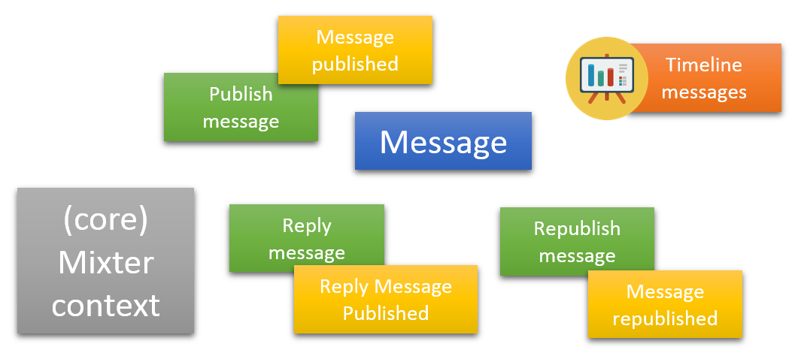
2. Timeline messages Projection
What we will learn
Create another model for Query (Projection, TimelineMessageProjection)
Transform events in a projection model through an EventHandler
A projection repository (in-memory) with its interface is given
In brief : Q of CQRS
Notes:
Additional messages :
develop against interfaces (repository interface)
emergent design & options delaying implementation details to later, like storage (event store & projection store)
projection repositories are more or less like a query side cache, as a side effect (i.e not a justification for CQRS!), it could lead to far more better performance
Tests (and tags):
[2.1] on MessagePublished, add message in author timeline
[2.2] on ReplyMessagePublished, add message in replier timeline
[2.3] on MessageRepublished, increment NbRepublish of message

Slide 12
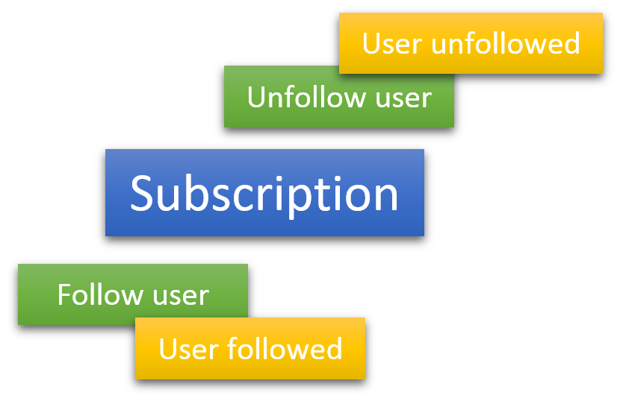
3. Subscription Aggregate
What we will learn
Create a new aggregate (Subscription)
Raise events from it : UserFollowed and UserUnfollowed
Create a decision projection for it
Implement replay of events (event sourced aggregate)
In brief : C of CQRS + Event Sourcing
Notes:
Tests/tags:
[3.1] Follow a user=> Subscription aggregate & UserFollowed
[3.2] Unfollow a user => UserUnfollowed+ DecisionProjection + replay event (used in test for initial UserFollowed)
[3.3] NotifyFollower
[3.4] Cannot NotifyFollower when user have been unfollowed

Slide 13
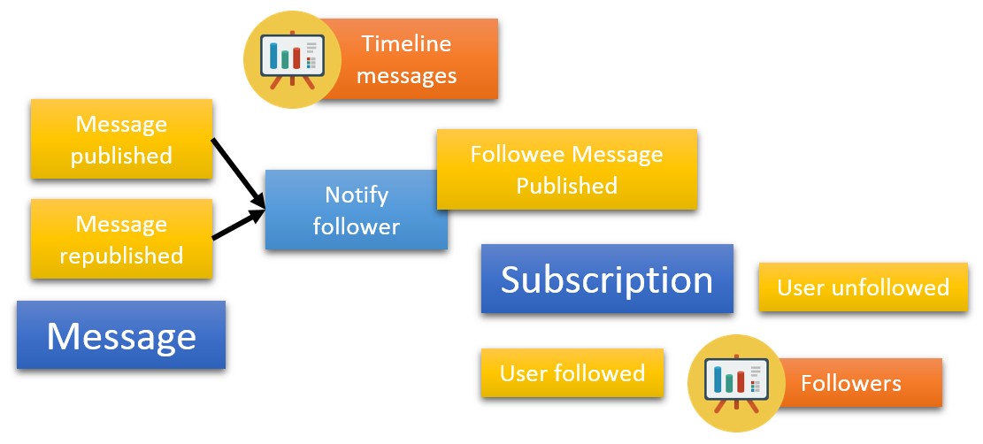
4. Aggregates interaction
What we will learn
Coordinate several aggregates to limit coupling
Concept of " Eventual consistency"

Slide 14
5. Command Handler
Request Rest to execute delete Message command, with session validity verification

Slide 15
Agilité par le code grâce à CQRS et EventSourcing
THANKS!
Forent @florentpellet
Clément @clem_bouiller
Jean @jeanhelou
Emilien @ouarzy

