Slide 1
WayFind
Jacob Foote, Levi Cooper, Sebastian Grabill, Kwame Adubofour, Samuel Ntadom

Slide 2
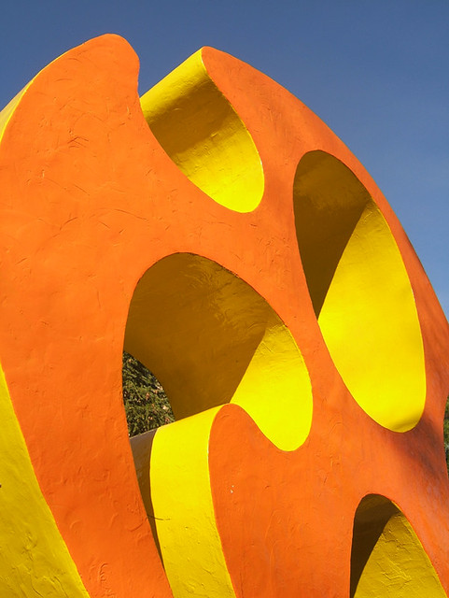
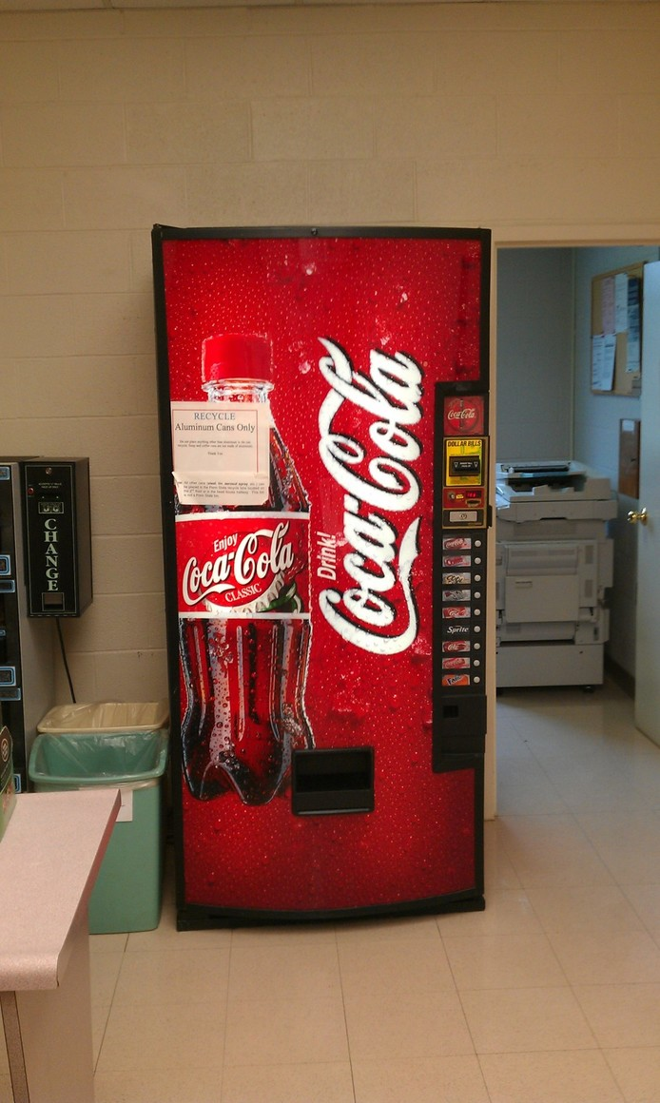
Notes:
What do these pictures have in common?
That’s right, they’re both iconic Calvin Landmarks – the cheese and the sole cola machine
But they’re both in out of the way places, so in order to bring more people to see the many interesting things and places that exist, we created wayfind.

Slide 3
Vision
Vision Statement
  Geocaching and collectathon app
  Transforms campus into an interactive adventure
  Encourage exploration and discovery
  Collect tokens and badges
  Compete with other students
Broad Vision goals
  Personalizable and customized experiences
  Provide communities with personalized orientation activities
  Provide plentiful and accessible puzzles
Notes:
Our team is building a Calvin geocaching and collectathon app that transforms campus into an interactive adventure. Students can explore by collecting virtual tokens at GPS locations tied to landmarks, buildings, and hidden spots, or by solving puzzles that unlock new coordinates. Users can also create their own landmarks and custom scavenger hunts, allowing the community to design challenges for others and share unique experiences. A map-based interface, digital gallery (“Calvin-dex”), and rewards such as badges, streaks, and leaderboards will encourage discovery, problem-solving, and friendly competition.
While apps like Pokémon GO or general geocaching platforms provide broad, global experiences, they lack customization for local environments and persistent community engagement. Traditional scavenger hunt apps often offer only one-off experiences. Our app fills this gap by combining location-based gameplay, puzzle-solving, and community-generated content tailored to campus life. Beyond Calvin, the platform could scale to schools, museums, and local communities, supporting orientation activities, tourism, and interactive cultural events.

Slide 4
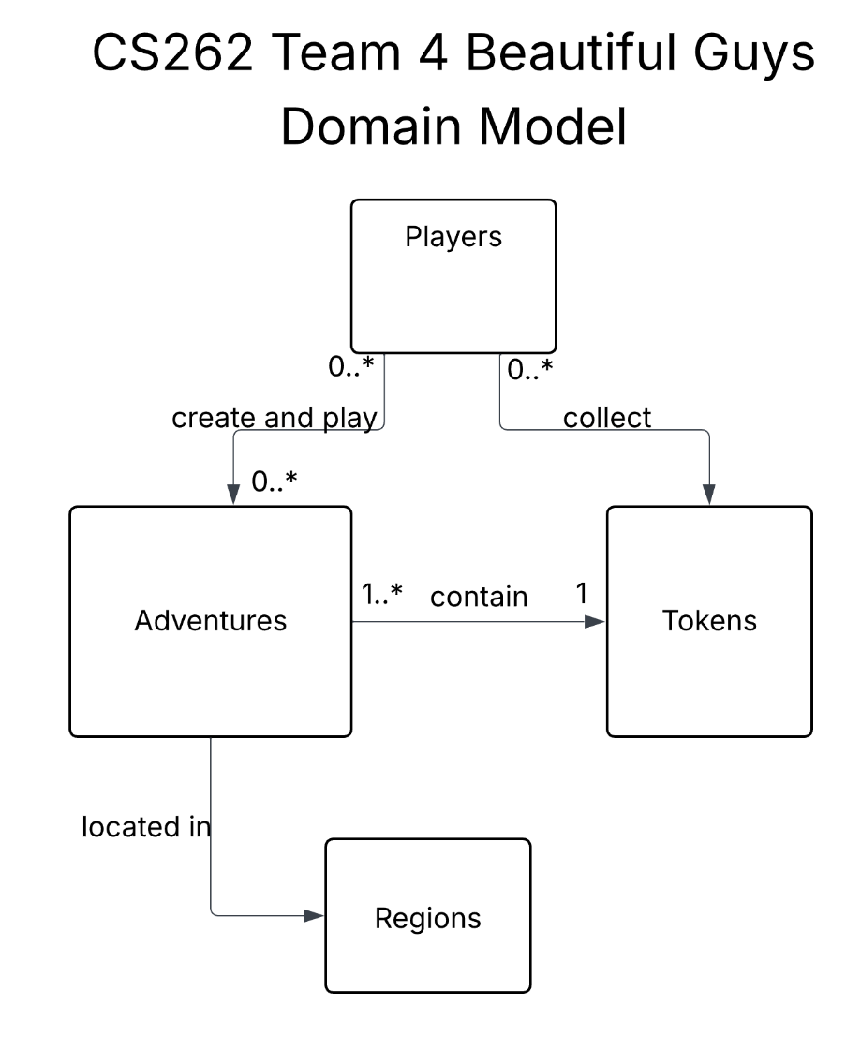
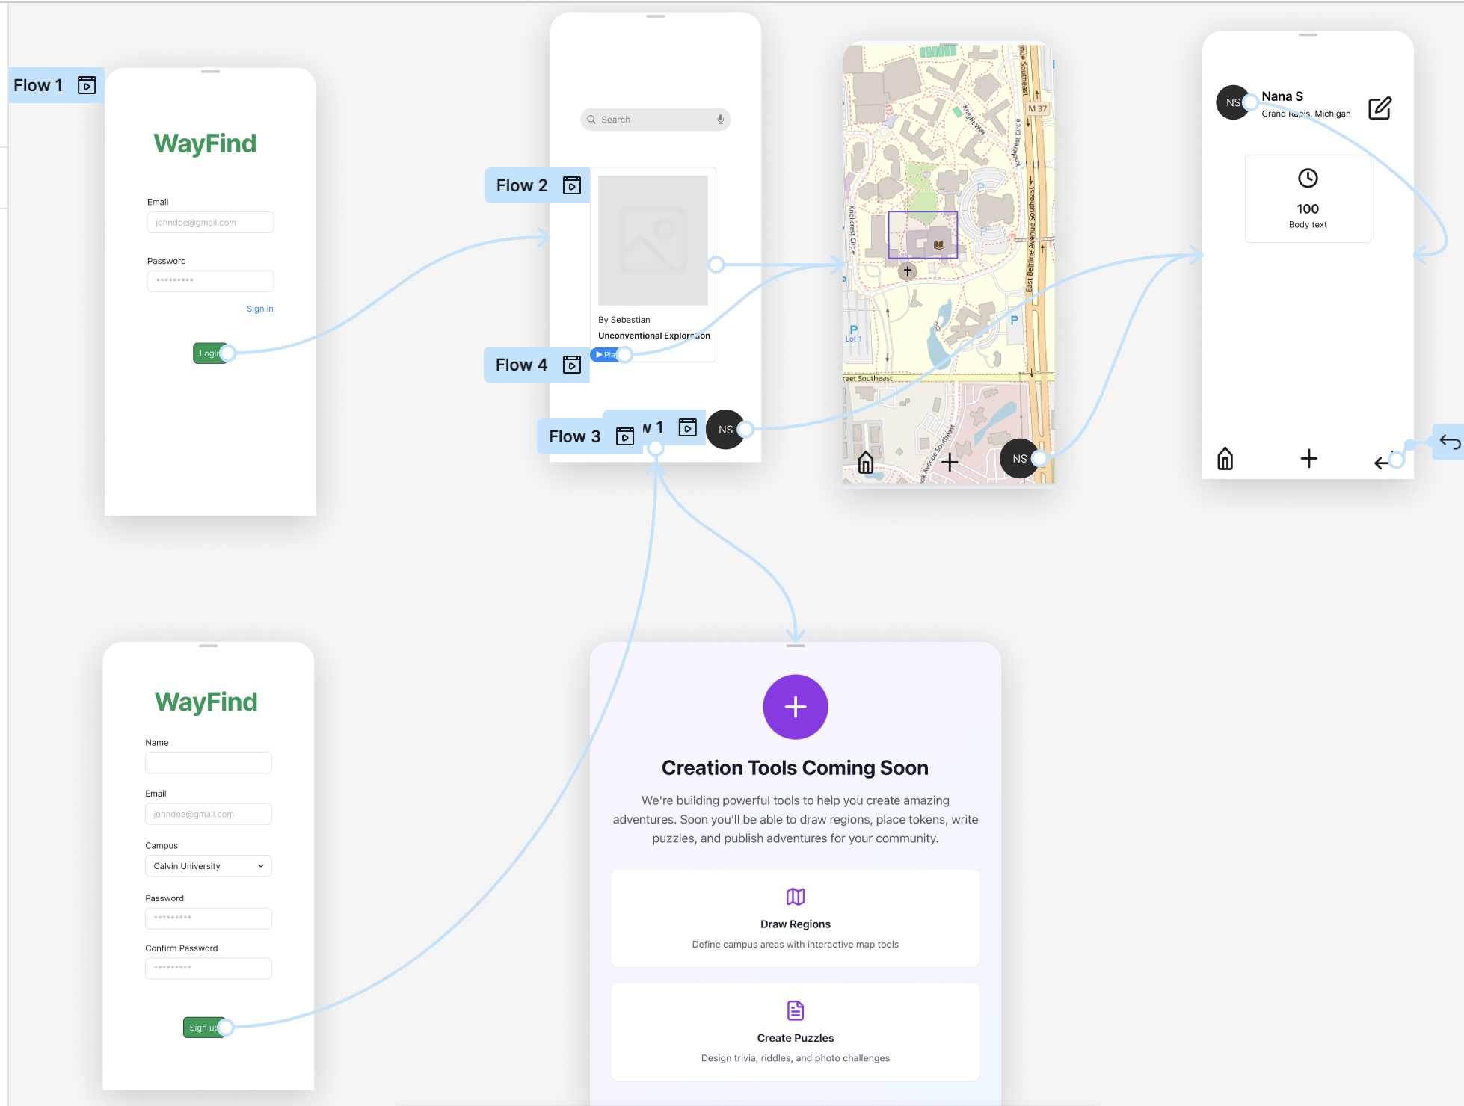
Analysis & Design
UI Model
Notes:
Levi

Slide 5
Status Report
Completed
Pages
  Login
  Home
  Map
  Profile
Features
  View Adventures
  View Profile
  Postgresql Database
  Azure Web Service (almost)
  Map Integration
Not Completed
Pages
  Create Region/Adventure
  Adventure In Progress
Creation
  Create Region
  Create Adventure
Features
  Playing Adventure
  Azure Fetches
  Updating Profile/Adventure/Region
  Authentication & Security

Slide 6
Questions
Links to previous slides

Slide 7
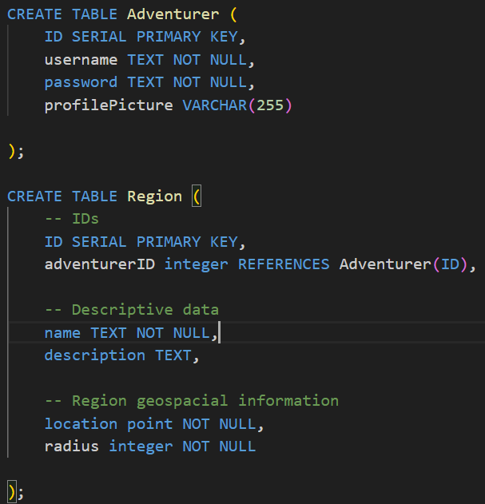
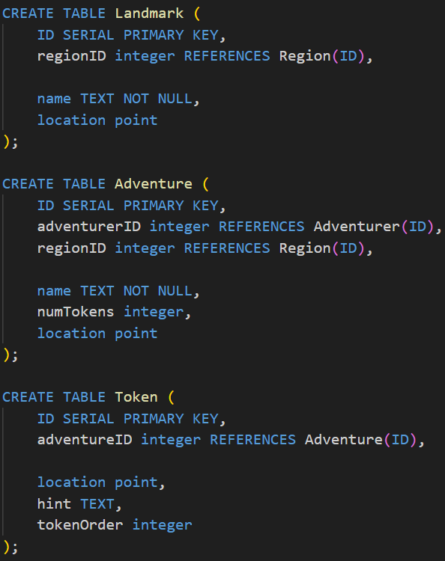
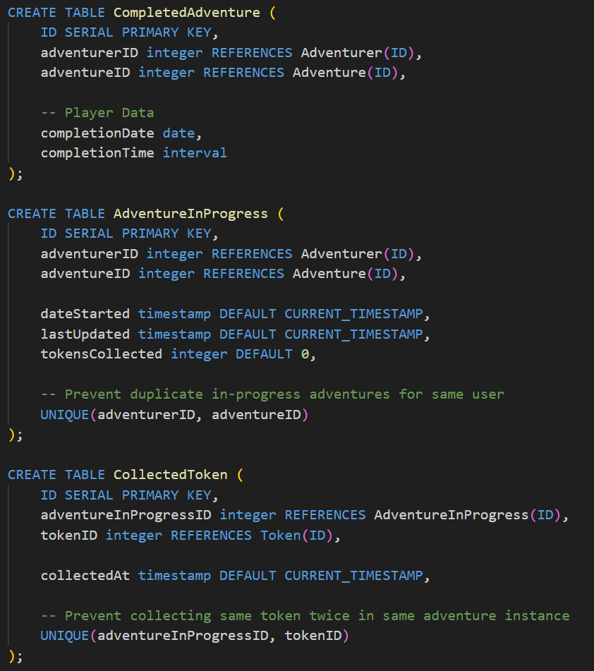
Information Systems Design
Join Tables
Notes:
Note complexity, be quick, don’t hover on this slide
Mention join tables Completed Adventure/AdventureInProgress

Slide 8
User Stories
Current
Interactive Stories
  Search and play adventuress
  Create and view profile
Creative Stories
  Create region
    Add landmarks
    Define “play area”
  Create adventure
    Add tokens
    Make hints
    Define sequencing
Future
Interactive Stories
  View leaderboards
  Compare completion stats
  “Favorite” adventures
  “Upvote” regions
  Virtual pets?
Creative Stories
  Scheduled Adventure
    Set date
    Set time
    Limited participants

Slide 9
Demonstration Outline (REMOVE BEFORE PRESENTING)
Demonstration
- Demonstrate login
- Navigate to profile
- Discuss profile user stories and future implementation
- Navigate to home page
- Discuss database/azure web service
- (make sure app is loaded before presenting since fetch takes a while)
- Discuss database schema (pull up slides)
- Note join tables
- Navigate to Map
- Discuss more user stories
- Navigate to create page
- Discuss future implementations -> go back to slides

