Slide 1
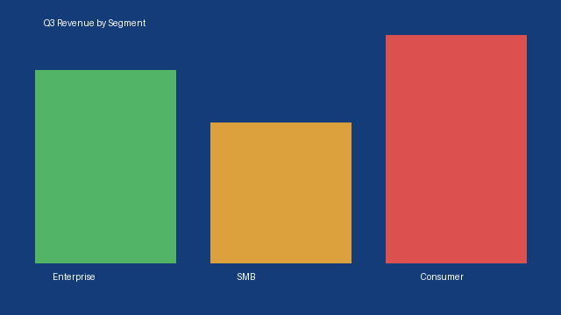
Q3 Revenue Overview
Infographic: revenue mix by segment

