Slide 1

FICO Score Bucketing & Default Risk Prediction
JP Morgan Quant Research | Tushar Verma
JP Morgan Confidential

Slide 2
Objective
Discretize continuous FICO scores using optimal quantization.
Use Mean Squared Error (MSE) minimization to define buckets.
Enable effective input to machine learning classification models.
JP Morgan Confidential
Notes:
Animation: Appear each bullet point one by one.

Slide 3
Data Overview
Dataset: Historical loan and borrower records.
Key columns: FICO Score, Default Indicator, Loan Amount, etc.
Filtered for completeness and sorted by FICO score.
JP Morgan Confidential
Notes:
Animation: Appear each bullet point one by one.

Slide 4
What is Quantization?
Quantization: Mapping continuous values to discrete levels.
In signal processing, used for digitizing analog signals.
Here: we quantize FICO scores to 5 optimal buckets minimizing MSE.
Goal: Preserve important predictive features while reducing complexity.
JP Morgan Confidential
Notes:
Animation: Appear each bullet point one by one.

Slide 5
Mean Squared Error (MSE)
Measures average of squared differences from mean.
Used to evaluate compactness within each bucket.
Lower MSE = tighter bucket = more representative average.
Objective: Minimize total intra-bucket MSE.
JP Morgan Confidential
Notes:
Animation: Appear each bullet point one by one.

Slide 6
Dynamic Programming
Technique to break down optimization problems into sub-problems.
Stores intermediate solutions for reuse (memoization).
Used here to find optimal score breakpoints in O(n²) time.
Ensures global MSE is minimized across all possible partitions.
JP Morgan Confidential
Notes:
Animation: Appear each bullet point one by one.

Slide 7
Likelihood Function (Next Steps)
Function of parameters given observed data.
Helps in estimating parameters using Maximum Likelihood Estimation (MLE).
Future extension: use log-likelihood over MSE for probabilistic bucketing.
Better alignment with classification model training objectives.
JP Morgan Confidential
Notes:
Animation: Appear each bullet point one by one.

Slide 8
Approach Summary
1. Precompute MSE for all FICO sub-ranges.
2. Apply dynamic programming to find optimal buckets.
3. Map each FICO score to a discrete rating label (B1–B5).
4. Label used as model input for predicting default risk.
JP Morgan Confidential
Notes:
Animation: Appear each bullet point one by one.

Slide 9
Results
Generated 5 buckets with low intra-bucket MSE.
Higher buckets correlated with increased default risk.
Enabled better interpretability and model performance.
Clear segmentation for downstream credit scoring models.
JP Morgan Confidential
Notes:
Animation: Appear each bullet point one by one.

Slide 10
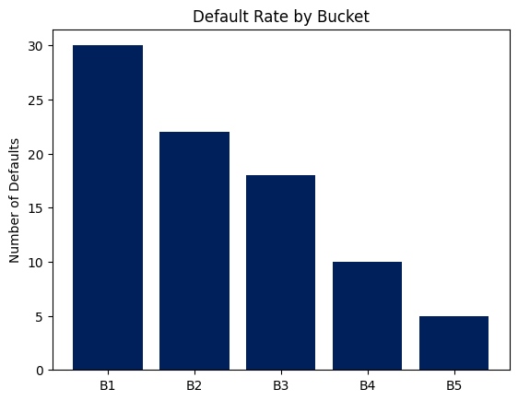
Default Distribution by Bucket
JP Morgan Confidential
Notes:
Animation: Fade-in chart for impact.

Slide 11
Conclusion
MSE-based quantization effectively groups FICO scores.
Dynamic programming enables optimal segmentation.
Model-ready ratings improve credit risk prediction performance.
Foundation laid for future likelihood-based modeling.
JP Morgan Confidential
Notes:
Animation: Appear each bullet point one by one.

Slide 12
Next Steps
Implement likelihood-based quantization for better calibration.
Incorporate additional borrower-level features (e.g., income, LTV).
Benchmark performance with logistic regression, XGBoost.
Explore real-time bucketing in credit risk systems.
JP Morgan Confidential
Notes:
Animation: Appear each bullet point one by one.

