Slide 1
Quantum Control presentation
22/9-2020

Slide 2
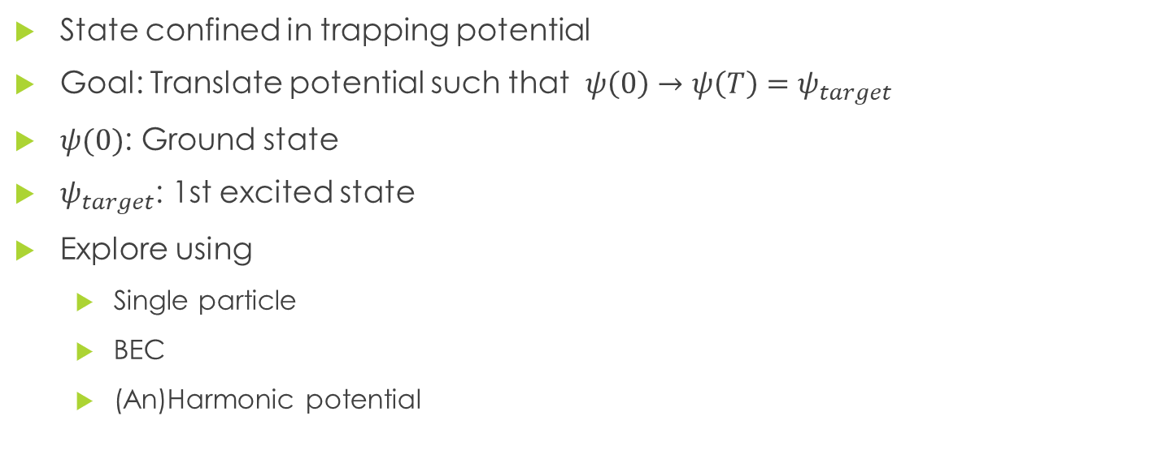
The Shake Up challenge
State confined in trapping potential
Goal: Translate potential such that $ψ\left(0\right)→ψ\left(T\right)=ψ_{target}$
$ψ(0)$: Ground state
$ψ_{target}$: 1st excited state
Explore using
Single particle
BEC
(An)Harmonic potential

Slide 3
My goals
Explore how BECs were different to single particles
Behavior in different potentials
How final time affected behaviour
Map out QSL for a BEC in the anharmonic potential

Slide 4

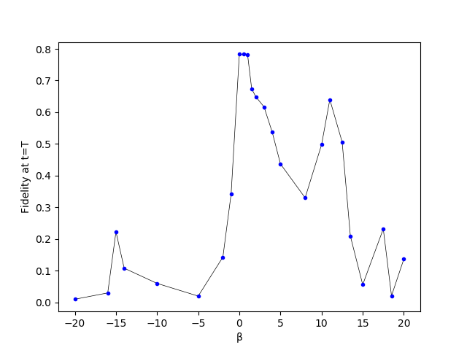

Results
BEC in anharmonic potential, no Grape
Control function
$u\left(t\right)=0.12⋅\sin{({0.86⋅ω}_{01} t/T)}$
Fidelity drops rapidly
Collapses/revivals
Not symmetric

Slide 5
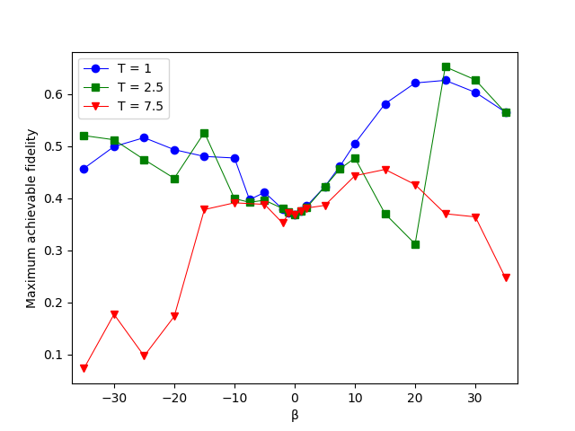
Results
BEC in harmonic potential, with Grape
Map out max reachable F given T, β
Still see “resonant” combinations
Can improve F by ~50% for some combinations compared to SP

Slide 6
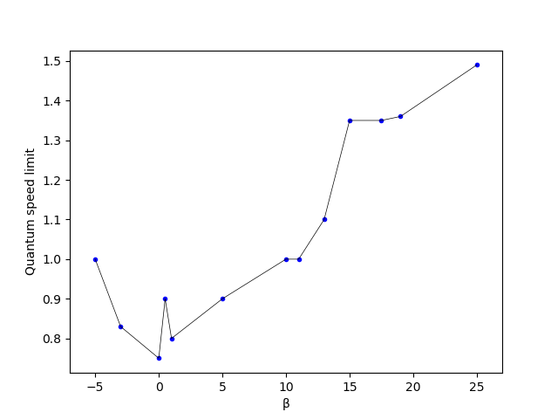

Results
Estimate QSL for Shake up using Grape optimization
Complex behavior means more time is needed
$β<0$ was difficult to optimize
Mainly top-down approaches

Slide 7
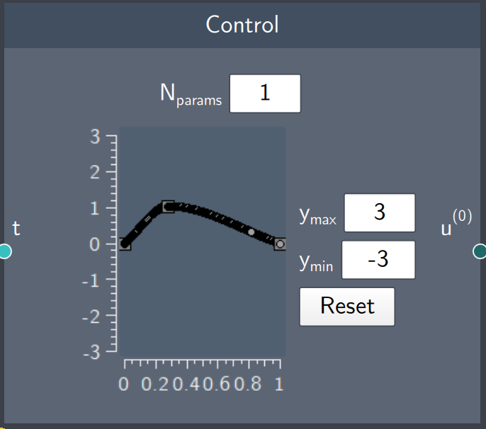
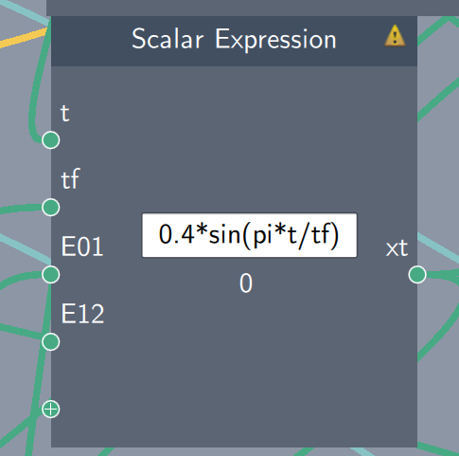
Strategies
2 different tools: Function or graph
Function
Constants
Finetuning
“Recreateable”
Graph
Step-by-step
Easy to make interesting shapes

Slide 8
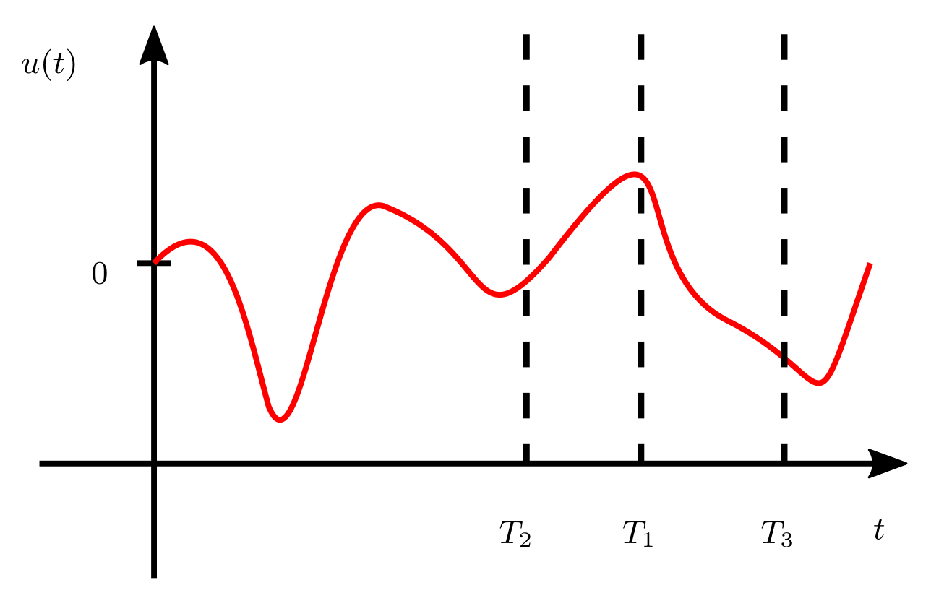
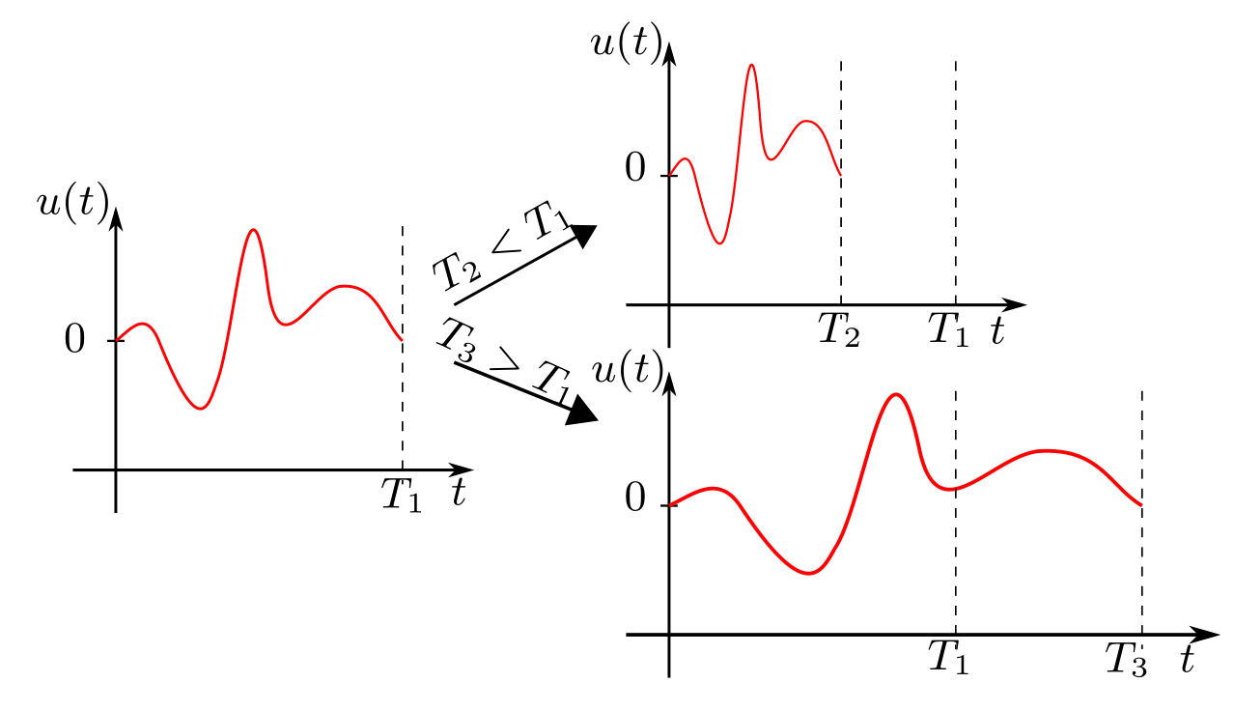
Strategies
Time variation
(In)dependent of final time
Cutoff → Transport issue

Slide 9
Strategies
Up-to-down or down-to-up
Up-to-down
Overestimate QSL
Find a solution
Shrink final time
Down-to-up
Underestimate QSL
Improve best seed
Increase final time

Slide 10
Considerations
Large T or β make system complicated
Even more sensitive to initial conditions
Simple functions have been tried
More complex functions might work even better
Also seen in Grape solutions: Rapidly oscillating terms

Slide 11
What else to try
QSL
More values on QSL figure
color points by strategy used
BEC in anharmonic potential
Max reachable F for negative beta

