Slide 1
ReactJS
Date:2017/11/07
Reporter:kevin

Slide 2
Introduction
ReactJS
Construct
Redux
React Router

Slide 3

ReactJS

Slide 4

ReactJS
Language
ES6
Sass
Redux
React-Router
React Server Render
Compiler
Babel
Webpack
Node-js

Slide 5
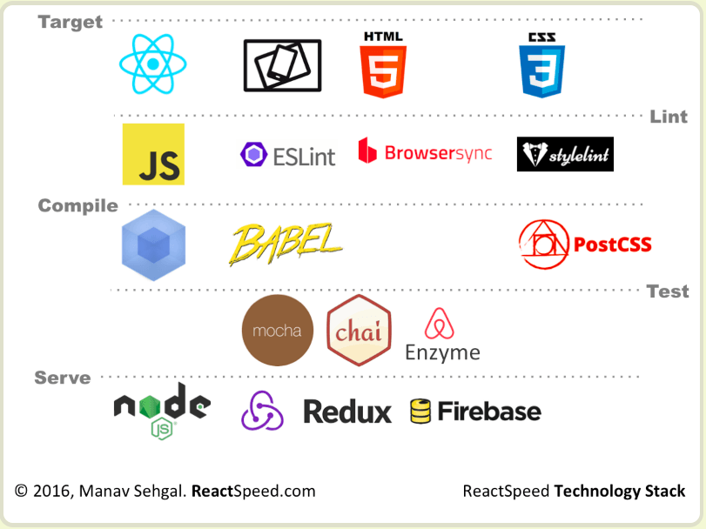
ReactJS

Slide 6
Construct
Container
Component
Data Flow

Slide 7

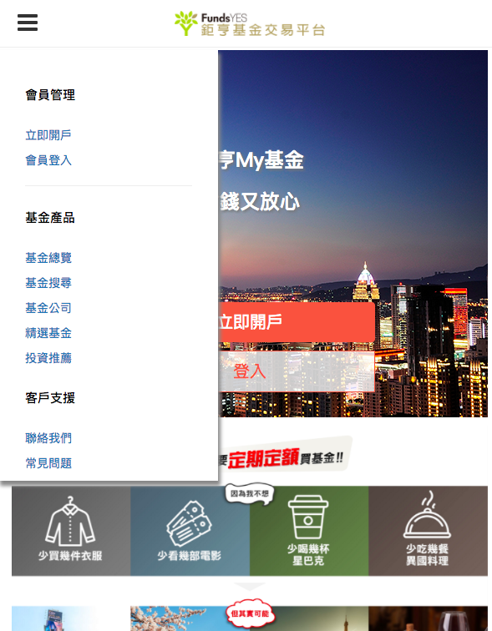
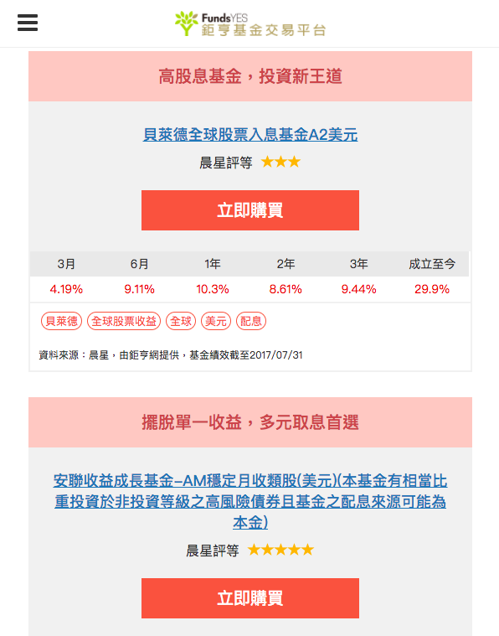
Construct

Slide 8
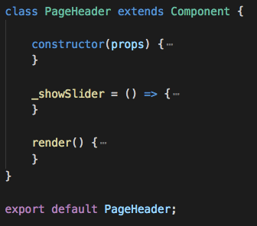
Construct

Slide 9
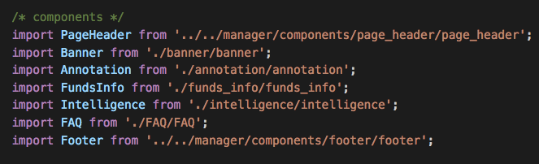
Construct

Slide 10
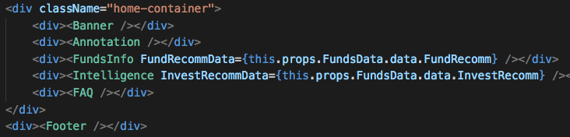
Construct

Slide 11
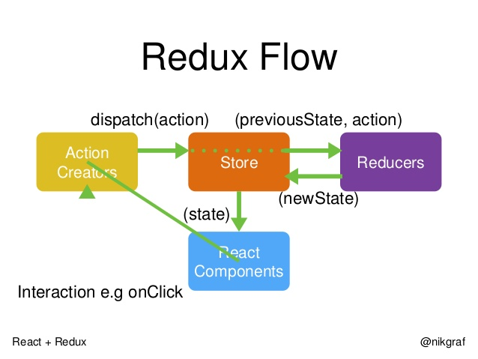
Redux

Slide 12
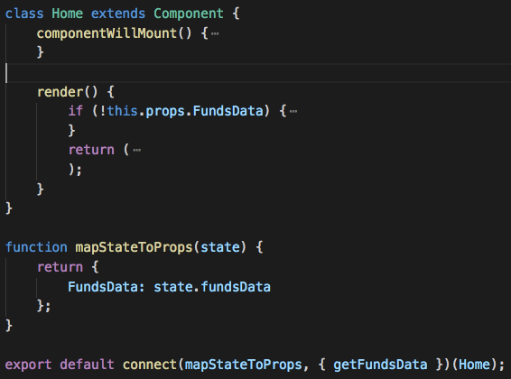
Redux

Slide 13
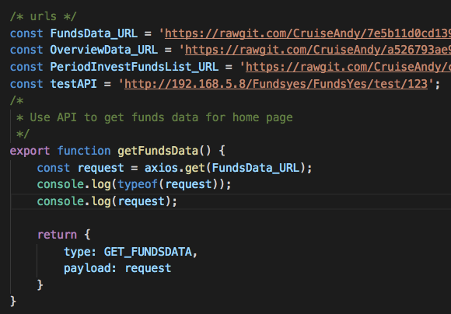
Redux

Slide 14
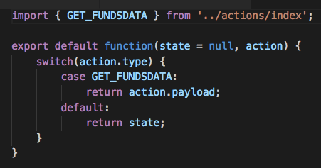
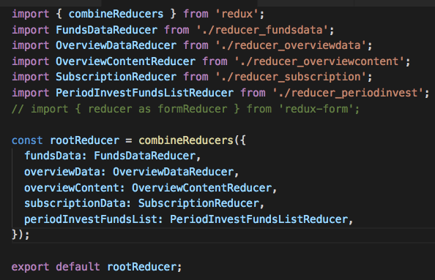
Redux

Slide 15
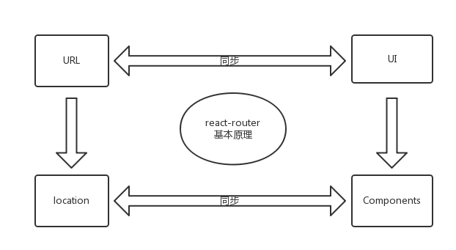
React Router

Slide 16
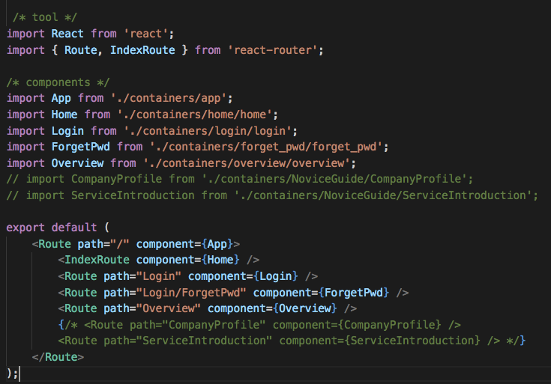
React Router

