Slide 1
Scriptura
Turning Scripture from static text into structured, queryable, and analysable data for study, research, and app integration.
Submitted by: Hansel D'Cruz

Slide 2
Problem
When reading Scripture, many themes in the New Testament echo or fulfil patterns in the Old Testament.
In practice, it is hard to:
Find a verse when only part of it is remembered.
Recover the full chapter context quickly.
Trace textually similar passages across books.
Organise and group related verses into personal sections.

Slide 3
What is Scriptura?
A sleek and intelligent API which gives users the ability to:
Search and retrieve verses from partial text.
Jump from a verse to its full chapter context.
Discover similar verses/books using lexical similarity analytics.
Create personal themed collections of relevant passages.

Slide 4
Solution Overview
Architecture:
Django + Django REST Framework API backend.
SQLite-backed relational data model.
Lightweight Vue 3 client.
Google OAuth for login, JWT for API authorization.
OpenAPI/Swagger documented endpoints.
Cached/precomputed analytics for performance

Slide 5
Data Sources
Data is pooled from various sources:
Biblical Text + Footnotes: USMF Douay-Rheims 1899 (DRA) from eBible
Pericope/Section headers from HuggingFace
Custom suite of Python ingestion scripts which sanitises, extracts, and standardises the DRA translation in a novel way that does not presently exist online.

Slide 6
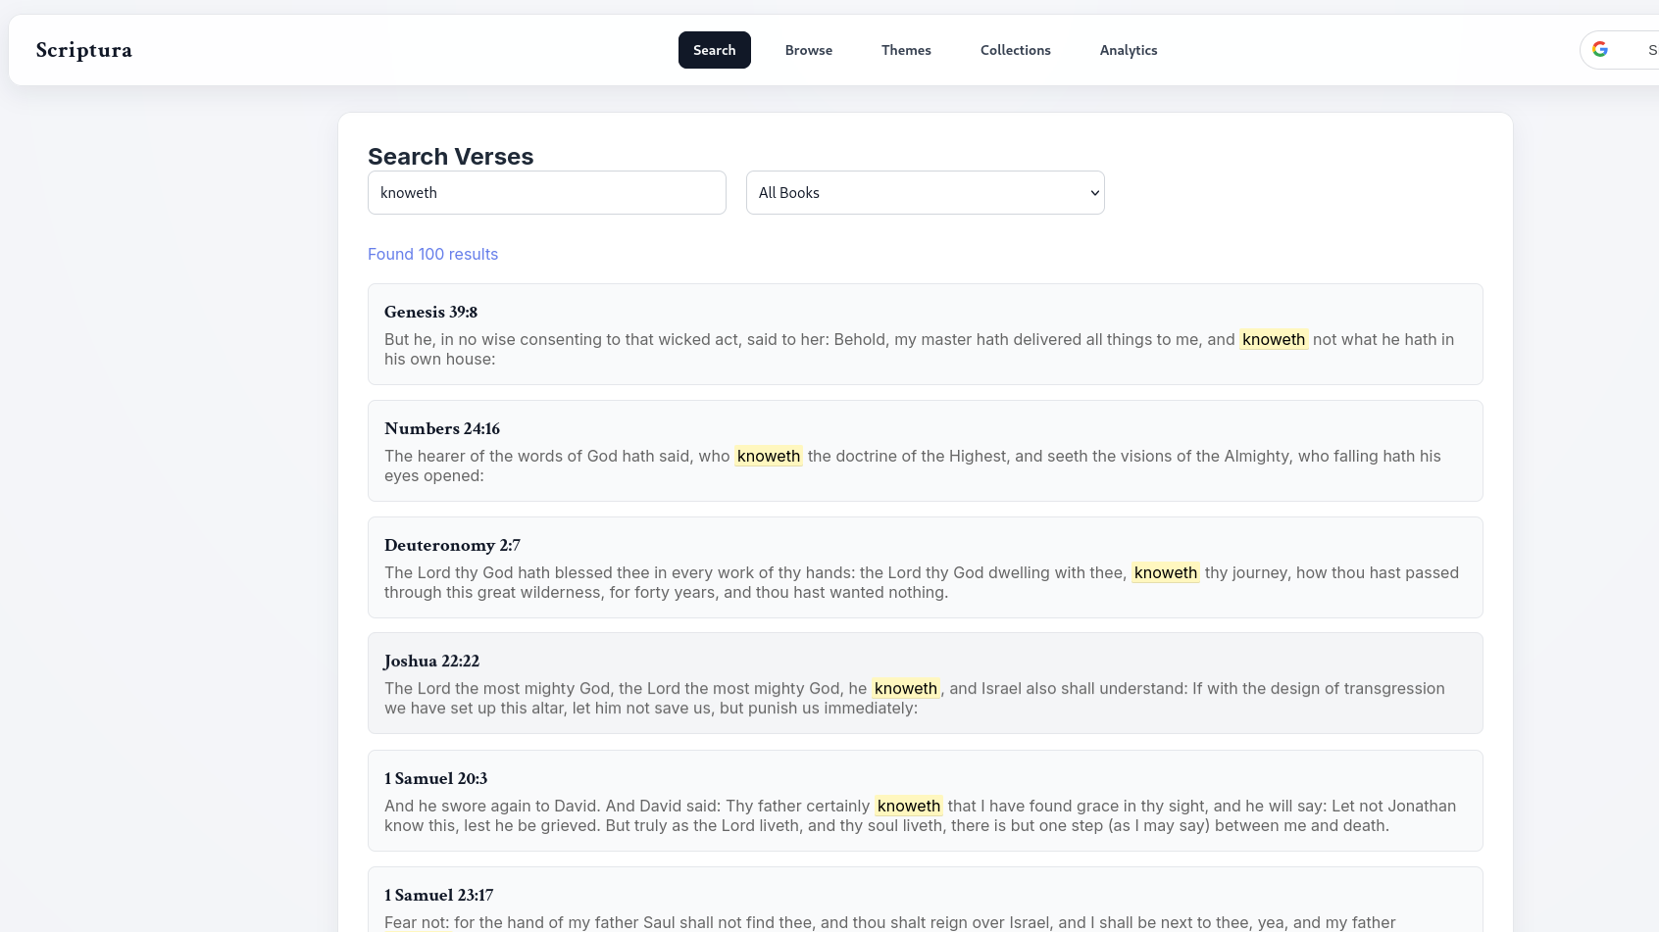

Slide 7
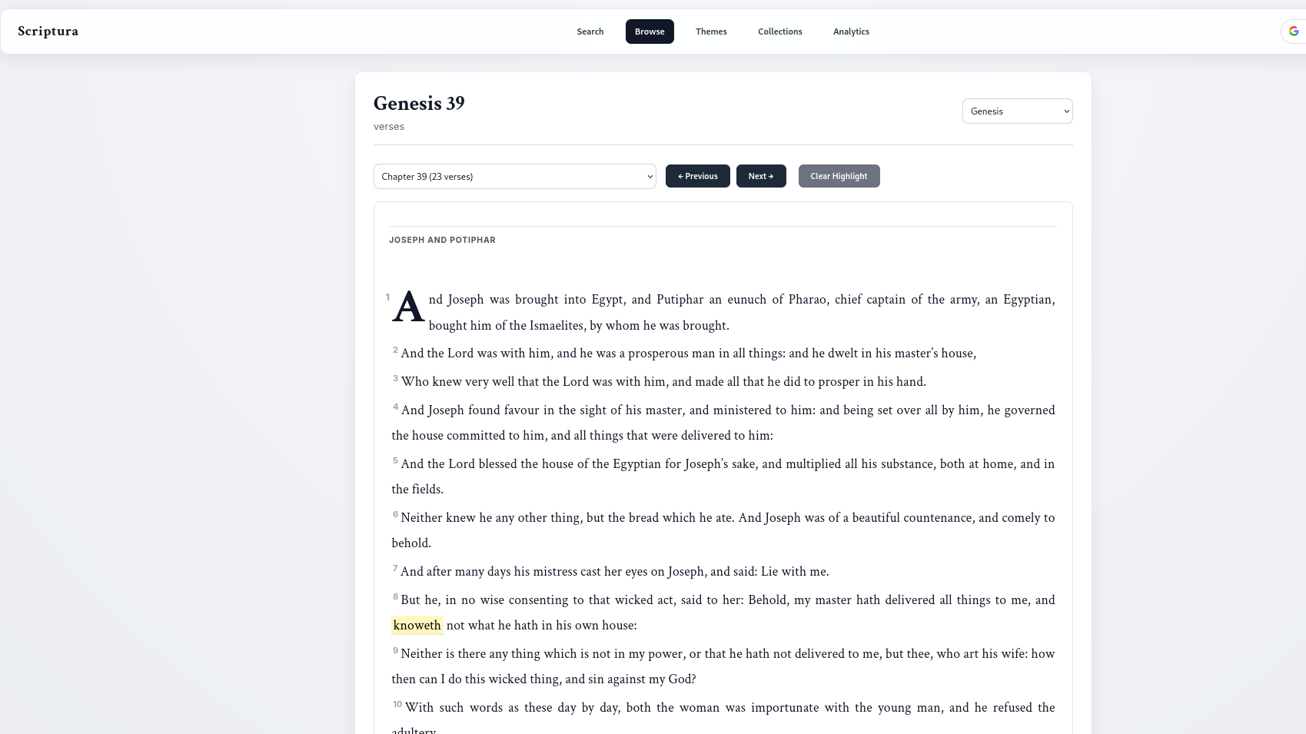

Slide 8
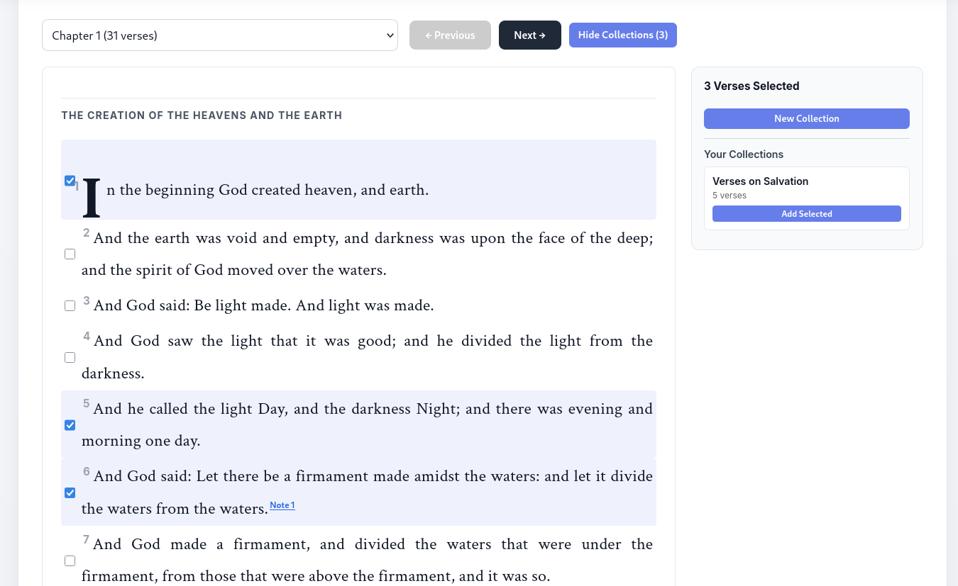

Slide 9
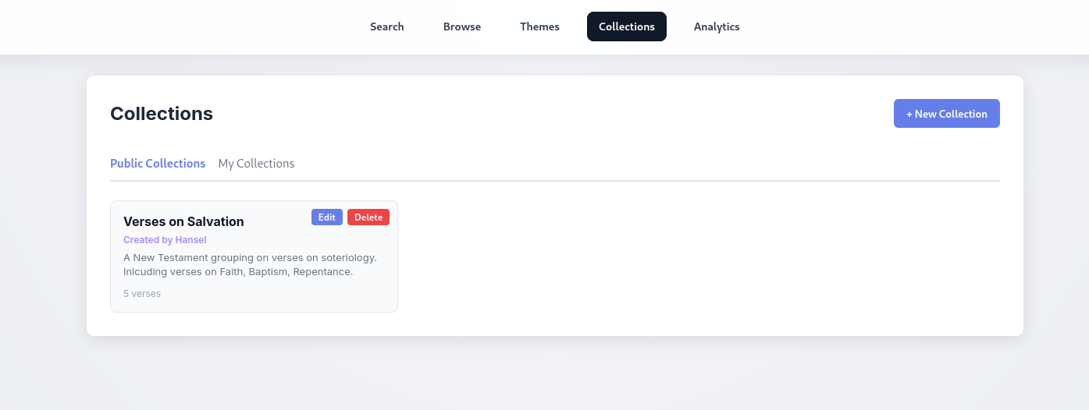

Slide 10
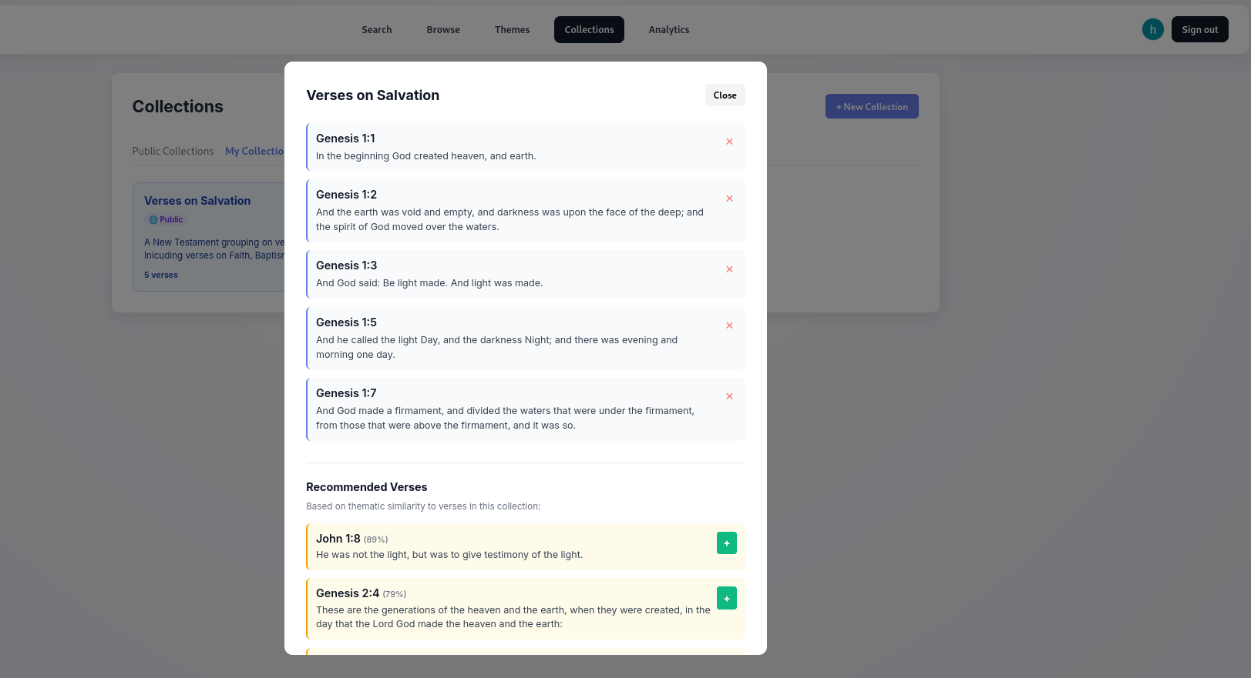

Slide 11
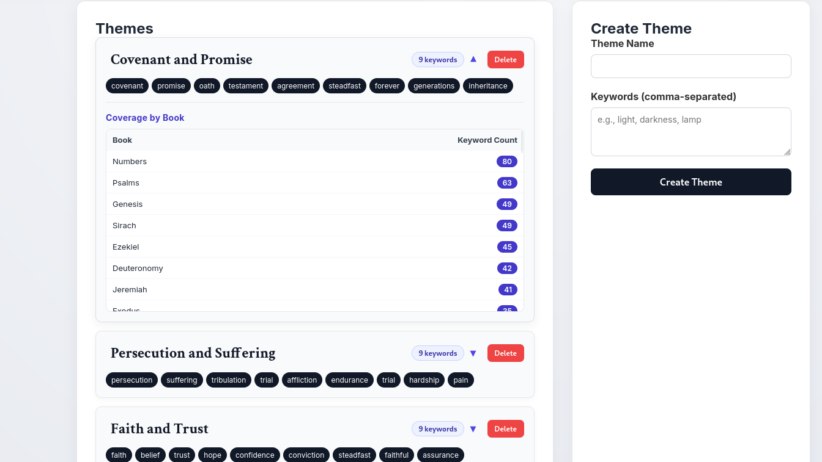

Slide 12
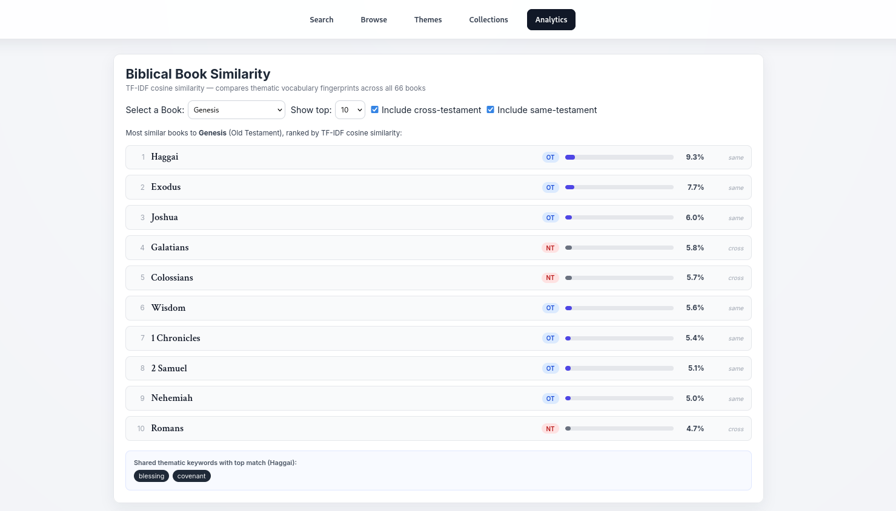

Slide 13
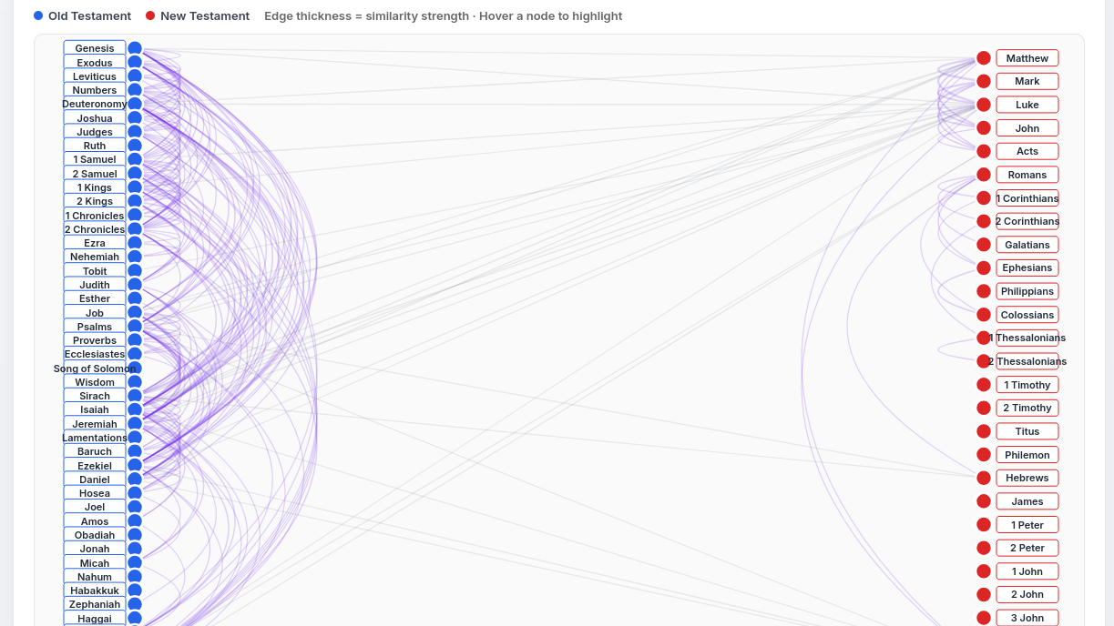

Slide 14
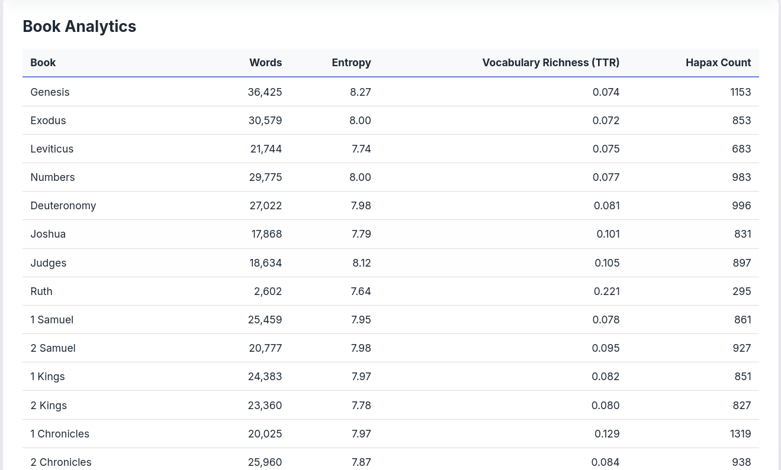

Slide 15
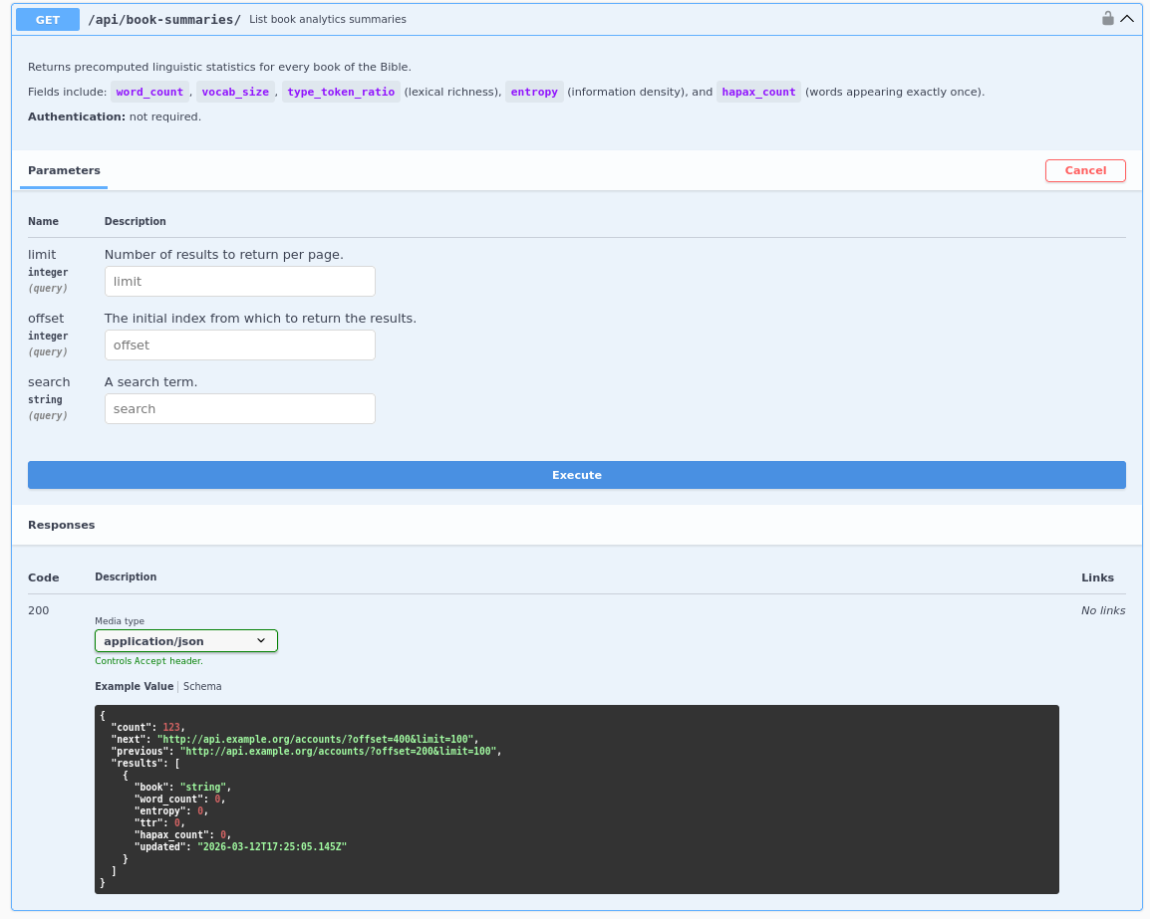
Implements DRF pagination and structured query parameters for scalable analytics access. Access control is handled through Google OAuth identity verification and JWT-based authorization for protected API routes

Slide 16
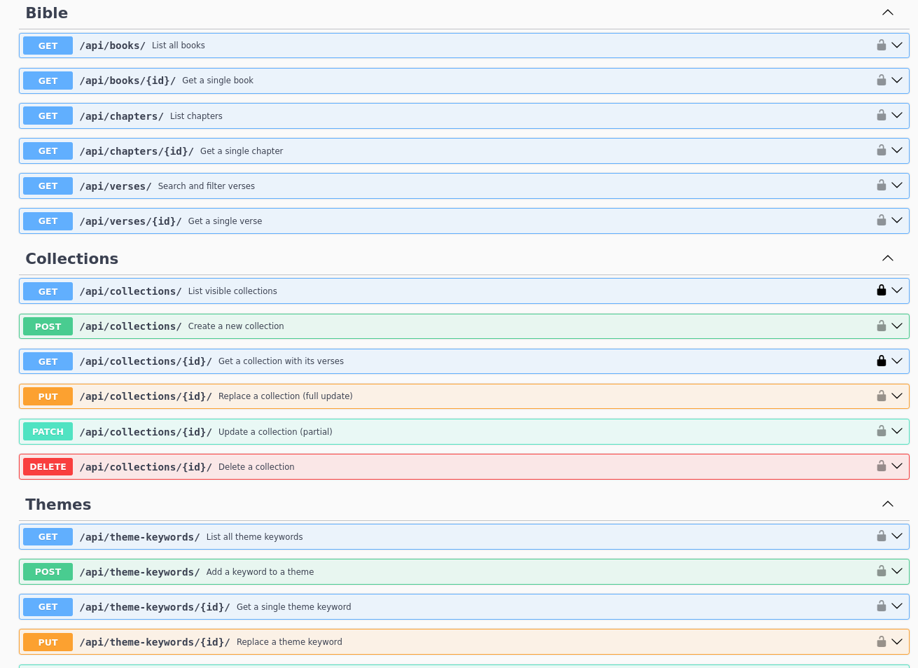
And... a lot more...

Slide 17

Git Usage
Worked on the project over the course of 2+ weeks, with more intensive development in the final week.
Followed a simple workflow: worked mainly on the main branch without a complex branching strategy.
Used GitHub primarily for version tracking, rollback safety, and documenting development progress.

Slide 18
Difficulties and Improvements moving forwards
Data ingestion consistency and tweaking data ingestion script.
Performance on analytics endpoints (used caching to precompute certain graph configurations).
Authentication integration complexity - using Google Cloud with correct setup (Authorised redirect URIs and the oddities of bugs when testing locally)
Next, I would like to extend authentication into full user accounts and add a conversational chat interface for natural-language scripture discovery.

Slide 19
Thank you for listening!
Q/A Time
Github Link: https://github.com/Cruizzer/Scriptura-API
Swagger PDF Docs: https://github.com/Cruizzer/Scriptura-API/blob/main/Scriptura%20API.pdf
Github API Docs PDF (Additional): https://github.com/Cruizzer/Scriptura-API/blob/main/API_ENDPOINTS.md
Technical Report: https://github.com/Cruizzer/Scriptura-API/blob/main/technical_document.pdf

