Slide 1

TOR
Alex Babenko10044281, Tusshar Rana 100426359

Slide 2
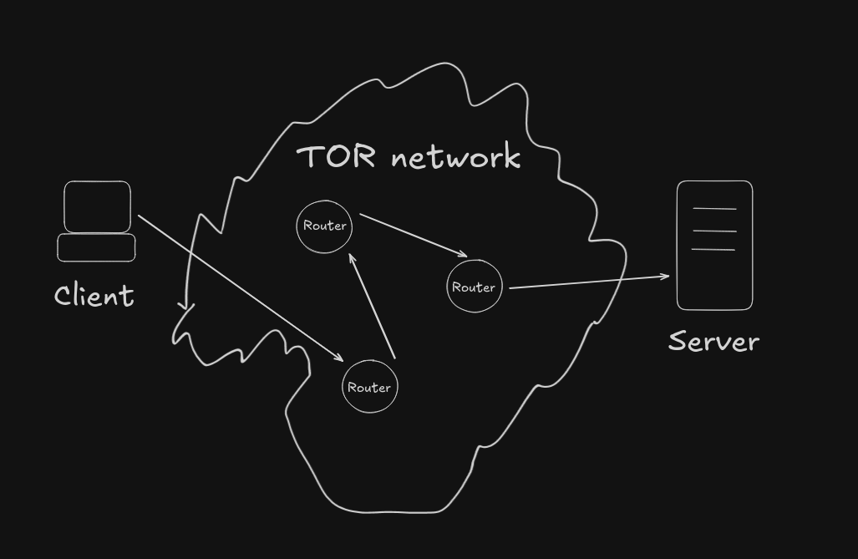
Exit node
Middle node
Guard node

Slide 3
Middle node
Exit node
Guard node

Slide 4
But how can it send packets like that?

Slide 5
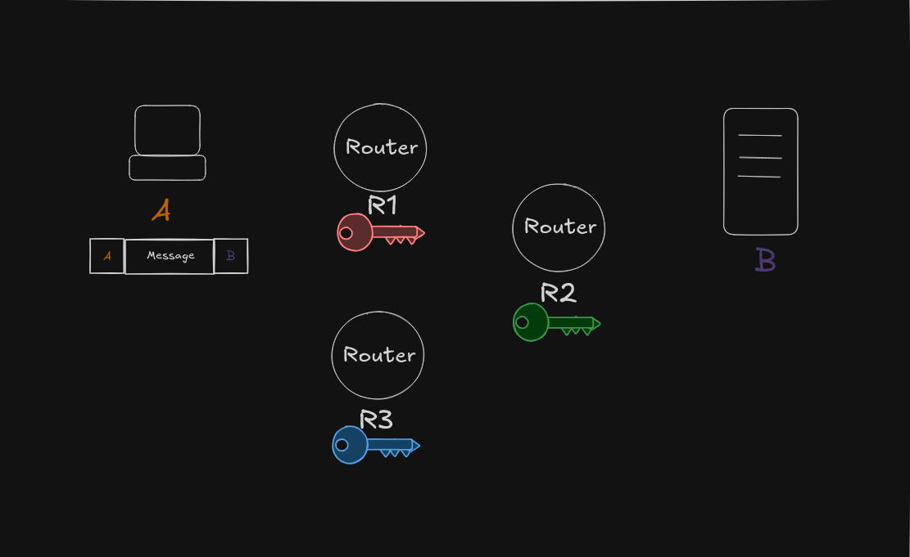

Slide 6
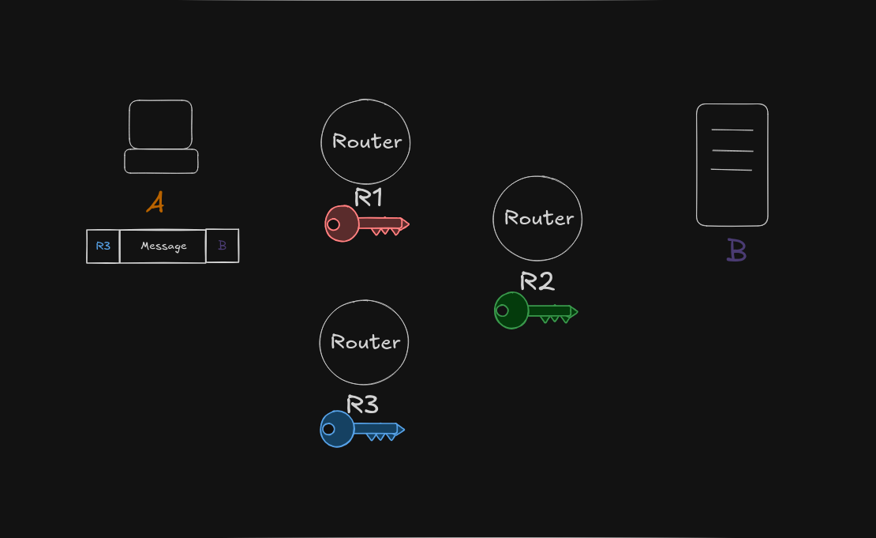

Slide 7
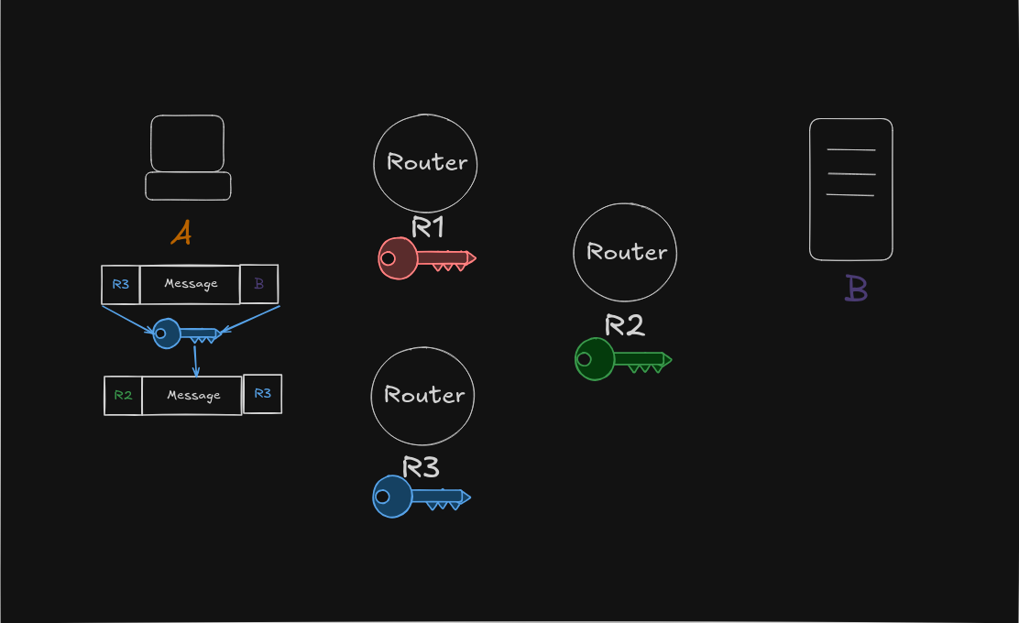

Slide 8
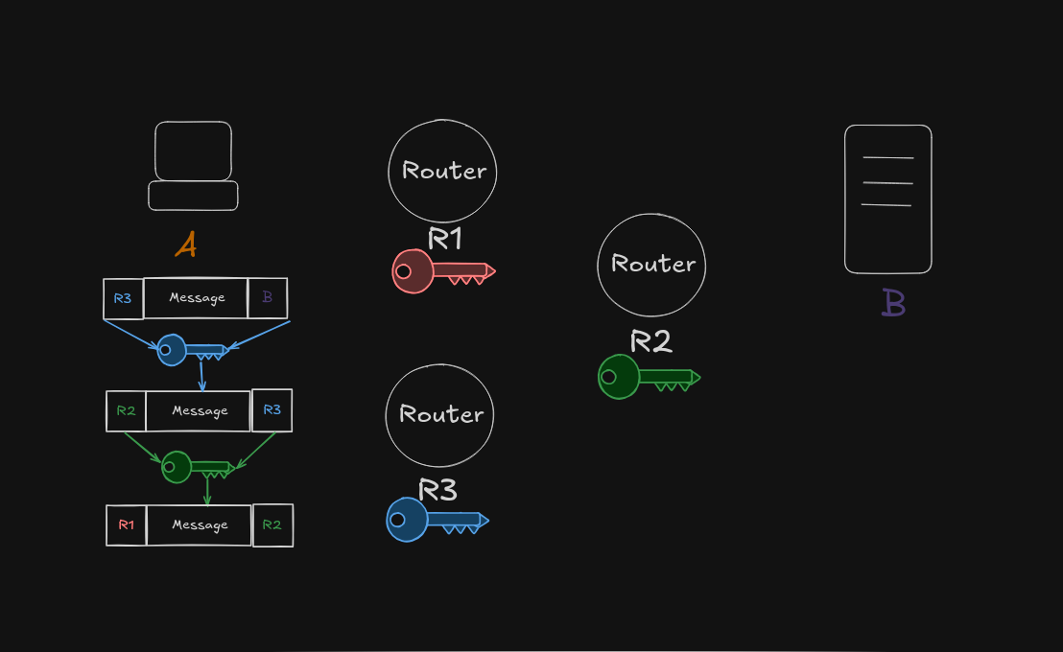

Slide 9
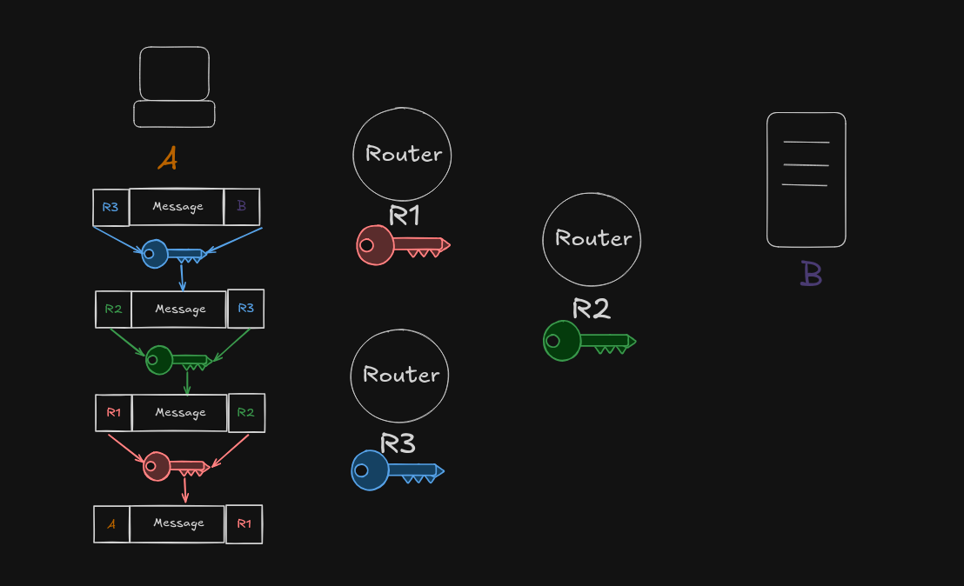

Slide 10
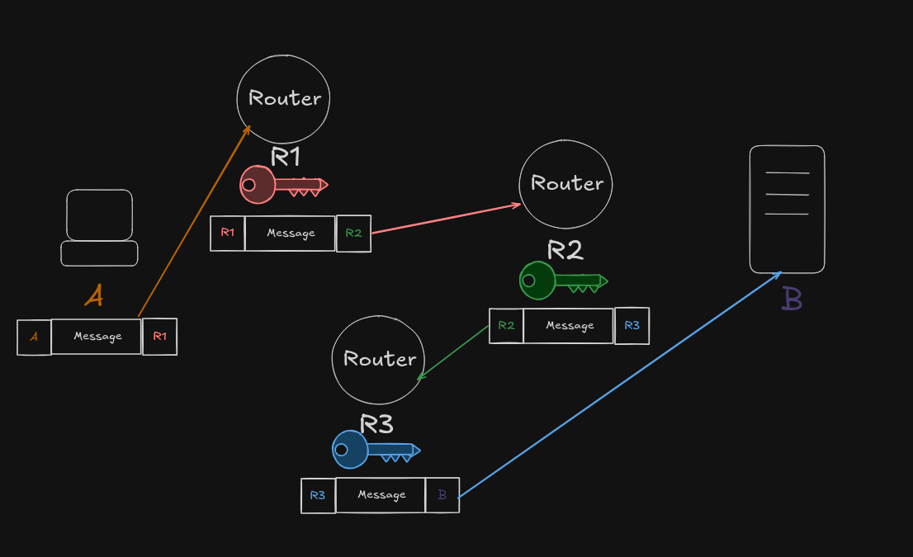

Slide 11
But how does it know about the Routers?

Slide 12
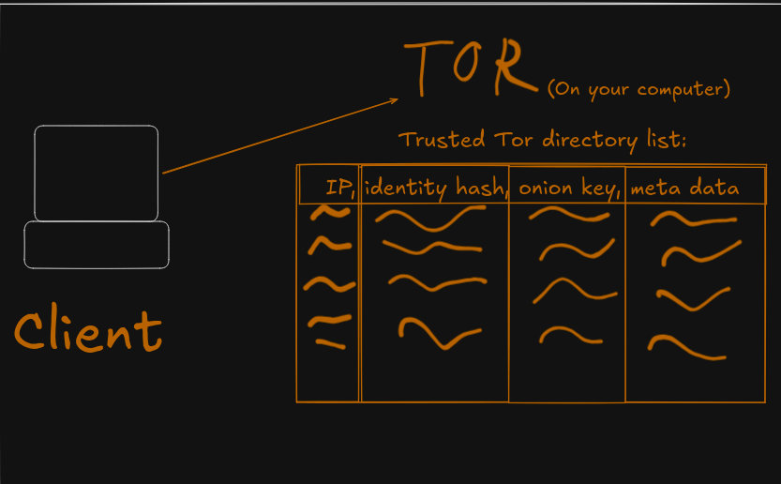

Slide 13
1.Identity hash – Hash of Identity key and meta data 2.Identify Key – is a pERMINANT KEY THAT IS USED TO IDENTIFY A ROUTER, IT IS USED IN combination of " TLS certificates, router descriptor ( onion keys it is using, address, bandwidth, exit policy, etc) 3.Onion Keys – are public keys

Slide 14
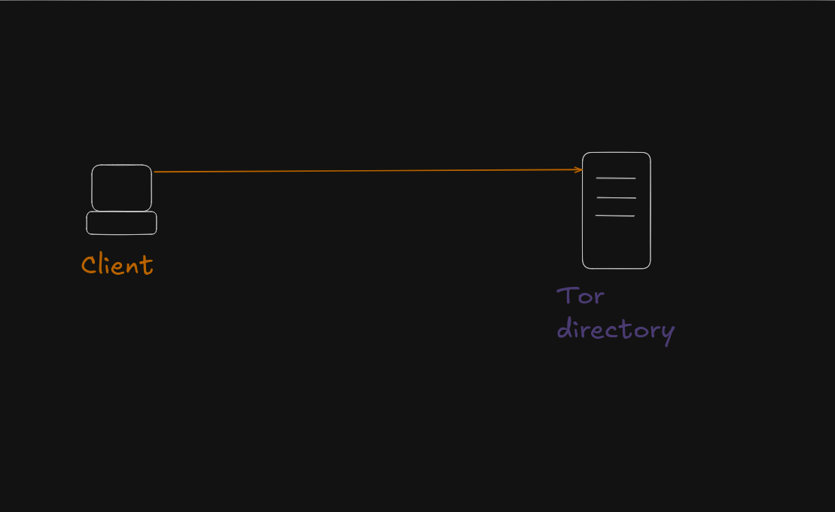
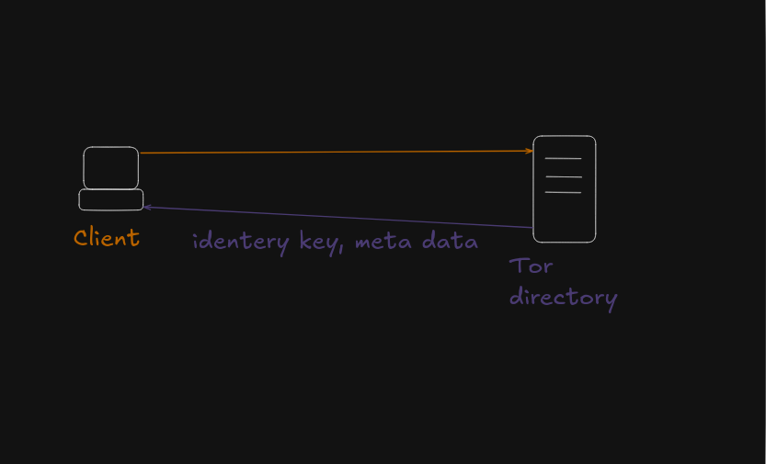

Slide 15
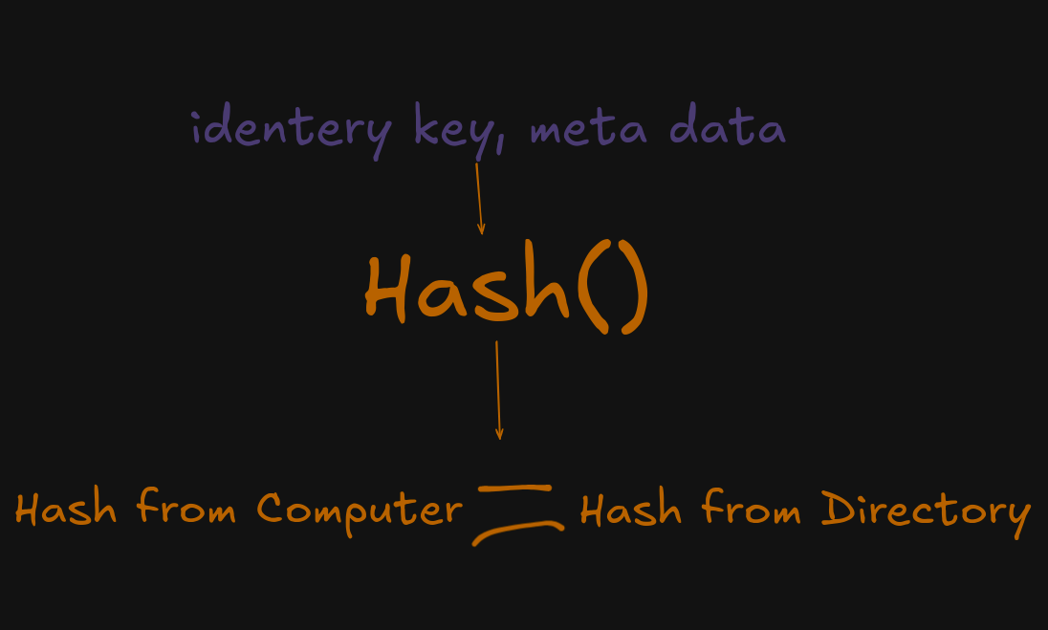

Slide 16
Using onion key

Slide 17
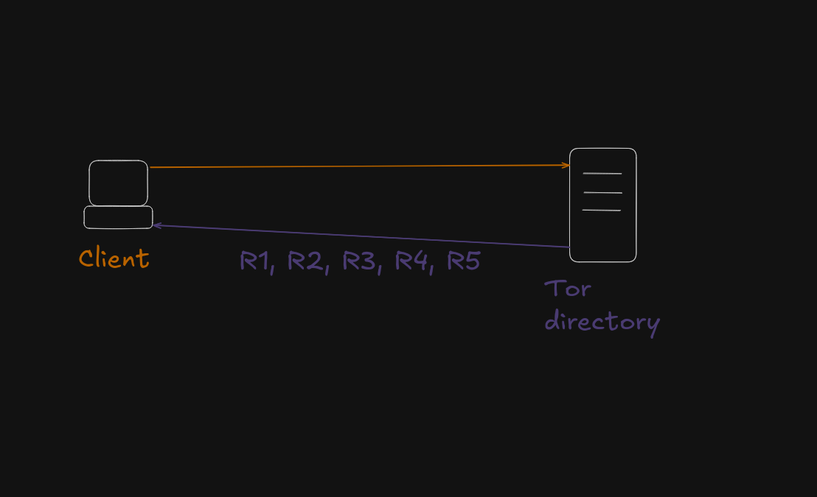

Slide 18


Slide 19
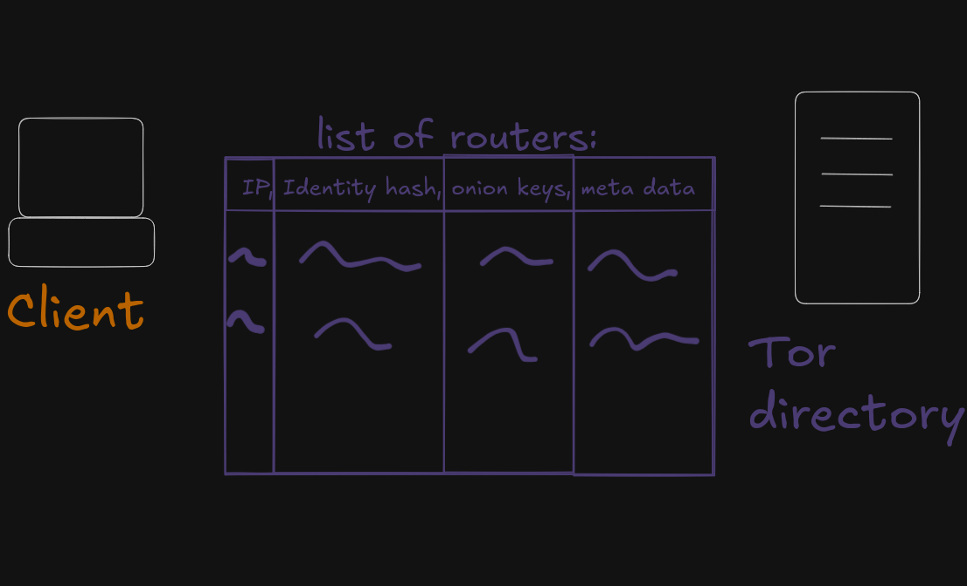

Slide 20
The same check we did with Directory server(using identity key) will happen with routers too

Slide 22
But how does it know what will be a route(R1, R2, R3)?

Slide 23
It will look at the meta data and locally decide what will be the best routes
Based on location, speed, and bandwidth

Slide 24
But how They know this route will work on practice and that every node is legitimate?

Slide 25
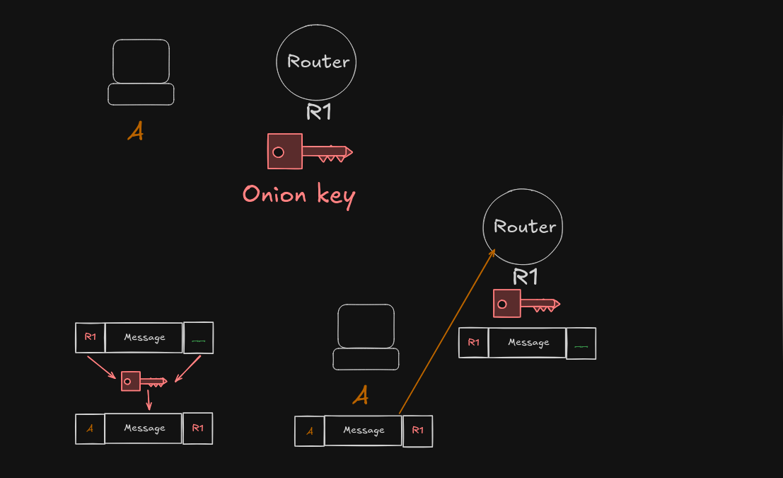

Slide 26
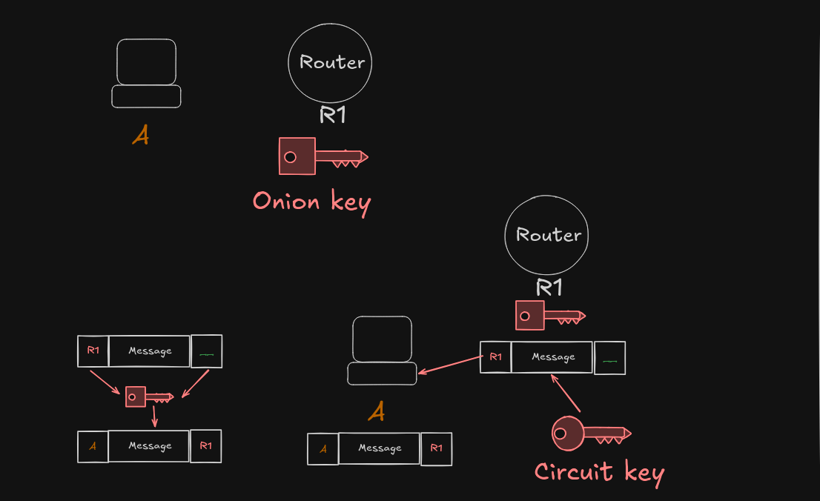

Slide 27
circuit key – is a shared/Session key, it means encryption end decryption will be done with it

Slide 28
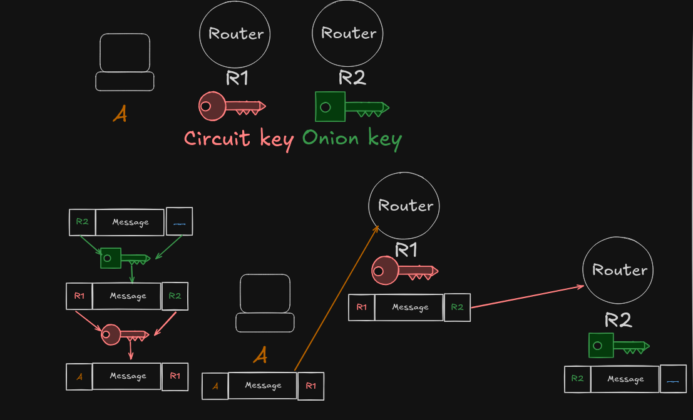

Slide 29
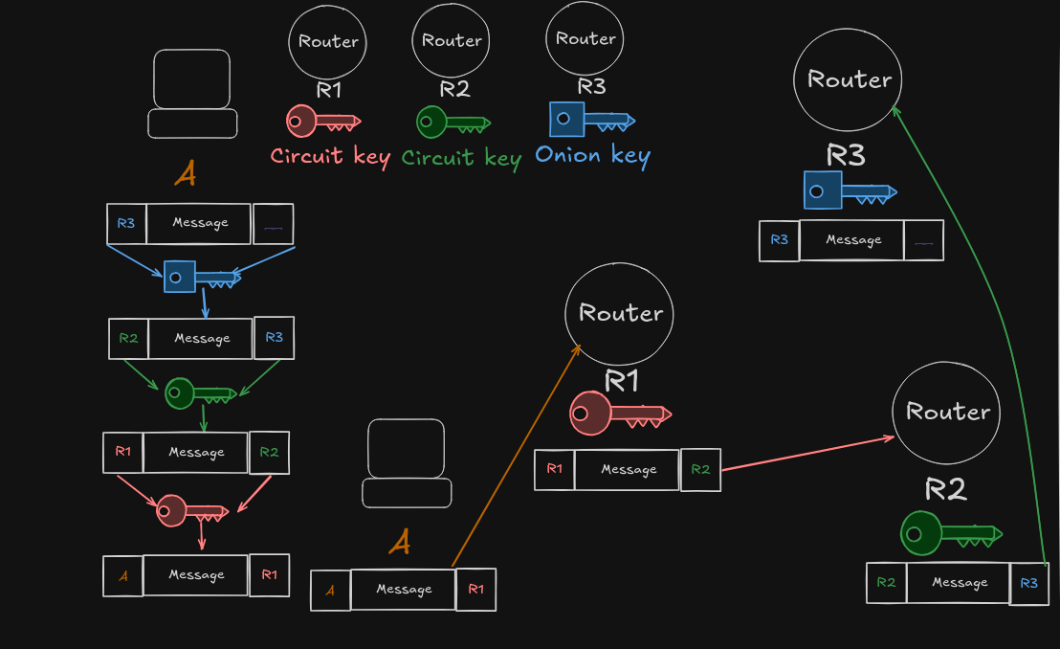

Slide 30
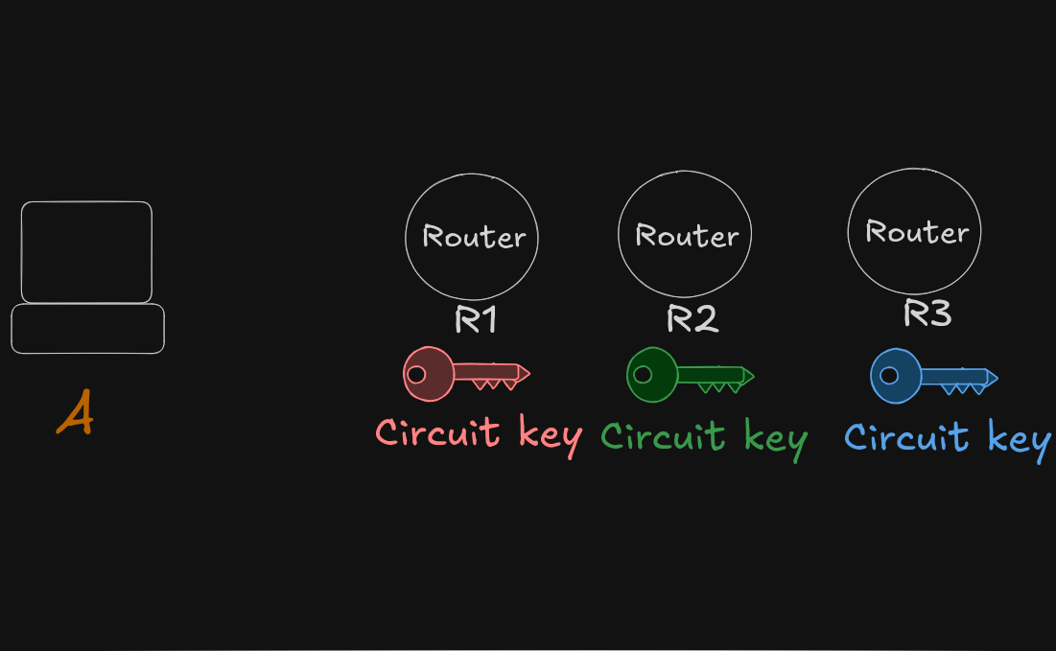

Slide 31
But how will packets go back? From server to client

Slide 32
When we were creating a circuit with every packet, we included circuit ID

Slide 33
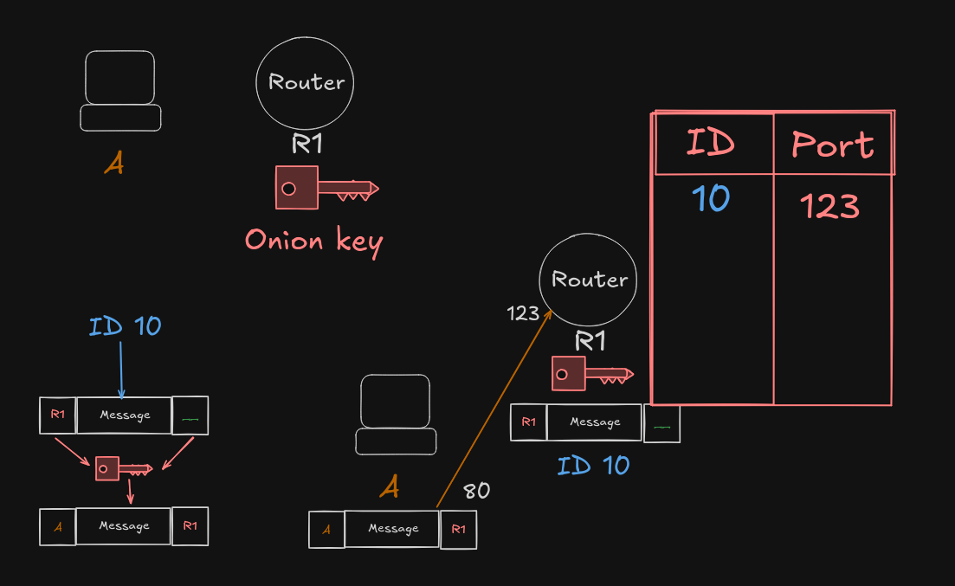

Slide 34
When Exit Node gets a message from a server it sees the port and knows what Circuit and key to use

Slide 35
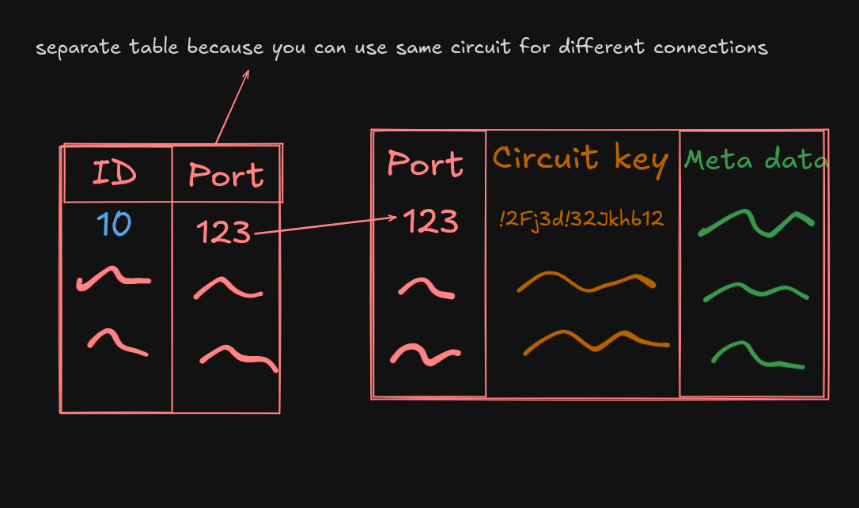

Slide 36
Thank you for your Time
Hope you liked it

