Slide 1
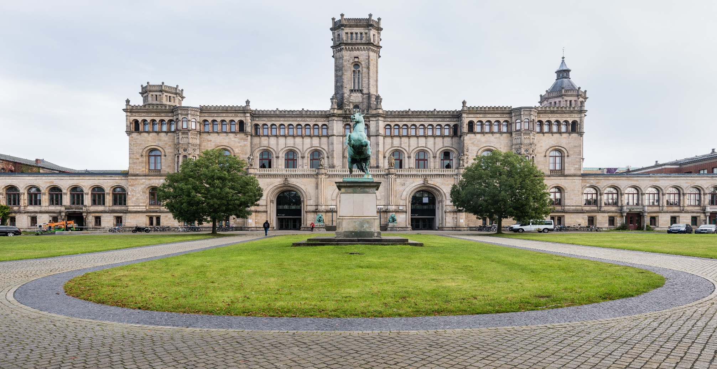
Advanced Topics in Reinforcement Learning

Slide 2
Dogs vs. Ants
If we ignore the more complex behavior (e.g. emotions) dogs can be a more memory efficient way to design an agent
Dogs can be modelled with 4 joints = 4D action space
It is scalable as we can decide to implement more complex behavior for dog agents
e.g. Emotions, more cognitive capabilities
Ants only have simple behavior and are useful for swarm intelligence
We get different type of inferences (competitive vs cooperative Multi-agent systems)
Swarm intelligence (ants) vs. Competitive behavior of dogs
Parameter variation can define dog classes/breeds (aggression, physicality, etc.)
Dog agents can support more ethical animal research
With generative algorithms or aspects from neuroevolution you could create different Multi-Agent setups with different dogs or create a superior dog which learns to solve a task faster

Slide 3
Cooperative vs. Competitive Multi-Agent Settings
Cooperative MA
Shared communication which influences the reward shaping
E.g. already visited states change the reward value if another agent visits
Possibly never converges or ends up in deadlock situations (e.g. in state coverage settings where only one unvisited state is left)
Competitive MA
Try to maximize own rewards against other agents
Do not share the same information for own reward "greed"
Different strategy for either agent
Combination
Can be combined (e.g. team-like formation)

