Slide 1
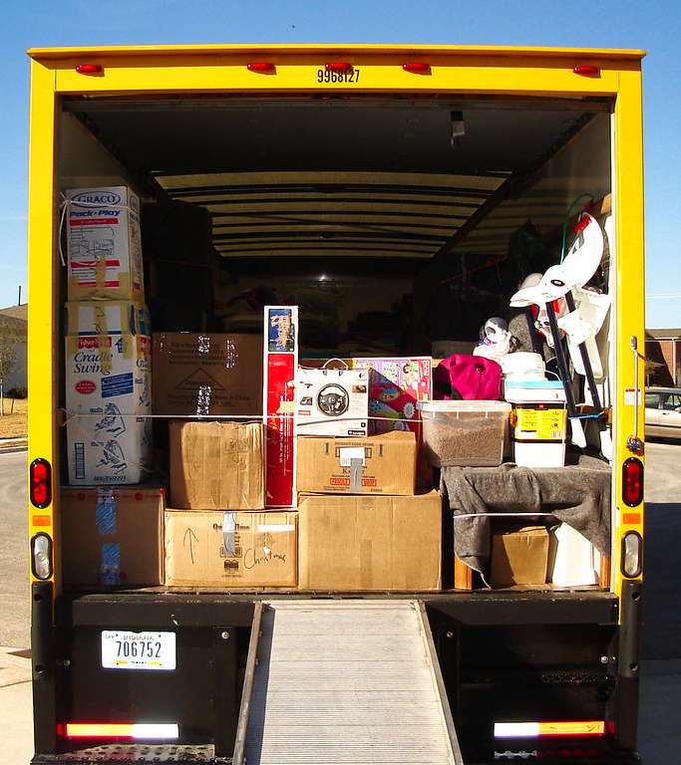
Load.in
Using AI and Computer Vision
to give your move a game plan.
Team Yellow
Prototype Design Presentation
Old Dominion University
12/13/2020
Notes:
1

Slide 2
Contents
Problem Statement: 3
Problem Characteristics: 4
Solution Statement: 5
Solution Characteristics: 6
RWP vs. Prototype: 7
Prototype MFCD: 8
Hardware and Software Requirements: 9
Third Party Libraries: 10
Prototype User Stories: 11
Tester Stories: 13
Test Harness: 14
Deliverables: 15
Risks: 16
Sprint Plan: 17

Slide 3

Problem Statement
“Do It Yourself” movers lack the expert knowledge required to handle the logistics of their move.
This Photo by theritemove.com is licensed under CC BY

Slide 4
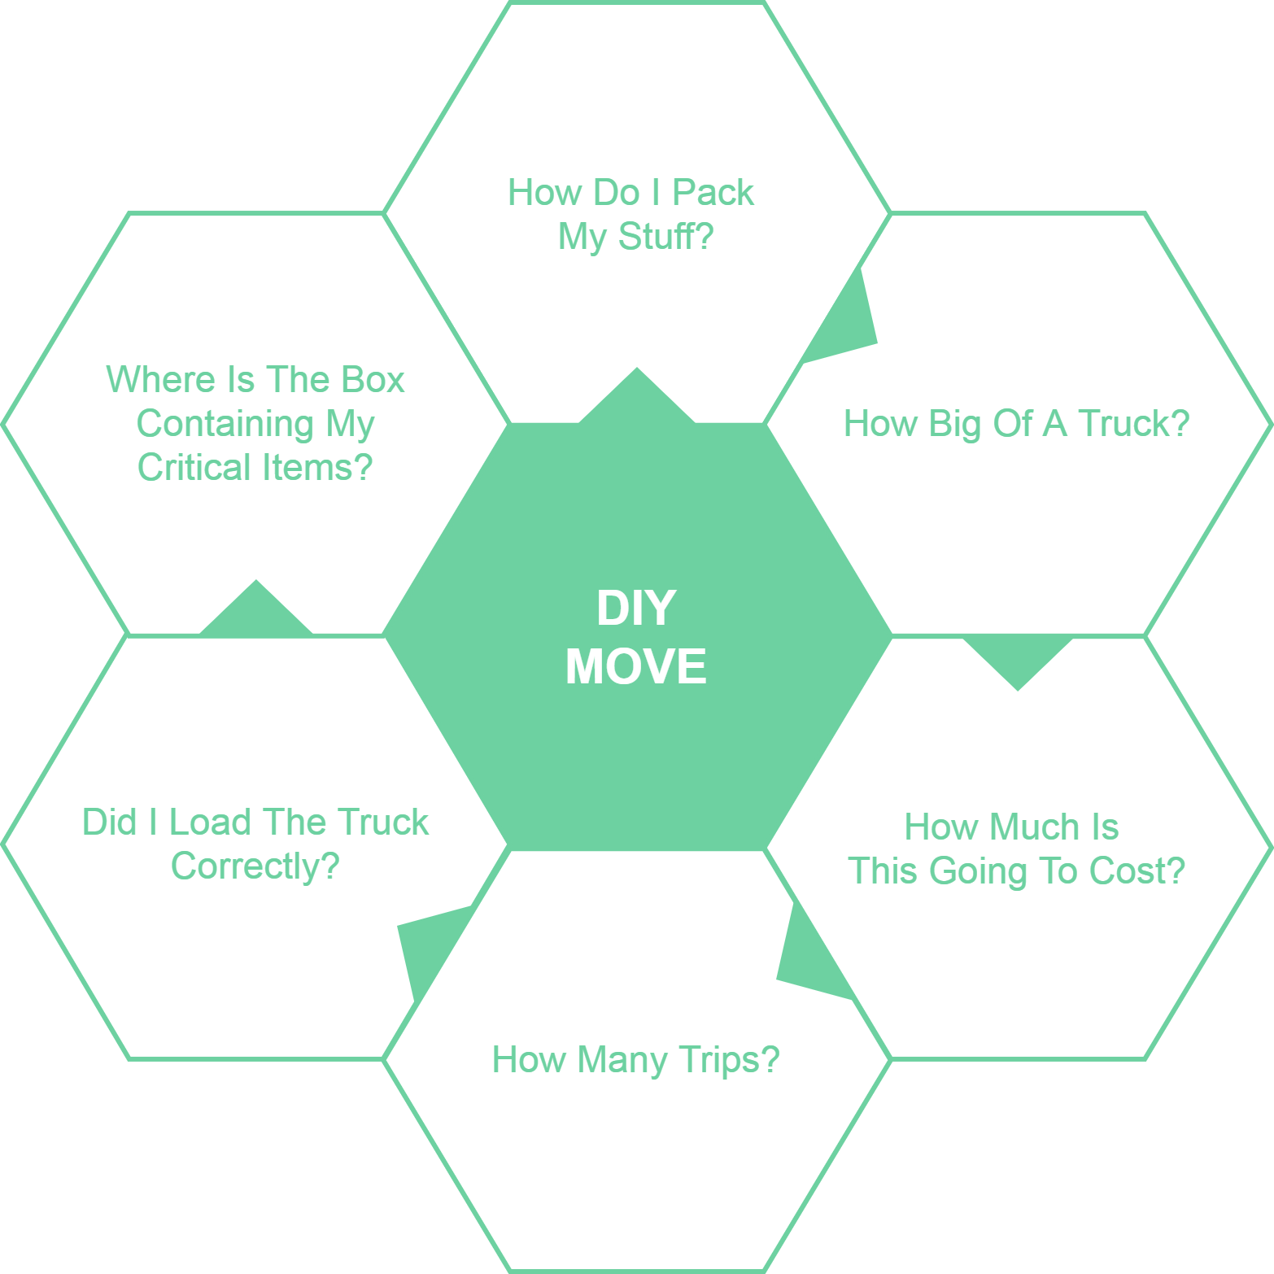
Problem Characteristics

Slide 5

Load.In Gives Your Move a Game Plan
Uses artificial intelligence and computer vision
Provides
Expert-level instructions
Tips and tricks on moving day
This Photo by realtor.com is licensed under CC BY
12/13/2020
CS 410 – Team Yellow – Load.In – Prototype Design
5

Slide 6
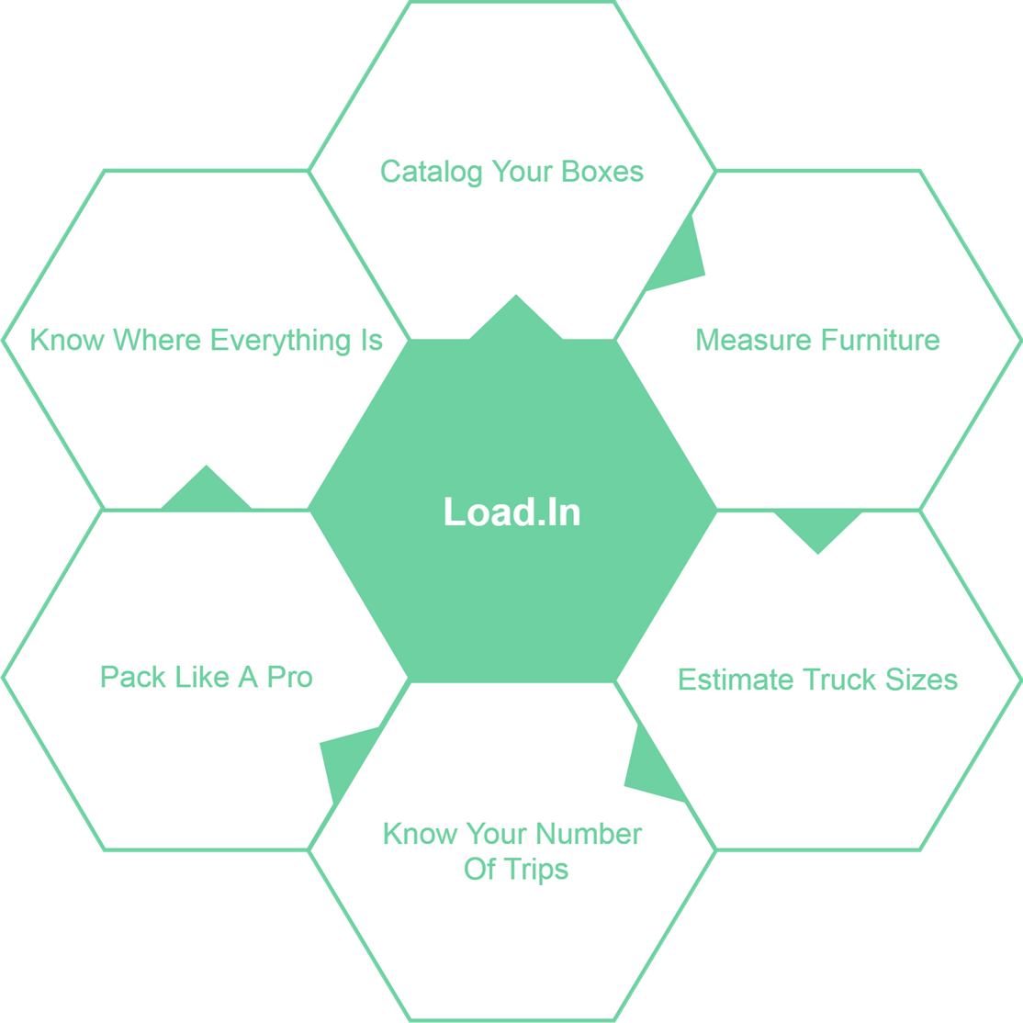
Solution Characteristics

Slide 7
RWP vs. Prototype Feature Set
Feature | Real World Product | Prototype
Move Inventory:
Furniture/Item measurement | Fully Functional | Partial
3D model generation | Fully Functional | Partial
Item weight | Fully Functional | Eliminated
Item fragility | Fully Functional | Eliminated
Box locator search feature | Fully Functional | Fully Functional
Move Plan:
Loan Plan | Fully Functional | Partial
Truck unloading instructions | Fully Functional | Eliminated
Logistics Planning:
Estimated number of trips | Fully Functional | Fully Functional
Estimated time to move | Fully Functional | Eliminated
Estimated rental truck costs | Fully Functional | Eliminated
Expert Help:
Packing Tips and suggestions | Fully Functional | Fully Functional
Tips search | Fully Functional | Fully Functional
Move experts' articles | Fully Functional | Fully Functional
Chatbot | Fully Functional | Eliminated
Live expert | Fully Functional | Eliminated
Vendor Integration/Data Import:
3rd party vendor Web scraper | Fully Functional | Eliminated
3rd party vendor Web API reader | Fully Functional | Eliminated
Box dimensions | Fully Functional | Eliminated
Truck sizes | Fully Functional | Eliminated
Truck availability | Fully Functional | Eliminated
Analytics:
Location data | Fully Functional | Eliminated
Move data | Fully Functional | Eliminated
Feedback data | Fully Functional | Partial
Heatmap | Fully Functional | Eliminated
Rental interest statistics | Fully Functional | Eliminated

Slide 8
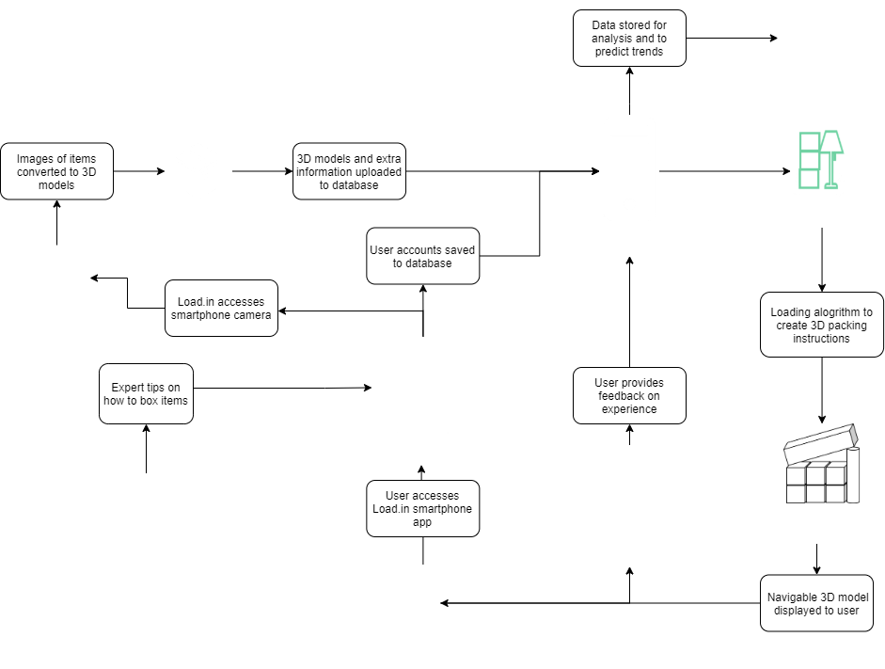
Prototype MFCD

Slide 9









Prototype Hardware and Software Reqs.
Category | Android App | Web API
Version Control
Issue Tracker
CI/CD
Language
Platform | Android Native App | Apache CFX on Amazon Elastic Beanstalk with Tomcat
Database | (or Aurora) on AWS RDS
IDEs | Android Studio | IntelliJ
Developer OS | Linux
CS 410 – Team Yellow – Load.In – Prototype Design
9

Slide 10
Third Party Libraries
Library | Purpose and Description
3Dorfi | 3D model generation from a series of images Written in Java 8, JavaFX, and uses aspects of OpenCV https://github.com/jacordero/3Dorfi
Java 3D | Manipulation for 3D objects in java
AliceVision | 3d photogrammetry library that can reconstruct 3d models from images downside is it is written in C++ https://github.com/alicevision/AliceVision
OpenCV | Stands for Open Computer Vision Open-source java development library Does 3D model generation and measurement of objects as well as other functions
Sumerian | Amazon solution for 3D modeling in the browser. Viable solution to perform 3D model generation using a web browser rather than hardware rendering.
CS 410 – Team Yellow – Load.In – Prototype Design
10

Slide 11
Prototype User Stories
As a DIY Mover I need to be able to:
Input the dimension of my box.
Be given a plan on how to properly load my boxes & truck to maximize the use of space.
View expert level tips that will inform me on how to pack my items.
Be able to locate a box within the truck.
Create an account inside of the Load.In application.

Slide 12
Prototype User Stories
As a DIY Mover I wish to be able to:
Reset my own password if I have forgotten it.
Estimate the truck size needed to move.
Unlock my own account via email when I have entered in my login credentials wrong too many times.
Inform the app creator his app didn’t work properly.
Measure items and create 3d model from computer vision

Slide 13
Tester User Stories
As a tester I need to be able to:
Simulate creating and logging into a Load.In account
Simulate a load plan using fake information
Simulate recreating load plan
Provide feedback to the developers
Randomly add inventory to a move inventory
As a tester I would like to:
Simulate having multiple special items that need to be easy to reach
Have a detailed error logging system
Have working unit tests for every stage of development
Have a tool for automating the database querying

Slide 14
Test Harness
Unit testing
JUnit 4 powered by AndroidJUnitRunner for android application
JUnit 4 for java backend implementation
UI Performance
Dumpsys command tools to measure performance
Test Data
Load random data into database
Java project
This project will run a console version of java interactively to run different routines for testing purposes

Slide 15

Deliverables
Produce an android application
Provide an APK file to end users
Used for distribution and installation of mobile apps, mobile games and middleware.
Demo application via android SDK

Slide 16
Risks
Risks
Customer
C-1: End users are not satisfied with the recommendations of the application.
C-1 Mitigation: Implement a customer feedback feature that allows the users to disclose his/her issues with the applications.
C-2: End user doesn’t follow the guidelines of the application.
C-2 Mitigation: Implement a feature that allows the user to repeat certain steps in the application as they progress.
Probability
 |  | Very Low | Low | Medium | High | Very High
Severity | Very High
 | High
 | Medium |  |  | C-1
 | Low |  | S-1 S-2 |  | C-2
 | Very Low
Security
S-1: End user want to ensure the pictures taken of personal information doesn’t fall into the wrong hands.
S-1 Mitigation: For the prototype, all photos will be stored locally and not transmitted/stored in the cloud
S-2: End user wants to ensure his/her data isn’t being collected for nefarious purposes.
S-2 Mitigation: For the prototype, the only information stored is given by the user for the purposes of the move inventory and can be deleted at any time.
12/13/2020
CS 410 – Team Yellow – Load.In – Prototype Design
16
Notes:
16

Slide 17
Prototype Sprint Plan
Sprint 1
Sprint 2
Sprint 3
Theme: Set-Up
Jason: Database Setup / User Log-In
Byron: Git repo/Beanstalk/Web API setup Lance: Setup AWS Database
Chris: Database Setup / User Log-In Greg: Database Setup / User Log-In
Paul: Database Setup / User Log-In Daniel: Test Harness Set-Up
Theme: MVP
Jason: 3D Rendering/Basic Load Plan
Byron: 3D Rendering/Basic Load Plan Lance: Expert Tips
Chris: Move Inventory Display Greg: Move Inventory Display
Paul: Expert Tips / Basic Box Size Entry Daniel: Basic Box Size Entry
Theme: Enhance!
Jason: Advanced Load Plan
Byron: Advanced Load Plan Lance: Photogrammetry
Chris: Photogrammetry Greg: Feedback Page
Paul: Feedback Page / Logistics Daniel: Logistics

Slide 18
18
Notes:
18

