Slide 1
Shiny Web App: K-Means Clustering with Elbow Test
MAT 224
Jeffrey Cruz

Slide 2
My App
My app accepts a .csv file given by the user (must only contain numeric values. NaN/NA/Inf values are cleaned by the app, but it will return an error if there is non-numeric data)
The next tab allows the user to view the data to make sure it was loaded correctly
Then it plots an elbow test of the data to show the optimal number of clusters to use for K-Means clustering
Finally it does K-Means Clustering and shows the resulting plot. There is a slider to allow the user to change the number of clusters K.

Slide 3

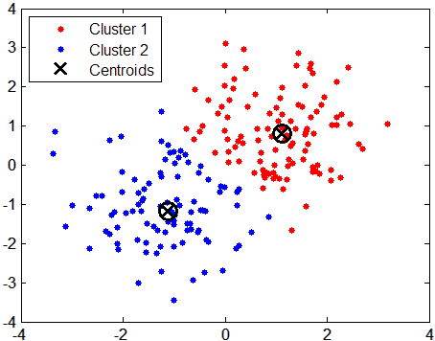
K-Means Clustering
K-Means Clustering is an unsupervised learning algorithm
It breaks the data into a K number of clusters, and assigns each data point to one of the clusters.
It analyzes the data and creates K clusters by finding K centroids (the mean of each cluster)
It assigns data points to the cluster that is closest (Euclidean Distance) to it

Slide 4
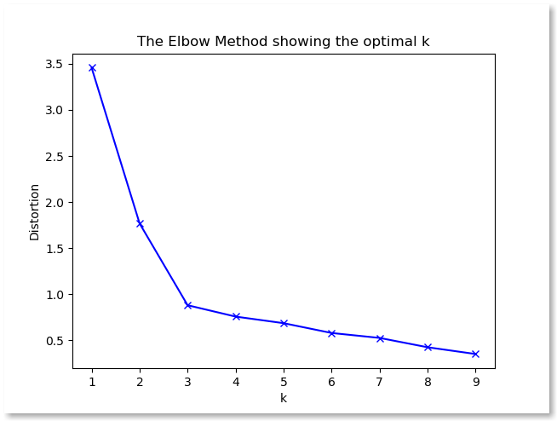
Elbow Test
K, the number of clusters in the model, must be given beforehand.
The elbow test is one of several tests that can give an appropriate amount of clusters for a dataset
To interpret the plot of the elbow test you look for the “Elbow” of the graph, that will give you the appropriate K to use for the dataset

