Slide 1



2010s Music Data Analysis
Cruz Flores
Data brought to you by…
https://www.kaggle.com/theoverman/the-spotify-hit-predictor-dataset

Slide 2

Overview
Hits and Flops
Song Sections
Acousticness
Danceability
Energy
Tempo
Chorus Hit
Song Length
Liveness

Slide 3

“Don’t bore us get to the chorus…”
Do “Hits” get to the chorus sooner than “Flops?”

Slide 4
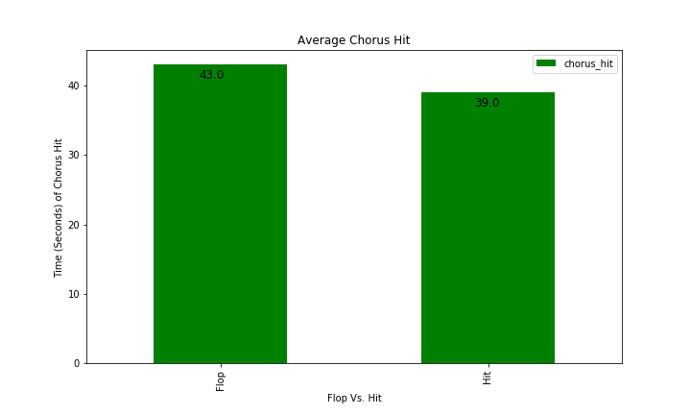

Slide 5
What if we think about the following:
Chorus starting point as it relates a song’s length
For example:
At what percentage into a song does the chorus hit for a song
that has a chorus hit of 10 seconds and a total song length of 100 seconds?

Slide 6
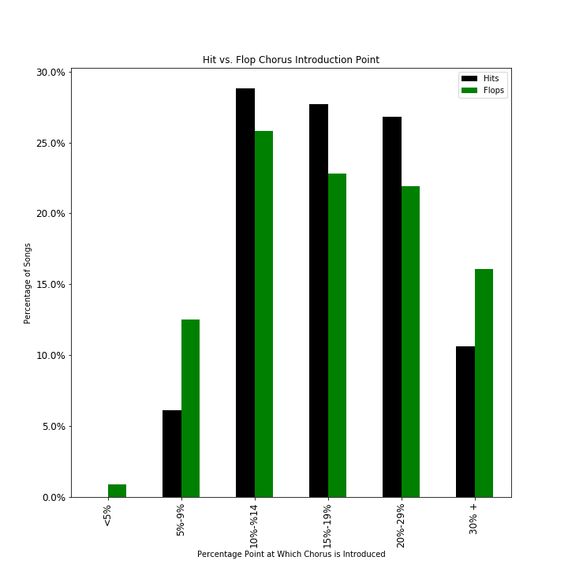

Slide 7


Importance of danceability
Are “Hits” more danceable than “Flops”?

Slide 8
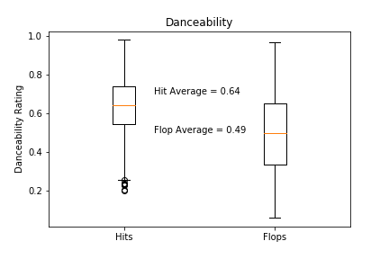

Slide 9
Impacts on danceability
Do other elements impact a song’s danceability?
Tempo
Song Sections
Energy

Slide 10
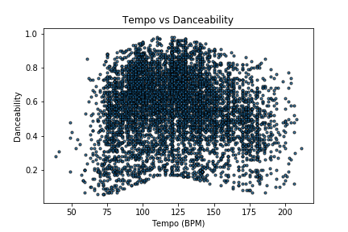

Slide 11
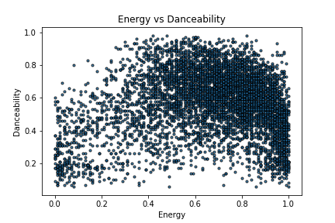

Slide 12
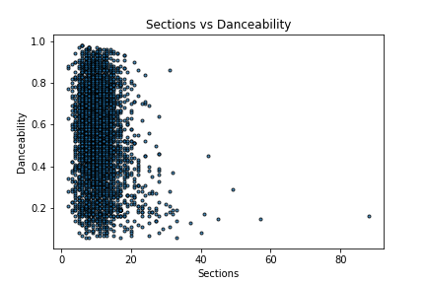

Slide 13
The human element
What is the human element in music?
Can you determine if music is “missing” it?
How do “live” and “acoustic” ratings/scores relate?

Slide 14
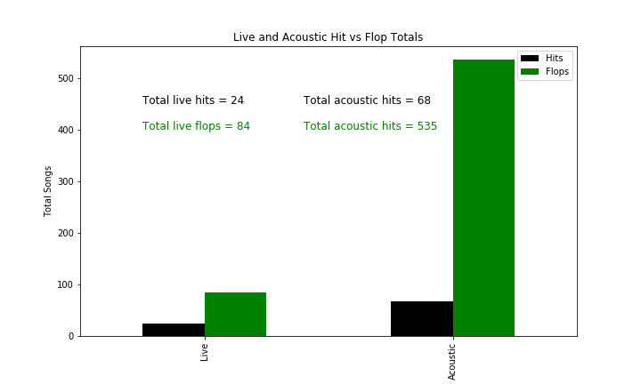

Slide 15
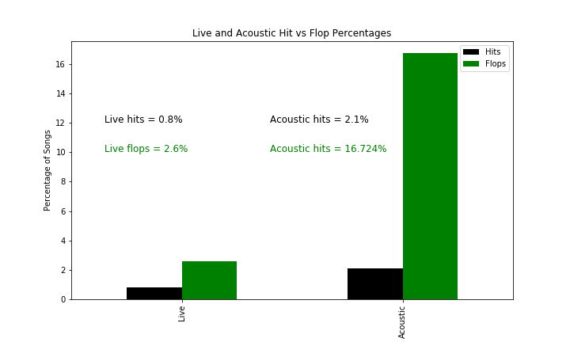

Slide 16


Questions? Thoughts?

