Slide 1

Task 01, Team Blue
A. Ademi, Y. Gehri, Y. Gund, A. Khalife, A. Landolt, L. Leuenberger,
BTX8081 - Software Engineering and Design - 18/19

Slide 2
Task Description
Implement a small part of an MHC-PMS
Target user group: Doctor in a clinic
Mental health problem: Addiction
Berner Fachhochschule | Haute école spécialisée bernoise | Bern University of Applied Sciences

Slide 3
Interview
Presentation of Interviewpartners
Impact on our decision making
Berner Fachhochschule | Haute école spécialisée bernoise | Bern University of Applied Sciences

Slide 4
Interview
Interviewpartners
Herr Dr. med. Michael Lehmann
Herr Dr. med. Jean Ziada
Frau Dr. med. Andrea Hufschmid

Slide 5
Interview
Impact on our decision making
Be aware of mobile notifications due to confidential information
Pay attention to documentation notes
Separation between addiction based health problems and regular health problems is nealry impossible
The importance of the medical history
A graphic representation is difficult to achieve

Slide 6
Personas
Doctor Persona
Patient Persona
Berner Fachhochschule | Haute école spécialisée bernoise | Bern University of Applied Sciences

Slide 7
Personas
Doctor Persona
Doctor 1
Dr. med. Cornelia Sacher
02.03.1968, 50 years of age
Praxis Sacher & Knuchel in Biel
Doctor 2
Dr. med. Rolf Knuchel
24.07.1963, 55 years of age
Praxis Sacher & Knuchel in Biel

Slide 8
Personas
Patient Persona
Patient 1
Mr. Michael Lenherr, 12.05.1960
Addiction: Alcohol
Anamnese: Bluthochdruck, Anzeichen von Leberzirrhose, Übergewichtig
Social Anamnese: Divorced, 2 children
Care: Tendency to aggressive behaviour, stated in past reports

Slide 9
Personas
Patient Persona
Patient 2
Ms. Nadine Meier, 22.08.1985
Addiction: Heroin
Anamnese: HIV-Positiv
Socialanamnese: Single, lost both her parents at the age of 17 (car accident)
Care: Tendency to abuse medicine, stated in past reports

Slide 10
Storyboards
Patient admission
Statistics
Warning sign
Berner Fachhochschule | Haute école spécialisée bernoise | Bern University of Applied Sciences

Slide 11
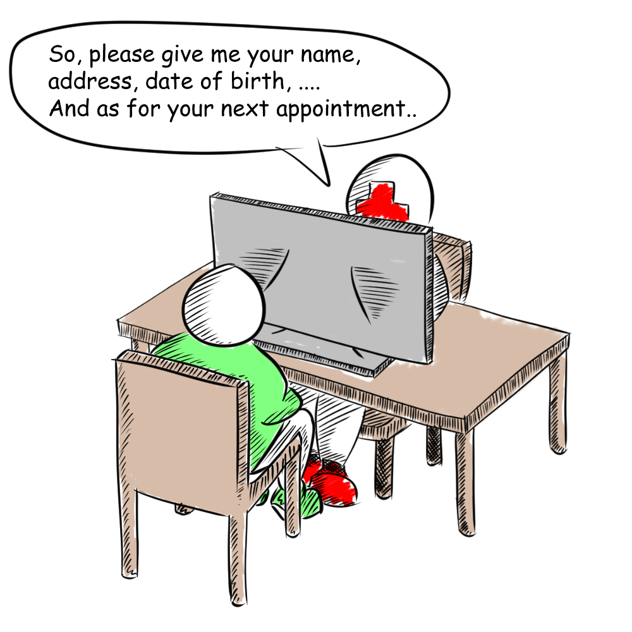
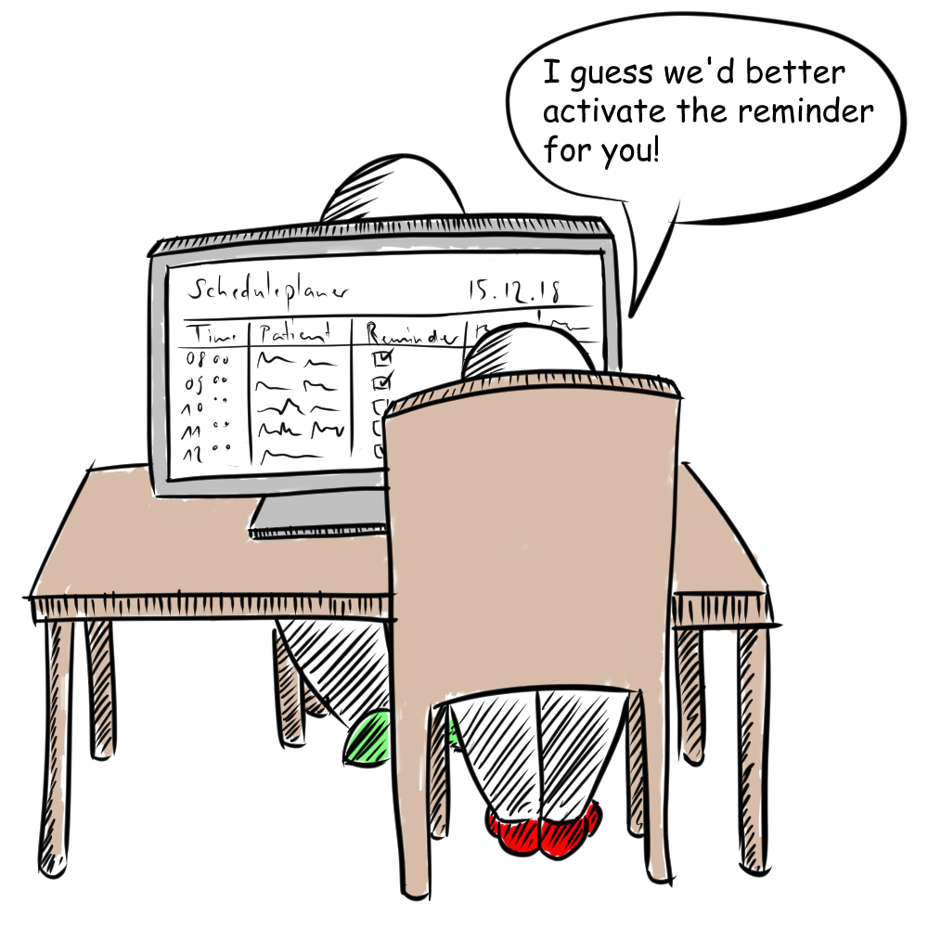
Storyboards
Patient admission
The person in charge takes all the patients information and proceeds with the further appointment planning.

Slide 12
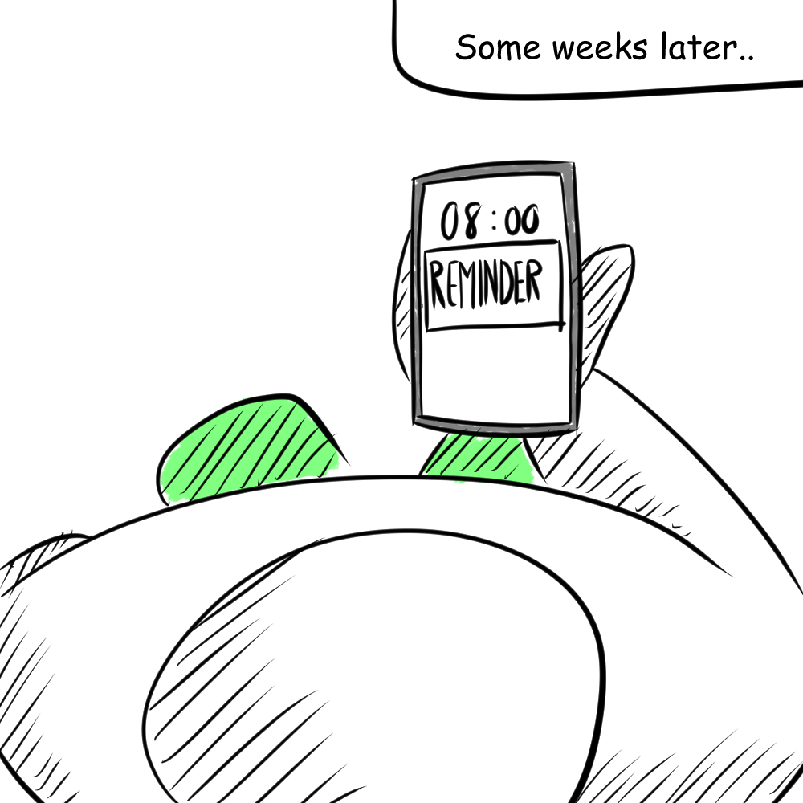
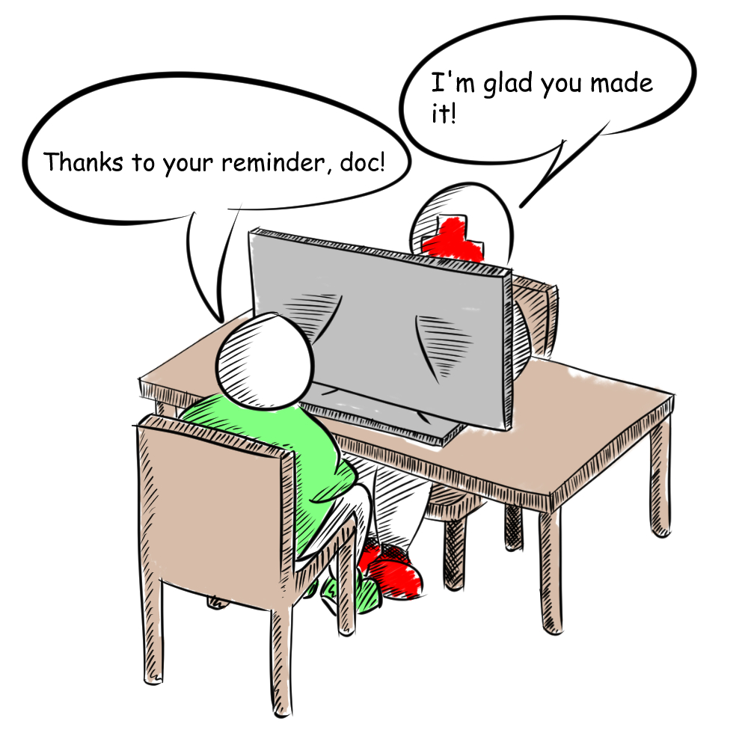
Storyboards
Patient admission
Since the reminder function was activated, the patient will receive a reminder after an agreed time.

Slide 13
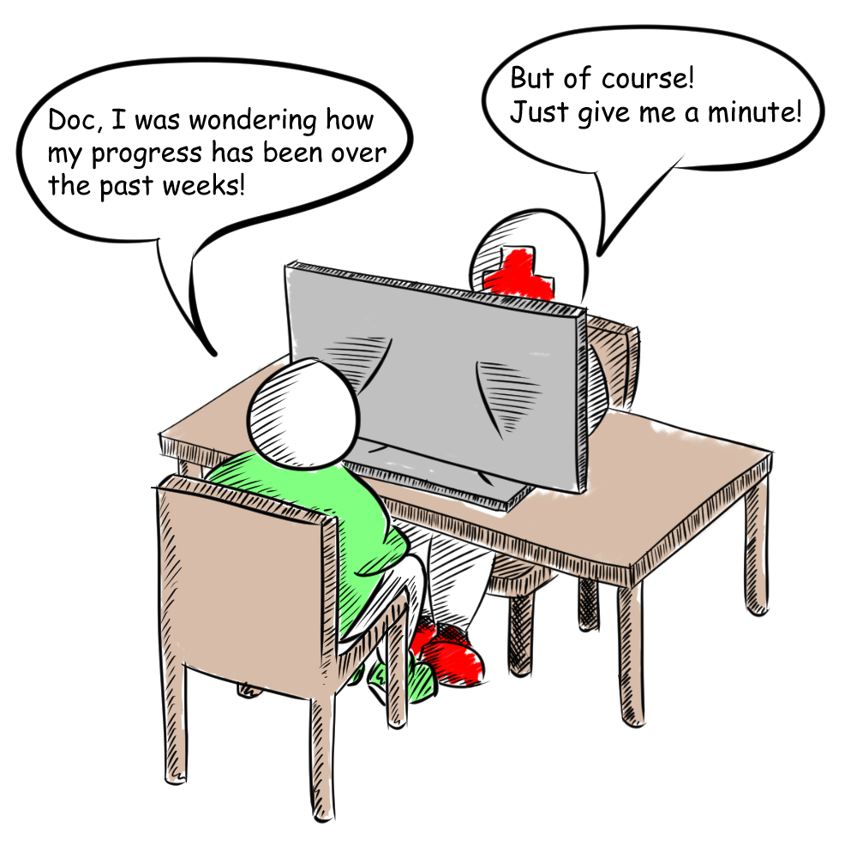
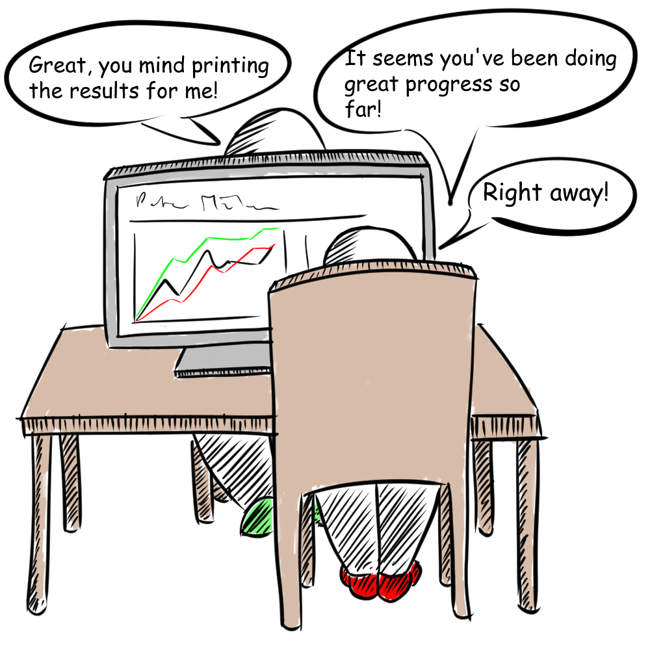
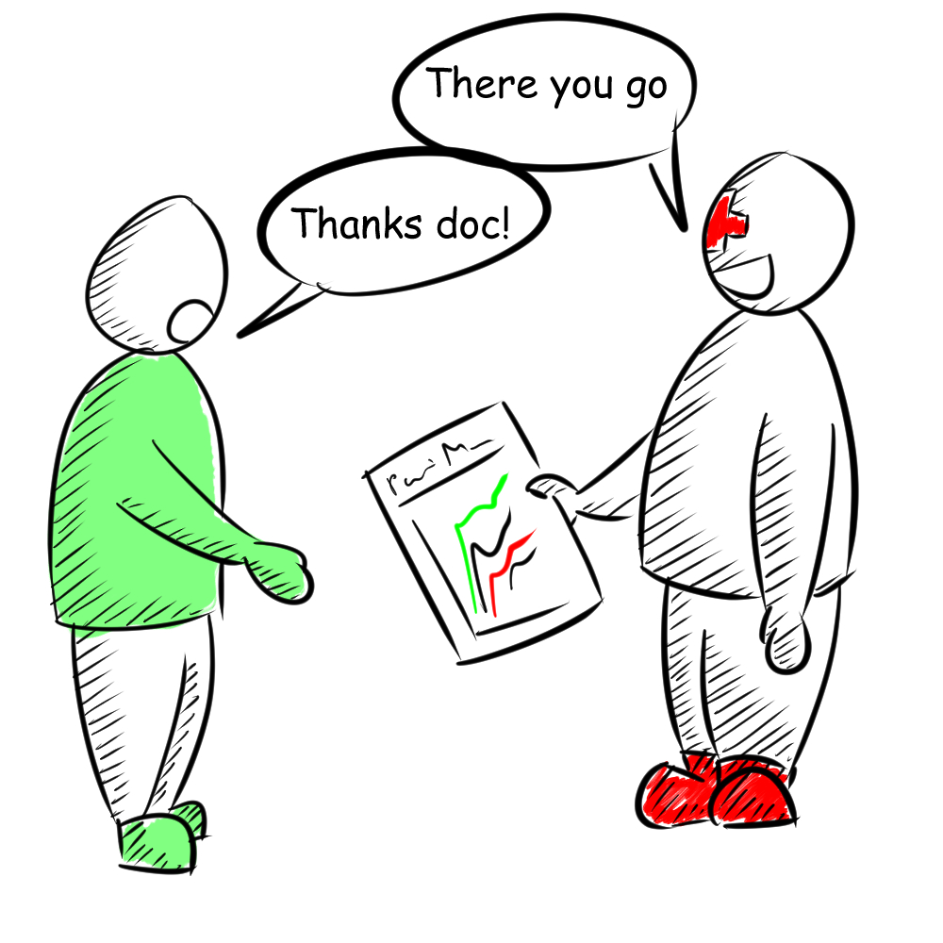
Storyboards
Statistics
The system automatically generates various statics for the patients health progress. They will be printable or online accessible.

Slide 14
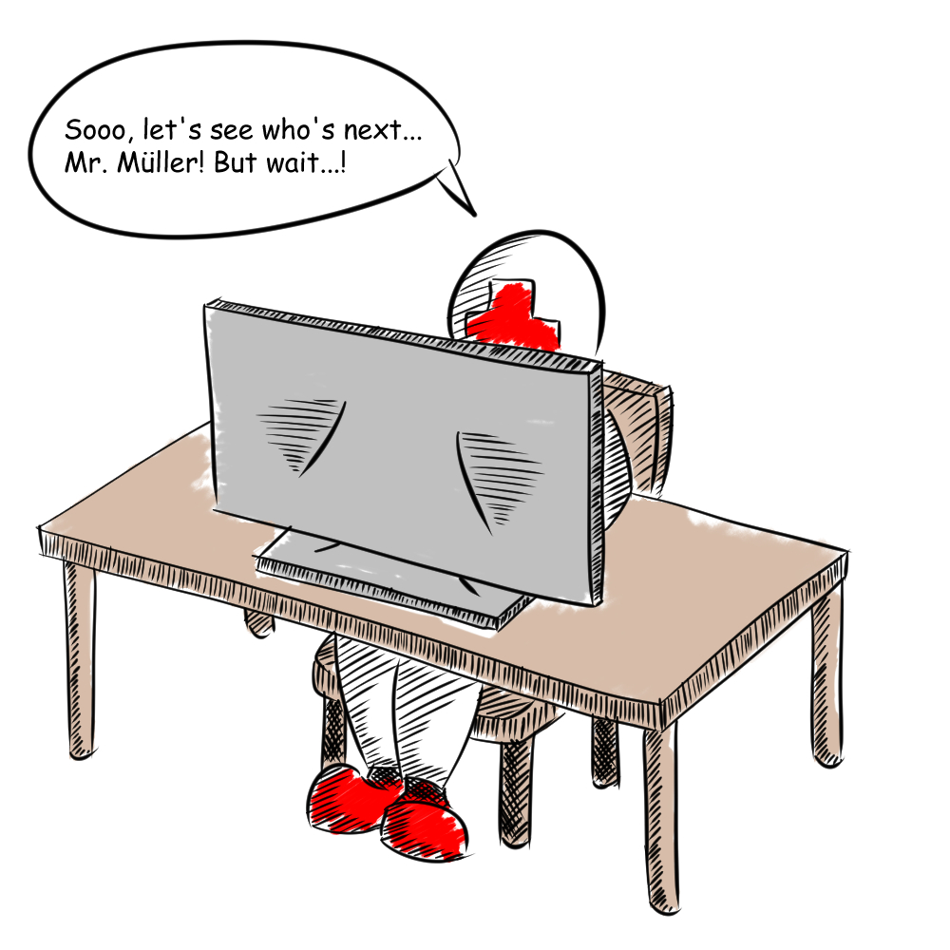
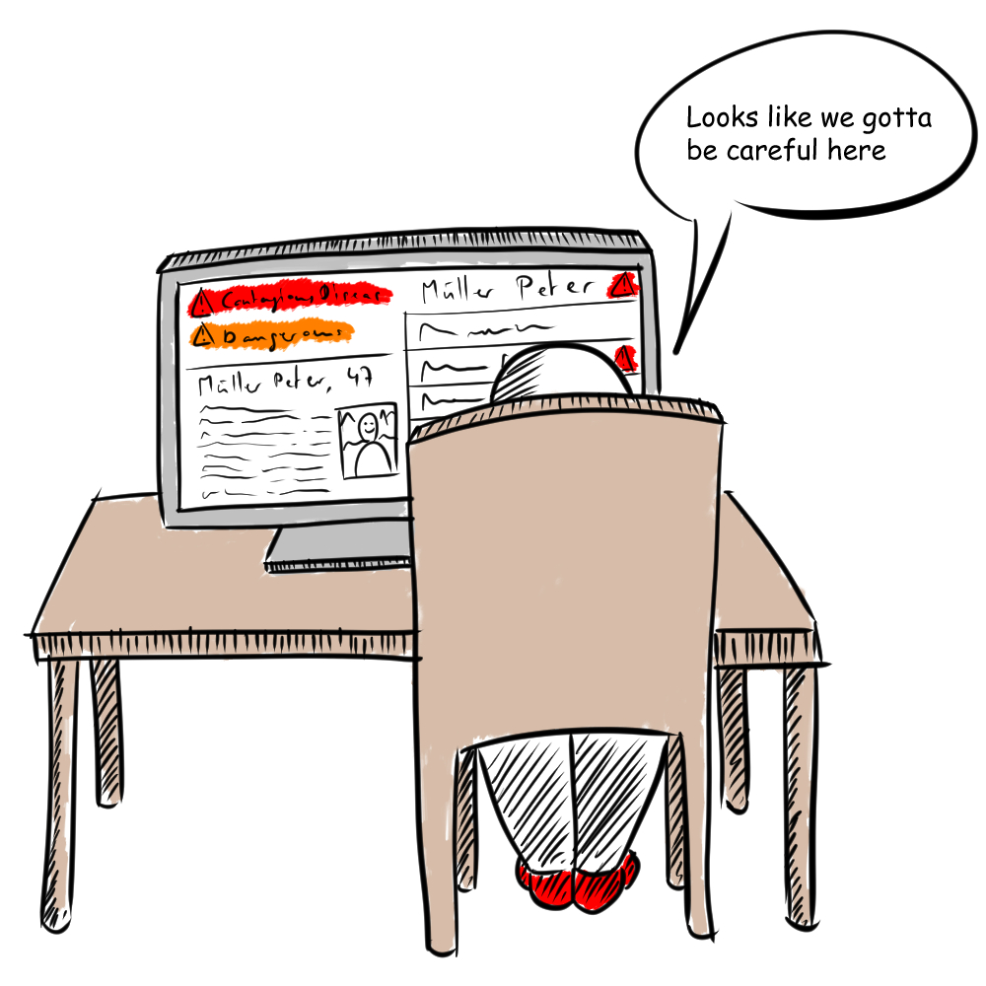
Storyboards
Warning sign
The person in charge looks through the upcoming appointments and sees a warning sign popping up on some specific patients.

Slide 15
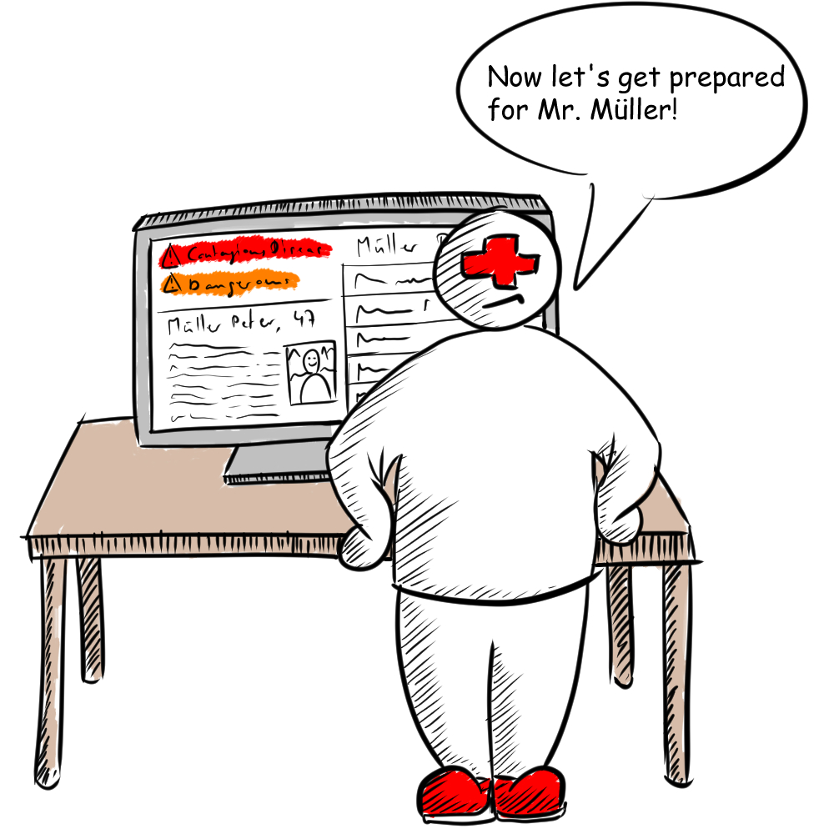
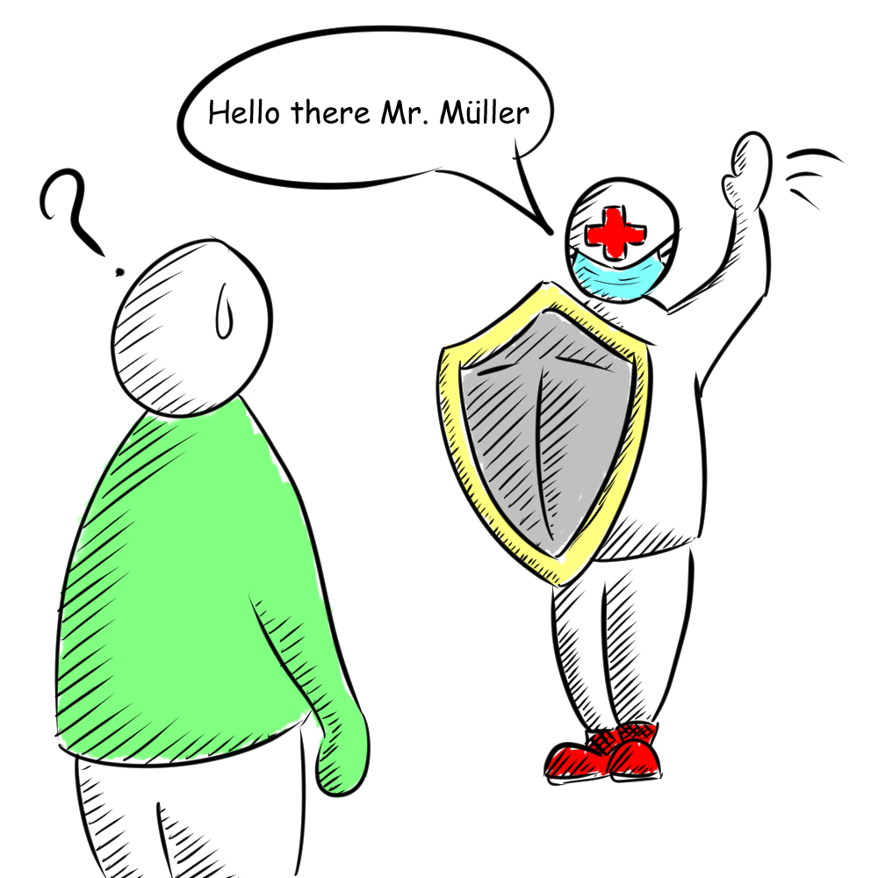
Storyboards
Warning sign
Depending on the patient‘s warn reports, the person in charge can prepare himsself for the coming appointments.

Slide 16
Thank you for listening!

