Slide 1
NodeJS V.S. NGINX as Web Server
COMP531 REPORT
Dai Li

Slide 2
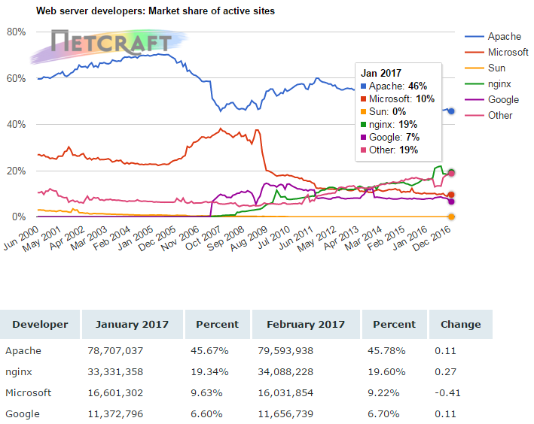
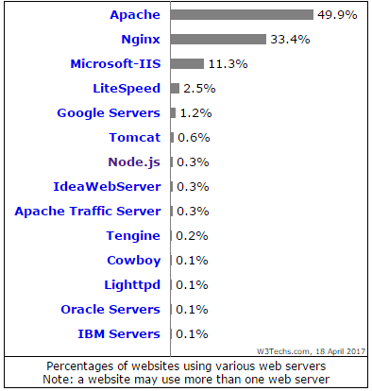
Market Share
2014/08
7:55
ESSENTIAL PRODUCT
Conveniently iterate top-line alignments for wireless metrics.
30%
Nginx
0.3%
NodeJS
2014/08
7:55
UNIQUE MARKETING
Conveniently iterate top-line alignments for wireless metrics.
2014/08
7:55
FASHION PRODUCT
Conveniently iterate top-line alignments for wireless metrics.

Slide 3






NodeJS Features
Written In C++
Support C/C++ Addons
Google V8 JavaScript Engine
Support Linux and Windows
Event driven
Non blocking I/O.
NPM manages packages conveniently
JavaScript is weakly typed.
Single thread
Good for high I/O and low CPU operations

Slide 4



Nginx
Often used as reverse proxy and load balancer
Developed by Igor Sysoev
Written completely in C
Event driven
Non blocking I/O Similar to NodeJS.
Good at serving static pages.

Slide 5
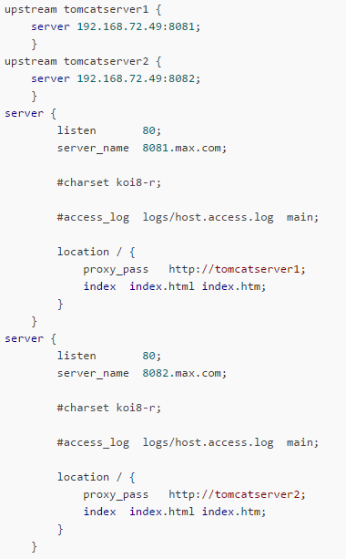
Nginx as Reverse Proxy
Nginx.conf

Slide 6
Nginx as Load Balancer
upstream backend {
#ip_hash;
server 192.168.1.251;
server 192.168.1.252;
server 192.168.1.247;
}
server {
listen 80;
server_name trffweb;
location / {
#reverse proxy
proxy_pass http://backend;
}
}
Nginx.conf
Round-robin fashion
Or ip-hashing fashion

Slide 7
NodeJS Performance v.s. PHP
var i, a, b, c, max; max = 1000000000; var d = Date.now(); for (i = 0; i < max; i++) { a = 1234 + 5678 + i; b = 1234 * 5678 + i; c = 1234 / 2 + i; } console.log(Date.now() - d)
$a = null; $b = null; $c = null; $i = null; $max = 1000000000; $start = microtime(true); for ($i = 0; $i < $max; $i++) { $a = 1234 + 5678 + $i; $b = 1234 * 5678 + $i; $c = 1234 / 2 + $i; } var_dump(microtime(true) - $start);
Loop count | Node.js (ms) | PHP (ms)
100 | 2.00 | 0.14
10’000 | 3.00 | 10.53
1’000’000 | 15.00 | 1119.24
10’000’000 | 143.00 | 10621.46
1’000’000’000 | 11118.00 | 1036272.1
Javascript Version
PHP Version

Slide 8
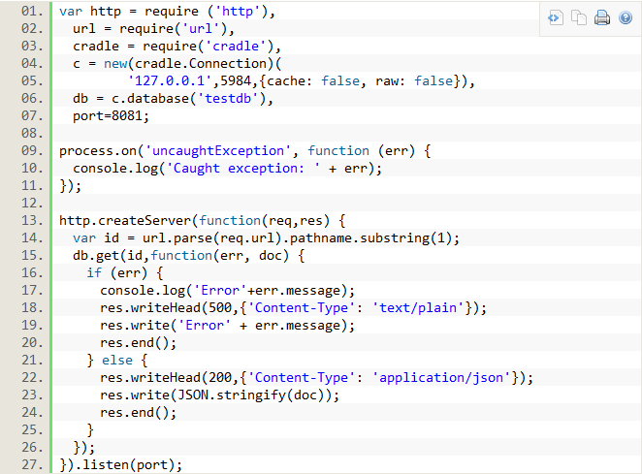
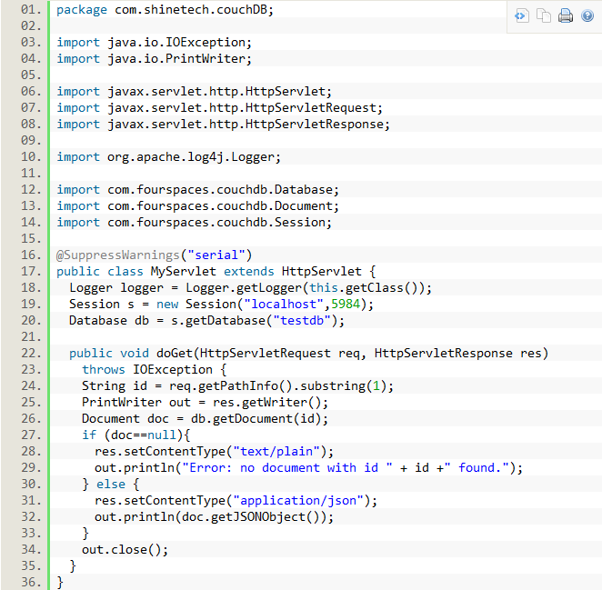
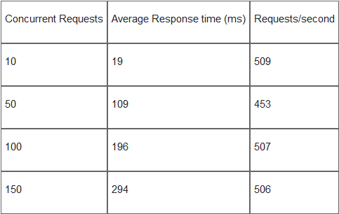
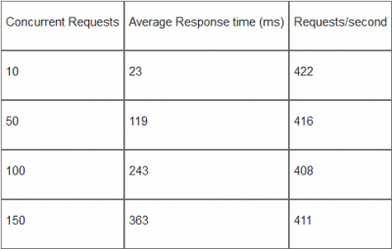
NodeJS Performance v.s. JAVA EE

Slide 9
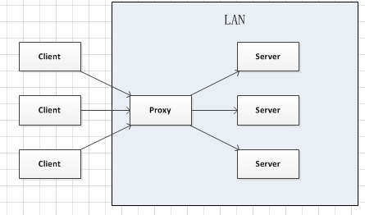
Nginx+NodeJS
Nginx as reverse proxy and NodeJS as Server
#proxy to a node app running on 3000 port
location /api {
proxy_pass http://localhost:3000; proxy_buffering on; }
app.get('/api', foo)
Nginx
Node

Slide 10
Thank you!

