Slide 1
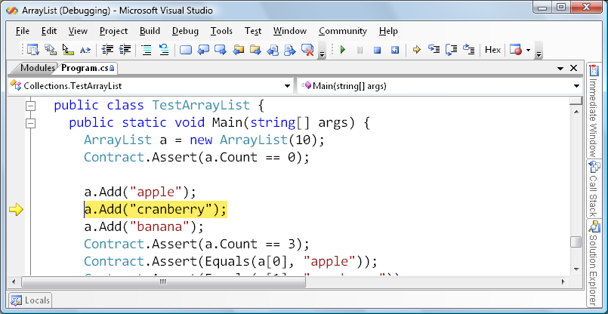
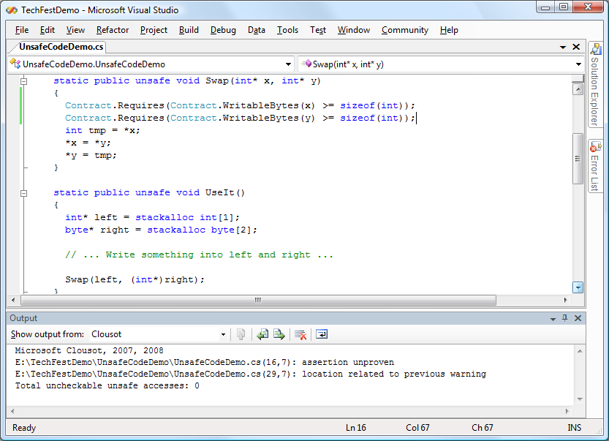
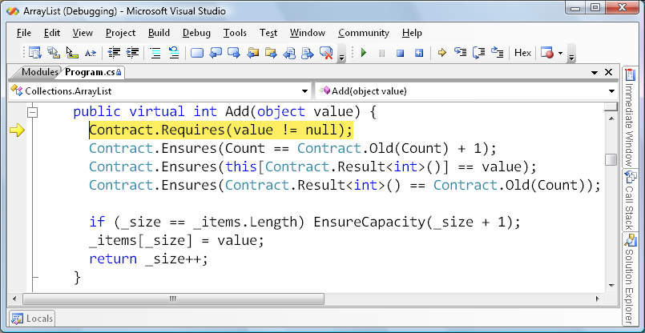
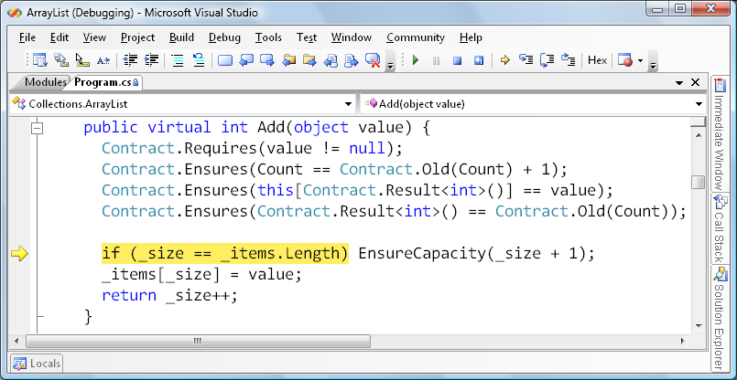
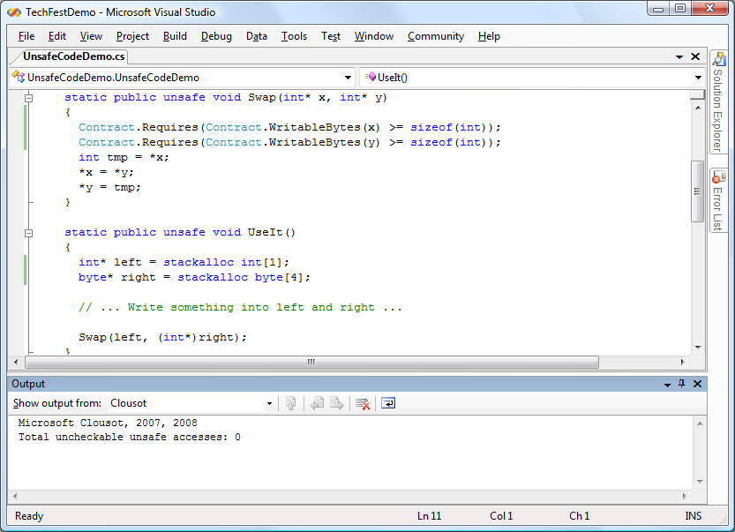
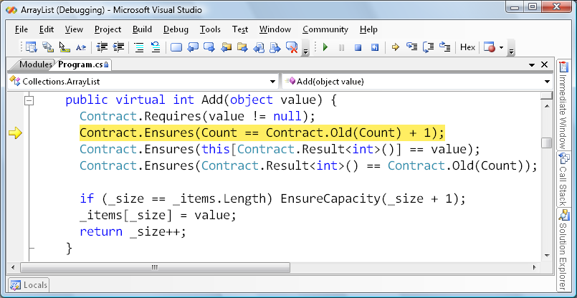
Language-Agnostic Contract Checking for .NET
Runtime Checking
Contract Library
Static Checking
with
Clousot!
1. Step into call
Sources
Sources
Compiler
Checks correctness of A.dll against its internal contracts and those of referenced reference assemblies
/d:CONTRACTS
A.dll
1. Analyze
F11
Execute
Declarative
Assembly
2. Check preconditions
Both method bodies and declarative contracts.
(not executable)
Checks well-formedness
Does contract inheritance
Removes method bodies
Rewriter
AsmMeta
F10
3. Execute code
X.meta
Compiler
Reference Assembly
Reference Assembly
Reference Assemblies
2. Fix & Check
F10
A.dll
No code, only declarative contracts. (not executable)
Testing
Assembly
Contracts are instrumented
at appropriate program points as runtime checks.
F10
4. Check postconditions
Ship with dev tools
A.dll
Retail
Assembly
Execute / Ship
Contains no declarative contracts.
Preconditions may be executable.

