Slide 1
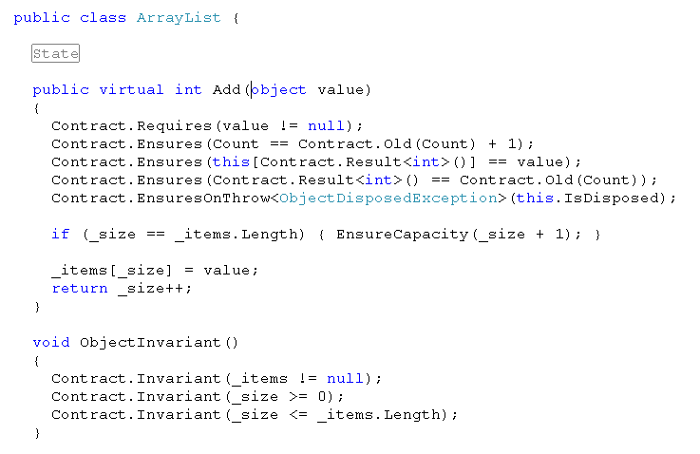
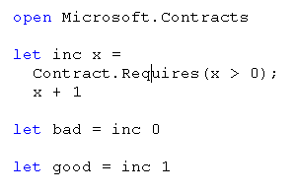
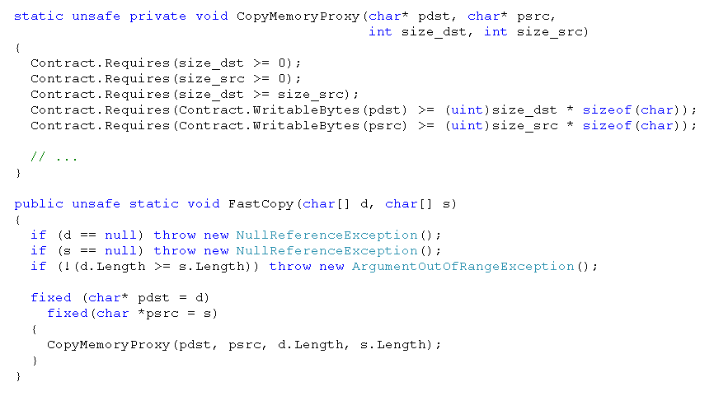
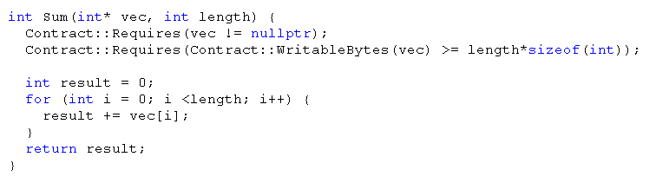
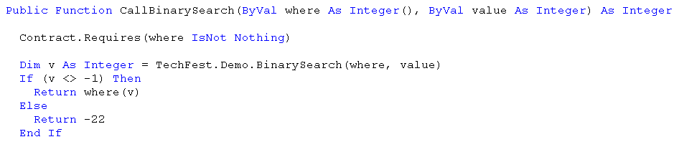
Language-Agnostic Contracts for .NET
Contracts in C#
Contracts are:
Pre-conditions
Post-conditions
Refer to method result
Refer to pre-state values
Object invariants
Logically part of method signatures
Contracts in F#
Contracts about Unsafe code
Contracts in managed C++
Contracts …
make Design Decisions explicit
verify boundary between safe/unsafe code
generate better API documentation
enable better VS intellisense tooltips
amplify testing via runtime checking
enable static verification and bug finding
Contracts in VB

