Slide 1
Clousot A static contract checker based on abstract interpretation
Francesco Logozzo
Microsoft Research, Redmond, WA

Slide 2
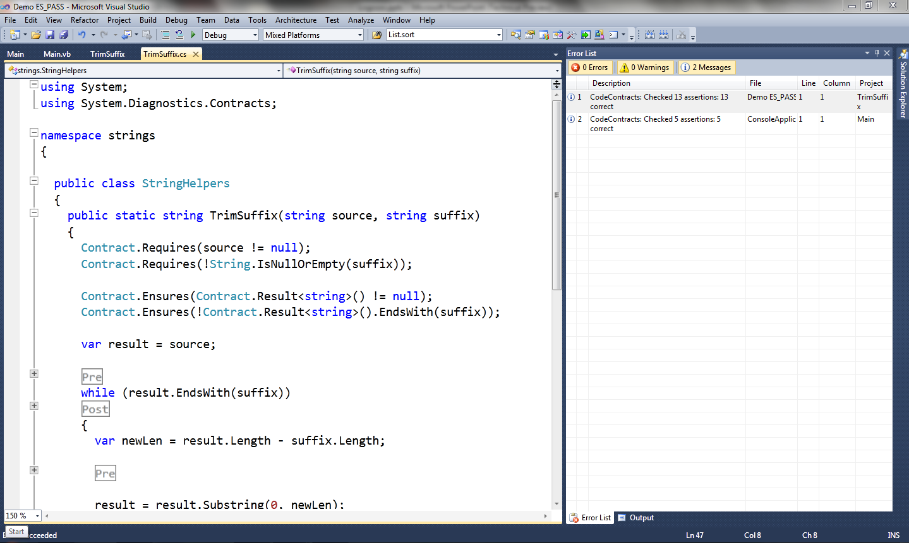
Demo!

Slide 3
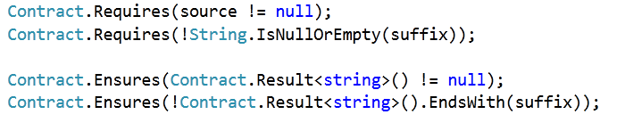

Code Contracts
Idea: Use the IL as contract representation
Use static methods to a contract library
Language agnostic: same for C#, VB, F# …

Slide 4
Code Contracts tools
Documentation generation (ccdoc)
Automatic generation of documentation
Runtime checking (ccrewrite)
Binary rewriting
Static checking (Clousot)

Slide 5
Abstract Interpretation
Theory of approximations
Semantics are order according to the precision
The more the precise the semantics
The more the properties captured
A static analysis is a semantics
Precise enough to capture the properties of interest
Rough enough to be computable

Slide 6
Clousot
Based on Abstract Interpretation
≠ Usual approaches based on theorem prover
Advantages
Automatic
Inference of loop invariants, pre, post, invariants
Predictable
No quantifier instantiation
No easy proofs by contradictory axioms
Scalable
Tune-up for the properties of interest

Slide 7
Clousot: The big picture
Assertion Checking
Analysis
Inference
Call Graph Construction
Contract Extraction
A.dll
B.dll
C.dll
…
Z.dll

Slide 8
Method Analysis
Analyze the method
Collect the proof obligations
Explicit: Pre/Post, assertions
Implicit: Array bounds, non-null …
Discharge proof obligations
If not, emit warning message
Propagate inferred contracts

Slide 9
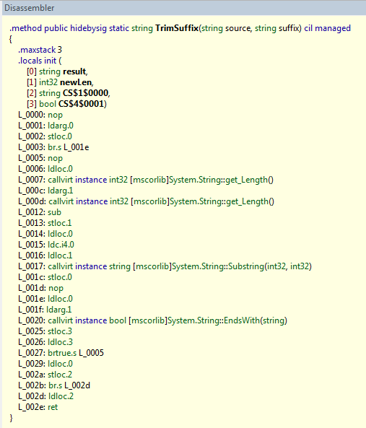
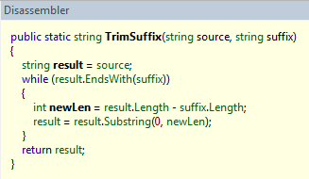
Bytecode
Stack language

Slide 10
Why the bytecode???
More faithful
Closer to what get executed
Clear semantics of the instructions
Exploit the work of the compiler
Name resolution, type inference, generics, LINQ…
Language agnostic
Bytecode does not change!
Languages yes : C# 2.0 → C# 3.0 → C# 4.0

Slide 11
Drawbacks
Explicit stack
Program structure lost
Expressions chunked out
…
Need a program normalization!

Slide 12



Clousot: Analysis structure
Expression analysis
Heap analysis
Stack analysis
Analyses
Bounds, nonnull, arrays…
Source: z = x + y

Slide 13
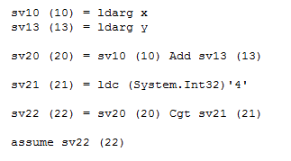
Expression recovery
Assume x + y ≤ 4
High level: easy!
Low level: problem!

Slide 14
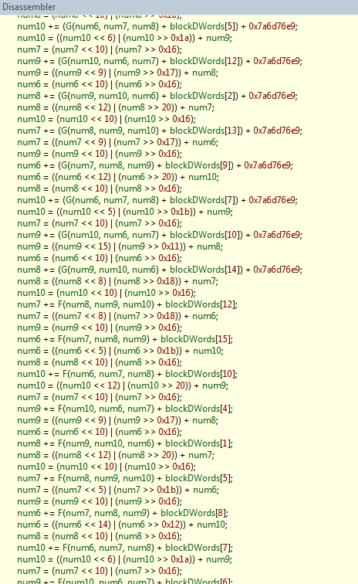
Eager expression reconstruction?
MDTransform
9000 straight line instructions

Slide 15
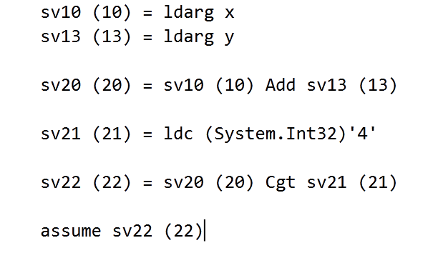
Lazy expression recovery

Slide 16
Value Analyses
Nonnull
Is a reference null?
Bounds
Array bounds, numerical values …
Arithmetic
Division by zero, negation of MinInt …
Unsafe
Buffer overrun

Slide 17
Array content
(with P. & R. Cousot)
Strings
Object Invariants
(M. Monereau)
Iterators
(S. Xia)
Pietro Ferrara, Francesco Logozzo and Manuel Fahndrich Safer Unsafe Code in .NET, in OOPSLA 2008

Slide 18
1. Numerical Abstract Domains

Slide 19
Abstract domains
0 ≤ index < array.Length?
Intervals
O(n)
a ≤ x ≤ b
No ☹
Pentagons
O(n)
a≤ x ≤ b & x <y
Yes ☺
Octagons
O(n³)
± x ± y ≤ a
Yes ☺
Polyhedra
O(2^{n})
Σ a_{i}x_{i} ≤ b
Yes ☺

Slide 20
Numerical domains in Clousot
Basic
Intervals, Pentagons, Leq, Karr, Octagons, Simple Disequalities, Stripes, Subpolyhedra …
Combination of thereof
Tree of domains
Incremental analysis
First analyze with “cheap” domains
Move to more expensive if fails to prove
Domain D1
Domain D2
Domain D3

Slide 21
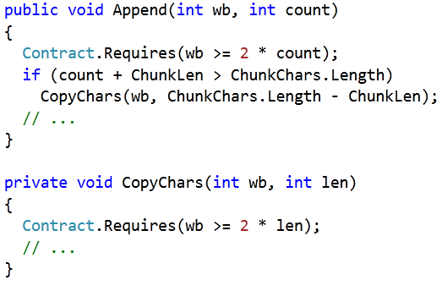
Why Subpolyhedra?
Often proving a “easy” precondition requires a complex reasoning
From StringBuilder:

Slide 22
Subpolyhedra
∑a_{i} x_{i} ≤ k ⇔ ∑a_{i} x_{i} = β ⋀ β ≤ k
Reduced product of
Intervals
Scalable, fast…
Linear Equalities
Precise join, fast …
Challenge: Have a precise Join
Vincent Laviron and Francesco Logozzo, Subpolyhedra: A (more) scalable approach to the inference of linear inequalities, in VMCAI 2009

Slide 23
Naif Join
assume x <= y
x = 0; y = 1
〈x - y == β, β ∈ [-∞, 0]〉
〈T, x ∈ [0,0] ⋀ y ∈ [1,1]〉
〈T, T〉
assert x <= y

Slide 24
Join algorithm : SubPolyhedra
Uniform slack variables
Reduce the states
Do the pair-wise join
Recover precision using deleted equalities
Recover precision using hints
Templates, 2D Convex Hull, Annotations …
Vincent Laviron and Francesco Logozzo, Refining Abstract Interpretation-based Static Analyses with Hints, in APLAS 2009

Slide 25
Example : Join Step 1
Entry State:
s₀ : 〈x - y == β, β ∈ [-∞, 0]〉
s₁ : 〈T, x ∈ [0,0] ⋀ y ∈ [1,1]〉
Step 1 (uniform slack variables)
s’₀ : 〈x - y == β, β ∈ [-∞, 0]〉
s’₁ : 〈x - y == β, x ∈ [0,0] ⋀ y ∈ [1,1]〉

Slide 26
Example: Join steps 2-3
Step 2 (Reduction)
s’’₀ : 〈x - y == β, β ∈ [-∞, 0]〉
s’’₁ : 〈x - y == β, x ∈ [0,0] ⋀ y ∈ [1,1] ⋀ β ∈ [-1,-1]〉
Step 3 (Pair-wise join)
s₂ : 〈x - y == β, β ∈ [-∞, 0]〉

Slide 27
Example: Join Step 4
Recover lost relations
assume x == y
x = 0; y = 1
〈x - y == 0, T〉
〈T, x ∈ [0,0] ⋀ y ∈ [1,1]〉
〈T, T〉
〈x - y == β, β ∈ [-1, 0]〉
assert x<= y

Slide 28
Critical operation: Reduction
Infer tightest bounds
Instance of a Linear programming problem
Solution in polynomial time
Drawbacks:
Numerical instability, Rounding errors
Simplex too slow for our purposes
Basis exploration (new)
Based on static basis exploration
Less concerned about numerical instability
Abstract when an error is detected
E.g. In a row operation, delete the row

Slide 29
To sum up on Subpolyhedra
Infer arbitrary linear inequalities
Scales to hundreds of variables
Precisely propagate linear inequalities
Give up some of the inference power
Family of abstract domains
Two precision axes
Hints
Tune the inference power at join points
Reduction
Infer the tightest intervals

Slide 30
2. Abstract domain for array content inference

Slide 31
Inferring array contents…
public void Init(int N)
{
Contract.Requires(N > 0);
int[] a = new int[N];
int i = 0;
while (i < N)
{
a[i] = 222;
i = i + 1;
}
Contract.Assert(∀ k ∈ [0, N). a[k] == 222);
}
Challenge 1:
Effective handling of disjunction
If i == 0 then
a not initialized
else if i > 0
a[0] == … a[i] == 222
else
impossible
Challenge 2:
No overapproximation (can be unsound)
(no hole, all the elements are initialized)

Slide 32

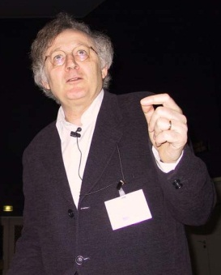

Our idea
Precise and very very fast!
Basis: Array segments
Segment bounds
Disjunction
Uniform content abstraction
0
[222, 222]
i, k
?
[0, 0]
N
0 ≤ i, 0 ≤ k
i == k
i < N, k < N

Slide 33
Example
Contract.Requires(N > 0);
int[] a = new int[N];
0
0
N
int i = 0;
0,i
0
N
0
222
1,i
0
N
?
assume i ≥ N
assume i < N
i -> _
j -> i
N -> N
0,i
0
N
a[i] = 222;
0,i
222
1,i+1
0
N
?
j = i+1;
0,i
222
1,i+1,j
0
N
?

Slide 34
Segment unification
0,i
0
N
0
222
1,i
0
N
?
0
⊥
i
?
0
N
0
222
1,i
0
N
?
0
⊥
i
?
0
N
0
222
i
0
N
?
Join
Can be empty segments! (Disjunction)
0
222
i
?
0
N
?

Slide 35
Example
Contract.Requires(N > 0);
int[] a = new int[N];
int i = 0;
0
222
i
?
0
N
?
Remove doubts
(i == N && N > 0)
assume i ≥ N
assume i < N
0
222
i
?
0
N
0
222
i, N
a[i] = 222;
i -> _
j -> i
N -> N
And so on up to a fixpoint …
We visited all the elements in [0, N)
j = i+1;

Slide 36
Other…
Intra-modular Inference
Pre/Post/Object invariants
Reduce annotation burden
Can make the analysis bridle
Serialize to C#
Backward analysis for disjunctions
Safe floating points in parameters
Selective verification
Ranking of warnings
…

Slide 37
TODO
Collections
Experimenting handling of arrays
Extend to iterators, List<T> …
Strings
Need good domains to approximate strings
Modular overflow checking
Combine with automatic test generation
PEX
Make Clousot parallel
…

Slide 38
Conclusions
Programmers are willing to write annotations
SAL, ESP … at Microsoft,
CodeContracts Forum, PDC …
We should provide valuable tools
Automatic, predictable, fast!!!!
Clousot is a step in that direction
Download it today at:
http://msdn.microsoft.com/en-us/devlabs/
(Academic and Commercial license)

Slide 39
Thanks!!!!

Slide 40
Example : Join Step 5
assume y >= 0 ;
x = 0;
〈T, x ∈ [0,0] ⋀ y ∈ [0,+∞]〉
〈T, x ∈ [1,1] ⋀ y ∈ [1,+∞]〉
〈x – y == β’, x ∈ [0,1] ⋀ y ∈ [0,+∞] ⋀ β’ ∈ [-∞,0]〉
〈T, x ∈ [0,1] ⋀ y ∈ [0,+∞]〉
〈T, x ∈ [0,0] ⋀ y ∈ [0,+∞]〉
while x < y
〈 x – y == β, x ∈ [0,1] ⋀ y ∈ [0,1] ⋀ β ∈ [0,+∞]〉
〈T, x ∈ [0,0] ⋀ y ∈ [1,+∞]〉
〈 x – y == β’, x ∈ [0,1] ⋀ y ∈ [0,1] ⋀ β’ ∈ [0,0]〉
〈T, x ∈ [0,0] ⋀ y ∈ [0,0]〉
assert x == y ;
x++;

