Slide 1
Language Agnostic SPECIFICATION AND Verification For .NET
Manuel Fähndrich, Michael Barnett, Francesco Logozzo
Daan Leijen, Daryl Zuniga, Herman Venter
http://codebox/contracts

Slide 2
What are Code Contracts?
Standard, language-agnostic way to express
Preconditions
Postconditions
Object invariants
Tools for
Documentation generation
Runtime checking of contracts
Static verification

Slide 3
Benefits of Code Contracts
Specify design decisions once Use information many times…
Code documentation (in sync with code)
Documentation generation
Runtime checking
Static verification

Slide 4










Historical Perspective
ESC/M3
Eiffel
ESC/Java
JML
Spec#
CodeContracts

Slide 5
Avoiding Barriers to Adoption
Don’t change existing .NET dev environment
Languages, IDE, compilers, etc.
Provide a standard specification format
Enable tool eco-system around contracts
Enable programmers
Familiar environment
Incremental adoption

Slide 6
Embedding a Contract Language
Previous approaches
Eiffel, Spec#: 1st class support
JML: specifications in comments
Attributes: [NotNull] @NonNull
Many research languages or extensions
Specifications or type systems
New Alternative
Embedding in an existing language CodeContracts

Slide 7
Example
/// <summary> Removes suffix from original </summary>
///
public string TrimSuffix(string original, string suffix)
{
Contract.Requires(original != null);
Contract.Requires(!String.IsEmptyOrNull(suffix));
Contract.Ensures(!Contract.Result<string>().EndsWith(suffix));
var result = original
while (result.EndsWith(suffix))
{
result = result.Substring(0, result.Length – suffix.Length);
}
return result;
}

Slide 8
Example
/// <summary> Removes suffix from original </summary>
///
public string TrimSuffix(string original, string suffix)
{
Contract.Requires(original != null);
Contract.Requires(!String.IsEmptyOrNull(suffix));
Contract.Ensures(!Contract.Result<string>().EndsWith(suffix));
var result = original;
if (result.EndsWith(suffix))
{
result = result.Substring(0, result.Length – suffix.Length);
}
return result;
}

Slide 9
Example
/// <summary> Removes suffix from original </summary>
///
public string TrimSuffix(string original, string suffix)
{
Contract.Requires(original != null);
Contract.Requires(!String.IsEmptyOrNull(suffix));
Contract.Ensures(!Contract.Result<string>().EndsWith(suffix));
var result = original;
if (result.EndsWith(suffix))
{
result = result.Substring(0, result.Length – suffix.Length);
}
return result;
}

Slide 10
Example
/// <summary> Removes suffix from original </summary>
///
public string TrimSuffix(string original, string suffix)
{
Contract.Requires(original != null);
Contract.Requires(suffix != null);
Contract.Ensures(!Contract.Result<string>().EndsWith(suffix));
var result = original;
if (result.EndsWith(suffix))
{
result = result.Substring(0, result.Length – suffix.Length);
}
return result;
}

Slide 11
Example
/// <summary> Removes suffix from original </summary>
///
public string TrimSuffix(string original, string suffix)
{
Contract.Requires(original != null);
Contract.Requires(suffix != null);
Contract.Ensures(!Contract.Result<string>().EndsWith(suffix));
var result = original;
if (result.EndsWith(suffix))
{
result = result.Substring(0, result.Length – suffix.Length);
}
return result;
}

Slide 12
Example
/// <summary> Removes suffix from original </summary>
///
public string TrimSuffix(string original, string suffix)
{
Contract.Requires(original != null);
Contract.Requires(suffix != null);
Contract.Ensures(!Contract.Result<string>().EndsWith(suffix));
var result = original;
if (result.EndsWith(suffix))
{
result = result.Substring(0, result.Length – suffix.Length);
}
return result;
}
2 Bugs

Slide 13
Example
/// <summary> Removes suffix from original </summary>
///
public string TrimSuffix(string original, string suffix)
{
Contract.Requires(original != null);
Contract.Requires(suffix != null);
Contract.Ensures(!Contract.Result<string>().EndsWith(suffix));
var result = original;
if (result.EndsWith(suffix))
{
result = result.Substring(0, result.Length – suffix.Length);
}
return result;
}
Bug 1
original = “foo” suffix = “”
result = “foo”

Slide 14
Example
/// <summary> Removes suffix from original </summary>
///
public string TrimSuffix(string original, string suffix)
{
Contract.Requires(original != null);
Contract.Requires(!String.IsEmptyOrNull(suffix));
Contract.Ensures(!Contract.Result<string>().EndsWith(suffix));
var result = original;
if (result.EndsWith(suffix))
{
result = result.Substring(0, result.Length – suffix.Length);
}
return result;
}
Strengthened
Precondition

Slide 15
Example
/// <summary> Removes suffix from original </summary>
///
public string TrimSuffix(string original, string suffix)
{
Contract.Requires(original != null);
Contract.Requires(!String.IsEmptyOrNull(suffix));
Contract.Ensures(!Contract.Result<string>().EndsWith(suffix));
var result = original;
if (result.EndsWith(suffix))
{
result = result.Substring(0, result.Length – suffix.Length);
}
return result;
}
Bug 2
original = “foo” suffix = “o”
result = “fo”

Slide 16
Example
/// <summary> Removes suffix from original </summary>
///
public string TrimSuffix(string original, string suffix)
{
Contract.Requires(original != null);
Contract.Requires(!String.IsEmptyOrNull(suffix));
Contract.Ensures(!Contract.Result<string>().EndsWith(suffix));
var result = original;
while (result.EndsWith(suffix))
{
result = result.Substring(0, result.Length – suffix.Length);
}
return result;
}
Handle repeated
suffixes

Slide 17
Contracts Authored as Code
Boolean expression in source language
No new language
Full expressiveness
No new IDE, compiler, or parser
Yet, full IDE support (intellisense, refactoring, errors, debugging)
Semantics of boolean expressions
Given by compiler translation to ECMA MSIL
Persisted compiled contract format
Metadata + IL

Slide 18
Language Research without the Language part…
Express extensions as
Library calls, attributes
Let standard compilers compile
Provide post-processing
Check well-formedness of extensions
Rewrite the target code
Perform analyses
Provide feedback to programmer

Slide 19
Contract API in .NET 4.0
namespace System.Diagnostics.Contracts {
public static class Contract
{
[Conditional(“CONTRACTS_FULL”)]
public static void Requires(bool condition) {}
[Conditional(“CONTRACTS_FULL”)]
public static void Ensures(bool condition) {}
[Conditional(“CONTRACTS_FULL”)]
public static void Invariant(bool condition) {}
public static T Result<T>() {…}
public static T OldValue<T>(T expression) {…}
…
}
}
Library reusable from C#, VisualBasic, F#, …

Slide 20

Post Processing Step
public virtual int Add(object value)
{
Contract.Requires(object != null);
Contract.Ensures( Count == Contract.Old(Count) + 1 );
Contract.Ensures( Contract.Result<int>() == Contract.OldValue(Count) );
if (_size == _items.Length) EnsuresCapacity(_size + 1);
_items[_size] = value;
return _size++;
}
public virtual int Add(object value)
{
Contract.Requires(object != null);
Contract.Ensures( Count == Contract.Old(Count) + 1 );
Contract.Ensures( Contract.Result<int>() == Contract.OldValue(Count) );
if (_size == _items.Length) EnsuresCapacity(_size + 1);
_items[_size] = value;
return _size++;
}
Executable runtime
Contract checking
csc
/d:CONTRACTS_FULL
.method public hidebysig newslot virtual instance int32 Add(object 'value') cil managed
{
.locals init (int32 'Contract.Old(Count)',
int32 'Contract.Result<int>()')
ldarg.1
ldnull
ceq
ldc.i4.0
ceq
ldstr "value != null"
call void __RewriterMethods::RewriterRequires$PST06000009(bool, string)ldarg.0
ldarg.0
call instance int32 TabDemo.BaseList::get_Count()
stloc.3
ldarg.0
ldfld int32 TabDemo.BaseList::count
ldarg.0
ldfld object[] TabDemo.BaseList::items
ldlen
conv.i4
ceq
ldc.i4.0
ceq
stloc.1
ldloc.1
brtrue IL_004d
nop
ldarg.0
ldarg.0
ldfld int32 TabDemo.BaseList::count
ldc.i4.1
add
call instance void TabDemo.BaseList::EnsureCapacity(int32)
nop
nop
ldarg.0
ldfld object[] TabDemo.BaseList::items
ldarg.0
ldfld int32 TabDemo.BaseList::count
ldarg.1
stelem.ref
ldarg.0
dup
ldfld int32 TabDemo.BaseList::count
dup
stloc.2
ldc.i4.1
add
stfld int32 TabDemo.BaseList::count
ldloc.2
stloc.0
br IL_0072
ldloc.0
stloc.s 'Contract.Result<int>()'
br IL_007a
ldarg.0
call instance int32 TabDemo.BaseList::get_Count()
ldloc.3
ldc.i4.1
add
ceq
ldstr "Count == Contract.Old(Count) + 1"
call void __RewriterMethods::RewriterEnsures$PST0600000B(bool, string)
ldloc.s 'Contract.Result<int>()'
ldloc.s V_4
ceq
ldstr "Contract.Result<int>() == Contract.Old(Count)"
call void __RewriterMethods::RewriterEnsures$PST0600000B(bool, string)
ldloc.s 'Contract.Result<int>()'
ret
}
.method public hidebysig newslot virtual instance int32 Add(object 'value') cil managed
{
ldarg.1
ldnull
ceq
ldc.i4.0
ceq
call void [Microsoft.Contracts]Microsoft.Contracts.Contract::Requires(bool)
ldarg.0
call instance int32 TabDemo.BaseList::get_Count()
ldarg.0
call instance int32 TabDemo.BaseList::get_Count()
call !!0 [Microsoft.Contracts]Microsoft.Contracts.Contract::Old<int32>(!!0)
ldc.i4.1
add
ceq
call void [Microsoft.Contracts]Microsoft.Contracts.Contract::Ensures(bool)
call !!0 [Microsoft.Contracts]Microsoft.Contracts.Contract::Result<int32>()
ldarg.0
call instance int32 TabDemo.BaseList::get_Count()
call !!0 [Microsoft.Contracts]Microsoft.Contracts.Contract::Old<int32>(!!0)
ceq
call void [Microsoft.Contracts]Microsoft.Contracts.Contract::Ensures(bool)
ldarg.0
ldfld int32 TabDemo.BaseList::count
ldarg.0
ldfld object[] TabDemo.BaseList::items
ldlen
conv.i4
ceq
ldc.i4.0
ceq
stloc.1
ldloc.1
brtrue.s IL_0069
ldarg.0
ldarg.0
ldfld int32 TabDemo.BaseList::count
ldc.i4.1
add
call instance void TabDemo.BaseList::EnsureCapacity(int32)
ldarg.0
ldfld object[] TabDemo.BaseList::items
ldarg.0
ldfld int32 TabDemo.BaseList::count
ldarg.1
stelem.ref
ldarg.0
dup
ldfld int32 TabDemo.BaseList::count
dup
stloc.2
ldc.i4.1
add
stfld int32 TabDemo.BaseList::count
ldloc.2
stloc.0
br.s IL_008b
ldloc.0
ret
} // end of method BaseList::Add
csc normal compile
.method public hidebysig newslot virtual instance int32 Add(object 'value') cil managed
{
ldarg.0
ldfld int32 TabDemo.BaseList::count
ldarg.0
ldfld object[] TabDemo.BaseList::items
ldlen
conv.i4
ceq
ldc.i4.0
ceq
stloc.1
ldloc.1
brtrue.s IL_0029
ldarg.0
ldarg.0
ldfld int32 TabDemo.BaseList::count
ldc.i4.1
add
call instance void TabDemo.BaseList::EnsureCapacity(int32)
ldarg.0
ldfld object[] TabDemo.BaseList::items
ldarg.0
ldfld int32 TabDemo.BaseList::count
ldarg.1
stelem.ref
ldarg.0
dup
ldfld int32 TabDemo.BaseList::count
dup
stloc.2
ldc.i4.1
add
stfld int32 TabDemo.BaseList::count
ldloc.2
stloc.0
br.s IL_004b
ldloc.0
ret
}
ccrewrite
WF checks
Inheritance
Invariants
Source text

Slide 21
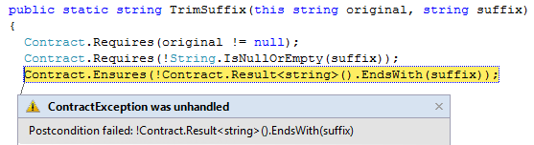
Runtime Checking Experience
Stepping, breakpoints work naturally
Runtime failure behavior fully configurable
Failing condition string available at runtime

Slide 22
Expressiveness: Quantifiers
/// <summary> Removes suffix from original </summary>
///
public string TrimSuffix(string original, string suffix)
{
Contract.Requires(original != null);
Contract.Requires(!String.IsEmptyOrNull(suffix));
Contract.Ensures(!Contract.Result<string>().EndsWith(suffix));
Contract.Ensures(Contract.ForAll(0,
Contract.Result<string>().Length,
i => Contract.Result<string>()[i] == original[i]));
}

Slide 23
Interface Contracts
[ContractClass(typeof(IListContract<>))]
public interface IList<T> : ICollection<T>
{
…
void RemoveAt(int index);
}
[ContractClassFor(typeof(IList<>))]
public class IListContract<T> : IList<T>
{
…
public void RemoveAt(int index)
{
Contract.Requires(index >= 0);
Contract.Requires(index < this.Count);
Contract.Ensures(this.Count == Contract.OldValue(this.Count) - 1);
}
}

Slide 24
Interface Contracts
[ContractClass(typeof(IListContract<>))]
public interface IList<T> : ICollection<T>
{
…
void RemoveAt(int index);
}
[ContractClassFor(typeof(IList<>))]
public class IListContract<T> : IList<T>
{
…
public void RemoveAt(int index)
{
Contract.Requires(index >= 0);
Contract.Requires(index < this.Count);
Contract.Ensures(this.Count == Contract.OldValue(this.Count) - 1);
}
}

Slide 25
Interface Contracts
[ContractClass(typeof(IListContract<>))]
public interface IList<T> : ICollection<T>
{
…
void RemoveAt(int index);
}
[ContractClassFor(typeof(IList<>))]
public class IListContract<T> : IList<T>
{
…
public void RemoveAt(int index)
{
Contract.Requires(index >= 0);
Contract.Requires(index < this.Count);
Contract.Ensures(this.Count == Contract.OldValue(this.Count) - 1);
}
}

Slide 26
Object Invariants
public class MyCollection
{
///<summary>data is never null<summary>
int[] data;
///<summary>count is non-negative and less equal data.Length<summary>
int count;
[ContractInvariantMethod]
void DataCountInvariants() {
Contract.Invariant( data != null );
Contract.Invariant( count >= 0 );
Contract.Invariant( count <= data.Length );
}
}

Slide 27
Object Invariants
public class MyCollection
{
///<summary>data is never null<summary>
int[] data;
///<summary>count is non-negative and less equal data.Length<summary>
int count;
[ContractInvariantMethod]
void DataCountInvariants() {
Contract.Invariant( data != null );
Contract.Invariant( count >= 0 );
Contract.Invariant( count <= data.Length );
}
}

Slide 28
Drawbacks of Approach
Encodings necessary for missing constructs
Result, OldValue, ValueAtReturn
Interface and abstract buddy classes
Contract extraction / decompilation from IL
Closures + closure instantiation
Field initialization in constructors
Language specific idioms (C#, VB, F#)
… Yet, we wouldn’t be here if we had taken the new programming language path.

Slide 29


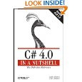
Code Contracts Impact
Externally available ~14 months
~20,000 downloads, active forum
3 book chapters on CodeContracts
Many dozens of blog articles
Publications, talks, lectures
SAC, OOPSLA, APLAS, VMCAI, SAS, giro d’italia
Internal usage (1 month tracking >80 users)
Integrated into CLR build, a few small groups
RiSE projects: SPUR, CodeContracts

Slide 30
Practical Matters
The legacy-requires saga
Interaction with other tools
CodeAnalysis / FxCop
Code coverage
Postsharper
Suppressing warnings / functionality
Contract.Assume(…), Attributes
Dealing with all of .NET
Silverlight, ASP.NET, Office.NET, Windows Phone 7, …

Slide 31
The Legacy Requires Saga 1
[ContractClass(typeof(IListContract<>))]
public int Sum(ICollection<int> values)
{
if (values == null) {
throw new ArgumentNullException(“values”, Resource.Lookup…);
…
}
[ContractClassFor(typeof(IList<>))]
public class IListContract<T> : IList<T>
{
…
public void RemoveAt(int index)
{
Contract.Requires(index >= 0);
Contract.Requires(index < this.Count);
Contract.Ensures(this.Count == Contract.OldValue(this.Count) - 1);
}
}

Slide 32
The Legacy Requires Saga 2
[ContractClass(typeof(IListContract<>))]
public int Sum(ICollection<int> values)
{
if (values == null) {
throw new ArgumentNullException(“values”, Resource.Lookup…);
Contract.EndContractBlock();
…
}
[ContractClassFor(typeof(IList<>))]
public class IListContract<T> : IList<T>
{
…
public void RemoveAt(int index)
{
Contract.Requires(index >= 0);
Contract.Requires(index < this.Count);
Contract.Ensures(this.Count == Contract.OldValue(this.Count) - 1);
}
}
Decompiled as
Requires( values != null );

Slide 33
The Legacy Requires Saga 3
[ContractClass(typeof(IListContract<>))]
public int Sum(ICollection<int> values)
{
Helpers.CheckNull(values, “values”);
…
}
class Helpers {
c public static void CheckNull(object object, string name) {
if (object == null) {
throw new ArgumentNullException(name, Resource.Lookup…);
}class IListContract<T> : IList<T>
{
…
public void RemoveAt(int index)
{
Contract.Requires(index >= 0);
Contract.Requires(index < this.Count);
Contract.Ensures(this.Count == Contract.OldValue(this.Count) - 1);
}
}

Slide 34
The Legacy Requires Saga 3
[ContractClass(typeof(IListContract<>))]
public int Sum(ICollection<int> values)
{
Helpers.CheckNull(values, “values”);
…
}
class Helpers {
[ContractArgumentValidator]
c public static void CheckNull(object object, string name) {
if (object == null) {
throw new ArgumentNullException(name, Resource.Lookup…);
Contract.EndContractBlock();
}class IListContract<T> : IList<T>
{
…
public void RemoveAt(int index)
{
Contract.Requires(index >= 0);
Contract.Requires(index < this.Count);
Contract.Ensures(this.Count == Contract.OldValue(this.Count) - 1);
}
}
Decompiled as
Requires( values != null );

Slide 35
Contract Format: Future Proof
Contracts as MSIL
Provides extension point
bool ProtectedBy<T>(ref T data, object lock);
No lock-in to particular tools
Language integration
C#, VB may provide syntax in the future, emit same format
CCrewrite
FxCop
CCCheck
Boogie
Coq, Isabelle
Prove Correct
Find Bugs

Slide 36
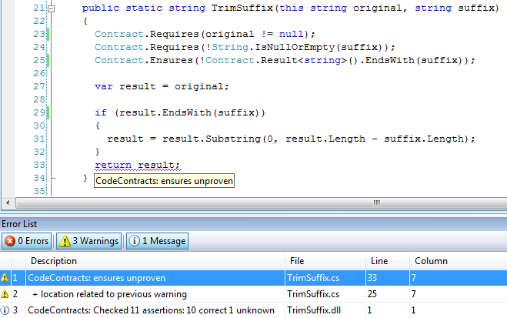
Static Contract Verification

Slide 37
Conclusions
Embedding approach to language research
General approach (see also Orcs/Versions)
Reuse of much infrastructure and environments
Decompilation is one disadvantage
Pushing a project this far forces one to deal with numerous practical details
Still, tech transfer remains difficult
Hope to productize ccrewrite
Much interesting work left on static checker
Please try CodeContracts on your code http://codebox/contracts

Slide 38
Contract Reference Assemblies
Contract Reference Assemblies
.method public hidebysig newslot virtual instance int32 Add(object 'value') cil managed
{
ldarg.1
ldnull
ceq
ldc.i4.0
ceq
call void [Microsoft.Contracts]Microsoft.Contracts.Contract::Requires(bool)
ldarg.0
call instance int32 TabDemo.BaseList::get_Count()
ldarg.0
call instance int32 TabDemo.BaseList::get_Count()
call !!0 [Microsoft.Contracts]Microsoft.Contracts.Contract::Old<int32>(!!0)
ldc.i4.1
add
ceq
call void [Microsoft.Contracts]Microsoft.Contracts.Contract::Ensures(bool)
call !!0 [Microsoft.Contracts]Microsoft.Contracts.Contract::Result<int32>()
ldarg.0
call instance int32 TabDemo.BaseList::get_Count()
call !!0 [Microsoft.Contracts]Microsoft.Contracts.Contract::Old<int32>(!!0)
ceq
call void [Microsoft.Contracts]Microsoft.Contracts.Contract::Ensures(bool)
ldarg.0
ldfld int32 TabDemo.BaseList::count
ldarg.0
ldfld object[] TabDemo.BaseList::items
ldlen
conv.i4
ceq
ldc.i4.0
ceq
stloc.1
ldloc.1
brtrue.s IL_0069
ldarg.0
ldarg.0
ldfld int32 TabDemo.BaseList::count
ldc.i4.1
add
call instance void TabDemo.BaseList::EnsureCapacity(int32)
ldarg.0
ldfld object[] TabDemo.BaseList::items
ldarg.0
ldfld int32 TabDemo.BaseList::count
ldarg.1
stelem.ref
ldarg.0
dup
ldfld int32 TabDemo.BaseList::count
dup
stloc.2
ldc.i4.1
add
stfld int32 TabDemo.BaseList::count
ldloc.2
stloc.0
br.s IL_008b
ldloc.0
ret
} // end of method BaseList::Add
ccrewrite
Runtime checks
cccheck
Compile-time warnings
ccdocgen
Augmented Xml doc

Slide 39
Code Contracts Overview
ccrewrite
cccheck
ccdocgen
ccrefgen
Tools
Contracts
BCL 4.0
Authoring
VS2010
Sandcastle
Presentation

Slide 40
Code Contracts
today
Authoring of Contracts
Build scripts
Rewriter
Contract Reference Assemblies
Property Pane
Contract XML Docs
Contract Visualization
Static Checker
BCL owns
Research owns

Slide 41
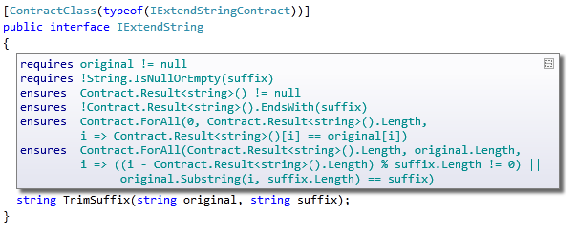
Contract Adornments (VS2010)
Shows inherited contracts
Shows interface contracts on interface
Shows contracts on metadata

Slide 42
Purity
Contract expression should have no observable side effects
Current practice with Asserts
Checked locally
Pure Methods
Purity of methods is declared [Pure]
Calls to pure methods allowed in contracts
Purity of methods unchecked

Slide 43
Code Contracts Overview
ccrewrite
cccheck
ccdocgen
ccrefgen
Tools
Contracts
BCL 4.0
Authoring
VS2010
Sandcastle
Presentation

Slide 44
Runtime Checking Functionality
Inheritance
Base and interfaces
Granularity knobs
Which checks are inserted
Closures and Iterators
Call-site checking
Recursion guards
Source text extraction
Debug experience / stepping / breakpoints

Slide 45
Challenges
Instrumentation in presence of generics/closures
Copying of contracts
Concurrency
Contracts specify non-interleaved behavior
Contracts on shared state may produce races
Inheritance may cause unexpected races
Notion of “thread-safe” is simplistic as it changes contracts
Caller side locking works better

Slide 46

Contract Reference Assemblies
public virtual int Add(object value)
{
Contract.Requires(object != null);
Contract.Ensures( Count == Contract.Old(Count) + 1 );
Contract.Ensures( Contract.Result<int>() == Contract.OldValue(Count) );
if (_size == _items.Length) EnsuresCapacity(_size + 1);
_items[_size] = value;
return _size++;
}
public virtual int Add(object value)
{
Contract.Requires(object != null);
Contract.Ensures( Count == Contract.Old(Count) + 1 );
Contract.Ensures( Contract.Result<int>() == Contract.OldValue(Count) );
if (_size == _items.Length) EnsuresCapacity(_size + 1);
_items[_size] = value;
return _size++;
}
Compile
/d:CONTRACTS_FULL
Contract Reference Assembly
.method public hidebysig newslot virtual instance int32 Add(object 'value') cil managed
{
ldarg.1
ldnull
ceq
ldc.i4.0
ceq
call void [Microsoft.Contracts]Microsoft.Contracts.Contract::Requires(bool)
ldarg.0
call instance int32 TabDemo.BaseList::get_Count()
ldarg.0
call instance int32 TabDemo.BaseList::get_Count()
call !!0 [Microsoft.Contracts]Microsoft.Contracts.Contract::Old<int32>(!!0)
ldc.i4.1
add
ceq
call void [Microsoft.Contracts]Microsoft.Contracts.Contract::Ensures(bool)
call !!0 [Microsoft.Contracts]Microsoft.Contracts.Contract::Result<int32>()
ldarg.0
call instance int32 TabDemo.BaseList::get_Count()
call !!0 [Microsoft.Contracts]Microsoft.Contracts.Contract::Old<int32>(!!0)
ceq
call void [Microsoft.Contracts]Microsoft.Contracts.Contract::Ensures(bool)
ldarg.0
ldfld int32 TabDemo.BaseList::count
ldarg.0
ldfld object[] TabDemo.BaseList::items
ldlen
conv.i4
ceq
ldc.i4.0
ceq
stloc.1
ldloc.1
brtrue.s IL_0069
ldarg.0
ldarg.0
ldfld int32 TabDemo.BaseList::count
ldc.i4.1
add
call instance void TabDemo.BaseList::EnsureCapacity(int32)
ldarg.0
ldfld object[] TabDemo.BaseList::items
ldarg.0
ldfld int32 TabDemo.BaseList::count
ldarg.1
stelem.ref
ldarg.0
dup
ldfld int32 TabDemo.BaseList::count
dup
stloc.2
ldc.i4.1
add
stfld int32 TabDemo.BaseList::count
ldloc.2
stloc.0
br.s IL_008b
ldloc.0
ret
} // end of method BaseList::Add
.method public hidebysig newslot virtual instance int32 Add(object 'value') cil managed
{
ldarg.1
ldnull
ceq
ldc.i4.0
ceq
call void [Microsoft.Contracts]Microsoft.Contracts.Contract::Requires(bool)
ldarg.0
call instance int32 TabDemo.BaseList::get_Count()
ldarg.0
call instance int32 TabDemo.BaseList::get_Count()
call !!0 [Microsoft.Contracts]Microsoft.Contracts.Contract::Old<int32>(!!0)
ldc.i4.1
add
ceq
call void [Microsoft.Contracts]Microsoft.Contracts.Contract::Ensures(bool)
call !!0 [Microsoft.Contracts]Microsoft.Contracts.Contract::Result<int32>()
ldarg.0
call instance int32 TabDemo.BaseList::get_Count()
call !!0 [Microsoft.Contracts]Microsoft.Contracts.Contract::Old<int32>(!!0)
ceq
call void [Microsoft.Contracts]Microsoft.Contracts.Contract::Ensures(bool)
} // end of method BaseList::Add
ccrefgen
Language-agnostic, persisted contract format
Free: produced by all compilers
Semantics given by MSIL encoding conditions
Uniform format to down-stream tools
Library for extracting contracts from MSIL

Slide 47
Providing Contracts for your Lib
src
src
src
src
Release Assemblies
Contract Reference Assemblies
PowerLib.dll
PowerLib.Contracts.dll
+
(minimal runtime checks)
All contracts, no code

Slide 48
Developing against 3rd Party Lib
can check Requires of PowerLib at call-sites
inherits contracts
src
src
src
MyApp.exe
MyApp.exe
src
ccrewrite
PowerLib.Contracts.dll
PowerLib.dll
(no runtime checks)

Slide 49
Contracts for Existing Libraries
Mscorlib
System
System.Data
System.Xml
System.Windows
System.Core
System.Configuration
System.Web
System.Windows.Browser
System.Windows.Forms
WindowsBase
System.Drawing
System.Security
Microsoft.VisualBasic.Compatibility
System.Xml.Linq
Microsoft.VisualBasic

Slide 50
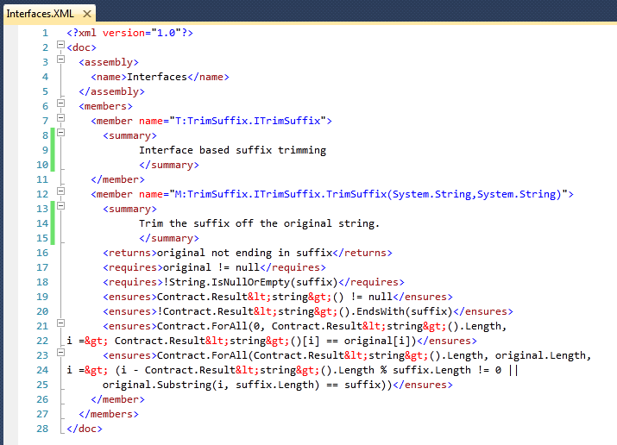
Documentation Generation
ccdocgen augments XML doc file with contract elements
Enables any other tool to read them
XSLT patches for Sandcastle prototyped

Slide 51
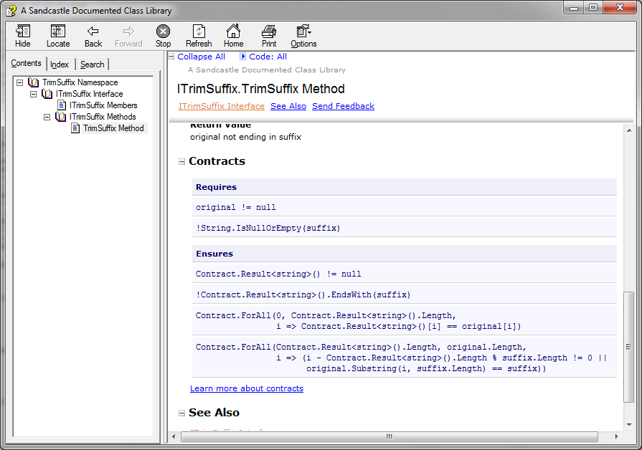
Doc Generation with Sandcastle

Slide 52
Static Checker Design
Abstract interpretation (rather than WP theorem proving)
More automation (loop invariants, post-conditions)
More control over precision/speed tradeoff
Research in Abstract Domains
Sub-polyhedra
Array partitions (with P. Cousot)

Slide 53
Static Checker Architecture
Requires and Ensures Inference
Abstract Interpreters
Backward
analysis
Proof-obligations
Non-null
Contracts
Non-null
Arrays
Pointers
Arrays
Pointers
Abstract Domains
Strings
Numeric
Symbolic
Fix-point Engine
String
Expression refinement
Used in conditionals and transfer functions
Expression IL (expression recovery)
Similar to SSA form
Suitable for Abstract Interpretation
Old eliminated
Scalar program (heap eliminated)
Temp IL (stack eliminated)
requires/ensures/invariant are subroutines
spliced in where needed
Subroutines (method, finally, contracts)
MSIL+ (assert, assume, old, ldstack, …)
Turns calls into primitives
Contract Extractor + CFG Builder
.NET Assembly Reader

Slide 54
Pros and Cons of IL Verification
Pros
Relatively small language of instructions
Well-specified semantics
Type/name/overloading resolution done by compiler
Targeted by multiple languages (C#,VB,F#,…)
Cons
Some expression recovery needed
or abstract domains get too complicated (CC’08)
Source context not precise enough (from pdb’s)
Abstractions are lost / some need to be recovered
Closures, Iterators, etc…

Slide 55
Abstract Interpretation (on 1 slide)
Abstract states
Abstract step
x++
x < y
x <= y
Abstraction
Concretization
Soundness
Concrete states
x = 1
y = 10
Concrete step
x = 2
y = 10
x = 0
y = 1
x = 1
y = 1
x++
x = 100
y = 200
x = 101
y = 200
…
…

Slide 56
Scalar Programs
Control-flow graphs
Passive form (SSA) assumptions
sv2 == sv0 + sv1
Composed of tree fragments
Assignments at tree boundaries (renaming)
Suitable for
Abstract Interpretation
Weakest Preconditions

Slide 57
MSIL+
Analyzed code is MSIL+
Stack machine
All requires/ensures/invariant calls turn into
assume
assert
Extra synthetic instructions
begin_old
end_old
ldstack.i
ldresult
scall subroutine

Slide 58
Contract Subroutines
int Increment(int i) {
Contract.Requires(i > 0);
Contract.Ensures(Contract.Result<int>() == i+1);
return i+1;
}
Subroutine : Increment.requires
ldarg.1 // i
ldc 0
cgt
assume
Subroutine : Increment.ensures
ldresult
begin_old
ldarg.1 // i
end_old
ldc 1
add
ceq
assert

Slide 59
Subroutines and Inheritance
B.Inc.Req
B.Inv
B.Inc
B.Inc.Ens
D.Inv
D.Inc
D.Inc.Ens

Slide 60
Contract Subroutines at Call Sites
B.Inc.Req
B.Inv
B.Inc.Ens
call D.Inc
D.Inv
D.Inc.Ens

Slide 61
Dealing with Disjunctions
M(int y) {
Contract.Ensures( y < 0 && result <= 0 ||
y >= 0 && result >= 0);
int x = 0;
int oldy = y;
while (y != 0) {
Contract.Assert( oldy < 0 && x <= 0 ||
oldy > 0 && x >= 0 );
if (y < 0) { if (*) x--; y++; }
else { if (*) x++; y--; }
}
return x;
}

Slide 62
Dealing with Disjunctions (2)
No disjunctions in abstract invariants
Prove assertions via (weakest) precondition backward path
assert y0 < 0 ⇒ x0 <= 0 √
assert y0 < 0 ⇒ x4 <= 0
assert x4 <= 0
assert b0

Slide 63
Dealing with Disjunctions (2)
No disjunctions in abstract invariants
Prove assertions via weakest precondition backward path
assert y0 < 0 /\ x4 <= 0 ⇒ x4 - 1 <= 0 √
assert y0 < 0 ⇒ x5 - 1 <= 0
assert y0 < 0 ⇒ x3 <= 0
assert y0 < 0 ⇒ x4 <= 0
assert x4 <= 0
assert b0

Slide 64
Experience
Downloads
>15000, 12 months
Active Forum
Useful feedback
Testing effort
Contexts
C#, VB, ASP.NET, Silverlight, Azure, Mobile 7
Internal adoption slow but increasing
Main stumbling block:
Migration from current argument validation practice

Slide 65
Conclusion
Code as Contracts is a viable approach
Many advantages over attributes, comment syntax, or custom language
Standard representation not tied to tools
Executable contracts important
Finds errors in specifications
Immediate value to programmer
http://research.microsoft.com/contracts

Slide 66
Moving Forward
Contract Authoring/API stable
Need to write contracts for existing libraries
Runtime Checking
Complete a few functionality loose ends (abbrevs)
Support language specific idioms
Stability testing
Build integration (standard, CoreXT done)
Documentation Generation
Prototyped
Need decompiler into multiple languages
VS2010 Adornments being prototyped
Interface contracts
Intellisense
Static Verifier needs work
Re-architecting for Z3 integration

Slide 67
Questions?
Internal
http://codebox/contracts
External
http://msdn.microsoft.com/devlabs/dd491992.aspx
Mail
mailto:maf mailto:mbarnett mailto:logozzo

