Slide 1
Our experience with the CodeContracts static checker
Francesco Logozzo
with M. Fahndrich, M. Barnett

Slide 2
CodeContracts?
Specify code with code
Advantages
Language agnostic
No new language/compiler …
Leverage existing tools
IDE, Compiler …
Disadvantages
Lost beauty
public virtual int Calculate(object x) {
Contract.Requires(x != null);
Contract.Ensures(Contract.Result<int>() >= 0);

Slide 3
CodeContracts tools
Documentation generator
MSDN-like documentation generation
VS plugin – tooltips as you write
Runtime checking
Postconditions, inheritance …
Via binary rewriting
Static checking
Based on abstract interpretation
This talk!!!!

Slide 4
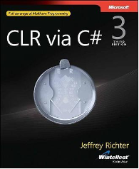
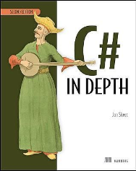
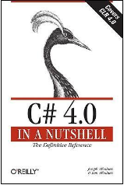
CodeContracts impact
API .NET standard
Externally available
> 55,000 downloads
Active forum (>1,500 threads)
Book chapters, blogs …
Internal and External adoption
Mainly professional
A few university courses
Publications, talks, tutorials
Academic, Programmers conferences

Slide 5
Let’s demo!

Slide 6
Why abstract interpretation?
Traditional verification workflow
Verification tool based on
Weakest preconditions
Symbolic execution
Model checking
Code
Verify
Fix

Slide 7
Fix the code?
Understand the warnings
Add missing specifications
Pre/Post-conditions, Object/Loop invariants
Assumptions
Environment, external code, OS …
Verifier limits
Incompleteness….
Fix bugs?
Tough task verifying a program with bugs…
Tedious and expensive process

Slide 8
Reality is a little bit different
New features, regressions, refactoring …
Help programmer, not drown her
“Verification” is only one facet
Should support correct SW development
Code
Verify
Fix the code

Slide 9
Why Abstract interpretation?
Focus on properties of interest
Few programmers interested in ∀∃∀…
Null dereferences a lot more relevant!
Programmer friendly, Tunable, Precise
Easy to explain what’s wrong
Properties known ahead of time
“Reverse engineered” by some users
Infer, not deduce or search
Loop invariants, contracts, code fixes …

Slide 10

The power of inference
Annotations
public int Max(int[] arr)
{
var max = arr[0];
for (var i = 1; i < arr.Length; i++)
{
var el = arr[i];
if (el > max)
max = el;
}
return max;
}
public int Max(int[] arr)
{
Contract.Requires(arr != null);
Contract.Requires(arr.Length > 0);
Contract.Ensures(Contract.ForAll(0, arr.Length, j => arr[j] <= Contract.Result<int>()));
Contract.Ensures(Contract.Exists(0, arr.Length, j => arr[j] == Contract.Result<int>()));
var max = arr[0];
for (var i = 1; i < arr.Length; i++)
{
Contract.Assert(1 <= i);
Contract.Assert(Contract.ForAll(0, i, j => arr[j] <= max));
Contract.Assert(Contract.Exists(0, i, j => arr[j] == max));
var el = arr[i];
if (el > max)
max = el;
}
return max;
}
public int Max(int[] arr)
{
var max = arr[0];
for (var i = 1; i < arr.Length; i++)
{
var el = arr[i];
if (el > max)
max = el;
}
return max;
}
Clousot

Slide 11
Code Repairs
int BinarySearch(int[] array, int value)
{
Contract.Requires(array != null);
var inf = 0;
var sup = array.Length - 1;
while (inf <= sup)
{
var index = (inf + sup) / 2;
var mid = array[index];
if (value == mid) return index;
if (mid < value) inf = index + 1;
else sup = index - 1;
}
return -1;
}
Exploit the inferred loop invariant
Clousot

Slide 12

Scaling up
Real code bases are huge
Turns out they were ~700K methods
Overloads, automatically generated
Analysis took 43h on a Xeon
Output: 116Mb text file
Cache file: 610Mb
Found new bugs

Slide 13
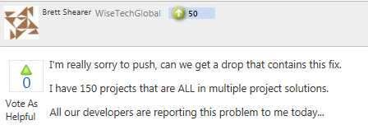
Scaling up
Real code bases are huge
Should cope with it
Myths:
“I am modular, hence I scale up”
“I analyze in < 1sec, hence I scale up”

Slide 14
Clousot on the huge assembly
No inter-method inference
Quadratic in #methods
Why???
GC?
DB?
If the app runs long enough, the GC/DB complexity matters
Intra-method can be costly
Nested loops, goto …
#methods

Slide 15
Scaling up: Our experience
Avoid complexity
∀costly corner case, ∃user who will hit it
Be incremental
Analysis time should be proportional to changes
Reduce annotation overhead
Avoid boredom of trivial annotations
Save programmer time
Prioritize
Not all the warnings are the same…

Slide 16

Clousot Overview
Inference
Reporting
Checking
CIL
C#
VB
F#
X++
…

Slide 17
Clousot Main Loop
Read Bytecode, Contracts
∀assembly, ∀module, ∀type, ∀method
Collect the proof obligations
Analyze the method, discover facts
Check the facts
Report outcomes, suggestions , repairs
Propagate inferred contracts

Slide 18
Examples of Proof Obligations
public int Div(int x, int y)
{
return x / y;
}
y != 0
x != MinValue || y != -1
public int Abs(int x)
{
Contract.Ensures(Contract.Result<int>() >= 0);
return x < 0 ? -x : x;
}
result >= 0
x != MinValue

Slide 19
Proof obligations collection
In theory, collect all the proof obligations
Language: non-null, div-by-0, bounds …
User supplied: contracts, assert …
In practice, too many language obligations
Non-null, div-by-0, various overflows, array/buffer overruns, enums, floating point precision ….
Let the user chose and focus

Slide 20
Clousot Main Loop
Read Bytecode, Contracts
∀assembly, ∀module, ∀type, ∀method
Collect the proof obligations
Analyze the method, discover facts
Check the facts
Report outcomes, suggestions , repairs
Propagate inferred contracts

Slide 21
Static Analysis
Goal: Discover facts on the program
Challenges:
Precise analysis of IL
Compilation lose structure
Which properties are interesting?
Which abstract domains should we use?
How we make them practical enough?
Performance
Usability
E.g. No templates

Slide 22
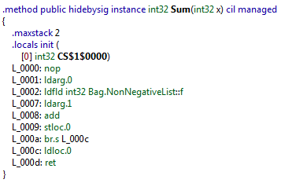
Precise IL Analysis
private int f;
int Sum(int x) {return this.f + x;}
s0 = ldarg this
s0 = ldfld Bag.NonNegativeList.f s0
s1 = ldarg x
s0 = s0 Add s1
nop
ret s0
De-Stack
Compiled
sv11 (13) = ldarg this
sv13 (15) = ldfld Bag.NonNegativeList.f sv11 (13)
sv8 (10) = ldarg x
sv22 (24) = sv13 (15) Add sv8 (10)
ret (sv13 (15) Add sv8 (10))
sv11 (13) = ldarg this
sv13 (15) = ldfld Bag.NonNegativeList.f sv11 (13)
sv8 (10) = ldarg x
sv22 (24) = sv13 (15) Add sv8 (10)
ret sv22 (24)
De-Heap
Exp. recovery

Slide 23
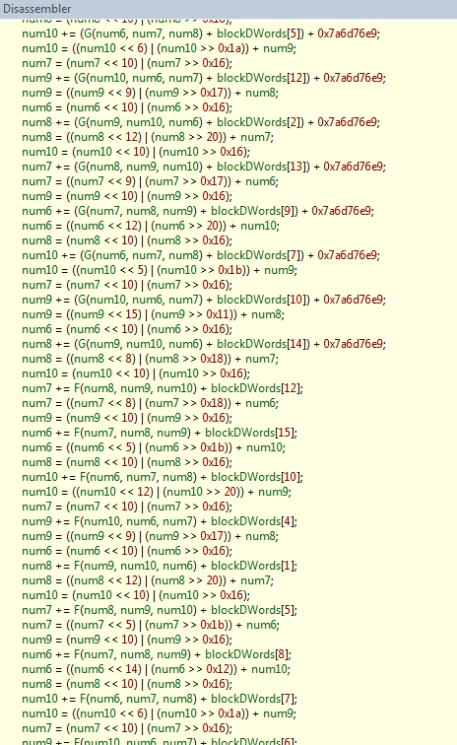
Expression Recovery is lazy
MDTransform in mscorlib.dll
9000 straight line instructions

Slide 24
Which Abstract Domains?
Which properties?
Exploratory study inspecting BCL sources
Existing parameter validation
Mainly Non-null, range checking, types
Types no more issue with Generics introduction
Well studied problems
Plenty of numerical abstract domains
Intervals, Octagons, Octahedra, Polyhedra …
Problem solved??

Slide 25
Myth
“For NaN checking only one bit is required!“
public double Sub(double x, double y)
{
Contract.Requires(!Double.IsNaN(x));
Contract.Requires(!Double.IsNaN(y));
Contract.Ensures(!Double.IsNaN(Contract.Result<double>()));
return x - y;
}
-∞ -∞ = NaN

Slide 26
Myth (popular in types)
“I should prove x != null, so I can simply use a non-null type system”
public void NonNull()
{
string foo = null;
for (int i = 0; i < 5; i++)
{
foo += "foo";
}
Contract.Assert(foo != null);
}
Need numerical information to prove it!

Slide 27
Numerical Abstract domains
0 ≤ index < array.Length?
Intervals
O(n)
a ≤ x ≤ b
No ☹
Pentagons
O(n)
a≤ x ≤ b & x <y
Yes ☺
Octagons
O(n³)
± x ± y ≤ a
Yes ☺
Polyhedra
O(2^{n})
Σ a_{i}x_{i} ≤ b
Yes ☺

Slide 28
Numerical domains in Clousot
Numerical information needed everywhere
Ranges, enums, ∀/∃, contracts, code repairs …
Core of Clousot
Several new numerical abstract domains
DisIntervals, Pentagons, SubPolyhedra …
Infinite height, no finite abstraction
Combined by reduced product
Incremental application
Validated by experience

Slide 29
∀/∃ abstract domain
Instance of FunArray (POPL’11)
Discover collection segments & contents
public int Max(int[] arr)
{
var max = arr[0];
for (var i = 1; i < arr.Length; i++)
{
var el = arr[i];
if (el > max) max = el;
}
return max;
}
{0} | <= max, ∃= max | {i} | Top | {arr.Length}? | i ∈ [1,+∞)
Compact for:
∀ j. 0≤ j < i: arr[j] ≤ max ∧
∃ k. 0 ≤ k <i: a[k] = max ∧
i ≤ arr.Length ∧
1≤ i

Slide 30
Other abstract domains
Heap, un-interpreted functions
Optimistic parameter aliasing hypotheses
Non-Null
A reference is null, non-null, non-null-if-boxed
Enum
Precise tracking of enum variables (ints at IL)
Intervals of floats, actual float types
To prove NaN, comparisons
Array purity
…

Slide 31
Clousot Main Loop
Read Bytecode, Contracts
∀assembly, ∀module, ∀type, ∀method
Collect the proof obligations
Analyze the method, discover facts
Check the facts
Report outcomes, suggestions, repairs
Propagate inferred contracts

Slide 32
Checking
For each proof obligation 〈 pc, ϕ 〉
Check if Facts@pc ⊨ ϕ
Four possible outcomes
True, correct
False, definite error
Bottom, assertion unreached
Top, we do not know
In the first 3 cases we are happy

Slide 33
Why Top?
The analysis is not precise enough
Abstract domain not precise
Re-analyze with more precise abstract domain
Algorithmic properties
Implementation bug
Incompleteness
Some contract is missing
Pre/Postcondition, Assumption, Object-invariant
The assertion is sometimes wrong (bug!)
Can we repair the code?

Slide 34
Dealing with Top
Every static analysis has to deal with Tops
a.k.a. warnings
Just report warnings: overkilling
Explain warnings: better
Still expensive, programmer should find a fix
Ex. no inter-method inference:
Checked 2 147 956 assertions: 1 816 023 correct 331 904 unknown 29 false
Inspecting 1 warning/sec, 24/24: 230 days
Suggest code repairs: even better
But, there still we be warnings: rank & filter

Slide 35
Clousot Main Loop
Read Bytecode, Contracts
∀assembly, ∀module, ∀type, ∀method
Collect the proof obligations
Analyze the method, discover facts
Check the facts
Report outcomes, suggestions, repairs
Propagate inferred contracts

Slide 36
Precondition inference
What is a precondition?
{P} C {Q}
So we have a solution?
{wp⟦C⟧Q} C {Q}
WP rule out good runs
Loops are a problem
Loop invariant ⇒ No “weakest” precondition
Inference of sufficient preconditions
public static void WPex(int[] a)
{
for (var i = 0; i <= a.Length; i++)
{
a[i] = 11;
if (NonDet()) return;
}
}

Slide 37
Necessary conditions
Our approach: Infer necessary conditions
Requirements
No new run is introduced
No good run is eliminated
Therefore, only bad runs are eliminated
Analyses infer 𝔹_{pc} , necessary condition at pc
If 𝔹_{pc} does not hold at pc, program will crash later
𝔹_{entry} is necessary precondition
Leverage them to code repairs

Slide 38
Verified Code Repairs
Semantically justified program repair
Contracts
Pre/post-conditions, object invariants inference
Bad initialization
Guards
Buffer overrun
Arithmetic overflow
…
Inferred by static analysis
Extracted by abstract states

Slide 39
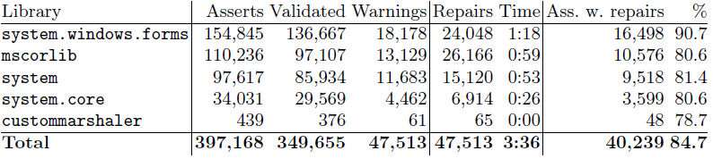

Some data
Un-annotated libraries
Suggest a repair >4/5 of times
If applied, precision raises 88%→98%
Precision: % of validated assertions
Annotated libraries: usually ~100%

Slide 40
And for the other Tops?
Make buckets
Related warnings go together
Rank them
Give each warning a score
f(Outcome, warning kind, semantic info)
Enable suppression via attribute
Particular warning, family of warnings
Preconditions at-call, object invariants
Inherited postconditions
…

Slide 41
Static Analysis is still incomplete!
public void TwoWaySortInlined(bool[] a)
{
Contract.Requires(a != null);
int i = 0, j = a.Length - 1;
while (i <= j)
{
var dist = j - i;
if (!a[i]) { i++; }
else if (a[j]) { j--; }
else
{
Contract.Assume(i < j);
var tmp = a[i];
a[i] = a[j];
a[j] = tmp;
i++;
j--;
}
Contract.Assert(dist >= 0);
Contract.Assert(dist > (j - i));
}
Contract.Assert(Contract.ForAll(0, i, indx => !a[indx]));
Contract.Assert(Contract.ForAll(j + 1, a.Length, indx => a[indx]));
}
Infer loop invariant
Add assumption: incomplete reduction
Auxiliary var for termination
Prove assert

Slide 42
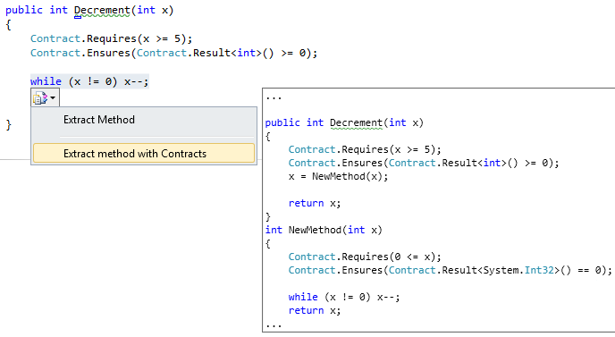
More?
Integrate in Roslyn CTP
Design time warnings, fixes, semantic refactoring, deep program understanding

Slide 43
Conclusions
“Verification” only a part of the verified software goal
Other facets
Scalable & incremental
Programmer support & aid
Inference
Automatic code repairs
IDE support
Refactoring, focus verification efforts
Try Clousot today!
Thanks!!!
M. Bouaziz, P.& R. Cousot, P. Ferrara, J.-H. Jourdan, V. Laviron, M. Peron,
H. Venter

