Slide 1
Towards a Semantic Program Development Environment
Francesco Logozzo

Slide 2
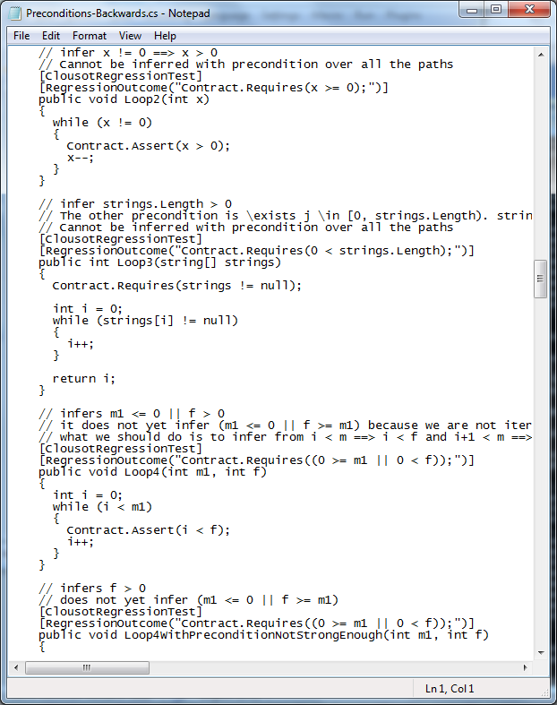
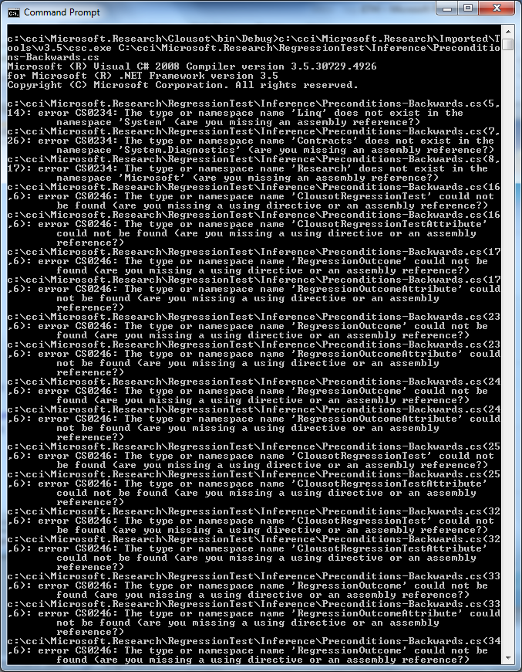
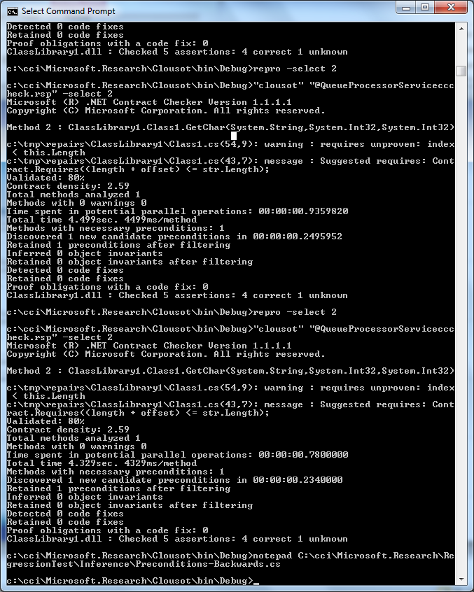
Program Development: The Theory
Write
Compile
Run

Slide 3
Program Development: The reality
Write
“Should I close the ‘{‘ ?”
“Is this a constant or a variable?”
“Which is the name of that constant?”
“Which parameters should I pass?”
…

Slide 4
Program Development: The reality
Compile
“Which is the compiler switch to optimize?”
“How do include this library?”
“Where is this library?”
“What is this obscure linker error?”
….

Slide 5
Program Development: The reality
Run
Segmentation fault
Division by zero
“does the wrong thing”
“does nothing”
“hangs forever”
Stack overflow
…
Everything works fine!
And so what?

Slide 6
A quick, personal history of IDE evolution

Slide 7
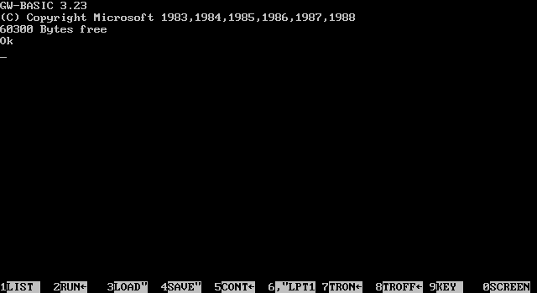
The beginning: GW-Basic
Very, very short experience…

Slide 8
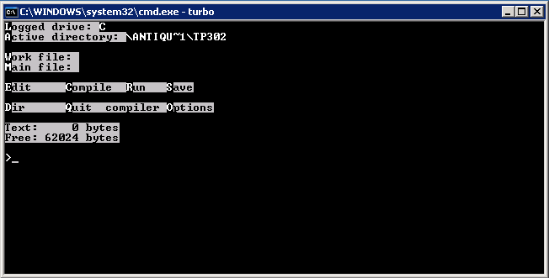
Next: Turbo Pascal 3.02
Write & Compile & Run integrated!

Slide 9
Pascal vs. Basic
Pascal is a way better language
Procedural
Nice syntax, type system
Compiler (in memory/disk)
…
Was it really important?
Not really, the IDE was more relevant

Slide 10
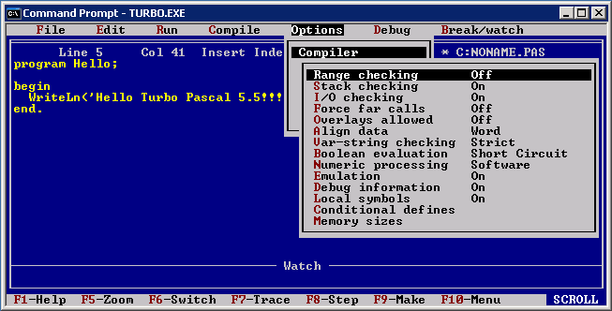
Next: Turbo Pascal 5.5
Debugger, Tracing, Compiler options

Slide 11
Turbo Pascal 3 vs Turbo Pascal 5.5
Turbo Pascal 5.5 was a major update
Introduction of Object Pascal
Was it relevant? Not really
The IDE (and the libraries) more important
Multi file
Advanced compiler options
Powerful debugger

Slide 12
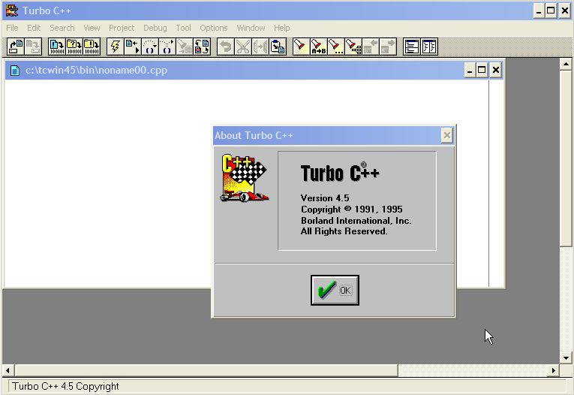
Borland Turbo C++
Windows v3.0 has arrived

Slide 13
Pascal vs C/C++
C/C++ was not a better language
More low level
Many more errors in my programs
Strings, null pointers, memory leaks, array accesses …
Worse library
However, easier to develop Windows apps
Why? Better IDE…
i.e. Syntax highlighting

Slide 14
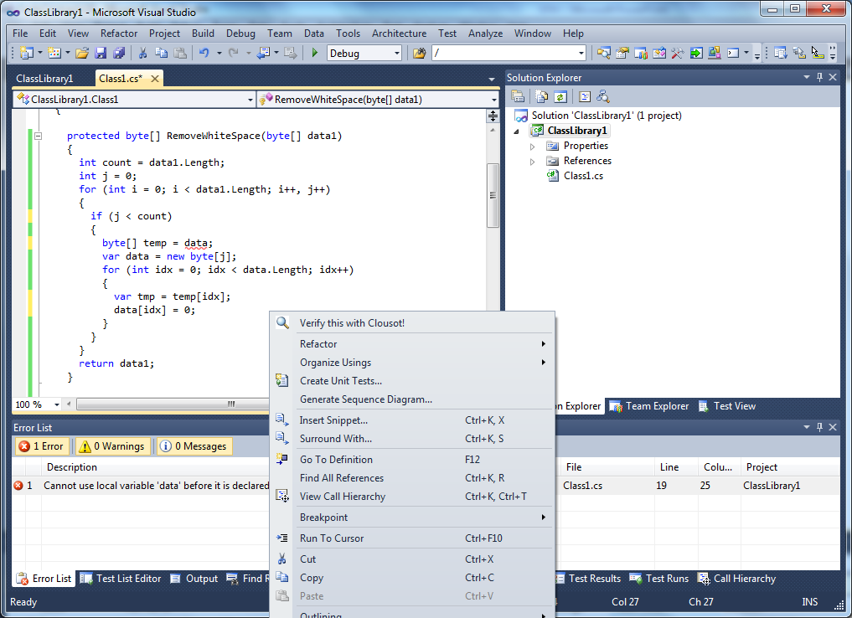
Fast forward: 2012
Write, Compile, Run …

Slide 15
Visual Studio 2010
Write
Syntax highlighting, Intellisense, Refactoring …
Object browser, Architecture views …
Dependencies
Compile
Many languages/platforms
C, C++,C#,VB, JavaScript… / Windows, .NET, WEB …
Run
Integrated debugger, Intellitrace, locals view …

Slide 16
Can we improve the IDEs?

Slide 17
What should we improve?
User Interface?
Maybe, but not in today’s talk
Tools?
Yes, definitely
Why? Which tools?
Need semantic program understanding
To improve the programming experience
Fewer bugs, design-time correctness, better search …

Slide 18
Programming languages
Should instead we start from the language?
Monumental research in PL design
Imperative, functional, logic, oo …
Typed/ untyped, compiled/interpreted …
Contracts/no-contracts
Parallel, distributed …
…
Reality:
Very little research moved into real world
Tools more important than the language?

Slide 19
Dream: Program Verification
Verify correctness statically in the IDE
What should we verify?
Specification?
How?
Which technology?
Code
Verify
Fix
Bugs

Slide 20
Specification via Contracts
Document code behavior
Pre/post-conditions, object invariants
Many research attempts
JML, Spec# …
Few successful industrial applications
Eiffel, Spark
CodeContracts

Slide 21
CodeContracts?
Specify code with code
Advantages
Language agnostic
No new language/compiler …
Leverage existing tools
IDE, Compiler …
Disadvantages
Lost beauty
public virtual int Calculate(object x) {
Contract.Requires(x != null);
Contract.Ensures(Contract.Result<int>() >= 0);
Extend the language, without changing the language!

Slide 22
CodeContracts tools
Documentation generator
MSDN-like documentation generation
VS extension – tooltips as you write
Runtime checking
Postconditions, inheritance …
Via binary rewriting
Static checking
Based on abstract interpretation

Slide 23
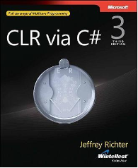
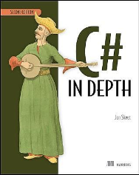
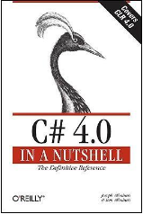
CodeContracts impact
API .NET standard
Externally available
> 60,000 downloads
Active forum (>1,500 threads)
Book chapters, blogs …
Internal and External adoption
Mainly professional
A few university courses
Publications, talks, tutorials
Academic, Programmers conferences

Slide 24
CodeContracts in VS2010: Towards a more semantic IDE

Slide 25

How it works?
Command Line
Dev{9,10,11}
Roslyn
Warnings report
Code repairs
Contracts Propagation
Assertion checking
Abstract Interpretation
Facts Discovery
IL, Contract Reader
CCI1
CCI2
Roslyn

Slide 26
Example: Array analysis
public void Init(int[] a)
{
Contract.Requires(a.Length > 0);
var j = 0;
while (j < a.Length)
{
a[j] = 11;
j++;
}
}
{0} | Top | {a.Length}?
Segment limits
Segment abstraction
Possibly
empty segment
P. Cousot, R. Cousot, F. Logozzo, A Parametric Segmentation Functor for Fully Automatic and Scalable Array Content Analysis, ACM POPL’11

Slide 27
‘?’ Removal
public void Init(int[] a)
{
Contract.Requires(a.Length > 0);
var j = 0;
while (j < a.Length)
{
a[j] = 11;
j++;
}
}
{0} | Top | {a.Length}
Remove doubt

Slide 28
Constant Assignment
public void Init(int[] a)
{
Contract.Requires(a.Length > 0);
var j = 0;
while (j < a.Length)
{
a[j] = 11;
j++;
}
}
{0,j} | Top | {a.Length} | j:[0,0]
∞
Record j = 0
Scalar variables abstraction
(omit a.Length ∈ [1, +∞))

Slide 29
Test
public void Init(int[] a)
{
Contract.Requires(a.Length > 0);
var j = 0;
while (j < a.Length)
{
a[j] = 11;
j++;
}
}
{0,j} | Top | {a.Length} | j:[0,0]

Slide 30
Array assignment
public void Init(int[] a)
{
Contract.Requires(a.Length > 0);
var j = 0;
while (j < a.Length)
{
a[j] = 11;
j++;
}
}
{0,j} | [11, 11] | {1, j+1} | Top | {a.Length}? | j:[0,0]
Materialize segment
Introduce ‘?’

Slide 31
Scalar Assignment
public void Init(int[] a)
{
Contract.Requires(a.Length > 0);
var j = 0;
while (j < a.Length)
{
a[j] = 11;
j++;
}
}
{0,j-1} | [11, 11] | {1,j} | Top | {a.Length}? | j:[1,1]
Replace j by j-1

Slide 32
Join
public void Init(int[] a)
{
Contract.Requires(a.Length > 0);
var j = 0;
while (j < a.Length)
{
a[j] = 11;
j++;
}
}
{0,j} | Top | {a.Length} | j:[0,0]
{0,j-1} | [11, 11] | {1, j} | Top | {a.Length}? | j:[1,1]

Slide 33
Segment unification
Unify the segments
Point-wise join
Similar for order, meet and widening
{0,j} | Top | {a.Length}
{0,j-1} | [11, 11] | {1,j} | Top | {a.Length}?
{0} | ⊥ | {j}? | Top | {a.Length}
{0} | [11, 11] | {j} | Top | {a.Length}?
{0} | [11, 11] | {j}? | Top | {a.Length}?
Notes:
Francesco: say ⊥ is the neutral element for the operation

Slide 34
After the first iteration
public void Init(int[] a)
{
Contract.Requires(a.Length > 0);
var j = 0;
while (j < a.Length)
{
a[j] = 11;
j++;
}
}
{0} | [11, 11] | {j}? | Top | {a.Length}? | j ∈ [0,1]

Slide 35
Test
public void Init(int[] a)
{
Contract.Requires(a.Length > 0);
var j = 0;
while (j < a.Length)
{
a[j] = 11;
j++;
}
}
{0} | [11, 11] | {j}? | Top | {a.Length} | j ∈ [0,1]
Remove ‘?'

Slide 36
Array assignment
public void Init(int[] a)
{
Contract.Requires(a.Length > 0);
var j = 0;
while (j < a.Length)
{
a[j] = 11;
j++;
}
}
{0} | [11,11] | {j}? | [11,11] | {j+1}? | Top | {a.Length}? | j ∈ [0,1]

Slide 37
Scalar assignement
public void Init(int[] a)
{
Contract.Requires(a.Length > 0);
var j = 0;
while (j < a.Length)
{
a[j] = 11;
j++;
}
}
{0} | [11,11] | {j-1}? | [11,11] | {j}? | Top | {a.Length}? | j ∈ [1,2]

Slide 38
Widening
public void Init(int[] a)
{
Contract.Requires(a.Length > 0);
var j = 0;
while (j < a.Length)
{
a[j] = 11;
j++;
}
}
{0} | [11, 11] | {j}? | Top | {a.Length}? | j ∈ [0,1]
{0} | [11,11] | {j-1}? | [11,11] | {j}? | Top | {a.Length}? | j ∈ [1,2]

Slide 39
Fixpoint
public void Init(int[] a)
{
Contract.Requires(a.Length > 0);
var j = 0;
while (j < a.Length)
{
a[j] = 11;
j++;
}
}
{0} | [11, 11] | {j}? | Top | {a.Length}? | j ∈ [0,+∞)

Slide 40
Reduction
public void Init(int[] a)
{
Contract.Requires(a.Length > 0);
var j = 0;
while (j < a.Length)
{
a[j] = 11;
j++;
}
// here j ≥ a.Length
}
{0} | [11, 11] | {j}? | Top | {a.Length}? | j ∈ [0,+∞)
Remove the empty segment
{0} | [11, 11] | {j, a.Length} | j ∈ [1,+∞)

Slide 41
Clousot
Different from usual contract checkers
No wp, use abstract interpretation
Focus on some common properties
More than a static checker
Infers deep semantics properties
Use them to prove correctness, suggest repairs
Repairs semantically justified
Enables the scenario of Semantic IDE
Help the programmer, do not drown her

Slide 42
Semantic IDE Demo!

Slide 43
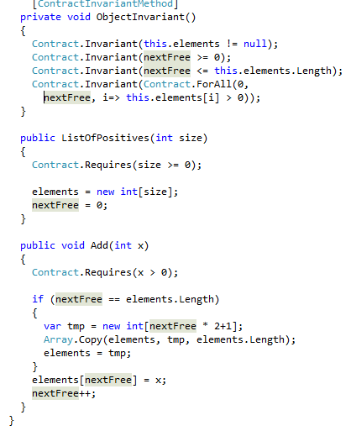
How it works?
Query
Driver
Semantic engine
(Clousot)
Issues
Repairs
Provider₁
Refactorings
…
Queries
Provider_{n}
Answers

Slide 44
Verified repairs
Goal: Provide code repairs at design time
Also: Static and verified repairs
What is a code repair?
In general, human dependent
Our definition: a code repair
Increase the number of good runs
Decreases the number of bad runs

Slide 45
Example: Overflow repairs
Input:
Possibly overflowing expression exp
(Inferred) Abstract state before exp
Output:
Expression exp’
Properties:
exp’ non-overflowing
exp’ equivalent on Z to exp

Slide 46
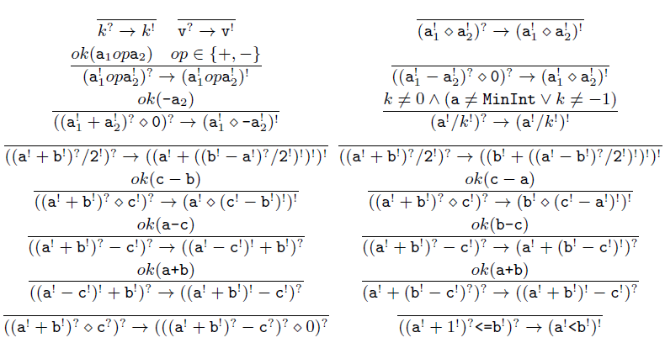
Algorithm

Slide 47
Semantic extract method
Goal:
Extract methods with contracts
Constraints:
Soundness
Contracts should be valid for the extracted method
Safety
Contracts should be ensure extracted method safety
Completeness
The original method is still provable
Generality
Extracted contracts are as general as possible

Slide 48
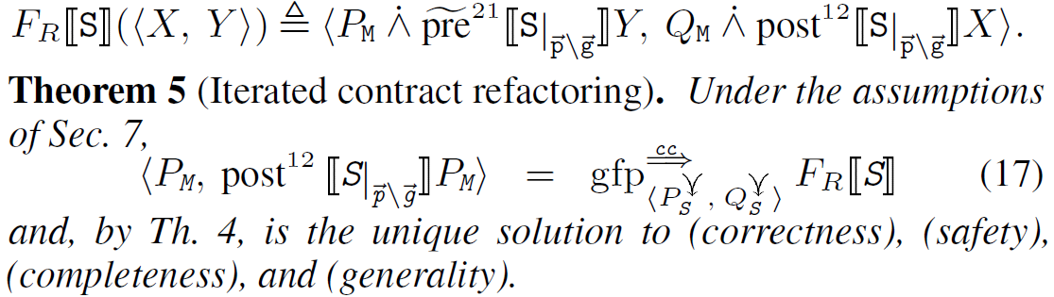
Results
There exists only 1 solution to the problem
Computable under finiteness hypotheses
Types, Model checking or deductive verification
Otherwise abstract the iterative schema:
Implemented in our semantic IDE

Slide 49
More?
Semantic search
“Where is this method called with x < 0?”
“Which override violates the postcondition?”
Test/Static analysis Integration
“Which methods have most warnings and smaller coverage?”
Versioning
“Who first introduced a warning in this class?”
Repetitive code synthesis
…

Slide 50
Conclusions

Slide 51
Overall
IDEs progressed
From Emacs/Vi to Visual Studio/Eclipse
We have powerful semantic tools
We should integrate them to improve the programming experience
Fewer design-time bugs, automatic and verified code repairs
Integrated program repository and search

