Slide 1
The Smart Programming Assistant
Francesco Logozzo
M. Barnett, M. Fahndrich, T. Ball, S. Lahiri

Slide 2
Demo!

Slide 3
How does it work?

Slide 4
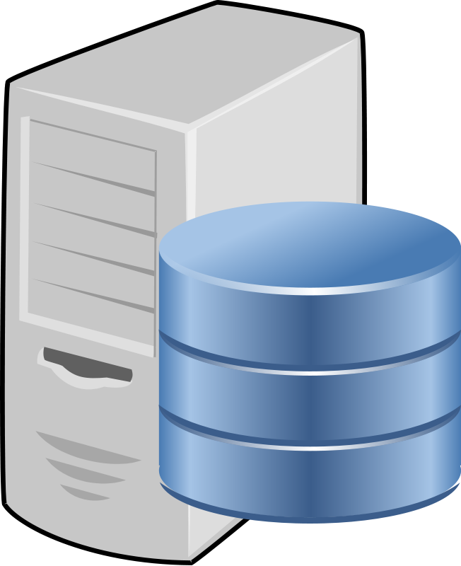
Code Contracts Static checker
Code
Semantic
Inference
Error Checking
Answer queries
Visual Studio/Roslyn
Verified repairs
Pre/Post inference
Semantic baseline
Stored Information

Slide 5
Semantic inference
M. Fahndrich and F. Logozzo, Static contract checking with Abstract Interpretation, FoVeOOS 2010

Slide 6
Code Analysis
Perform deep semantic code analysis
For each program point, infer invariants
Invariants are properties that hold for all possible executions
Based on Abstract Interpretation
Focus on properties of interest
Ex: non-null, linear arithmetic, array contents …
Main Idea: replace concrete values with abstract values
Ex: instead of x : {0, 2, 4, 6, 8, 10} have x : [0, 10] && x is even

Slide 7
Inference
public int BinarySearch(int[] array, int value)
{
Contract.Requires(array != null);
var inf = 0;
var sup = array.Length - 1;
while (inf <= sup)
{
var mid = (inf + sup) / 2;
var midValue = array[mid];
if (midValue < value)
inf = mid + 1;
else if (midValue > value)
sup = mid - 1;
else
return mid;
}
return -1;
}
array != null
inf: [0, MaxValue], sup: [-1, MaxValue), sup < array.Length
inf: [0, 0], sup: [-1, MaxValue), sup < array.Length
inf ≤ sup, sup: [0, MaxValue)
mid: [0, MaxValue), mid ≤ sup, mid < array.Length
inf: [1, MaxValue], sup: [0, MaxValue)
inf:[0, 0], sup: [-1, MaxValue-1), sup < array.Length
inf: [0, MaxValue], sup: [-1, MaxValue), sup < array.Length

Slide 8
Checks
public int BinarySearch(int[] array, int value)
{
Contract.Requires(array != null);
var inf = 0;
var sup = array.Length - 1;
while (inf <= sup)
{
var mid = (inf + sup) / 2;
var midValue = array[mid];
if (midValue < value)
inf = mid + 1;
else if (midValue > value)
sup = mid - 1;
else
return mid;
}
return -1;
}
array != null
0 ≤ array.Length -1 ≤ MaxValue
0 ≤ (inf + sup) ≤ MaxValue
0 ≤ (inf + sup)/2 ≤ MaxValue
array != null
0 ≤ mid
mid < array.Length
0 ≤ mid + 1 ≤ MaxValue
0 ≤ mid - 1 ≤ MaxValue

Slide 9
Error checking
public int BinarySearch(int[] array, int value)
{
Contract.Requires(array != null);
var inf = 0;
var sup = array.Length - 1;
while (inf <= sup)
{
var mid = (inf + sup) / 2;
var midValue = array[mid];
if (midValue < value)
inf = mid + 1;
else if (midValue > value)
sup = mid - 1;
else
return mid;
}
return -1;
}
array != null
array != null
0 ≤ array.Length -1 ≤ MaxValue
inf: [0, MaxValue], sup: [0, MaxValue], sup < array.Length
0 ≤ (inf + sup) ≤ MaxValue
0 ≤ (inf + sup)/2 ≤ MaxValue
0 ≤ (inf + sup) ≤ MaxValue
array != null
0 ≤ mid
mid < array.Length
mid: [0, MaxValue)
0 ≤ mid + 1 ≤ MaxValue
0 ≤ mid - 1 ≤ MaxValue

Slide 10
Verified Code Repairs
F. Logozzo and T. Ball, Modular and Verified Automatic Program Repair, OOPSLA’12

Slide 11
Program analysis and Code repairs
There are three components in program analysis
The program text
The specification, the property to be specified
The analysis result, the semantic knowledge about the program execution
The (usual) verification problem is
“Check that the analysis result guarantees that the program meets its specification"
The (new) verified code repair problem is
“Refine the program using the analysis result so that it meets its specification”
Related, but different than program synthesis

Slide 12
Verified code repairs
Have a semantic notion of repairs
A verified repair reduces the bad runs while increasing the good runs
A good run is one that satisfies the specification
Assertion, precondition, runtime condition …
A bad run is one that violates the specification
Consequences:
When we repair a program we cannot remove any good behavior
There can be multiple, non comparable, repairs
No best repair in general!

Slide 13
Repairs are property-dependent
In static analysis tools, the knowledge is given by the inferred abstract state
The abstract state belongs to some abstract domain
E.g.: linear arithmetic
The abstract domain encodes some property of interest
Idea: An abstract domain should also know how to repair the program
Therefore the verified code repairs depend are property-dependent
E.g., often we cannot repair non-functional bugs like performance

Slide 14
Repairing floats
double f;
void SimpleError(double a, double b)
{
var tmp = a + b;
this.f = tmp;
if (this.f == tmp)
{ … }
}
⊤
f32
f64
fext
The static checker infers
this.f : f64
tmp : fext
Emits warning for precision mismatch
Suggests the verified repair:
tmp = (double)(a + b)
⊥

Slide 15
Repairing overflows
Assume that 0 ≤ x, 0 ≤ y, 0 ≤ z
Then x + y < z may overflow
Exactly, x + y < z in computer precision does not have the same meaning than in ℤ
We derive a non-overflowing expression like that
 | (x! + y!)? < z!
 | as 0 ≤ x, then –x cannot underflow
= | y! < (z! +(– x!)!)?
 | as 0 ≤ z and 0 ≤ x, then z – x cannot underflow
= | y! < (z! +(– x!)!)!

Slide 16
Refactoring with Contracts
P. Cousot, R. Cousot, F. Logozzo, and M. Barnett, An Abstract Interpretation Framework for Refactoring with Application to Extract Methods with Contracts, OOPSLA’12

Slide 17
Extract method
public int Decrement(int x)
{
Contract.Requires(x >= 5);
Contract.Ensures(Contract.Result<int>() >= 0);
while (x != 0) x--;
return x;
}
public int Decrement(int x)
{
Contract.Requires(x >= 5);
Contract.Ensures(Contract.Result<int>() >= 0);
x = NewMethod(x);
return x;
}
private static int NewMethod(int x)
{
while (x != 0) x--;
return x;
}

Slide 18
and the (modular) proof?
public int Decrement(int x)
{
Contract.Requires(x >= 5);
Contract.Ensures(Contract.Result<int>() >= 0);
while (x != 0) x--;
return x;
}
public int Decrement(int x)
{
Contract.Requires(x >= 5);
Contract.Ensures(Contract.Result<int>() >= 0);
x = NewMethod(x);
return x;
}
private static int NewMethod(int x)
{
while (x != 0) x--;
return x;
}
Postcondition: ok
Postcondition
Violation?
No overflow
Possible overflow

Slide 19
Completeness
The verification of the callee should still go through
Counterexample: Valid and safe contract, but not complete
public int Decrement(int x) { Contract.Requires(x >= 5); Contract.Ensures(Contract.Result<int>() >=0); x = NewMethod(x); return x; } | private static int NewMethod(int x) { Contract.Requires(x >= 5); Contract.Ensures(Contract.Result<int>() <= x); while (x != 0) x--; return x; }
Can’t prove ensures
ok

Slide 20
Validity
The inferred contract should be valid
Counterexample:
public int Decrement(int x) { Contract.Requires(x >= 5); Contract.Ensures(Contract.Result<int>() >=0); x = NewMethod(x); return x; } | private static int NewMethod(int x) { Contract.Requires(x >= 5); Contract.Ensures(Contract.Result<int>()==12345); while (x != 0) x--; return x; }
ok
Invalid ensures

Slide 21
Safety
The precondition of the extracted method should advertise possible errors
Counterexample:
public int Decrement(int x) { Contract.Requires(x >= 5); Contract.Ensures(Contract.Result<int>() >=0); x = NewMethod(x); return x; } | private static int NewMethod(int x) { Contract.Ensures(Contract.Result<int>() == 0); while (x != 0) x--; return x; }
ok
Possible overflow

Slide 22
Generality
The inferred contract is the most general satisfying Validity, Safety, and Completeness
Counterexample: Valid, Safe, Complete but not General contract
Requires too strong
public int Decrement(int x) { Contract.Requires(x >= 5); Contract.Ensures(Contract.Result<int>() >=0); x = NewMethod(x); return x; } | private static int NewMethod(int x) { Contract.Requires(x >= 5); Contract.Ensures(Contract.Result<int>() == 0); while (x != 0) x--; return x; }
ok
ok

Slide 23
Our solution
Valid, Safe, Complete, and General contract
public int Decrement(int x) { Contract.Requires(x >= 5); Contract.Ensures(Contract.Result<int>() >=0); x = NewMethod(x); return x; } | private static int NewMethod(int x) { Contract.Requires(x >= 0); Contract.Ensures(Contract.Result<int>() == 0); while (x != 0) x--; return x; }
ok
ok

Slide 24
Results
Theoretical: there exists a unique solution to the problem
En passant: Definition of a more general Hoare Logic, new results!
Algorithm:
Extract the method using Roslyn
Infer Pre, Post using the CodeContracts Static checker
Repeat to fixpoint:
Forward analysis to strengthen the postcondition
Backwards analysis to weaken the precondition

Slide 25
Semantic baselining

Slide 26
Baseline
Reality: Have huge code bases
Static analysis produces many warnings
Should we fix all of them?
Ideally: Show only the new warnings
Problem: What is a “new” warning
Syntactic characterization: too brittle
Define Semantic Baselining

Slide 27
Semantic baseline
1. Extract the correctness conditions from the base program
Sufficient conditions: Under which conditions the program is always correct
Necessary conditions: Under which conditions the program is always incorrect
2. Apply the correctness conditions to the new program
If Sufficient, and a new warning is reported: Introduced new bug
If Necessary, and no warning is reported: Fixed a bug

Slide 28
Current Status

Slide 29
CodeContracts
Contract API part of .NET since v.4.0
Internally
Dynamics: found bugs in the monster .dll (>8Mb)
TSE: CI builds, cache with shared Database, 76 projects
Tools available outside the company
Almost 100K downloads overall
Devlabs, VS Gallery
Active user MSDN forum
7700+ messages

Slide 30
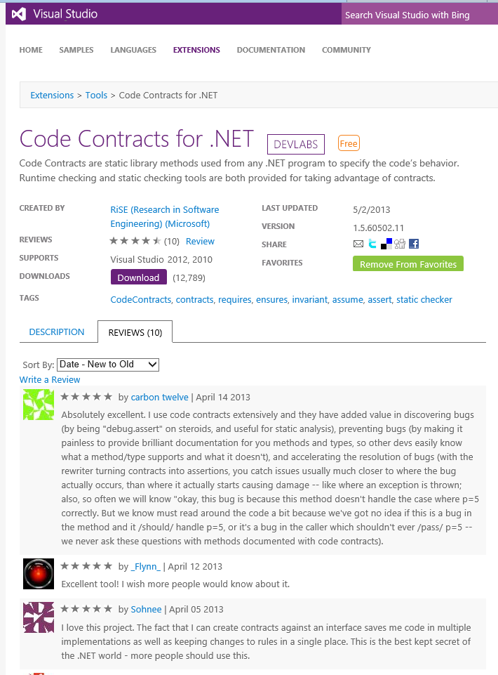
Available in VS Gallery!
More
VS 2012 Integration
Runtime checking
Documentation generation
Less
Post-build static analysis
Scale via team shared SQL DB
No refactoring

