Slide 1
Verification Modulo Versions
Francesco Logozzo
With S. Lahiri, M. Fahndrich, S. Blackshear

Slide 2
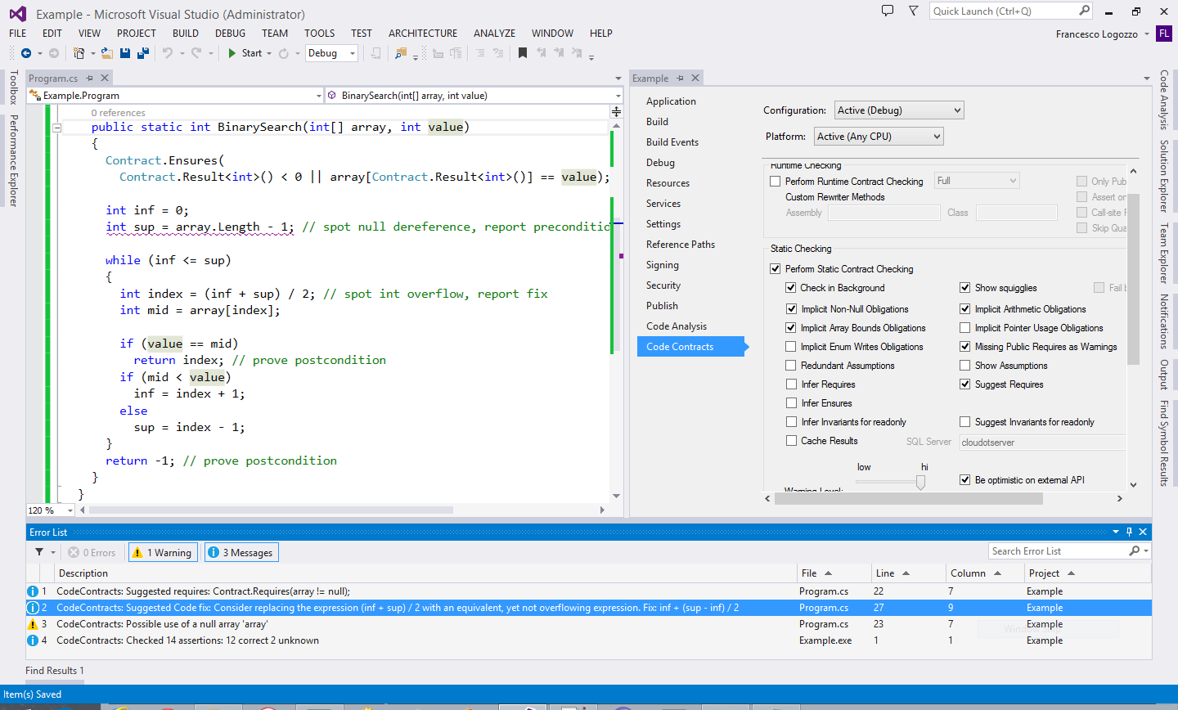
What I did in the last n years?
Language agnostic specifications
Verification for the working programmer
With Abstract Interpretation!
Automatic code fixes

Slide 3
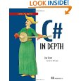

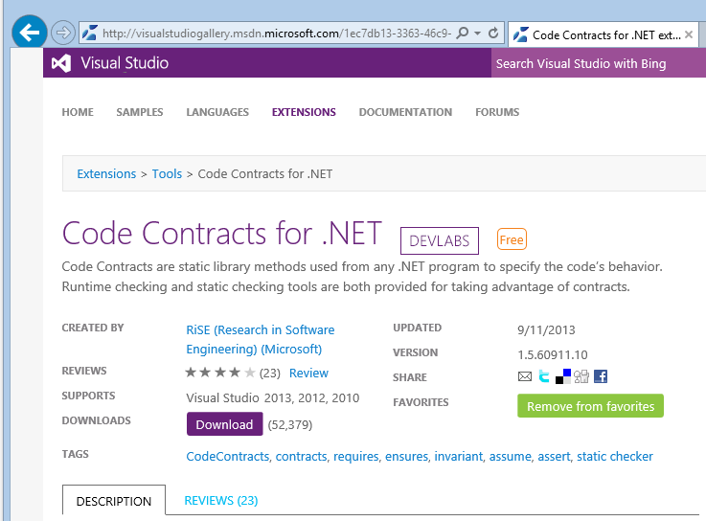
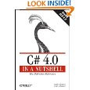
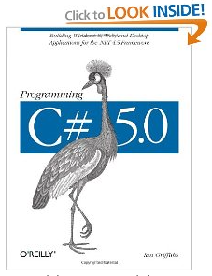
Background: CodeContracts
Internal and external adoption
API in .NET core library
Externally available ~4 years
>120,000 external downloads
> 4,500 internal downloads
4 book chapters on CodeContracts
Many dozens of blog articles
Active forum
> 5,000 messages
State of the art research
Publications, talks, lectures
BUILD, POPL, PLDI, OOPSLA, ECOOP, VMCAI, APLAS, SAS, SAC, FoVeOOS, VSTTE …

Slide 4
Background: Verification
Problem Verification of program P’ produces a long set of alarms
Missing annotations on external APIs, handling of the environment …
Ideal Go over the list of alarms and fix all of them
Fix the code, add annotations …
Reality Fixing all the warnings is just too expensive
Slow convergence to 0 alarms
Dream Only report new warnings introduced in P’
But we already have baseline!
“Francesco why are you wasting our time?”

Slide 5


Baseline?
Syntactic baseline Report the set of alarms Alarms(P’) \ Alarms(P)
Problem How do we match the same assertion in P and P’ ?
Syntactic matching inherently brittle
Mask new assertion
Baseline assertion
Resurrect masked assertion

Slide 6
Syntactic Baseline
Brittle How do we match the assertions in different versions of the program?
Line number, position in the method …
Path to the assertion (Coverity)
…
Inherently unreliable No guarantee whatsoever on the reported/masked warnings
Unsound Masked warning may be a new one
Noisy Reported warning may be an old one

Slide 7
VMV: Verification Modulo Versions
Idea
Extract the semantic environmental conditions E from the base program P
Inject E in the new program P’, to generate P’_{E}
Report alarms from P’_{E}
Questions
What are the properties E?
How do we inject them in P’?
Same problem as syntactic baseline?
Which semantic guarantees do we have on P’_{E} output?
Spoiler alert: We can find regressions or we can have relative proofs

Slide 8
Properties Extraction
Or, What should we extract from the base program?

Slide 9
Extraction from the base program P
We have a base program P
We want to extract some semantic conditions on the environment
Environment: Inputs, external API, etc.
Is this a problem of contract inference?
Not really as our inference is on the client side
We do not have access to the environment
Call to the OS, external input, etc.

Slide 10
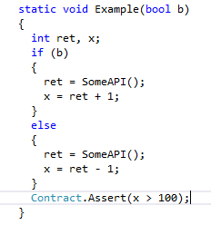
Example
Correctness depends on SomeAPI()
We do not have access to SomeAPI()
Can’t analyze it to infer a postcondition
We want to extract from the usage info on SomeAPI()
What happens if…
ret = 0?
ret = 1000?
ret = 100?
Error!
Good!
Sometimes good sometimes bad

Slide 11
Sufficient conditions
Sufficient condition: guarantees there is no bad execution
May remove some good execution
Can be under-approximated
Weakest Sufficient condition:
ret > 99 ∧ ret > 101
= ret > 101
ret > 99
ret > 101

Slide 12
Necessary conditions
Necessary condition: holds in all the good executions
May not remove all bad executions
Can be over-approximated
Strongest Necessary Condition:
ret > 99 ∨ ret > 101
= ret > 99
ret > 99
ret > 101

Slide 13
Why the difference matters?
Short answer: Because it gives different guarantees semantic on P’_{E}
Spoiler Alert:
Sufficient conditions good for bug-finding
Necessary conditions good fore relative verification
(weakest) Sufficient:
ret > 101
(strongest) Necessary:
ret > 99

Slide 14
How do we inject them?
Or, How do we match different versions?

Slide 15
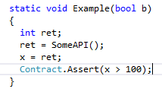
Example
P
P’
How do we match calls?

Slide 16
Matching of program points
P and P’ may be very different
We allow for arbitrary program changes
Avoid or minimize syntactic heuristics
E.g., matching of loop heads, etc.
We keep our framework parametric w.r.t. the syntactic matching
The more precise the matching the more precise the results
The more precise the matching the harder to do it
Our compromise: Match entry points and function calls
Other options in the PLDI’14 paper …

Slide 17
Example: Matching of calls
P
P’
ret > 99
ret > 101

Slide 18
Which Guarantees?

Slide 19
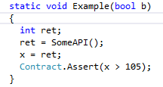
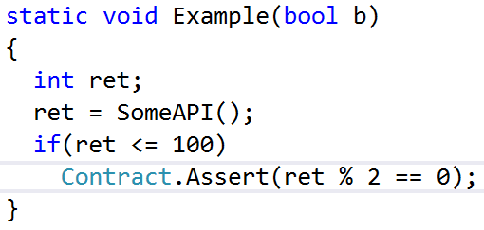
With sufficient conditions: VMV(S)
Found new error!
VMV(S)
ret > 101
Masks new error!

Slide 20
With sufficient conditions VMV(S)
Theorem: Every raised warning is a new warning
New code, Regression …
May mask good warnings
E.g., the inferred condition is too strong
Good for: Bug finding

Slide 21
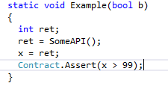
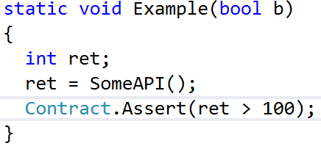
With necessary conditions: VMV(N)
Relative verification!
VMV(N)
ret > 99
Does not suppress all warnings

Slide 22
With necessary conditions VMV(N)
Theorem: Every proven assertion is absolutely or relatively verified
Under the same conditions holding in all good runs of P, P’ is correct
May fail to suppress warnings
E.g., the inferred conditions is too weak
Good for: Relative verification

Slide 23
Results?

Slide 24
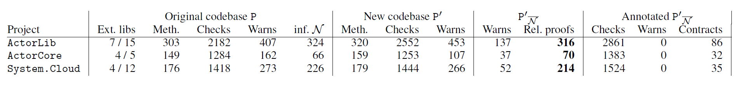
Examples: Azure
Three months among P and P’
VMV(N) dramatically reduces the number of alarms (roughly by 70%)
Still semantic guarantees!
VMV(N) eliminated great majority of the warnings from external non-annotated API
We added annotations to P’_{E} to go to 0 warnings
Less than 3 hours overall

Slide 25
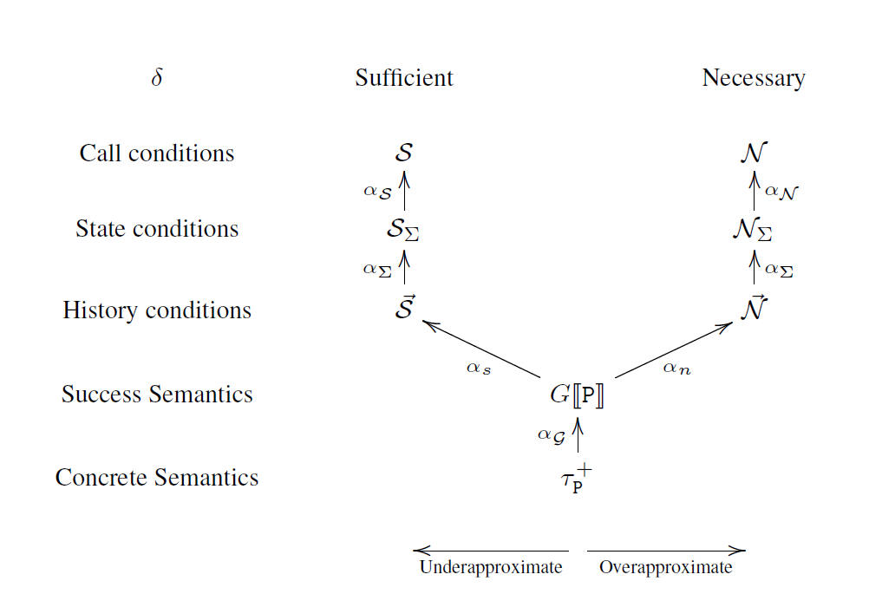
Conclusions
Verification Modulo Versions
Exploit previous versions to refine static analysis/verification
VMV(S) for regression finding
VMV(N) for relative verification
Implemented in Clousot, to be used in ReviewBot
Details on the forthcoming PLDI paper
Abstract regressions, abstractions of necessary/ sufficient, etc.

