Slide 1
CodeContracts & Clousot
M. Barnett, M. Fahndrich, F. Logozzo, & RiSE friends

Slide 2
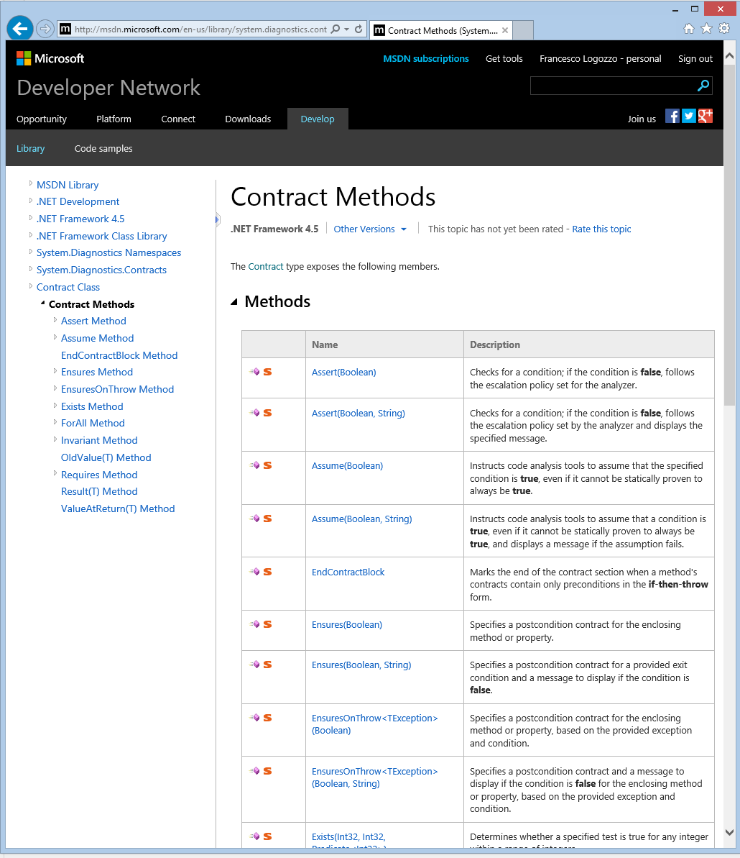
CodeContracts
Language agnostic contract specification for .NET
Since .NET v4.0
Tools on Devlabs, then VS Gallery
100+K downloads
Contracts:
Precondition
Postconditions
Object invariants
Main idea: use code to specify code
Very expressive, extensible …

Slide 3
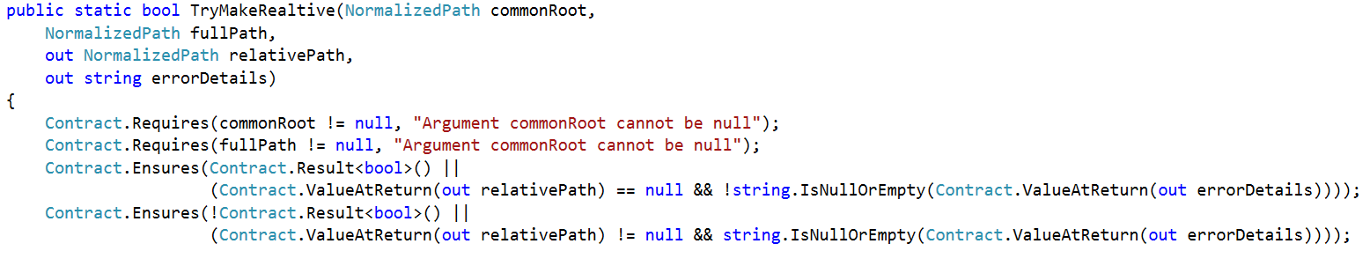
Code to specify code?

Slide 4
Main advantages for users
No change to the development environment
Leverage IDE, Intellisense, Compiler …
No need to learn a new specification language
Familiar language: plain C# (or VB)
Very Expressive
Essentially all C#
Infinitely Extensible
Expressions and pure functions
Unlike, e.g., SAL

Slide 5
Main advantages for tools
Compiler takes care of parsing, type checking, code generation …
Uniform and unambiguous specification format
No more: _Validate(…), DebugValidate(…), ValidateName(…) ThrowIfNull(…) …
Semantic given by the MSIL
CodeContracts are executable
Checked documentation
Amplify testing, use Pex
Improve the precision of static analysis

Slide 6
FAQ #1: Why not attributes?
Attributes have limited expressiveness
[NotNull] [Positive] …
Ex. What about x + y > 0?
[Requires(“x + y > 0”)]
[Requires(GT(Add(Var(x), Var(y)), Const(0))]
Duplication of effort
Parser, type checking
Semantics?
Ex. What does “==“ mean??

Slide 7
FAQ #2: Why not assert?
Assert is not visible to the callers
Should validate parameters, internal state, etc?
What about
Postconditions?
Object invariants?
Inheritance?
Interfaces and abstract methods?

Slide 8
Clousot Demo!
CodeFlow code base

Slide 9

Static analysis: Clousot
Code Contracts Static checker
Source Code
.cs
VS/Roslyn
Semantic
Inference
Error Checking
Verified repairs
Pre/Post inference
Assemblies
.dll/.exe
Warning prioritization
VS/Roslyn
Semantic baseline
Stored Information

Slide 10
Workflow
Un-annotated
code base
Lightly annotated
code base
Medium annotated
code base
Full annotated
code base
Clousot
Warn level: low
Clousot
Warn level: medium
Clousot
Warn level: full
Hi-prob. errors
Missing external preconditions
…
Likely errors
Missing postconditions
…
Full Verification
Missing object invariants
All code Assumptions explicit
…

Slide 11
What do we check?
User-provided Contracts
Preconditions for callers, postconditions for callees, object invariants
Language-induced Contracts
Null pointers, array bounds, unsafe memory accesses, arithmetic overflows, division by zero, ...
Unwanted behaviors (not runtime errors, but mostly erroneous)
Ints not in the enum range
80bits vs 64bits floating point comparisons
…

Slide 12
How do we scale?
Analyzed huge libraries
Dynamics.AX: 80+Mbytes
Modular analysis
Create approximated call-flow graph
Analyze methods bottom-up
Infer (necessary) preconditions, postconditions, object invariants
Use Contracts to reason about method calls
Assert precondition/assume postcondition
Cache analysis results
DB shared among team members, e.g., TSE

Slide 13
And external libraries?
src
src
src
src
Use Contract reference assemblies
Automatically picked up by our tools
Have a set of contracts for existing libraries
mscorlib, System.dll, …
Release Assemblies
Contract Reference Assemblies
PowerLib.dll
PowerLib.Contracts.dll
+
(minimal runtime checks)
All contracts, no code

Slide 14
How do we manage alarms?
Add Contracts!
Rank alarms according to witnesses
A witness provide information about the alarm
Ex. Value flowing, can infer a precondition, have a code fix, is a too complex expression …
Threshold to determine highest priority, high priority, etc.
Syntactic baseline
FxCop’s [SuppressMessage(…)], XML file, Exclude from analysis
Semantic baseline
Compute correctness conditions
Install to the next version

Slide 15
Demo!
Roslyn integration

Slide 16
Future?
Clousot in the cloud (Cloudot)
Static analysis as a service
Smart programming assistant
Alarms (and fixes!) at design time
Refactoring with contracts
…

Slide 17
Backup slides

Slide 18
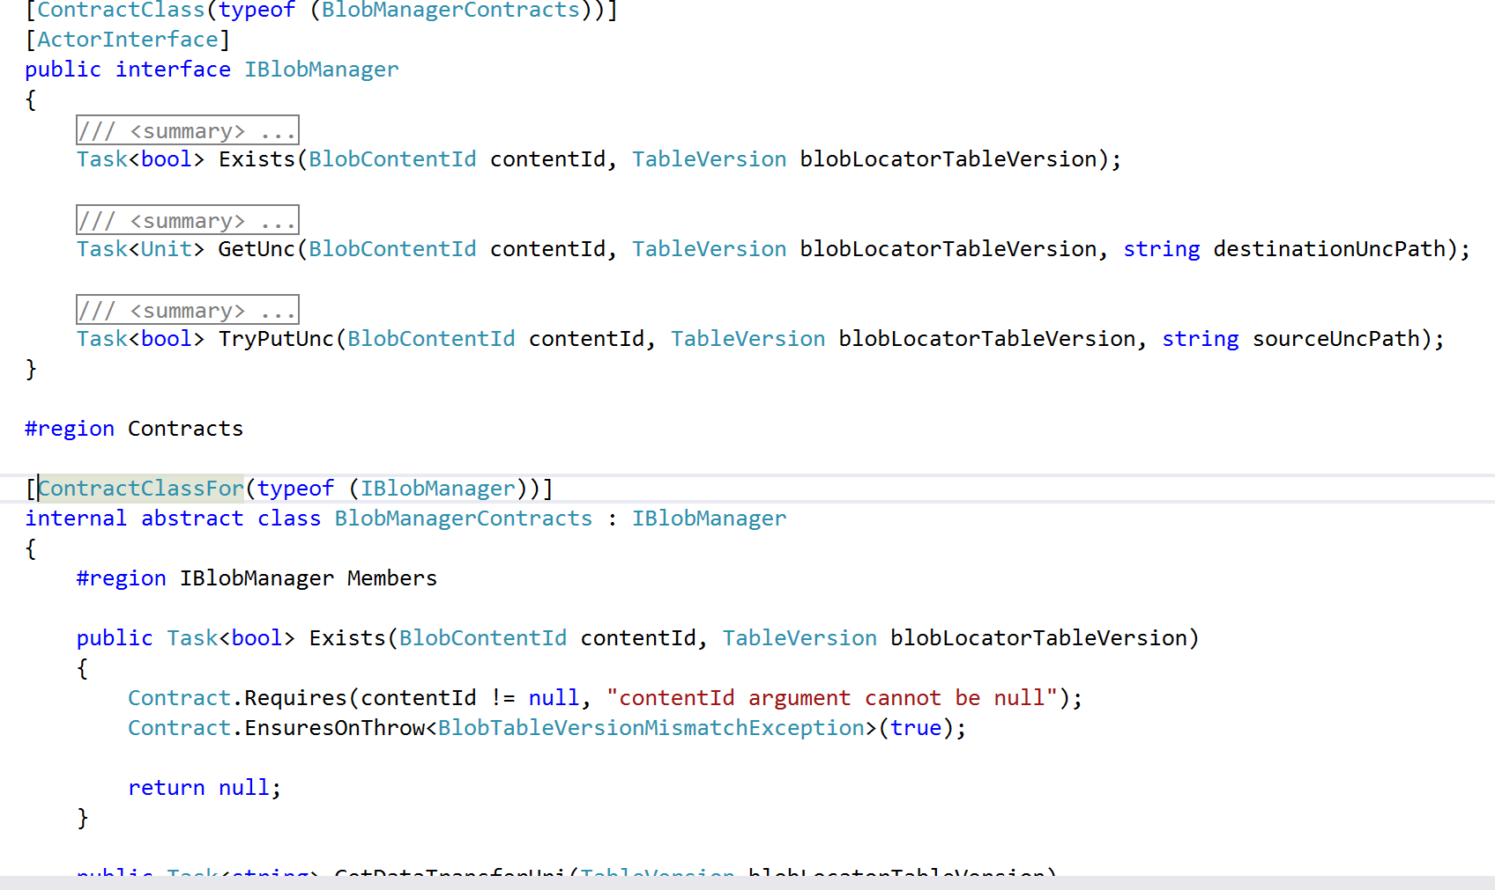
FAQ #2: Contracts for interfaces etc.?
Write code where code is not allowed?

Slide 19
FAQ #3: Why not analyzing source?
C# is a very complex language
900+ pages of specification
Too many cases to consider
Being language agnostic
Analyze C#, VB, Dynamic’s own language …
Languages change, MSIL do not

Slide 20
Developing against 3rd parties Libs
src
src
src
MyApp.exe
MyApp.exe
Check Requires of PowerLib at call-sites
Inherits contracts
src
CodeContracts
PowerLib.Contracts.dll
PowerLib.dll
(no runtime checks)

