Slide 1
A gentle introduction to Code Contacts
Mike Barnett
Manuel Fahndrich*
Francesco Logozzo

Slide 2
Contracts in a nutshell
Preconditions
What my I expect from the callers
Postconditions
What I ensure to my callers
Object invariants
What holds in the steady state of the object

Slide 3
FAQ #1: “I already have Debug.Assert”
// throws if x is negative
public void MyAPI(int x)
{
if (x <= 0)
throw new Exception();
private void callGCD()
{
…
x = GCD(a, b);
Debug.Assert(x >= 0);
Documentation: What do I expect?
Assert/throw not visible to callers
Postconditions: e.g., How do I express return != null?
Add an assert at each return point?
Spaghetti code, not scalable, no inheritance …
Object-oriented:
Inheritance
Abstract methods, interfaces
static public int GCD(int x, int y)
{
Debug.Assert(x > 0);
Debug.Assert(y > 0);
while (true)
if (x < y) { y %= x; if (y == 0) return x; }
else { x %= y; if (x == 0) return y; }
}
Debug.Assert(result > 0);

Slide 4
FAQ #2: “I have validation methods”
Custom validations are ad-hoc
Validate, ValidateLogUploadInput, ValidateArgValueIsNotNull…
Can’t tool against it
E.g., to generate documentation automatically
Object invariants
When should I call ValidateFields?
Object oriented
Inheritance?
Abstract methods, interfaces?
void ValidateNotNull(string arg, string msg)
{
if(arg == null)
throw new ArgumentNullException(msg);
}

Slide 5
CodeContracts
Language agnostic way of specifying contracts
// from mscorlib.dll > v4.0
namespace System.Diagnostics.Contracts
{
// Summary:
// Contains static methods for representing program contracts such as preconditions,
// postconditions, and object invariants.
public static class Contract
{
[Conditional("CONTRACTS_FULL")]
public static void Requires(bool condition);
[Conditional("CONTRACTS_FULL")]
public static void Ensures(bool condition);
[Conditional("CONTRACTS_FULL")]
public static void Invariant(bool condition);
[Conditional("CONTRACTS_FULL")]
public static void EnsuresOnThrow<TException>(bool condition) where TException : Exception;
// …

Slide 6
Example: Pre/Post-condition
Contracts appear just after the method declaration
public static byte[] ReadExpectedBytes(FileStream inputFile, int expectedBytes)
{
Contract.Requires(inputFile != null);
Contract.Requires(expectedBytes >= 0);
Contract.Ensures(Contract.Result<byte[]>() != null);
Contract.Ensures(Contract.Result<byte[]>().Length == expectedBytes);
Contract.EnsuresOnThrow<InvalidDataException>(false);
var buffer = new byte[expectedBytes];
int totalBytesRead = 0;
do
{
int bytesRead = inputFile.Read(buffer, totalBytesRead, expectedBytes - totalBytesRead);
if (bytesRead == 0)
{
// End of file, unexpected
throw new InvalidDataException(string.Format(
CultureInfo.InvariantCulture, "Unexpected end of file in {0}", inputFile.Name));
}
totalBytesRead += bytesRead;
} while (totalBytesRead < expectedBytes);
return buffer;
}

Slide 7
Example: Object invariant
Object invariants are marked by opportune attribute
public class SettingReader
{
#region Object invariant
[ContractInvariantMethod]
private void ObjectInvariant()
{
Contract.Invariant(!this._loaded || this._settingLookup != null);
}
#endregion
public class BuilderManagerDataContext : DbContext, IDisposable
{
#region Object invariant
[ContractInvariantMethod]
private void ObjectInvariant()
{
Contract.Invariant(this.Machines != null);
Contract.Invariant(this.Enlistments != null);
// …
}
#endregion
public DbSet<Machine> Machines { get; set; }
public DbSet<Enlistment> Enlistments { get; set; }

Slide 8
Example: Interfaces
[ContractClass(typeof(IClientFactoryContracts))]
public interface IClientFactory
{
IClient CreateClient(GlobalBuildData globalBuildData, IDependencyGraph dependencyGraph);
}
[ContractClassFor(typeof(IClientFactory))]
abstract class IClientFactoryContracts : IClientFactory
{
public IClient CreateClient(GlobalBuildData globalBuildData, IDependencyGraph dependencyGraph)
{
Contract.Ensures(Contract.Result<IClient>() != null);
return null;
}
}
public class ClientFactory : IClientFactory
{
public IClient CreateClient(GlobalBuildData globalBuildData, IDependencyGraph dependencyGraph)
{
return new Client(globalBuildData, dependencyGraph);
}
}
Contracts-only implementation
Contract inherited

Slide 9
FAQ #3: “Why not use attributes?”
/// <param name="name"> a non-null name </param> Person([NotNull] string name)
{
if (name == null)
throw new ArgumentNullException("name");
Name = name;
}
Expressiveness: Attributes are limited
What about e.g. “x < y+2”?
Redundancy
Documentation (English)
Runtime checking (if .. throw)
Static checking ([NotNull])
But I can have shortcuts
Study of UW found 17 (!) annotations are needed for null-checking in Java
Someone in Bing is working on a Resharper to CC rewriting via Roslyn

Slide 10
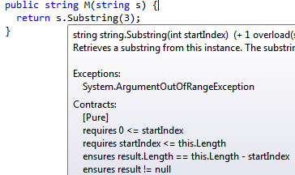
CodeContracts tools
Automatic documentation generation
Show contracts as you type
Runtime checking
Via binary rewriting
Instruments binary with pre/post conditions, etc.
Static checking
Proves absence of contract violations, exception checking, at compile time!

Slide 11
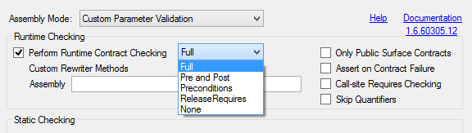
FAQ #4: “What happens at runtime?”
Runtime cost: It can be finally tuned
Contracts are conditionally defined
Rule of thumb
Debug: All contracts on
Release: Only surface preconditions
Runtime behavior: It can be finally tuned
Throw exception, behave as assert, write into a log file …

Slide 12
FAQ #5: “How do I ship contacts?”
src
src
src
src
src
src
src
src
Check Requires of Lib at call-sites
Inherits contracts
Release Assemblies
Contract Reference Assemblies
MyApp.exe
MyApp.exe
Lib.dll
+
Lib.Contracts.dll
ccrewrite
(minimal runtime checks)
All contracts, no code
Lib.Contracts.dll
Lib.dll
(no runtime checks)

Slide 13
Contracts for existing libraries
Mscorlib
System
System.Data
System.Xml
System.Windows
System.Core
System.
Configuration
System.Web
System.
Windows.Browser
System.
Windows.Forms
WindowsBase
System.Drawing
System.Security
Microsoft.VisualBasic.Compatibility
System.Xml.Linq
Microsoft.
VisualBasic
…

Slide 14
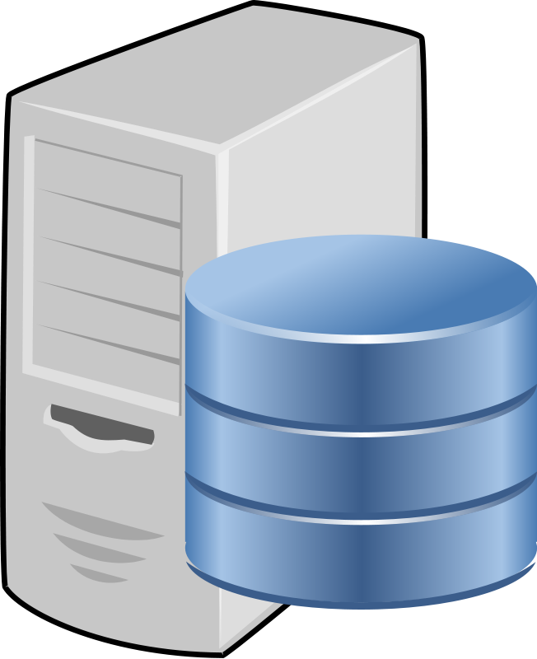
Static verification: cccheck/Clousot
Code Contracts Static checker
Source Code
.cs
VS/Roslyn
Semantic
Inference
Error Checking
Verified repairs
Pre/Post inference
Assemblies
.dll/.exe
Warning prioritization
VS/Roslyn
Semantic baseline
Stored Information

Slide 15
Demo

Slide 16
FAQ #5: “Is it useful?”
internal static string GetPackageFileFromTargetPath(this Target t)
{
string path = t.Path;
if (path == null)
{
throw new ArgumentNullException("path", "Target Path cannot be null");
}
string[] paths = path.Split(new char[] { '\\', '/' });
if (paths.Length > 2
&& paths[0].Equals("private", StringComparison.OrdinalIgnoreCase) &&
paths[1].Equals("packages", StringComparison.OrdinalIgnoreCase))
{
paths[0] = "//depot";
paths[3] = "main";
return string.Join("/", paths, 0, 4) + "/package.xml";
}
return null;
}

Slide 17
protected void RunDevBuild(… string dpk, …, Dictionary<string, object> jobInputs)
{
Contract.Requires(bmClient != null);
Contract.Requires(jobInputs != null);
string newDpkPath;
if (Changelist == null)
{
Changelist = SdHelper.DefaultChangeListName;
}
ClientProgram.AutoPackLocalFiles(
LOG, false, new List<string> { Changelist }, dpk, DpkSharePath, out newDpkPath, sessionId,
localBuild: true, copyLocalDpkToRemote: true);
dpk = newDpkPath;
if (string.IsNullOrEmpty(dpk))
{
throw new CommandException(DpkError);
}
string jobInputsJson = jobInputs.SerializeToJson();
public class PresubmitCommand : DevBuildBaseCommand
{
public override void ExecuteCommand()
{
base.ExecuteCommand();
…
RunDevBuild(bmClient, sessionId, null, "presubmit", null);

Slide 18
FAQ #5: “Does it scale?”
Performance: Use SQL server to cache analysis results
But I can implement a particular data accessor
Best practices
Static checker in CI builds
Share cache among team

Slide 19


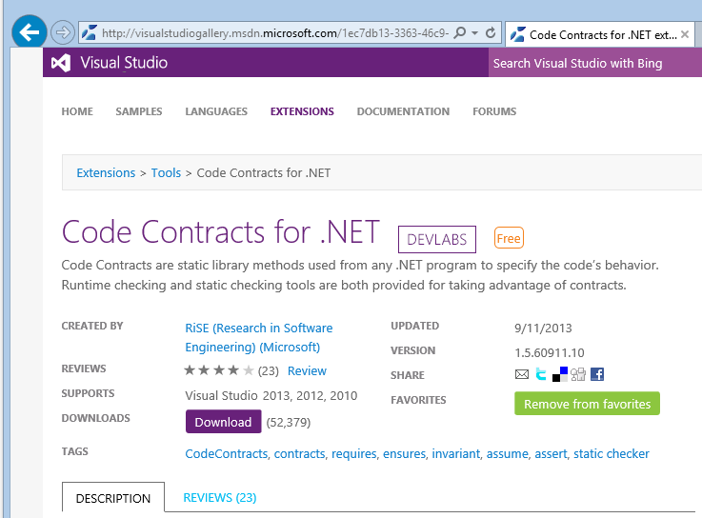
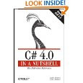
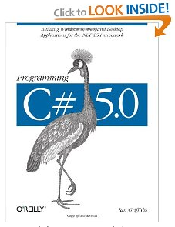
FAQ #6: “How good are the tools?”
Widely tested
Externally available ~4 years
4 book chapters on CodeContracts
Many dozens of blog articles
Active forum
> 5,000 messages
Internal and external adoption
Downloads:
> 120, 000 external, > 4,000 internal
State of the art research
Publications, talks, lectures
BUILD (x2), POPL, PLDI, OOPSLA, ECOOP, VMCAI, APLAS, SAS, SAC, FoVeOOS, VSTTE …

Slide 20
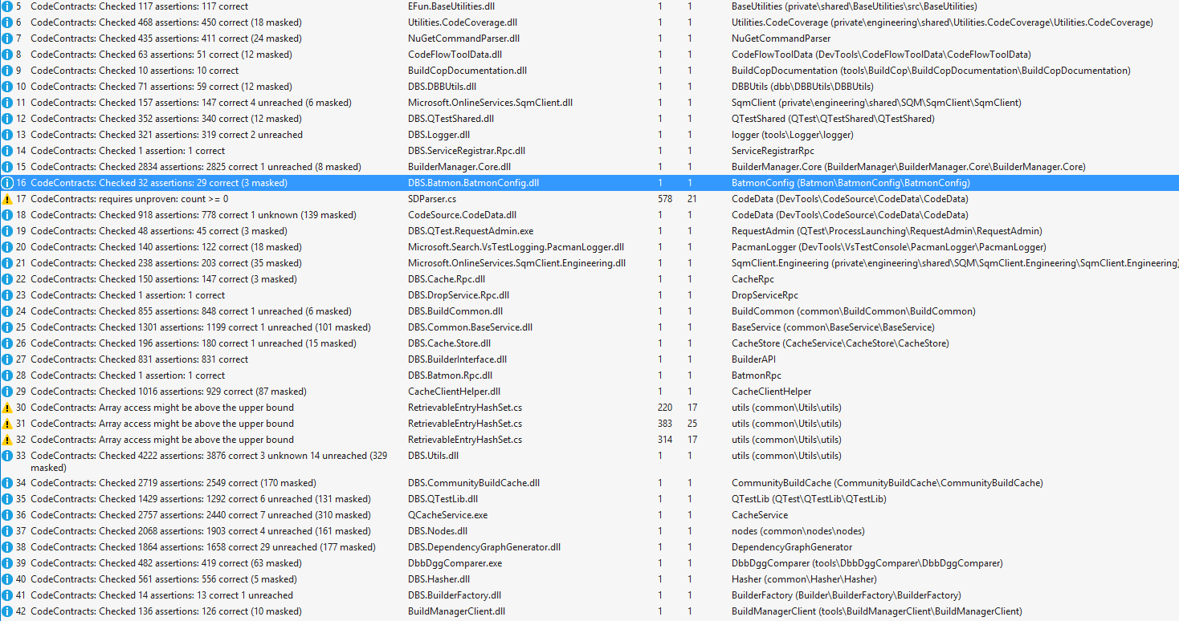
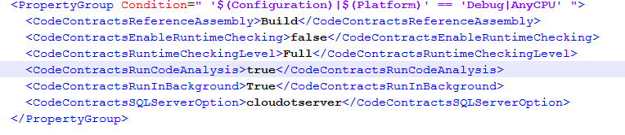
FAQ #7: “Can I try them today?”
Include Common.CodeContracts.props in your project
Make sure they runtimes/static check are enabled

Slide 21
FAQ #8: “But I already have validators”
Use ContractArgumentValidator attribute to retrofit validators
[ContractArgumentValidator]
private static void ValidateLogUploadInput(Logger logger, string sourceFilePath, string sourceFileNameRegexPattern, string destinationDirectory)
{
if (logger == null)
{
throw new ArgumentNullException(“…”);
}
if (destinationDirectory == null)
{
throw new ArgumentNullException(“…”);
}
if (string.IsNullOrEmpty(sourceFilePath))
{
throw new ArgumentException(“…”);
}
// …
}

Slide 22
FAQ #9: “Is my public surface checking complete?”
public bool LogUpload(Logger logger, string sourceFilePath, string sourceFileNameRegexPattern, string destinationDirectory)
{
ValidateLogUploadInput(logger, sourceFilePath, sourceFileNameRegexPattern, destinationDirectory);
Contract.Assume(destinationDirectory.Length != 0, "check check : missing precondition in the parameter validation above");
try
{
StartLogUpload(logger, sourceFilePath, sourceFileNameRegexPattern, destinationDirectory);
}
catch (Exception ex)
{
// …
}
}
Requires destinationDirectory != “”
private void StartLogUpload(… string destinationDirectory)
{
Directory.CreateDirectory(destinationDirectory);

Slide 23
FAQ #10: “Can you do it for unmanaged?”
We use IL to persist contracts, is there an equivalent in C++?
Modules?
What is the equivalent of the rewriter in C++?
Need changes to the compiler?
Probably not so many

Slide 24
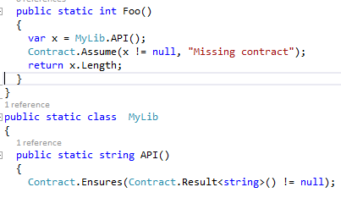
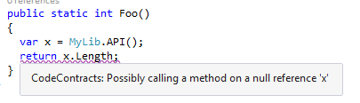

Other FAQs
Q: “I have to press too many keys”
A: Use VS shortcuts: e.g., “cr + <tab> + <tab>” -> “Contract.Requires”
Q: “The static checker does not know about MyExternalLib”
A: Use Contract.Assume, static checker will tell you when ok to remove

Slide 25
What’s next?
Automatic Refactoring to migrate large code bases to CodeContracts
See Scott’s demo
Integration with code reviewing
ReviewBot to automatically add comments to the review
Focus on changes, newly introduced changes
Need a build server for that ;-)
Other FAQ? email logozzo, mbarnett

