Slide 1
Code Contracts Documentation
Daryl Zuniga

Slide 2
Overview
Overview | CCDoc | Adornments | Conclusion
Code Contracts
CCDoc
Generating documentation with contracts
Contract Adornments
Exposing inherited contracts in the VS IDE

Slide 3

Code Contracts
Overview | CCDoc | Adornments | Conclusion
Express assumptions
Preconditions
What must be true
Postconditions
What will be true
Object invariants
What will always* be true

Slide 4
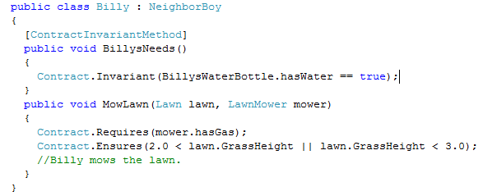
Code Contracts
Overview | CCDoc | Adornments | Conclusion
Requires | Ensures | Invariant
Mower has gas | 2” < Lawn < 3” | Billy has water

Slide 5
Benefits of Code Contracts
Overview | CCDoc | Adornments | Conclusion
Express assumptions
Debugging
In-code specification
Static analysis
Documentation

Slide 6
CCDoc
Overview | CCDoc | Adornments | Conclusion
Getting contract information into documentation
For using an API
Knowing what to give it
API
Knowing what to expect from it

Slide 7
Demo
Overview | CCDoc | Adornments | Conclusion

Slide 8
CCDoc
Overview | CCDoc | Adornments | Conclusion
XML Injector
Sandcastle Patch
Documentation!
Contract Extractor
CCDoc Tool
Other tools too!
Sandcastle
XSLTs
MSDN?

Slide 9
Contract Adornments
Overview | CCDoc | Adornments | Conclusion
For implementing an override or interface method
What are their contracts?
Contracts?
override int M(int input){
…
}

Slide 10
Demo
Overview | CCDoc | Adornments | Conclusion
Did it work? Yes | No

Slide 11
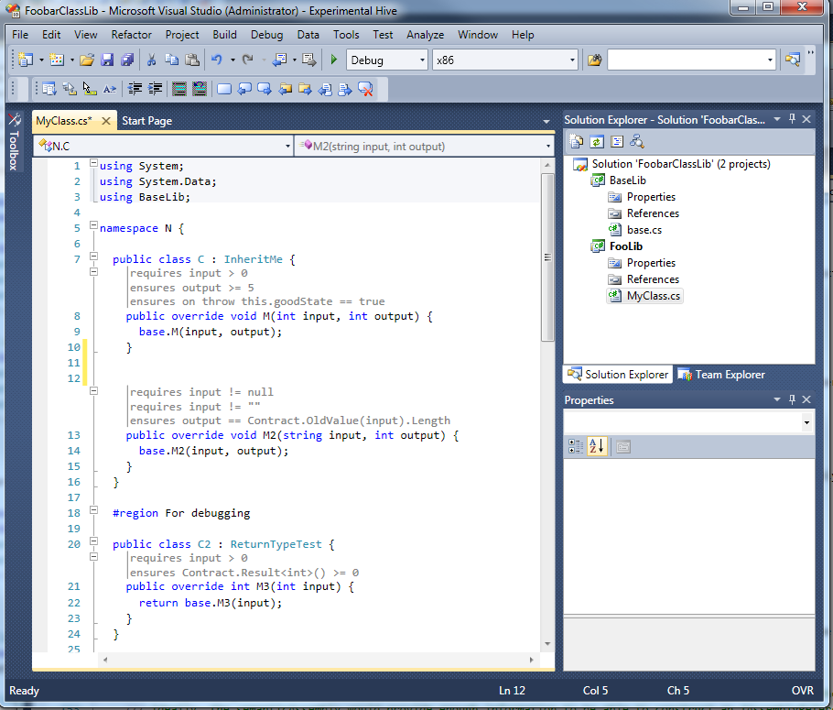

Slide 12
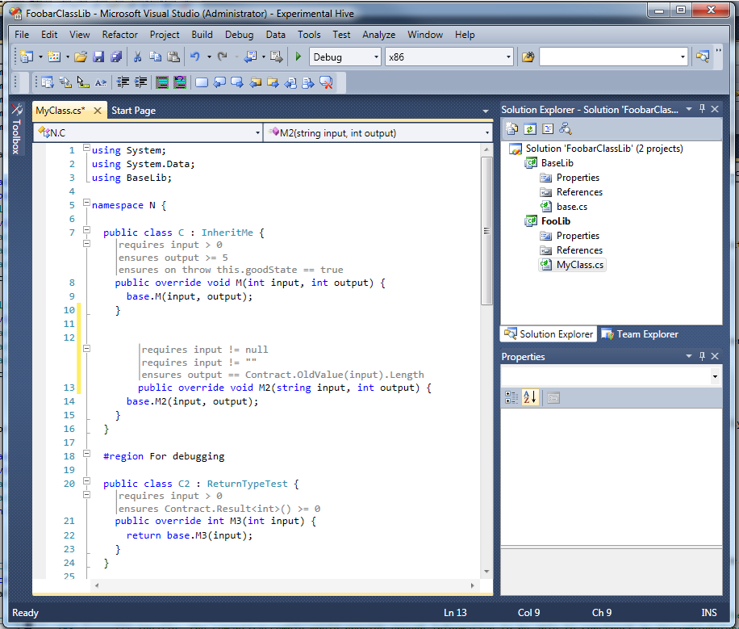

Slide 13
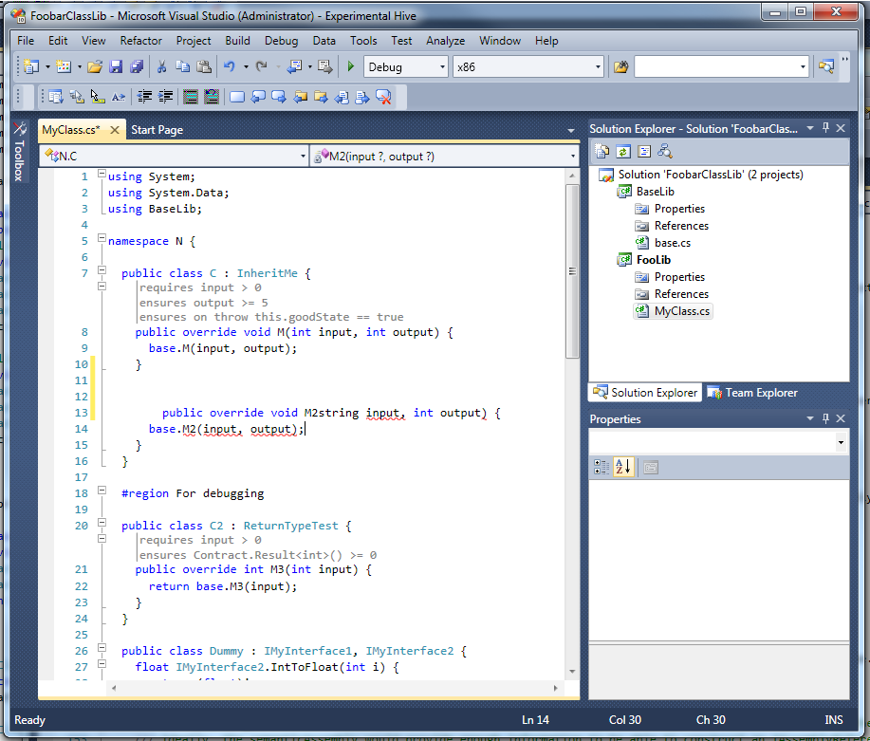

Slide 14


Slide 15
Contract Adornments
Overview | CCDoc | Adornments | Conclusion
Visual Studio
(2010, Beta 1)
VS
Code Model
CCI2
Code Model
Visual
(Text Adornment)
Contract Provider

Slide 16
Conclusion
Overview | CCDoc | Adornments | Conclusion
CCDoc
Help use an API
Been shipping since Sept. 3rd! (600 downloads)
Contract Adornments
Help developing with contracts
Prototype for VS 2010 (C#)

Slide 17

Future Vision
Overview | CCDoc | Adornments | Conclusion
Intellisense?
MSDN?

Slide 18
Questions?
Overview | CCDoc | Adornments | Conclusion

