Slide 1

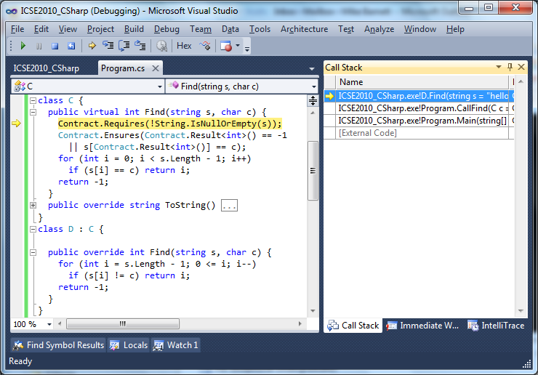
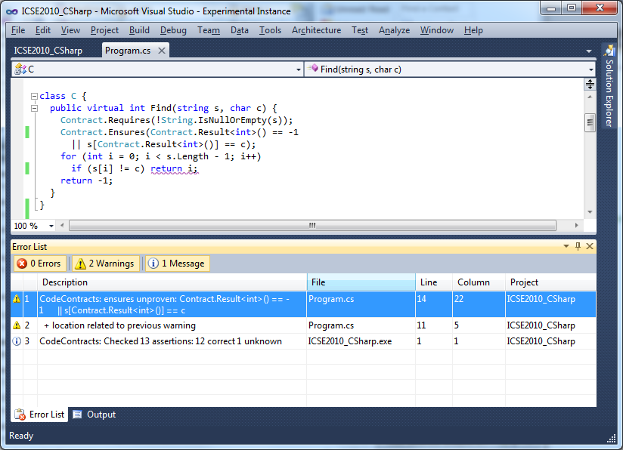
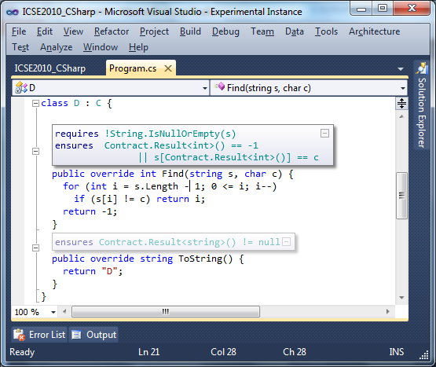
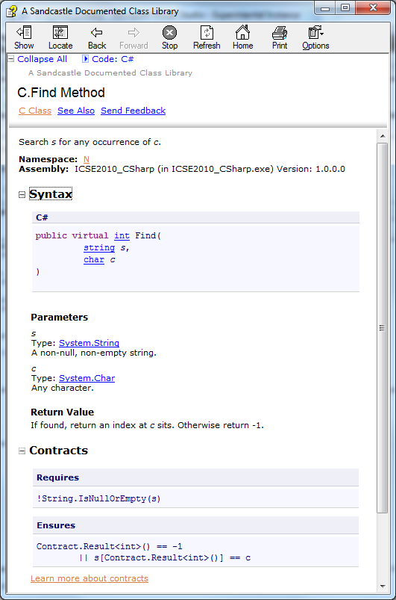

Code Contracts for .NET
Contract Inheritance!
Failing condition string available at runtime
Stepping, breakpoints, coverage work naturally
Fully configurable (which checks, error behavior)
Compile-time warnings
Contract violations,
Null dereferences
Array indexing
Automatic loop invariant inference
Abstract-Interpretation based
Runtime Checking
Static Checking
Author in any .NET Language
C#
VB
public virtual int Find(string s, char c) {
Contract.Requires(!String.IsNullOrEmpty(s));
Contract.Ensures(Contract.Result<int>() == -1 ||
s[Contract.Result<int>()] == c);
for (int i = 0; i < s.Length-1; i++)
if (s[i] == c) return i;
return -1;
}
Function Find(ByVal s As String, ByVal c As Char) As Integer
Contract.Requires(Not String.IsNullOrEmpty(s))
Contract.Ensures(Contract.Result(Of Integer)() = -1 Or
s(Contract.Result(Of Integer)()) = c)
For i = 0 To Len(s) Step 1
If s(i) = c Then
Return i
End If
Next
Return -1
End Function
Documentation
Enriched IDE
Contract Reference Assemblies
Augment XML files generated by compiler
Sandcastle XLST extensions for MSDN-style documentation
VS 2010 Extensions
Displays inherited contracts
Augments metadata files
Mike Barnett, Manuel Fähndrich, Francesco Logozzo
http://research.microsoft.com/contracts

