Slide 1

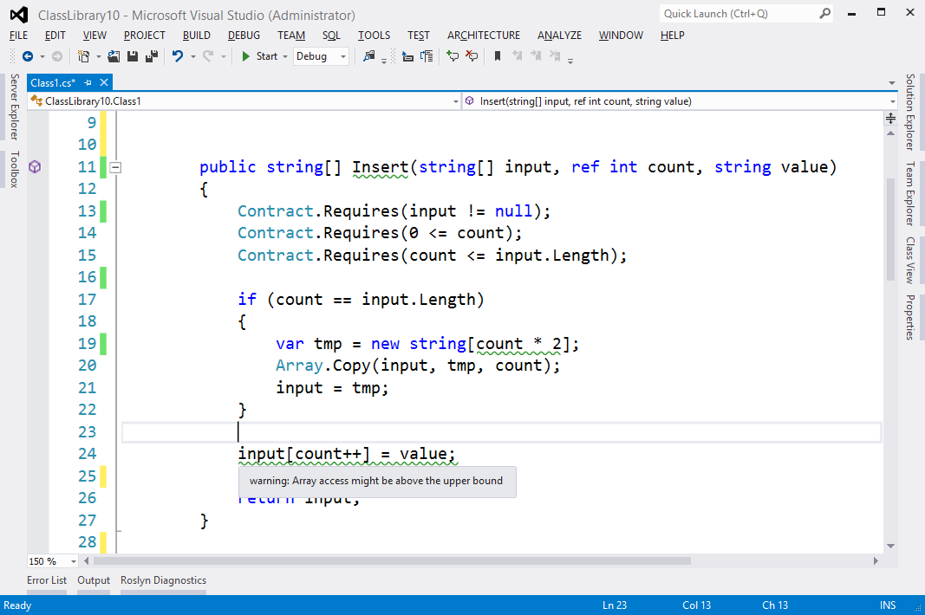
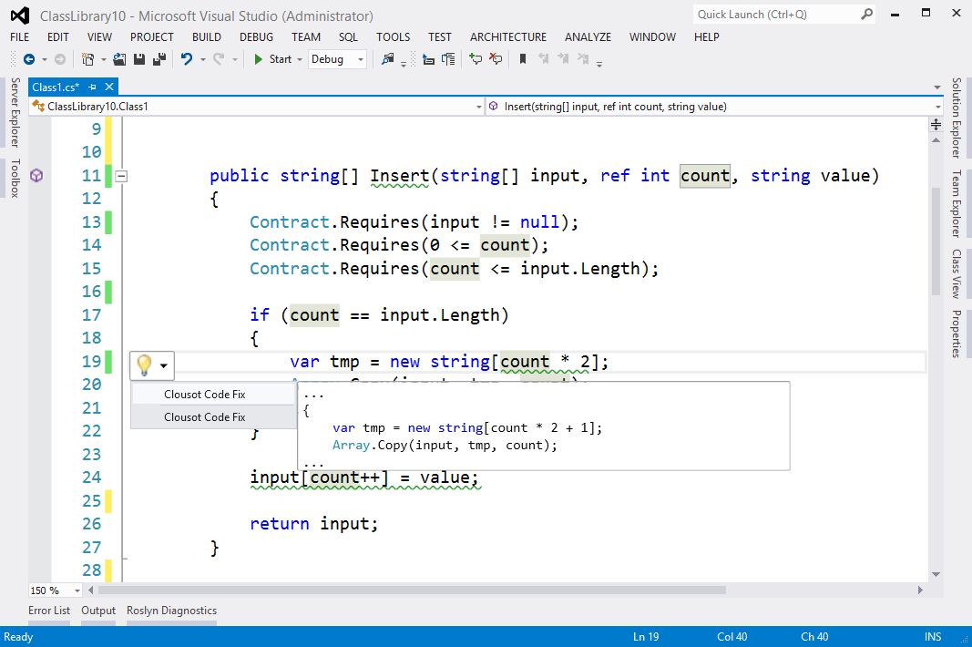
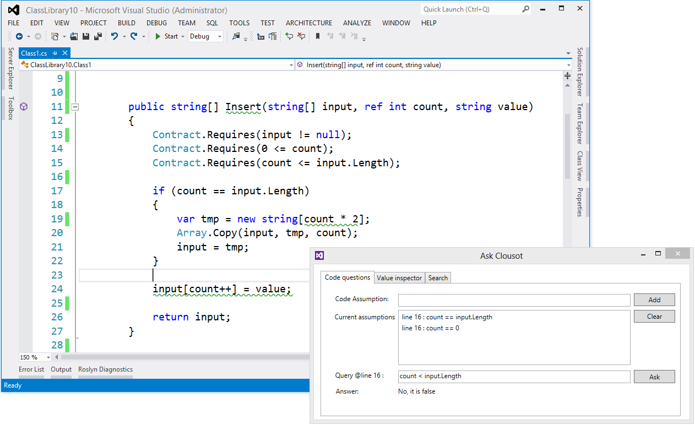
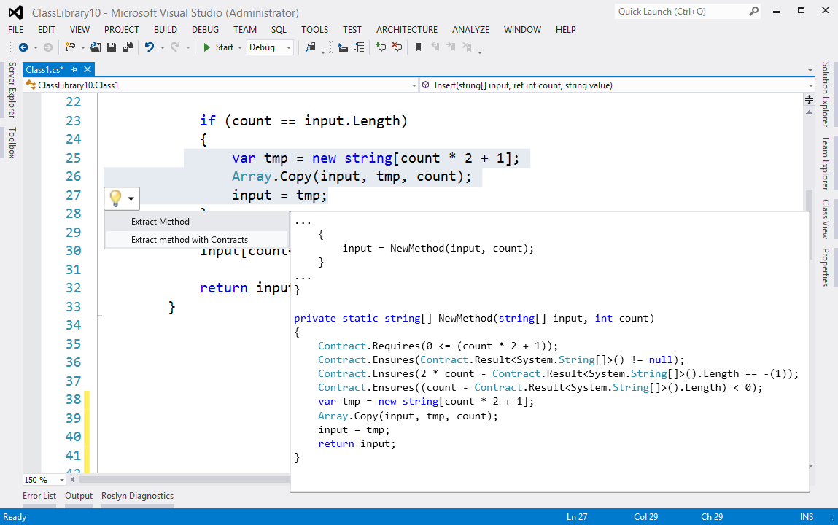
Smart Programming Assistant, SPA
Powered by
Find tricky bugs at design time
Get verified bug fixes
Ask semantic questions
Refactor with contracts

