Slide 1
Static Validation of Managed Code and Contracts
Manuel Fähndrich (maf)
In collaboration with… | Brian Grunkemeyer (briangru)
Mike Barnett (mbarnett) | Melitta Andersen (melitta)
Francesco Logozzo (logozzo) | Katy King (katyk)

Slide 2
Managed Contracts
Language-Agnostic Contracts for .NET
pre-conditions
post-conditions
object invariants
Runtime Checking
Foxtrot
Static checking
Clousot

Slide 3
Outline
Motivation
Contracts for .NET
Runtime Checking
Scenarios
Static Checking
Scenarios
Internals

Slide 4


Motivation : Code Quality
Can this method return null?
What is wrong with this parameter?
How do I use this API ?
?
?
?
vulnerabilities
How do I implement this interface ?
This method shouldn’t return null!
My method does not accept negative values!

Slide 5
Why Contracts?
Contracts document design decisions
Pre-conditions, post-conditions, and object invariants
Facilitate code evolution
Contracts are executable
Checked documentation
Amplify testing as oracles, automatic test generation (Pex)
Contracts help static verification
Early error detection
Clarify responsibility at interfaces
Assertions help, but each team has their own
Difficult to tool against
Not seen as a contract between 2 parties
Notes:
Important API and internal code properties are not documented or checked, making coding difficult and maintenance worse.
Same contract thus serves as documentation, acts as runtime checking, and as specification for static checking.

Slide 6
How Are Contracts Written?
Using static method calls to a Contract library
Language-agnostic (same library for C#, VB, F#, …)
namespace Microsoft.Contracts {
public static class Contract {
[Conditional(“Contracts”)] public static void Requires(bool condition) {}
[Conditional(“Contracts”)] public static void Ensures(bool condition) {}
[Conditional(“Contracts”)] public static void Invariant(bool condition) {}
public static T Result<T>() { return default(T); }
public static T Old<T>(T value) { return default(T); }
...
} }

Slide 7
Specifying Contracts (C#)
public virtual int Add(object value) { Contract.Requires( value != null ); Contract.Ensures( Count == Contract.Old(Count) + 1 ); Contract.Ensures( Contract.Result<int>() == Contract.Old(Count) ); if (count == items.Length) EnsureCapacity(count + 1); items[count] = value; return count++; }
Features
Declarative
Language expression syntax
Type checking / IDE
Special Encodings
Result and Old
void ObjectInvariant() { Contract.Invariant( items != null ); }
Notes:
Make a simpler example (too many contracts, explain old better)
Talk about static methods!!!
Questions: what happens at runtime, how can I choose what’s in my build, what’s the methodology (can I rely on the checks?)
Quantifiers?

Slide 8
Demo
Notes:
Add Add method override
Add(null)
Fix
Run static checker to see what additional things could be off
Fix some of them

Slide 9
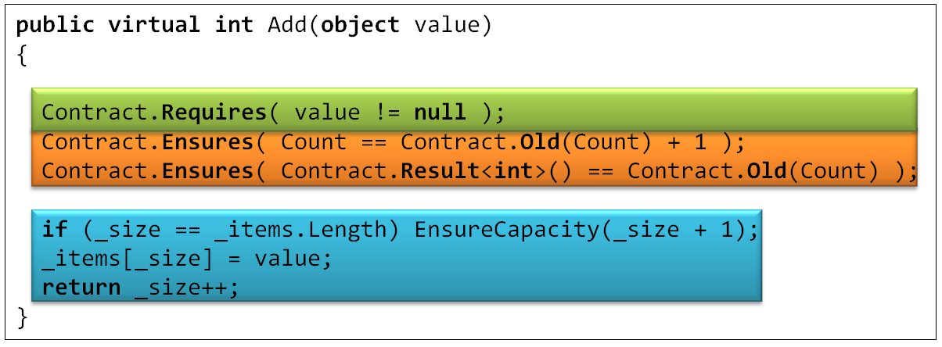
Compilation and Runtime Checking
Executable runtime
Contract checking
.method public hidebysig newslot virtual instance int32 Add(object 'value') cil managed
{
.locals init (int32 'Contract.Old(Count)',
int32 'Contract.Result<int>()')
ldarg.0
call instance int32 TabDemo.BaseList::get_Count()
stloc.3
ldarg.1
ldnull
ceq
ldc.i4.0
ceq
ldstr "value != null"
call void __RewriterMethods::RewriterRequires$PST06000009(bool, string)
ldarg.0
ldfld int32 TabDemo.BaseList::count
ldarg.0
ldfld object[] TabDemo.BaseList::items
ldlen
conv.i4
ceq
ldc.i4.0
ceq
stloc.1
ldloc.1
brtrue IL_004d
nop
ldarg.0
ldarg.0
ldfld int32 TabDemo.BaseList::count
ldc.i4.1
add
call instance void TabDemo.BaseList::EnsureCapacity(int32)
nop
nop
ldarg.0
ldfld object[] TabDemo.BaseList::items
ldarg.0
ldfld int32 TabDemo.BaseList::count
ldarg.1
stelem.ref
ldarg.0
dup
ldfld int32 TabDemo.BaseList::count
dup
stloc.2
ldc.i4.1
add
stfld int32 TabDemo.BaseList::count
ldloc.2
stloc.0
br IL_0072
ldloc.0
stloc.s 'Contract.Result<int>()'
br IL_007a
ldarg.0
call instance int32 TabDemo.BaseList::get_Count()
ldloc.3
ldc.i4.1
add
ceq
ldstr "Count == Contract.Old(Count) + 1"
call void __RewriterMethods::RewriterEnsures$PST0600000B(bool, string)
ldloc.s 'Contract.Result<int>()'
ldloc.s V_4
ceq
ldstr "Contract.Result<int>() == Contract.Old(Count)"
call void __RewriterMethods::RewriterEnsures$PST0600000B(bool, string)
ldloc.s 'Contract.Result<int>()'
ret
}
Compile
/d:Contracts language- agnostic
Release Compile
.method public hidebysig newslot virtual instance int32 Add(object 'value') cil managed
{
ldarg.1
ldnull
ceq
ldc.i4.0
ceq
call void [Microsoft.Contracts]Microsoft.Contracts.Contract::Requires(bool)
ldarg.0
call instance int32 TabDemo.BaseList::get_Count()
ldarg.0
call instance int32 TabDemo.BaseList::get_Count()
call !!0 [Microsoft.Contracts]Microsoft.Contracts.Contract::Old<int32>(!!0)
ldc.i4.1
add
ceq
call void [Microsoft.Contracts]Microsoft.Contracts.Contract::Ensures(bool)
call !!0 [Microsoft.Contracts]Microsoft.Contracts.Contract::Result<int32>()
ldarg.0
call instance int32 TabDemo.BaseList::get_Count()
call !!0 [Microsoft.Contracts]Microsoft.Contracts.Contract::Old<int32>(!!0)
ceq
call void [Microsoft.Contracts]Microsoft.Contracts.Contract::Ensures(bool)
ldarg.0
ldfld int32 TabDemo.BaseList::count
ldarg.0
ldfld object[] TabDemo.BaseList::items
ldlen
conv.i4
ceq
ldc.i4.0
ceq
stloc.1
ldloc.1
brtrue.s IL_0069
ldarg.0
ldarg.0
ldfld int32 TabDemo.BaseList::count
ldc.i4.1
add
call instance void TabDemo.BaseList::EnsureCapacity(int32)
ldarg.0
ldfld object[] TabDemo.BaseList::items
ldarg.0
ldfld int32 TabDemo.BaseList::count
ldarg.1
stelem.ref
ldarg.0
dup
ldfld int32 TabDemo.BaseList::count
dup
stloc.2
ldc.i4.1
add
stfld int32 TabDemo.BaseList::count
ldloc.2
stloc.0
br.s IL_008b
ldloc.0
ret
} // end of method BaseList::Add
Foxtrot IL
rewriting
.method public hidebysig newslot virtual instance int32 Add(object 'value') cil managed
{
ldarg.0
ldfld int32 TabDemo.BaseList::count
ldarg.0
ldfld object[] TabDemo.BaseList::items
ldlen
conv.i4
ceq
ldc.i4.0
ceq
stloc.1
ldloc.1
brtrue.s IL_0029
ldarg.0
ldarg.0
ldfld int32 TabDemo.BaseList::count
ldc.i4.1
add
call instance void TabDemo.BaseList::EnsureCapacity(int32)
ldarg.0
ldfld object[] TabDemo.BaseList::items
ldarg.0
ldfld int32 TabDemo.BaseList::count
ldarg.1
stelem.ref
ldarg.0
dup
ldfld int32 TabDemo.BaseList::count
dup
stloc.2
ldc.i4.1
add
stfld int32 TabDemo.BaseList::count
ldloc.2
stloc.0
br.s IL_004b
ldloc.0
ret
}
Inheritance
WF checks

Slide 10
What do you ship?
src
src
src
src
Release Assemblies
Contract Reference Assemblies
PowerLib.dll
PowerLib.Contracts.dll
+
(minimal runtime checks)
All contracts, no code

Slide 11
Contract Reference Assemblies
Contract Reference Assembly
Compile
/d:Contracts
.method public hidebysig newslot virtual instance int32 Add(object 'value') cil managed
{
ldarg.1
ldnull
ceq
ldc.i4.0
ceq
call void [Microsoft.Contracts]Microsoft.Contracts.Contract::Requires(bool)
ldarg.0
call instance int32 TabDemo.BaseList::get_Count()
ldarg.0
call instance int32 TabDemo.BaseList::get_Count()
call !!0 [Microsoft.Contracts]Microsoft.Contracts.Contract::Old<int32>(!!0)
ldc.i4.1
add
ceq
call void [Microsoft.Contracts]Microsoft.Contracts.Contract::Ensures(bool)
call !!0 [Microsoft.Contracts]Microsoft.Contracts.Contract::Result<int32>()
ldarg.0
call instance int32 TabDemo.BaseList::get_Count()
call !!0 [Microsoft.Contracts]Microsoft.Contracts.Contract::Old<int32>(!!0)
ceq
call void [Microsoft.Contracts]Microsoft.Contracts.Contract::Ensures(bool)
ldarg.0
ldfld int32 TabDemo.BaseList::count
ldarg.0
ldfld object[] TabDemo.BaseList::items
ldlen
conv.i4
ceq
ldc.i4.0
ceq
stloc.1
ldloc.1
brtrue.s IL_0069
ldarg.0
ldarg.0
ldfld int32 TabDemo.BaseList::count
ldc.i4.1
add
call instance void TabDemo.BaseList::EnsureCapacity(int32)
ldarg.0
ldfld object[] TabDemo.BaseList::items
ldarg.0
ldfld int32 TabDemo.BaseList::count
ldarg.1
stelem.ref
ldarg.0
dup
ldfld int32 TabDemo.BaseList::count
dup
stloc.2
ldc.i4.1
add
stfld int32 TabDemo.BaseList::count
ldloc.2
stloc.0
br.s IL_008b
ldloc.0
ret
} // end of method BaseList::Add
.method public hidebysig newslot virtual instance int32 Add(object 'value') cil managed
{
ldarg.1
ldnull
ceq
ldc.i4.0
ceq
call void [Microsoft.Contracts]Microsoft.Contracts.Contract::Requires(bool)
ldarg.0
call instance int32 TabDemo.BaseList::get_Count()
ldarg.0
call instance int32 TabDemo.BaseList::get_Count()
call !!0 [Microsoft.Contracts]Microsoft.Contracts.Contract::Old<int32>(!!0)
ldc.i4.1
add
ceq
call void [Microsoft.Contracts]Microsoft.Contracts.Contract::Ensures(bool)
call !!0 [Microsoft.Contracts]Microsoft.Contracts.Contract::Result<int32>()
ldarg.0
call instance int32 TabDemo.BaseList::get_Count()
call !!0 [Microsoft.Contracts]Microsoft.Contracts.Contract::Old<int32>(!!0)
ceq
call void [Microsoft.Contracts]Microsoft.Contracts.Contract::Ensures(bool)
} // end of method BaseList::Add
asmmeta2

Slide 12
Runtime Checking Scenario
ACME
ACME.dll
ACME.Contracts.dll
PowerLib
PowerLib.dll
PowerLib.Contracts.dll
Developing MyApp against libraries ACME and PowerLib
Libraries come with contract reference assemblies
ACME.Contracts.dll
PowerLib.Contracts.dll
When developing MyApp with runtime checked contracts
Checks contracts within MyApp
Inherits contracts from ACME and PowerLib
Instruments preconditions at call-sites to ACME and PowerLib
MyApp

Slide 13
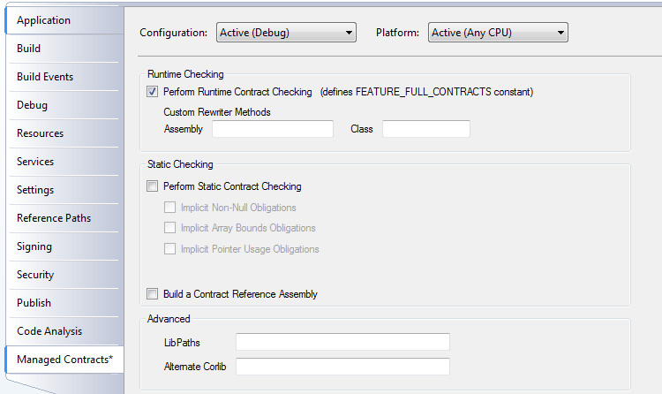
VS Integration Under the Hood
MsBuild hook
Builds declarative assembly
Builds contract reference assemblies
Runs rewriter

Slide 14
Language-agnostic Format
Language-agnostic, persisted contract format
Free produced by all compilers
MSIL encodes conditions
Fixed interpretation
Uniform format to down-stream tools
Library for extracting contracts from MSIL
Compile
/d:Contracts language- agnostic
.method public hidebysig newslot virtual instance int32 Add(object 'value') cil managed
{
ldarg.1
ldnull
ceq
ldc.i4.0
ceq
call void [Microsoft.Contracts]Microsoft.Contracts.Contract::Requires(bool)
ldarg.0
call instance int32 TabDemo.BaseList::get_Count()
ldarg.0
call instance int32 TabDemo.BaseList::get_Count()
call !!0 [Microsoft.Contracts]Microsoft.Contracts.Contract::Old<int32>(!!0)
ldc.i4.1
add
ceq
call void [Microsoft.Contracts]Microsoft.Contracts.Contract::Ensures(bool)
call !!0 [Microsoft.Contracts]Microsoft.Contracts.Contract::Result<int32>()
ldarg.0
call instance int32 TabDemo.BaseList::get_Count()
call !!0 [Microsoft.Contracts]Microsoft.Contracts.Contract::Old<int32>(!!0)
ceq
call void [Microsoft.Contracts]Microsoft.Contracts.Contract::Ensures(bool)
ldarg.0
ldfld int32 TabDemo.BaseList::count
ldarg.0
ldfld object[] TabDemo.BaseList::items
ldlen
conv.i4
ceq
ldc.i4.0
ceq
stloc.1
ldloc.1
brtrue.s IL_0069
ldarg.0
ldarg.0
ldfld int32 TabDemo.BaseList::count
ldc.i4.1
add
call instance void TabDemo.BaseList::EnsureCapacity(int32)
ldarg.0
ldfld object[] TabDemo.BaseList::items
ldarg.0
ldfld int32 TabDemo.BaseList::count
ldarg.1
stelem.ref
ldarg.0
dup
ldfld int32 TabDemo.BaseList::count
dup
stloc.2
ldc.i4.1
add
stfld int32 TabDemo.BaseList::count
ldloc.2
stloc.0
br.s IL_008b
ldloc.0
ret
} // end of method BaseList::Add

Slide 15
Quantification
bool Forall(int from, int to, Func<int,bool> predicate)
bool Exists(int from, int to, Func<int,bool> predicate)
bool Forall(IEnumerable<T> coll, Func<T,bool> predicate)
bool Exists(IEnumerable<T> coll, Func<T,bool> predicate)
Examples
Contract.Forall(0, arr.Length, i => arr[i] == null);
Contract.Exists(mycoll, elem => elem < max);

Slide 16
Contracts On Abstract methods
[ContractClass(typeof(CloneableContract))]
public interface ICloneable { object Clone(); }
public class CloneableContract : ICloneable { object ICloneable.Clone() { Contract.Ensures(Contract.Result<object>() != null); return Contract.Result<object>(); } }

Slide 17
Key Take-Aways
Contract library class enables Contract writing in all source languages
No a-priori restrictions what can be expressed
Compiled contract format is MSIL
Uniform format for tools
Same contracts used for
Runtime checking
Static checking
Documentation generation
…

Slide 18
Research: Theory and Practice
Long history of contract research at MSR
Vault, Fugue, Spec#, SAL, BoogiePL, VerifiedC
Past issues
Expressiveness of contracts
Tech transfer of new programming languages/features
Difficulty of proving “the last mile”
Predictability of checker
Lessons learned
General language of properties (we can’t anticipate all you want to express)
Make it work on existing languages
Non-theorem proving approaches work too
Provide value without proving “last mile”, but make it possible

Slide 19
Static Checking
No silver bullet
False warnings
Prefix/Prefast/FxCop
Masking
SAL
Annotate
Contracts
Write more contracts
Runtime checked
Annotation Overhead
Precision
Performance
Noise
Notes:
We feel we have a better handle.

Slide 20
Clousot: Static Contract Checker
Design goals
Make it practical
Make it fast (and predictable)
Abstract Interpretation-based
Provides control over precision-performance trade-off
Use coarsest abstraction able to prove property of interest
Soundness trade-offs
Invariants (ignoring re-entrancy)
Heap abstraction (non aliasing assumes)
Validates
Non-nullness, array usage, unsafe pointer accesses
Explicit contracts

Slide 21
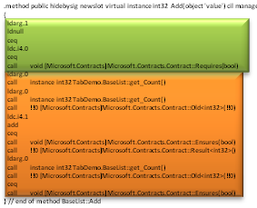
Static Checking
Contract Reference Assemblies
Compile
/d:Contracts language- agnostic
.method public hidebysig newslot virtual instance int32 Add(object 'value') cil managed
{
ldarg.1
ldnull
ceq
ldc.i4.0
ceq
call void [Microsoft.Contracts]Microsoft.Contracts.Contract::Requires(bool)
ldarg.0
call instance int32 TabDemo.BaseList::get_Count()
ldarg.0
call instance int32 TabDemo.BaseList::get_Count()
call !!0 [Microsoft.Contracts]Microsoft.Contracts.Contract::Old<int32>(!!0)
ldc.i4.1
add
ceq
call void [Microsoft.Contracts]Microsoft.Contracts.Contract::Ensures(bool)
call !!0 [Microsoft.Contracts]Microsoft.Contracts.Contract::Result<int32>()
ldarg.0
call instance int32 TabDemo.BaseList::get_Count()
call !!0 [Microsoft.Contracts]Microsoft.Contracts.Contract::Old<int32>(!!0)
ceq
call void [Microsoft.Contracts]Microsoft.Contracts.Contract::Ensures(bool)
ldarg.0
ldfld int32 TabDemo.BaseList::count
ldarg.0
ldfld object[] TabDemo.BaseList::items
ldlen
conv.i4
ceq
ldc.i4.0
ceq
stloc.1
ldloc.1
brtrue.s IL_0069
ldarg.0
ldarg.0
ldfld int32 TabDemo.BaseList::count
ldc.i4.1
add
call instance void TabDemo.BaseList::EnsureCapacity(int32)
ldarg.0
ldfld object[] TabDemo.BaseList::items
ldarg.0
ldfld int32 TabDemo.BaseList::count
ldarg.1
stelem.ref
ldarg.0
dup
ldfld int32 TabDemo.BaseList::count
dup
stloc.2
ldc.i4.1
add
stfld int32 TabDemo.BaseList::count
ldloc.2
stloc.0
br.s IL_008b
ldloc.0
ret
} // end of method BaseList::Add
Static Contract Checking with Clousot
Compile-time warnings

Slide 22
Demo

Slide 23
Abstract Interpretation
long Exp(long x, long y)
y x result
⊥
⊥
⊥
result = 1;
result == 1
y >= 0; result
⊥
y > 0
N
y > 0; result == 1
y even
Y
y > 1; result == 1
y > 0; result == 1
Contract.Assert( y == 0 );
assert y == 0
result *= x;
y--;
x = x * x;
y = y / 2;
return result;
y >= 0; result == x
y > 0; result == 1

Slide 24
Abstract Interpretation
long Exp(long x, long y)
y x result
⊥
⊥
⊥
result = 1;
result
⊥
y >= 0; result
⊥
y > 0
y <= 0
N
y > 0
y even
Y
y > 1
y > 0
assert y == 0
result *= x;
y--;
x = x * x;
y = y / 2;
return result;
y >= 0
y > 0

Slide 25
With Contracts
long Exp(long x, long y)
Contract.Requires( y >= 0 )
assume y >= 0
result = 1;
y >= 0
y > 0
y == 0
N
y > 0
y even
Y
y > 1
y > 0
assert y == 0
result *= x;
y--;
x = x * x;
y = y / 2;
return result;
y >= 0
y > 0

Slide 26
With Post-Condition
long Exp(long x, long y)
Contract.Requires( x >= 0 )
assume x >= 0
result = 1;
x >= 0; result >= 0
y > 0
result >= 0
N
x >= 0; result >= 0; y > 0
y even
Y
x >= 0; result >= 0; y > 1
x >= 0; result >= 0; y > 0
Contract.Ensures( result >= 0 );
assert result >= 0
result *= x;
y--;
x = x * x;
y = y / 2;
return result;
x >= 0; result >= 0; y >= 0
x >= 0; result >= 0; y > 0

Slide 27
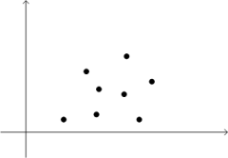
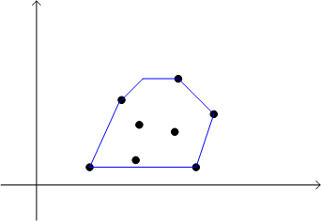
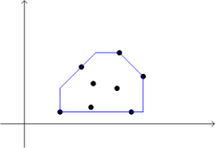
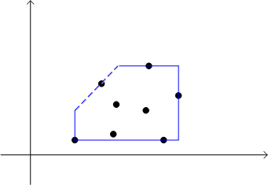
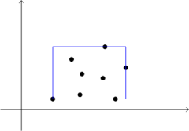
Trade-offs in Abstract Domains
y
Is 0 ≤ y < x ?
Testing: try some points
Model checking: try all the points
Often unbounded
Abstract interpretation: approximation
x
Program executions
Polyhedra
Yes!
in O(2^{n})
Octagons
Yes!
in Θ(n³)
Pentagons
Yes!
in O(n)
Intervals
No ☹
in O(n)
Notes:
Predictability and analysis time
Infers loop invariants
Create domains that are tuned for precision-efficiency trade-off.
Pentagons are good for bounds checking.

Slide 28
Clousot Architecture
Abstract Interpreters
Proof-obligations
Non-null
Non-null
Contracts
Arrays
Arrays
Pointers
Pointers
Abstract Domains
Strings
Numerical
Symbolic
Fix-point Engine
String
Expression IL (expression recovery)
Scalar program (heap eliminated)
Temp IL (stack eliminated)
Subroutines (method, finally, contracts)
MSIL+ (assert, assume, old, ldstack, …)
Contract Extractor
.NET Assembly Reader

Slide 29
MSIL+
Analyzed code is MSIL+
Stack machine
All requires/ensures/invariant calls turn into
assume
assert
Extra synthetic instructions
begin_old
end_old
ldstack.i
ldresult
scall subroutine

Slide 30
Contract subroutines
int increment(int i) {
Contract.Requires(i > 0);
Contract.Ensures(Contract.Result<int>() == i+1);
return i+1;
}
Subroutine : increment.requires
ldarg.1 // i
ldc 0
cgt
assume
Subroutine : increment.ensures
ldresult
begin_old
ldarg.1 // i
end_old
ldc 1
add
ceq
assert

Slide 31
Subroutines and inheritance
B.m.Req
B.Inv
B.m
B.m.Ens
D.Inv
D.m
D.m.Ens

Slide 32
Contract Subroutines at call sites
B.m.Req
B.Inv
B.m.Ens
call D.m
D.Inv
D.m.Ens

Slide 33
.NET Pointer Use
Unsafe (potential crashes and security holes)
Needs contracts similar to SAL
Identified vulnerabilities in System.Drawing.dll
Demo

Slide 34
Preconditions in Retail/Release
Question: How should I write a pre-condition that executes in release builds?
Answer: three options
if-then-throw Contract.EndContract();
RequiresInRetail(…);
Requires(…) - compile with FEATURE_RUNTIME_PRECONDITIONS
Use rewriter to get condition string automatically

Slide 35
Preconditions in Retail/Release
Question: Where should I put preconditions that execute at runtime?
Answer: At methods visible outside your assembly
Internal methods should use Require
Use static checker to push them to public boundary
Allows systematically eliminating redundant checks

Slide 36
Virtuous Cycle
Revise Contracts
Code
Static Validation
More Contracts
Testing

Slide 37
Contract Format: Future Proof
Contracts as MSIL
Provides extension point
bool ProtectedBy<T>(ref T data, object lock);
No lock-in to particular tools
Language integration
C#, VB may provide syntax in the future, emit same format
Foxtrot
FxCop
Clousot
Boogie
Coq, Isabelle
Prove Correct
Find Bugs

Slide 38
Status
Engaged with product groups
Contract class in .NET framework (mscorlib)
.NET Base Class Library
Surfaces implicit existing contracts
Trial with a team in Win7
Sandcastle (doc generation)
Plan to ship tools in dev10 time frame
Working prototypes
Runtime checker
Static checker
VS integration

Slide 39
Future Work
More inference of contracts
Performance
Validate pointer use in existing .NET framework
Concurrency
Specifications (locking, purity, isolation)
Already engaged with PCP on purity

Slide 40
Conclusions
Language-Agnostic Contracts
standard compilers/IDEs csc, vbc, …
persisted as MSIL (semantics fixed)
uniform format for tools
drawbacks
Source context limited to what is in PDB
Abstract methods and interfaces need shadow class for contracts
Foxtrot
instrumentation for runtime checking
contract inheritance
checks well-formedness
Clousot
efficient static checking
Abstract Interpretation based
trades-off practicality vs. soundness

Slide 41
More Info
http://codebox/contracts

Slide 42
Publications
F. Logozzo, M. Fähndrich. On the Relative Completeness of Bytecode Analysis versus Source Code Analysis. In Compiler Construction 2008 (CC’08)
F. Logozzo, M. Fähndrich. Pentagons: A weakly relational domain for the efficient validation of array accesses, in Proceedings of the 23rd ACM Symposium on Applied Computing (SAC 2008)
P. Ferrara, F. Logozzo, M. Fähndrich. Safer Unsafe Code in .NET, in Proceedings of the 23rd annual ACM SIGPLAN conference on Object Oriented Programming Systems and Applications (OOPSLA 2008)
plus two patents

Slide 43
Backup Slides

Slide 44
Release Build with Pre-Condition Checks
Release Compile
.method public hidebysig newslot virtual instance int32 Add(object 'value') cil managed
{
ldarg.1
ldnull
ceq
ldc.i4.0
ceq
call void [Microsoft.Contracts]Microsoft.Contracts.Contract::RequiresInRelease(bool)
ldarg.0
ldfld int32 TabDemo.BaseList::count
ldarg.0
ldfld object[] TabDemo.BaseList::items
ldlen
conv.i4
ceq
ldc.i4.0
ceq
stloc.1
ldloc.1
brtrue.s IL_0029
ldarg.0
ldarg.0
ldfld int32 TabDemo.BaseList::count
ldc.i4.1
add
call instance void TabDemo.BaseList::EnsureCapacity(int32)
ldarg.0
ldfld object[] TabDemo.BaseList::items
ldarg.0
ldfld int32 TabDemo.BaseList::count
ldarg.1
stelem.ref
ldarg.0
dup
ldfld int32 TabDemo.BaseList::count
dup
stloc.2
ldc.i4.1
add
stfld int32 TabDemo.BaseList::count
ldloc.2
stloc.0
br.s IL_004b
ldloc.0
ret
}

