Slide 1


Code Contracts for .NET
Manuel Fähndrich, Mike Barnett, and Francesco Logozzo
2/26/2009

Slide 2
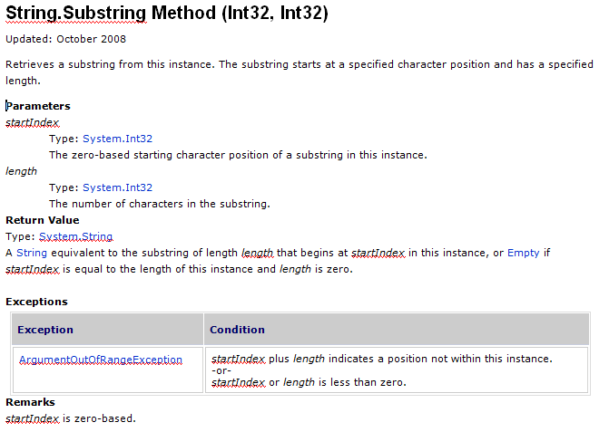
MSDN: Where are the Contracts ?
Notes:
Most of you have probably used MSDN documentation about APIs you are programming against. Some of you may have implemented these APIs. When I go to MSDN, I’m usually looking for documentation on how to use a method. In other words, I’m looking for the contract of the method. The contract should tell me the requirements on my part, the caller, about what values to pass or not to pass. Similarly, the contract should tell me what the method guarantees to me the caller. E.g., returning non-null, etc. Let’s look at an example.

Slide 3
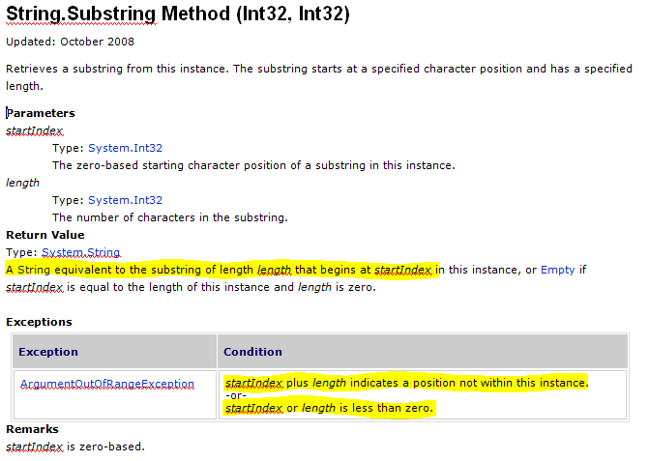
MSDN: Where are the Contracts ?

Slide 4
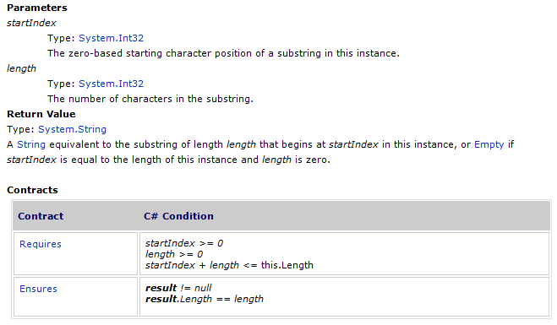
MSDN Tomorrow

Slide 5
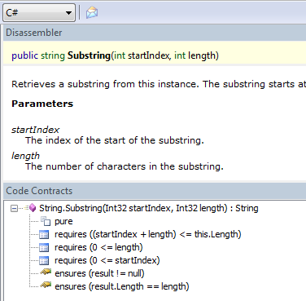
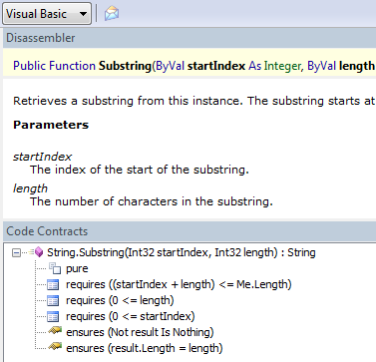
Proof of Concept

Slide 6
Why Contracts?
Contracts document design decisions
Preconditions, postconditions, and object invariants
Facilitate code reuse and evolution
Contracts are executable
Checked documentation
Amplify testing through oracles, including test exploration (Pex)
Contracts help static verification
Early error detection
Clarify responsibility at interfaces
Assertions help, but
Not seen as a contract between 2 parties
Every team has their own
Difficult to tool against
Notes:
Important API and internal code properties are not documented or checked, making coding difficult and maintenance worse.
Same contract thus serves as documentation, acts as runtime checking, and as specification for static checking.

Slide 7
Outline
Language-Agnostic Contracts for .NET
Specifying Contracts in Code
preconditions, postconditions, object invariants
Runtime Checking
Static Checking

Slide 8
Specifying Contracts (C#)
public virtual int Add(object value) { Contract.Requires( value != null ); Contract.Ensures( Count == Contract.OldValue(Count) + 1 ); Contract.Ensures( Contract.Result<int>() == Contract.OldValue(Count) ); if (count == items.Length) EnsureCapacity(count + 1); items[count] = value; return count++; }
Features
Language expression syntax
Type checking / IDE
Declarative
Special Encodings
Result and Old
[ContractInvariantMethod] void ObjectInvariant() { Contract.Invariant( items != null ); }
Notes:
Make a simpler example (too many contracts, explain old better)
Talk about static methods!!!
Questions: what happens at runtime, how can I choose what’s in my build, what’s the methodology (can I rely on the checks?)
Quantifiers?

Slide 9
Specifying Contracts (in VisualBasic)
Function Add( ByVal value As Object ) As Integer
Contract.Requires(value IsNot Nothing)
Contract.Ensures(Count = Contract.OldValue(Count) + 1)
Contract.Ensures(Contract.Result(Of Integer)() = Contract.OldValue(Count))
If _items.Length = _count Then
EnsureCapacity(_count + 1)
End If
_items(_count) = value
Dim oldCount = _count
_count = _count + 1
Return oldCount
End Function

Slide 10
Static Methods as Contract Markers
namespace System.Diagnostics.Contracts {
public static class Contract {
public static void Requires(bool condition) { … }
public static void Ensures(bool condition) { … }
public static void Invariant(bool condition) { … }
public static T Result<T>() { … }
public static T OldValue<T>(T value) { … }
...
} }
Library reusable from C#, VisualBasic, F#, …

Slide 11
Contracts == Metadata + IL
Contracts are written in development language
Standard IDE
Standard compilers translate contracts to IL
csc, vbc, …
Downstream tools extract contracts from IL
ccrewrite
ccrefgen
cccheck

Slide 12
Demo

Slide 13
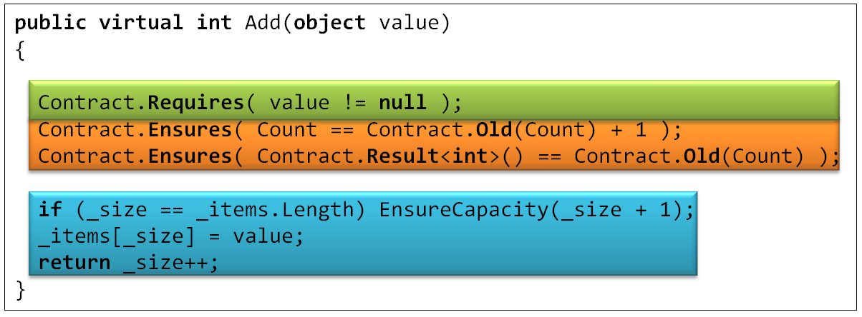
Compilation and Runtime Checking
Executable runtime
Contract checking
Compile
/d:CONTRACTS_FULL
.method public hidebysig newslot virtual instance int32 Add(object 'value') cil managed
{
.locals init (int32 'Contract.Old(Count)',
int32 'Contract.Result<int>()')
ldarg.1
ldnull
ceq
ldc.i4.0
ceq
ldstr "value != null"
call void __RewriterMethods::RewriterRequires$PST06000009(bool, string)ldarg.0
ldarg.0
call instance int32 TabDemo.BaseList::get_Count()
stloc.3
ldarg.0
ldfld int32 TabDemo.BaseList::count
ldarg.0
ldfld object[] TabDemo.BaseList::items
ldlen
conv.i4
ceq
ldc.i4.0
ceq
stloc.1
ldloc.1
brtrue IL_004d
nop
ldarg.0
ldarg.0
ldfld int32 TabDemo.BaseList::count
ldc.i4.1
add
call instance void TabDemo.BaseList::EnsureCapacity(int32)
nop
nop
ldarg.0
ldfld object[] TabDemo.BaseList::items
ldarg.0
ldfld int32 TabDemo.BaseList::count
ldarg.1
stelem.ref
ldarg.0
dup
ldfld int32 TabDemo.BaseList::count
dup
stloc.2
ldc.i4.1
add
stfld int32 TabDemo.BaseList::count
ldloc.2
stloc.0
br IL_0072
ldloc.0
stloc.s 'Contract.Result<int>()'
br IL_007a
ldarg.0
call instance int32 TabDemo.BaseList::get_Count()
ldloc.3
ldc.i4.1
add
ceq
ldstr "Count == Contract.Old(Count) + 1"
call void __RewriterMethods::RewriterEnsures$PST0600000B(bool, string)
ldloc.s 'Contract.Result<int>()'
ldloc.s V_4
ceq
ldstr "Contract.Result<int>() == Contract.Old(Count)"
call void __RewriterMethods::RewriterEnsures$PST0600000B(bool, string)
ldloc.s 'Contract.Result<int>()'
ret
}
Release Compile
.method public hidebysig newslot virtual instance int32 Add(object 'value') cil managed
{
ldarg.1
ldnull
ceq
ldc.i4.0
ceq
call void [Microsoft.Contracts]Microsoft.Contracts.Contract::Requires(bool)
ldarg.0
call instance int32 TabDemo.BaseList::get_Count()
ldarg.0
call instance int32 TabDemo.BaseList::get_Count()
call !!0 [Microsoft.Contracts]Microsoft.Contracts.Contract::Old<int32>(!!0)
ldc.i4.1
add
ceq
call void [Microsoft.Contracts]Microsoft.Contracts.Contract::Ensures(bool)
call !!0 [Microsoft.Contracts]Microsoft.Contracts.Contract::Result<int32>()
ldarg.0
call instance int32 TabDemo.BaseList::get_Count()
call !!0 [Microsoft.Contracts]Microsoft.Contracts.Contract::Old<int32>(!!0)
ceq
call void [Microsoft.Contracts]Microsoft.Contracts.Contract::Ensures(bool)
ldarg.0
ldfld int32 TabDemo.BaseList::count
ldarg.0
ldfld object[] TabDemo.BaseList::items
ldlen
conv.i4
ceq
ldc.i4.0
ceq
stloc.1
ldloc.1
brtrue.s IL_0069
ldarg.0
ldarg.0
ldfld int32 TabDemo.BaseList::count
ldc.i4.1
add
call instance void TabDemo.BaseList::EnsureCapacity(int32)
ldarg.0
ldfld object[] TabDemo.BaseList::items
ldarg.0
ldfld int32 TabDemo.BaseList::count
ldarg.1
stelem.ref
ldarg.0
dup
ldfld int32 TabDemo.BaseList::count
dup
stloc.2
ldc.i4.1
add
stfld int32 TabDemo.BaseList::count
ldloc.2
stloc.0
br.s IL_008b
ldloc.0
ret
} // end of method BaseList::Add
Rewrite IL
.method public hidebysig newslot virtual instance int32 Add(object 'value') cil managed
{
ldarg.0
ldfld int32 TabDemo.BaseList::count
ldarg.0
ldfld object[] TabDemo.BaseList::items
ldlen
conv.i4
ceq
ldc.i4.0
ceq
stloc.1
ldloc.1
brtrue.s IL_0029
ldarg.0
ldarg.0
ldfld int32 TabDemo.BaseList::count
ldc.i4.1
add
call instance void TabDemo.BaseList::EnsureCapacity(int32)
ldarg.0
ldfld object[] TabDemo.BaseList::items
ldarg.0
ldfld int32 TabDemo.BaseList::count
ldarg.1
stelem.ref
ldarg.0
dup
ldfld int32 TabDemo.BaseList::count
dup
stloc.2
ldc.i4.1
add
stfld int32 TabDemo.BaseList::count
ldloc.2
stloc.0
br.s IL_004b
ldloc.0
ret
}
Inheritance
WF checks
Invariants

Slide 14
What do you ship?
src
src
src
src
Release Assemblies
Contract Reference Assemblies
PowerLib.dll
PowerLib.Contracts.dll
+
(minimal runtime checks)
All contracts, no code

Slide 15
Contract Reference Assemblies
Language-agnostic, persisted contract format
Free produced by all compilers
MSIL encodes conditions
Fixed interpretation
Uniform format to down-stream tools
Library for extracting contracts from MSIL
Compile
/d:CONTRACTS_FULL
Contract Reference Assembly
.method public hidebysig newslot virtual instance int32 Add(object 'value') cil managed
{
ldarg.1
ldnull
ceq
ldc.i4.0
ceq
call void [Microsoft.Contracts]Microsoft.Contracts.Contract::Requires(bool)
ldarg.0
call instance int32 TabDemo.BaseList::get_Count()
ldarg.0
call instance int32 TabDemo.BaseList::get_Count()
call !!0 [Microsoft.Contracts]Microsoft.Contracts.Contract::Old<int32>(!!0)
ldc.i4.1
add
ceq
call void [Microsoft.Contracts]Microsoft.Contracts.Contract::Ensures(bool)
call !!0 [Microsoft.Contracts]Microsoft.Contracts.Contract::Result<int32>()
ldarg.0
call instance int32 TabDemo.BaseList::get_Count()
call !!0 [Microsoft.Contracts]Microsoft.Contracts.Contract::Old<int32>(!!0)
ceq
call void [Microsoft.Contracts]Microsoft.Contracts.Contract::Ensures(bool)
ldarg.0
ldfld int32 TabDemo.BaseList::count
ldarg.0
ldfld object[] TabDemo.BaseList::items
ldlen
conv.i4
ceq
ldc.i4.0
ceq
stloc.1
ldloc.1
brtrue.s IL_0069
ldarg.0
ldarg.0
ldfld int32 TabDemo.BaseList::count
ldc.i4.1
add
call instance void TabDemo.BaseList::EnsureCapacity(int32)
ldarg.0
ldfld object[] TabDemo.BaseList::items
ldarg.0
ldfld int32 TabDemo.BaseList::count
ldarg.1
stelem.ref
ldarg.0
dup
ldfld int32 TabDemo.BaseList::count
dup
stloc.2
ldc.i4.1
add
stfld int32 TabDemo.BaseList::count
ldloc.2
stloc.0
br.s IL_008b
ldloc.0
ret
} // end of method BaseList::Add
.method public hidebysig newslot virtual instance int32 Add(object 'value') cil managed
{
ldarg.1
ldnull
ceq
ldc.i4.0
ceq
call void [Microsoft.Contracts]Microsoft.Contracts.Contract::Requires(bool)
ldarg.0
call instance int32 TabDemo.BaseList::get_Count()
ldarg.0
call instance int32 TabDemo.BaseList::get_Count()
call !!0 [Microsoft.Contracts]Microsoft.Contracts.Contract::Old<int32>(!!0)
ldc.i4.1
add
ceq
call void [Microsoft.Contracts]Microsoft.Contracts.Contract::Ensures(bool)
call !!0 [Microsoft.Contracts]Microsoft.Contracts.Contract::Result<int32>()
ldarg.0
call instance int32 TabDemo.BaseList::get_Count()
call !!0 [Microsoft.Contracts]Microsoft.Contracts.Contract::Old<int32>(!!0)
ceq
call void [Microsoft.Contracts]Microsoft.Contracts.Contract::Ensures(bool)
} // end of method BaseList::Add
ccrefgen

Slide 16
Static Contract Checking
No silver bullet
False warnings
Prefix/Prefast/FxCop
Masking
SAL
Annotate
Contracts
More expressive contracts
Runtime checked
Annotation Overhead
Precision
Performance
Noise
Notes:
We feel we have a better handle.

Slide 17
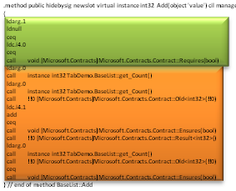
Static Contract Checking
Contract Reference Assemblies
Compile
/d:CONTRACTS_FULL
.method public hidebysig newslot virtual instance int32 Add(object 'value') cil managed
{
ldarg.1
ldnull
ceq
ldc.i4.0
ceq
call void [Microsoft.Contracts]Microsoft.Contracts.Contract::Requires(bool)
ldarg.0
call instance int32 TabDemo.BaseList::get_Count()
ldarg.0
call instance int32 TabDemo.BaseList::get_Count()
call !!0 [Microsoft.Contracts]Microsoft.Contracts.Contract::Old<int32>(!!0)
ldc.i4.1
add
ceq
call void [Microsoft.Contracts]Microsoft.Contracts.Contract::Ensures(bool)
call !!0 [Microsoft.Contracts]Microsoft.Contracts.Contract::Result<int32>()
ldarg.0
call instance int32 TabDemo.BaseList::get_Count()
call !!0 [Microsoft.Contracts]Microsoft.Contracts.Contract::Old<int32>(!!0)
ceq
call void [Microsoft.Contracts]Microsoft.Contracts.Contract::Ensures(bool)
ldarg.0
ldfld int32 TabDemo.BaseList::count
ldarg.0
ldfld object[] TabDemo.BaseList::items
ldlen
conv.i4
ceq
ldc.i4.0
ceq
stloc.1
ldloc.1
brtrue.s IL_0069
ldarg.0
ldarg.0
ldfld int32 TabDemo.BaseList::count
ldc.i4.1
add
call instance void TabDemo.BaseList::EnsureCapacity(int32)
ldarg.0
ldfld object[] TabDemo.BaseList::items
ldarg.0
ldfld int32 TabDemo.BaseList::count
ldarg.1
stelem.ref
ldarg.0
dup
ldfld int32 TabDemo.BaseList::count
dup
stloc.2
ldc.i4.1
add
stfld int32 TabDemo.BaseList::count
ldloc.2
stloc.0
br.s IL_008b
ldloc.0
ret
} // end of method BaseList::Add
cccheck
Compile-time warnings

Slide 18
Demo

Slide 19
cccheck Architecture
Requires and Ensures Inference
Abstract Interpreters
Weakest precond.
backward
analysis
Proof-obligations
Non-null
Contracts
Non-null
Arrays
Pointers
Arrays
Pointers
Abstract Domains
Strings
Numerical
Symbolic
Fix-point Engine
String
Expression refinement
Used in conditionals and some transfer functions
Expression IL (expression recovery)
Similar to SSA form
Suitable for Abstract Interpretation
Old eliminated
Scalar program (heap eliminated)
Temp IL (stack eliminated)
requires/ensures/invariant are subroutines
spliced in where needed
Subroutines (method, finally, contracts)
MSIL+ (assert, assume, old, ldstack, …)
Turns calls into primitives
Contract Extractor + CFG Builder
.NET Assembly Reader

Slide 20
Pros and Cons of IL Verification
Pros
Relatively small language of instructions
Well-specified semantics
Type/name/overloading resolution done by compiler
Targeted by multiple languages (C#,VB,F#,…)
Cons
Some expression recovery needed
or abstract domains get too complicated (CC’08)
Source context missing
Abstractions are lost / some need to be recovered
Closures, Iterators, etc…

Slide 21
Contract Format: Future Proof
Contracts as MSIL
Provides extension point
bool ProtectedBy<T>(ref T data, object lock);
No lock-in to particular tools
Language integration
C#, VB may provide syntax in the future, emit same format
CCrewrite
FxCop
CCCheck
Boogie
Coq, Isabelle
Prove Correct
Find Bugs

Slide 22
Conclusions
Contract library class enables Contract writing in all source languages
No a-priori restrictions what can be expressed
Compiled contract format is Metadata + MSIL
Uniform format for tools
Same contracts used for
Runtime checking
Static checking
Documentation generation
Available externally
Academic and DevLabs licenses.

Slide 23
More Information
Internal
http://codebox/contracts
External
http://research.microsoft.com/contracts
http://msdn.microsoft.com/devlabs/dd491992.aspx
Email
mailto:maf@microsoft.com
mailto:mbarnett@microsoft.com

Slide 24
Backup Slides

Slide 25
Future Work
Support for contracts on
Iterators
Closures
Delegates
Better contract inference
Cross-assembly persistence
Concurrency

Slide 26
Specifications where no Code allowed
[ ContractClass( typeof( CloneableContract )) ]
public interface ICloneable { object Clone(); }
public class CloneableContract : ICloneable { object ICloneable.Clone() { Contract.Ensures(Contract.Result<object>() != null); Contract.Ensures(Contract.Result<object>().GetType() == this.GetType()); return default(object); } }

Slide 27
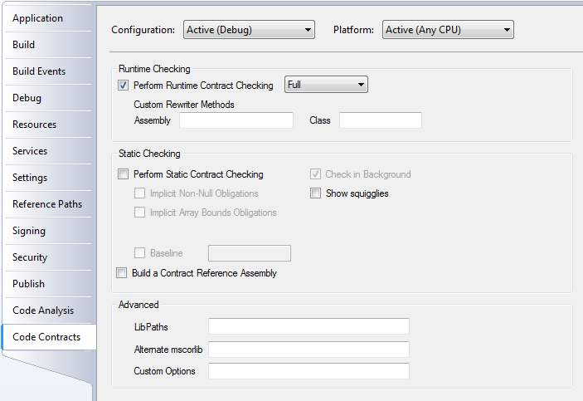
VS Integration Under the Hood
MsBuild hook
Builds declarative assembly
Builds contract reference assemblies
Runs rewriter

Slide 28
Preconditions in Retail/Release
Question: How should I write a pre-condition that executes in release builds?
Answer: three options
if-then-throw Contract.EndContract();
RequiresInRetail(…);
Requires(…) - compile with FEATURE_RUNTIME_PRECONDITIONS
Use rewriter to get condition string automatically

Slide 29
Preconditions in Retail/Release
Question: Where should I put preconditions that execute at runtime?
Answer: At methods visible outside your assembly
Internal methods should use Require
Use static checker to push them to public boundary
Allows systematically eliminating redundant checks

Slide 30
Release Build with Pre-Condition Checks
Release Compile
.method public hidebysig newslot virtual instance int32 Add(object 'value') cil managed
{
ldarg.1
ldnull
ceq
ldc.i4.0
ceq
call void [Microsoft.Contracts]Microsoft.Contracts.Contract::RequiresInRelease(bool)
ldarg.0
ldfld int32 TabDemo.BaseList::count
ldarg.0
ldfld object[] TabDemo.BaseList::items
ldlen
conv.i4
ceq
ldc.i4.0
ceq
stloc.1
ldloc.1
brtrue.s IL_0029
ldarg.0
ldarg.0
ldfld int32 TabDemo.BaseList::count
ldc.i4.1
add
call instance void TabDemo.BaseList::EnsureCapacity(int32)
ldarg.0
ldfld object[] TabDemo.BaseList::items
ldarg.0
ldfld int32 TabDemo.BaseList::count
ldarg.1
stelem.ref
ldarg.0
dup
ldfld int32 TabDemo.BaseList::count
dup
stloc.2
ldc.i4.1
add
stfld int32 TabDemo.BaseList::count
ldloc.2
stloc.0
br.s IL_004b
ldloc.0
ret
}

