Slide 1
Code Contracts
Using Code as Specification
Manuel Fahndrich (maf)
SAL Meeting 6/2/2009

Slide 2
Basic Idea of Code Contracts
Write Specification Conditions as Code
Let compilers parse/check/emit conditions in special builds
Tools extract the conditions from the IL/binary for
static checking
runtime instrumentation
or documentation

Slide 3
Why use Code?
Specifications written in programmer’s language
Compiler parses/checks/translates code
Overloading resolution done (e.g. &)
Semantics reduced to lower language with fewer constructs (e.g., VB/C# vs. MSIL)
Infinitely extensible
It’s all just expressions and function calls

Slide 4
CodeContracts for C#
public virtual int Add(object value) { Contract.Requires( value != null ); Contract.Ensures( Count == Contract.OldValue(Count) + 1 ); Contract.Ensures( Contract.Result<int>() == Contract.OldValue(Count) ); if (count == items.Length) EnsureCapacity(count + 1); items[count] = value; return count++; }
Features
Language expression syntax
Type checking / IDE
Declarative
Special Encodings
Result and Old
[ContractInvariantMethod] void ObjectInvariant() { Contract.Invariant( items != null ); }
Notes:
Make a simpler example (too many contracts, explain old better)
Talk about static methods!!!
Questions: what happens at runtime, how can I choose what’s in my build, what’s the methodology (can I rely on the checks?)
Quantifiers?

Slide 5
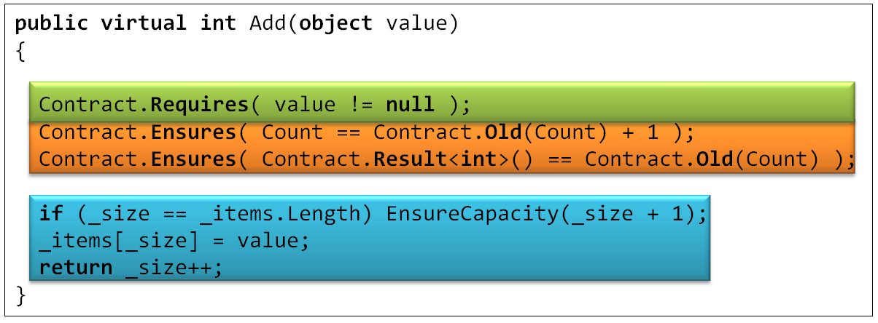
Tool Chain
Compile
/d:CONTRACTS_FULL
Release Compile
.method public hidebysig newslot virtual instance int32 Add(object 'value') cil managed
{
ldarg.1
ldnull
ceq
ldc.i4.0
ceq
call void [Microsoft.Contracts]Microsoft.Contracts.Contract::Requires(bool)
ldarg.0
call instance int32 TabDemo.BaseList::get_Count()
ldarg.0
call instance int32 TabDemo.BaseList::get_Count()
call !!0 [Microsoft.Contracts]Microsoft.Contracts.Contract::Old<int32>(!!0)
ldc.i4.1
add
ceq
call void [Microsoft.Contracts]Microsoft.Contracts.Contract::Ensures(bool)
call !!0 [Microsoft.Contracts]Microsoft.Contracts.Contract::Result<int32>()
ldarg.0
call instance int32 TabDemo.BaseList::get_Count()
call !!0 [Microsoft.Contracts]Microsoft.Contracts.Contract::Old<int32>(!!0)
ceq
call void [Microsoft.Contracts]Microsoft.Contracts.Contract::Ensures(bool)
ldarg.0
ldfld int32 TabDemo.BaseList::count
ldarg.0
ldfld object[] TabDemo.BaseList::items
ldlen
conv.i4
ceq
ldc.i4.0
ceq
stloc.1
ldloc.1
brtrue.s IL_0069
ldarg.0
ldarg.0
ldfld int32 TabDemo.BaseList::count
ldc.i4.1
add
call instance void TabDemo.BaseList::EnsureCapacity(int32)
ldarg.0
ldfld object[] TabDemo.BaseList::items
ldarg.0
ldfld int32 TabDemo.BaseList::count
ldarg.1
stelem.ref
ldarg.0
dup
ldfld int32 TabDemo.BaseList::count
dup
stloc.2
ldc.i4.1
add
stfld int32 TabDemo.BaseList::count
ldloc.2
stloc.0
br.s IL_008b
ldloc.0
ret
} // end of method BaseList::Add
.method public hidebysig newslot virtual instance int32 Add(object 'value') cil managed
{
ldarg.0
ldfld int32 TabDemo.BaseList::count
ldarg.0
ldfld object[] TabDemo.BaseList::items
ldlen
conv.i4
ceq
ldc.i4.0
ceq
stloc.1
ldloc.1
brtrue.s IL_0029
ldarg.0
ldarg.0
ldfld int32 TabDemo.BaseList::count
ldc.i4.1
add
call instance void TabDemo.BaseList::EnsureCapacity(int32)
ldarg.0
ldfld object[] TabDemo.BaseList::items
ldarg.0
ldfld int32 TabDemo.BaseList::count
ldarg.1
stelem.ref
ldarg.0
dup
ldfld int32 TabDemo.BaseList::count
dup
stloc.2
ldc.i4.1
add
stfld int32 TabDemo.BaseList::count
ldloc.2
stloc.0
br.s IL_004b
ldloc.0
ret
}
ldarg.1
ldnull
ceq
ldc.i4.0
ceq
call void [Microsoft.Contracts]Microsoft.Contracts.Contract::Requires(bool)
Extract
Tools
ldarg.0
call instance int32 TabDemo.BaseList::get_Count()
ldarg.0
call instance int32 TabDemo.BaseList::get_Count()
call !!0 [Microsoft.Contracts]Microsoft.Contracts.Contract::Old<int32>(!!0)
ldc.i4.1
add
ceq
call void [Microsoft.Contracts]Microsoft.Contracts.Contract::Ensures(bool)
call !!0 [Microsoft.Contracts]Microsoft.Contracts.Contract::Result<int32>()
ldarg.0
call instance int32 TabDemo.BaseList::get_Count()
call !!0 [Microsoft.Contracts]Microsoft.Contracts.Contract::Old<int32>(!!0)
ceq
call void [Microsoft.Contracts]Microsoft.Contracts.Contract::Ensures(bool)

Slide 6
Separate Compilation
src
src
src
src
Release DLLs
Contract Reference DLLs
Lib.dll
Lib.Contracts.dll
+
All contracts, no bodies

Slide 7
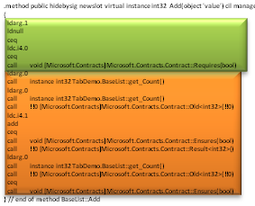
Checking Code Against Contracts
Contract Reference DLLs
Compile
/d:CONTRACTS_FULL
.method public hidebysig newslot virtual instance int32 Add(object 'value') cil managed
{
ldarg.1
ldnull
ceq
ldc.i4.0
ceq
call void [Microsoft.Contracts]Microsoft.Contracts.Contract::Requires(bool)
ldarg.0
call instance int32 TabDemo.BaseList::get_Count()
ldarg.0
call instance int32 TabDemo.BaseList::get_Count()
call !!0 [Microsoft.Contracts]Microsoft.Contracts.Contract::Old<int32>(!!0)
ldc.i4.1
add
ceq
call void [Microsoft.Contracts]Microsoft.Contracts.Contract::Ensures(bool)
call !!0 [Microsoft.Contracts]Microsoft.Contracts.Contract::Result<int32>()
ldarg.0
call instance int32 TabDemo.BaseList::get_Count()
call !!0 [Microsoft.Contracts]Microsoft.Contracts.Contract::Old<int32>(!!0)
ceq
call void [Microsoft.Contracts]Microsoft.Contracts.Contract::Ensures(bool)
ldarg.0
ldfld int32 TabDemo.BaseList::count
ldarg.0
ldfld object[] TabDemo.BaseList::items
ldlen
conv.i4
ceq
ldc.i4.0
ceq
stloc.1
ldloc.1
brtrue.s IL_0069
ldarg.0
ldarg.0
ldfld int32 TabDemo.BaseList::count
ldc.i4.1
add
call instance void TabDemo.BaseList::EnsureCapacity(int32)
ldarg.0
ldfld object[] TabDemo.BaseList::items
ldarg.0
ldfld int32 TabDemo.BaseList::count
ldarg.1
stelem.ref
ldarg.0
dup
ldfld int32 TabDemo.BaseList::count
dup
stloc.2
ldc.i4.1
add
stfld int32 TabDemo.BaseList::count
ldloc.2
stloc.0
br.s IL_008b
ldloc.0
ret
} // end of method BaseList::Add
cccheck
Compile-time warnings
Uniform Analysis of IL
Method bodies
Contracts
IL to evaluate condition
+ Assert or Assume

Slide 8
CodeContracts for C++ ?
Requires, Ensures, etc. macros
Empty in normal builds
Calls in contract builds
Use at head of function bodies
Use Vulcan/Phoenix to extract contracts
Analyze compiled code rather than source
Uniform treatment of code and contracts and same semantics
Drawbacks
Contracts not in headers (but can generate doc)
Reliance on PDBs for connection to source/metadata
X86 is lower level than IL (maybe hook into CIL)
Lack of annotations on typedefs

Slide 9
Backups

Slide 10
Specifications where no Code allowed
[ ContractClass( typeof( CloneableContract )) ]
public interface ICloneable { object Clone(); }
public class CloneableContract : ICloneable { object ICloneable.Clone() { Contract.Ensures(Contract.Result<object>() != null); Contract.Ensures(Contract.Result<object>().GetType() == this.GetType()); return default(object); } }

Slide 11
Contract Format: Future Proof
Contracts as MSIL
Provides extension point
bool ProtectedBy<T>(ref T data, object lock);
No lock-in to particular tools
Language integration
C#, VB may provide syntax in the future, emit same format
CCrewrite
FxCop
CCCheck
Boogie
Coq, Isabelle
Prove Correct
Find Bugs

