Slide 1
Code Contracts
2/24/2012
logozzo, maf, mbarnett,, briangru
http://codebox/contracts

Slide 2
What are Code Contracts?
Standard, language-agnostic way to express
Preconditions
Postconditions
Object invariants
Tools for
Runtime checking of contracts
Documentation generation
Static verification

Slide 3
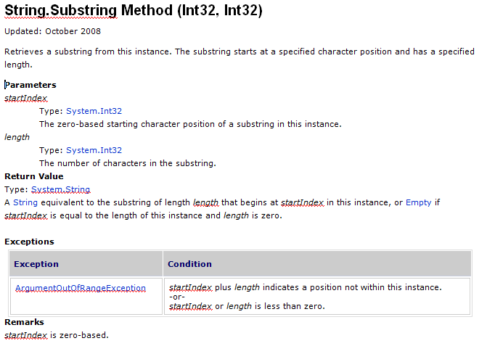
Informal Contracts Already Exist
Notes:
Most of you have probably used MSDN documentation about APIs you are programming against. Some of you may have implemented these APIs. When I go to MSDN, I’m usually looking for documentation on how to use a method. In other words, I’m looking for the contract of the method. The contract should tell me the requirements on my part, the caller, about what values to pass or not to pass. Similarly, the contract should tell me what the method guarantees to me the caller. E.g., returning non-null, etc. Let’s look at an example.

Slide 4
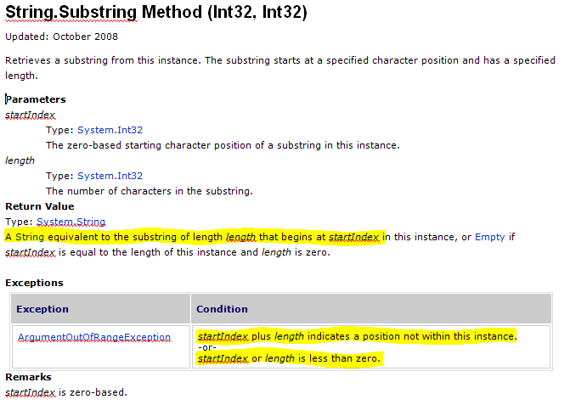
Informal Contracts Already Exist

Slide 5
Goals for Code Contracts
Specify design decisions once Use many times…
Code documentation (in sync with code)
Documentation generation
Runtime checking
Static verification
Don’t change existing .NET dev environment
Languages, IDE, compilers, etc.
Provide a standard specification format
Enable tool eco-system around contracts

Slide 6
Example
/// <summary> Removes suffix from original </summary>
///
public string TrimSuffix(string original, string suffix)
{
Contract.Requires(original != null);
Contract.Requires(!String.IsEmptyOrNull(suffix));
Contract.Ensures(!Contract.Result<string>().EndsWith(suffix));
var result = original
while (result.EndsWith(suffix))
{
result = result.Substring(0, result.Length – suffix.Length);
}
return result;
}

Slide 7
Example
/// <summary> Removes suffix from original </summary>
///
public string TrimSuffix(string original, string suffix)
{
Contract.Requires(original != null);
Contract.Requires(!String.IsEmptyOrNull(suffix));
Contract.Ensures(!Contract.Result<string>().EndsWith(suffix));
var result = original;
if (result.EndsWith(suffix))
{
result = result.Substring(0, result.Length – suffix.Length);
}
return result;
}

Slide 8
Example
/// <summary> Removes suffix from original </summary>
///
public string TrimSuffix(string original, string suffix)
{
Contract.Requires(original != null);
Contract.Requires(!String.IsEmptyOrNull(suffix));
Contract.Ensures(!Contract.Result<string>().EndsWith(suffix));
var result = original;
if (result.EndsWith(suffix))
{
result = result.Substring(0, result.Length – suffix.Length);
}
return result;
}

Slide 9
Example
/// <summary> Removes suffix from original </summary>
///
public string TrimSuffix(string original, string suffix)
{
Contract.Requires(original != null);
Contract.Requires(suffix != null);
Contract.Ensures(!Contract.Result<string>().EndsWith(suffix));
var result = original;
if (result.EndsWith(suffix))
{
result = result.Substring(0, result.Length – suffix.Length);
}
return result;
}

Slide 10
Example
/// <summary> Removes suffix from original </summary>
///
public string TrimSuffix(string original, string suffix)
{
Contract.Requires(original != null);
Contract.Requires(suffix != null);
Contract.Ensures(!Contract.Result<string>().EndsWith(suffix));
var result = original;
if (result.EndsWith(suffix))
{
result = result.Substring(0, result.Length – suffix.Length);
}
return result;
}

Slide 11
Code Contracts Overview
ccrewrite
cccheck
ccdocgen
ccrefgen
Tools
Contracts
BCL 4.0
Authoring
VS2010
Sandcastle
Presentation

Slide 12
Example
/// <summary> Removes suffix from original </summary>
///
public string TrimSuffix(string original, string suffix)
{
Contract.Requires(original != null);
Contract.Requires(suffix != null);
Contract.Ensures(!Contract.Result<string>().EndsWith(suffix));
var result = original;
if (result.EndsWith(suffix))
{
result = result.Substring(0, result.Length – suffix.Length);
}
return result;
}
2 Bugs

Slide 13
Example
/// <summary> Removes suffix from original </summary>
///
public string TrimSuffix(string original, string suffix)
{
Contract.Requires(original != null);
Contract.Requires(suffix != null);
Contract.Ensures(!Contract.Result<string>().EndsWith(suffix));
var result = original;
if (result.EndsWith(suffix))
{
result = result.Substring(0, result.Length – suffix.Length);
}
return result;
}
Bug 1
original = “foo” suffix = “”
result = “foo”

Slide 14
Example
/// <summary> Removes suffix from original </summary>
///
public string TrimSuffix(string original, string suffix)
{
Contract.Requires(original != null);
Contract.Requires(!String.IsEmptyOrNull(suffix));
Contract.Ensures(!Contract.Result<string>().EndsWith(suffix));
var result = original;
if (result.EndsWith(suffix))
{
result = result.Substring(0, result.Length – suffix.Length);
}
return result;
}
Strengthened
Precondition

Slide 15
Example
/// <summary> Removes suffix from original </summary>
///
public string TrimSuffix(string original, string suffix)
{
Contract.Requires(original != null);
Contract.Requires(!String.IsEmptyOrNull(suffix));
Contract.Ensures(!Contract.Result<string>().EndsWith(suffix));
var result = original;
if (result.EndsWith(suffix))
{
result = result.Substring(0, result.Length – suffix.Length);
}
return result;
}
Bug 2
original = “foo” suffix = “o”
result = “fo”

Slide 16
Example
/// <summary> Removes suffix from original </summary>
///
public string TrimSuffix(string original, string suffix)
{
Contract.Requires(original != null);
Contract.Requires(!String.IsEmptyOrNull(suffix));
Contract.Ensures(!Contract.Result<string>().EndsWith(suffix));
var result = original;
while (result.EndsWith(suffix))
{
result = result.Substring(0, result.Length – suffix.Length);
}
return result;
}
Handle repeated
suffixes

Slide 17
Contracts Authored as Code
No new language, compilers, IDEs
Boolean expression in language used
No a-priori restrictions what can be expressed
Intellisense, refactoring, error checking, debugging, …
Compiled contract format is .NET CIL
Compiler translates to CIL
Semantics provided by ECMA CIL standard
Uniform persisted format for tools

Slide 18
Contract API in CLR 4.0
namespace System.Diagnostics.Contracts {
public static class Contract
{
[Conditional(“CONTRACTS_FULL”)]
public static void Requires(bool condition) {}
[Conditional(“CONTRACTS_FULL”)]
public static void Ensures(bool condition) {}
[Conditional(“CONTRACTS_FULL”)]
public static void Invariant(bool condition) {}
…
}
}

Slide 19
Preconditions
namespace System.Diagnostics.Contracts {
public static class Contract
{
[Conditional(“CONTRACTS_FULL”)]
public static void Requires(bool condition) {}
condition must
be true at method entry
only contain pure members
reference members as visible as the method
Requires is conditionally defined

Slide 20
Postconditions
namespace System.Diagnostics.Contracts {
public static class Contract
{
[Conditional(“CONTRACTS_FULL”)]
public static void Ensures(bool condition) {}
condition must
be true at normal method exits
The call to ensures appears before any code
Runtime checking enforced by rewriter
What about
The return value?
The old value?

Slide 21
Return and Old values
namespace System.Diagnostic.Contracts
{
public static class Contract
{
public static T Result<T>() { return default(T); }
public static T OldValue<T>(T v) { return default(T); }
Essentially placeholders
No way to express them in C#/VB …
Question:
Why generics?

Slide 22
Expressiveness: Quantifiers
/// <summary> Removes suffix from original </summary>
///
public string TrimSuffix(string original, string suffix)
{
Contract.Requires(original != null);
Contract.Requires(!String.IsEmptyOrNull(suffix));
Contract.Ensures(!Contract.Result<string>().EndsWith(suffix));
Contract.Ensures(Contract.ForAll(0,
Contract.Result<string>().Length,
i => Contract.Result<string>()[i] == original[i]));
}

Slide 23
Interface Contracts
[ContractClass(typeof(IListContract<>))]
public interface IList<T> : ICollection<T>
{
…
void RemoveAt(int index);
}
[ContractClassFor(typeof(IList<>))]
public class IListContract<T> : IList<T>
{
…
public void RemoveAt(int index)
{
Contract.Requires(index >= 0);
Contract.Requires(index < this.Count);
Contract.Ensures(this.Count == Contract.OldValue(this.Count) - 1);
}
}

Slide 24
Interface Contracts
[ContractClass(typeof(IListContract<>))]
public interface IList<T> : ICollection<T>
{
…
void RemoveAt(int index);
}
[ContractClassFor(typeof(IList<>))]
public class IListContract<T> : IList<T>
{
…
public void RemoveAt(int index)
{
Contract.Requires(index >= 0);
Contract.Requires(index < this.Count);
Contract.Ensures(this.Count == Contract.OldValue(this.Count) - 1);
}
}

Slide 25
Interface Contracts
[ContractClass(typeof(IListContract<>))]
public interface IList<T> : ICollection<T>
{
…
void RemoveAt(int index);
}
[ContractClassFor(typeof(IList<>))]
public class IListContract<T> : IList<T>
{
…
public void RemoveAt(int index)
{
Contract.Requires(index >= 0);
Contract.Requires(index < this.Count);
Contract.Ensures(this.Count == Contract.OldValue(this.Count) - 1);
}
}

Slide 26
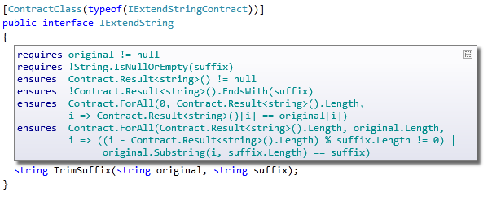
Contract Adornments (VS2010)
Shows inherited contracts
Shows interface contracts on interface
Shows contracts on metadata

Slide 27
Object Invariants
public class MyCollection
{
///<summary>data is never null<summary>
int[] data;
///<summary>count is non-negative and less equal data.Length<summary>
int count;
[ContractInvariantMethod]
void DataCountInvariants() {
Contract.Invariant( data != null );
Contract.Invariant( count >= 0 );
Contract.Invariant( count <= data.Length );
}
}

Slide 28
Object Invariants
public class MyCollection
{
///<summary>data is never null<summary>
int[] data;
///<summary>count is non-negative and less equal data.Length<summary>
int count;
[ContractInvariantMethod]
void DataCountInvariants() {
Contract.Invariant( data != null );
Contract.Invariant( count >= 0 );
Contract.Invariant( count <= data.Length );
}
}

Slide 29
Code Contracts Overview
ccrewrite
cccheck
ccdocgen
ccrefgen
Tools
Contracts
BCL 4.0
Authoring
VS2010
Sandcastle
Presentation

Slide 30

Runtime Contract Checking
public virtual int Add(object value)
{
Contract.Requires(object != null);
Contract.Ensures( Count == Contract.Old(Count) + 1 );
Contract.Ensures( Contract.Result<int>() == Contract.OldValue(Count) );
if (_size == _items.Length) EnsuresCapacity(_size + 1);
_items[_size] = value;
return _size++;
}
public virtual int Add(object value)
{
Contract.Requires(object != null);
Contract.Ensures( Count == Contract.Old(Count) + 1 );
Contract.Ensures( Contract.Result<int>() == Contract.OldValue(Count) );
if (_size == _items.Length) EnsuresCapacity(_size + 1);
_items[_size] = value;
return _size++;
}
Executable runtime
Contract checking
csc
/d:CONTRACTS_FULL
.method public hidebysig newslot virtual instance int32 Add(object 'value') cil managed
{
.locals init (int32 'Contract.Old(Count)',
int32 'Contract.Result<int>()')
ldarg.1
ldnull
ceq
ldc.i4.0
ceq
ldstr "value != null"
call void __RewriterMethods::RewriterRequires$PST06000009(bool, string)ldarg.0
ldarg.0
call instance int32 TabDemo.BaseList::get_Count()
stloc.3
ldarg.0
ldfld int32 TabDemo.BaseList::count
ldarg.0
ldfld object[] TabDemo.BaseList::items
ldlen
conv.i4
ceq
ldc.i4.0
ceq
stloc.1
ldloc.1
brtrue IL_004d
nop
ldarg.0
ldarg.0
ldfld int32 TabDemo.BaseList::count
ldc.i4.1
add
call instance void TabDemo.BaseList::EnsureCapacity(int32)
nop
nop
ldarg.0
ldfld object[] TabDemo.BaseList::items
ldarg.0
ldfld int32 TabDemo.BaseList::count
ldarg.1
stelem.ref
ldarg.0
dup
ldfld int32 TabDemo.BaseList::count
dup
stloc.2
ldc.i4.1
add
stfld int32 TabDemo.BaseList::count
ldloc.2
stloc.0
br IL_0072
ldloc.0
stloc.s 'Contract.Result<int>()'
br IL_007a
ldarg.0
call instance int32 TabDemo.BaseList::get_Count()
ldloc.3
ldc.i4.1
add
ceq
ldstr "Count == Contract.Old(Count) + 1"
call void __RewriterMethods::RewriterEnsures$PST0600000B(bool, string)
ldloc.s 'Contract.Result<int>()'
ldloc.s V_4
ceq
ldstr "Contract.Result<int>() == Contract.Old(Count)"
call void __RewriterMethods::RewriterEnsures$PST0600000B(bool, string)
ldloc.s 'Contract.Result<int>()'
ret
}
.method public hidebysig newslot virtual instance int32 Add(object 'value') cil managed
{
ldarg.1
ldnull
ceq
ldc.i4.0
ceq
call void [Microsoft.Contracts]Microsoft.Contracts.Contract::Requires(bool)
ldarg.0
call instance int32 TabDemo.BaseList::get_Count()
ldarg.0
call instance int32 TabDemo.BaseList::get_Count()
call !!0 [Microsoft.Contracts]Microsoft.Contracts.Contract::Old<int32>(!!0)
ldc.i4.1
add
ceq
call void [Microsoft.Contracts]Microsoft.Contracts.Contract::Ensures(bool)
call !!0 [Microsoft.Contracts]Microsoft.Contracts.Contract::Result<int32>()
ldarg.0
call instance int32 TabDemo.BaseList::get_Count()
call !!0 [Microsoft.Contracts]Microsoft.Contracts.Contract::Old<int32>(!!0)
ceq
call void [Microsoft.Contracts]Microsoft.Contracts.Contract::Ensures(bool)
ldarg.0
ldfld int32 TabDemo.BaseList::count
ldarg.0
ldfld object[] TabDemo.BaseList::items
ldlen
conv.i4
ceq
ldc.i4.0
ceq
stloc.1
ldloc.1
brtrue.s IL_0069
ldarg.0
ldarg.0
ldfld int32 TabDemo.BaseList::count
ldc.i4.1
add
call instance void TabDemo.BaseList::EnsureCapacity(int32)
ldarg.0
ldfld object[] TabDemo.BaseList::items
ldarg.0
ldfld int32 TabDemo.BaseList::count
ldarg.1
stelem.ref
ldarg.0
dup
ldfld int32 TabDemo.BaseList::count
dup
stloc.2
ldc.i4.1
add
stfld int32 TabDemo.BaseList::count
ldloc.2
stloc.0
br.s IL_008b
ldloc.0
ret
} // end of method BaseList::Add
csc normal compile
.method public hidebysig newslot virtual instance int32 Add(object 'value') cil managed
{
ldarg.0
ldfld int32 TabDemo.BaseList::count
ldarg.0
ldfld object[] TabDemo.BaseList::items
ldlen
conv.i4
ceq
ldc.i4.0
ceq
stloc.1
ldloc.1
brtrue.s IL_0029
ldarg.0
ldarg.0
ldfld int32 TabDemo.BaseList::count
ldc.i4.1
add
call instance void TabDemo.BaseList::EnsureCapacity(int32)
ldarg.0
ldfld object[] TabDemo.BaseList::items
ldarg.0
ldfld int32 TabDemo.BaseList::count
ldarg.1
stelem.ref
ldarg.0
dup
ldfld int32 TabDemo.BaseList::count
dup
stloc.2
ldc.i4.1
add
stfld int32 TabDemo.BaseList::count
ldloc.2
stloc.0
br.s IL_004b
ldloc.0
ret
}
ccrewrite
WF checks
Inheritance
Invariants
Source text

Slide 31
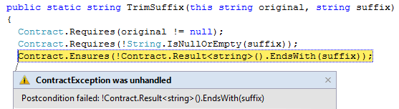
Runtime Checking Experience
Stepping, breakpoints work naturally
Runtime failure behavior fully configurable
Failing condition string available at runtime

Slide 32
Runtime Checking Functionality
Inheritance
Base and interfaces
Granularity knobs
Which checks are inserted
Closures and Iterators
Call-site checking
Recursion guards
Source text extraction
Debug experience/stepping/breakpoints

Slide 33
Challenges
Concurrency
Contracts specify non-interleaved behavior
Contracts on shared state may produce races
Inheritance may cause unexpected races
Mitigations
Control inheritance/runtime checking via attributes
[ContractOption(“contract”,”inheritance”, false)]
[ContractOption(“runtime”, “checking”, false)]

Slide 34

Contract Reference Assemblies
public virtual int Add(object value)
{
Contract.Requires(object != null);
Contract.Ensures( Count == Contract.Old(Count) + 1 );
Contract.Ensures( Contract.Result<int>() == Contract.OldValue(Count) );
if (_size == _items.Length) EnsuresCapacity(_size + 1);
_items[_size] = value;
return _size++;
}
public virtual int Add(object value)
{
Contract.Requires(object != null);
Contract.Ensures( Count == Contract.Old(Count) + 1 );
Contract.Ensures( Contract.Result<int>() == Contract.OldValue(Count) );
if (_size == _items.Length) EnsuresCapacity(_size + 1);
_items[_size] = value;
return _size++;
}
Compile
/d:CONTRACTS_FULL
Contract Reference Assembly
.method public hidebysig newslot virtual instance int32 Add(object 'value') cil managed
{
ldarg.1
ldnull
ceq
ldc.i4.0
ceq
call void [Microsoft.Contracts]Microsoft.Contracts.Contract::Requires(bool)
ldarg.0
call instance int32 TabDemo.BaseList::get_Count()
ldarg.0
call instance int32 TabDemo.BaseList::get_Count()
call !!0 [Microsoft.Contracts]Microsoft.Contracts.Contract::Old<int32>(!!0)
ldc.i4.1
add
ceq
call void [Microsoft.Contracts]Microsoft.Contracts.Contract::Ensures(bool)
call !!0 [Microsoft.Contracts]Microsoft.Contracts.Contract::Result<int32>()
ldarg.0
call instance int32 TabDemo.BaseList::get_Count()
call !!0 [Microsoft.Contracts]Microsoft.Contracts.Contract::Old<int32>(!!0)
ceq
call void [Microsoft.Contracts]Microsoft.Contracts.Contract::Ensures(bool)
ldarg.0
ldfld int32 TabDemo.BaseList::count
ldarg.0
ldfld object[] TabDemo.BaseList::items
ldlen
conv.i4
ceq
ldc.i4.0
ceq
stloc.1
ldloc.1
brtrue.s IL_0069
ldarg.0
ldarg.0
ldfld int32 TabDemo.BaseList::count
ldc.i4.1
add
call instance void TabDemo.BaseList::EnsureCapacity(int32)
ldarg.0
ldfld object[] TabDemo.BaseList::items
ldarg.0
ldfld int32 TabDemo.BaseList::count
ldarg.1
stelem.ref
ldarg.0
dup
ldfld int32 TabDemo.BaseList::count
dup
stloc.2
ldc.i4.1
add
stfld int32 TabDemo.BaseList::count
ldloc.2
stloc.0
br.s IL_008b
ldloc.0
ret
} // end of method BaseList::Add
.method public hidebysig newslot virtual instance int32 Add(object 'value') cil managed
{
ldarg.1
ldnull
ceq
ldc.i4.0
ceq
call void [Microsoft.Contracts]Microsoft.Contracts.Contract::Requires(bool)
ldarg.0
call instance int32 TabDemo.BaseList::get_Count()
ldarg.0
call instance int32 TabDemo.BaseList::get_Count()
call !!0 [Microsoft.Contracts]Microsoft.Contracts.Contract::Old<int32>(!!0)
ldc.i4.1
add
ceq
call void [Microsoft.Contracts]Microsoft.Contracts.Contract::Ensures(bool)
call !!0 [Microsoft.Contracts]Microsoft.Contracts.Contract::Result<int32>()
ldarg.0
call instance int32 TabDemo.BaseList::get_Count()
call !!0 [Microsoft.Contracts]Microsoft.Contracts.Contract::Old<int32>(!!0)
ceq
call void [Microsoft.Contracts]Microsoft.Contracts.Contract::Ensures(bool)
} // end of method BaseList::Add
ccrefgen
Language-agnostic, persisted contract format
Free: produced by all compilers
Semantics given by MSIL encoding conditions
Uniform format to down-stream tools
Library for extracting contracts from MSIL

Slide 35
Contract Reference Assemblies
Contract Reference Assemblies
.method public hidebysig newslot virtual instance int32 Add(object 'value') cil managed
{
ldarg.1
ldnull
ceq
ldc.i4.0
ceq
call void [Microsoft.Contracts]Microsoft.Contracts.Contract::Requires(bool)
ldarg.0
call instance int32 TabDemo.BaseList::get_Count()
ldarg.0
call instance int32 TabDemo.BaseList::get_Count()
call !!0 [Microsoft.Contracts]Microsoft.Contracts.Contract::Old<int32>(!!0)
ldc.i4.1
add
ceq
call void [Microsoft.Contracts]Microsoft.Contracts.Contract::Ensures(bool)
call !!0 [Microsoft.Contracts]Microsoft.Contracts.Contract::Result<int32>()
ldarg.0
call instance int32 TabDemo.BaseList::get_Count()
call !!0 [Microsoft.Contracts]Microsoft.Contracts.Contract::Old<int32>(!!0)
ceq
call void [Microsoft.Contracts]Microsoft.Contracts.Contract::Ensures(bool)
ldarg.0
ldfld int32 TabDemo.BaseList::count
ldarg.0
ldfld object[] TabDemo.BaseList::items
ldlen
conv.i4
ceq
ldc.i4.0
ceq
stloc.1
ldloc.1
brtrue.s IL_0069
ldarg.0
ldarg.0
ldfld int32 TabDemo.BaseList::count
ldc.i4.1
add
call instance void TabDemo.BaseList::EnsureCapacity(int32)
ldarg.0
ldfld object[] TabDemo.BaseList::items
ldarg.0
ldfld int32 TabDemo.BaseList::count
ldarg.1
stelem.ref
ldarg.0
dup
ldfld int32 TabDemo.BaseList::count
dup
stloc.2
ldc.i4.1
add
stfld int32 TabDemo.BaseList::count
ldloc.2
stloc.0
br.s IL_008b
ldloc.0
ret
} // end of method BaseList::Add
ccrewrite
Runtime checks
cccheck
Compile-time warnings
ccdocgen
Augmented Xml doc

Slide 36
Providing Contracts for your Lib
src
src
src
src
Release Assemblies
Contract Reference Assemblies
PowerLib.dll
PowerLib.Contracts.dll
+
(minimal runtime checks)
All contracts, no code

Slide 37
Developing against 3rd Party Lib
can check Requires of PowerLib at call-sites
inherits contracts
src
src
src
MyApp.exe
MyApp.exe
src
ccrewrite
PowerLib.Contracts.dll
PowerLib.dll
(no runtime checks)

Slide 38
Contracts for Existing Libraries
Mscorlib
System
System.Data
System.Xml
System.Windows
System.Core
System.Configuration
System.Web
System.Windows.Browser
System.Windows.Forms
WindowsBase
System.Drawing
System.Security
Microsoft.VisualBasic.Compatibility
System.Xml.Linq
Microsoft.VisualBasic

Slide 39
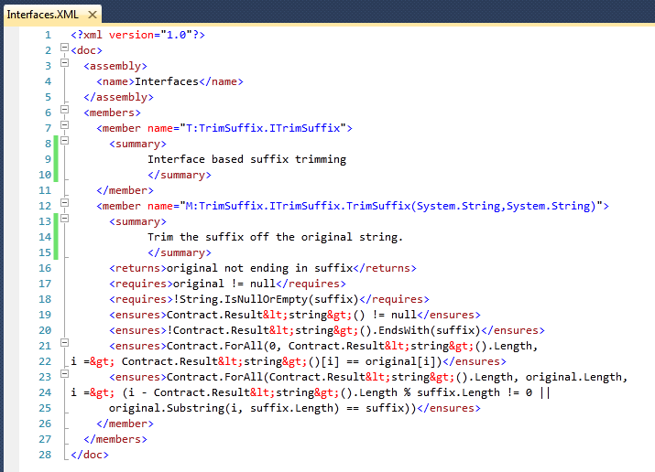
Documentation Generation
ccdocgen augments XML doc file with contract elements
Enables any other tool to read them
XSLT patches for Sandcastle prototyped

Slide 40
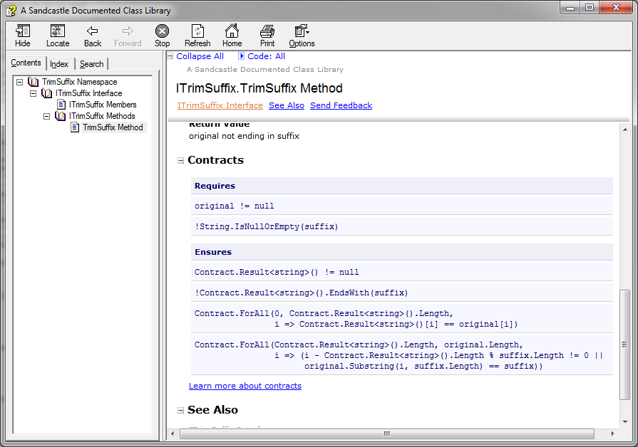
Doc Generation with Sandcastle

Slide 41
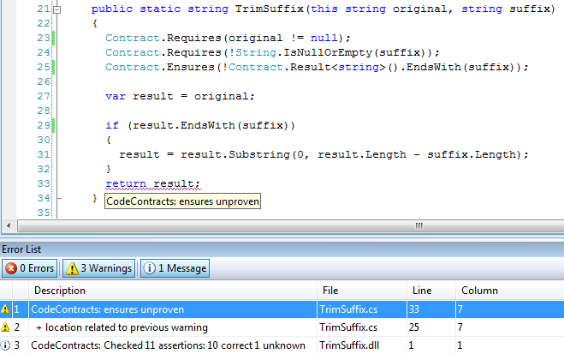
Static Contract Verification

Slide 42
What the Static Checker does
Method level deep static analysis
(Abstract Interpretation)
Assumes
the precondition, invariants, post conditions at calls
Computes facts about each program point of the method
Use facts to prove:
Assertions
Preconditions at call site
Postcondition
Object-invariant
Non-null, index in bounds …

Slide 43
Static Contract Checking
No silver bullet
False warnings
Prefast/FxCop
Masking
SAL
Annotate
Contracts
More expressive annotations
Runtime checked
Annotation Overhead
Precision
Performance
Noise
Notes:
We feel we have a better handle.

Slide 44
Curb your Enthusiasm
Static checking requires time and effort
Requires authoring many contracts
Must deal with false positives
Scope your attention on critical code
[ContractVerification(true)]
[ContractVerification(false)]
Gradually enlarge analyzed codebase

Slide 45
Experience
Downloads
External: ~55000, 3 years
Internal: http://leaderboard/applications.aspx?appid=555555
Forum
http://social.msdn.microsoft.com/Forums/en-US/codecontracts
Contexts
C#, VB, ASP.NET, WCF, WPF, Silverlight, Azure
Groups
BCL, VB, Activesync, Midori, WCL, MSR, ???

Slide 46
Questions?
Internal
http://codebox/contracts mailto:condconfb
External
http://social.msdn.microsoft.com/Forums/en-US/codecontracts
Mail
mailto:maf mailto:mbarnett mailto:logozzo

