Slide 1
Clousot and CodeContracts: Bringing the power of Contracts and Abstract interpretation to the working programming
Francesco Logozzo
Manuel Fahndrich
Microsoft Research, Redmond, WA

Slide 2
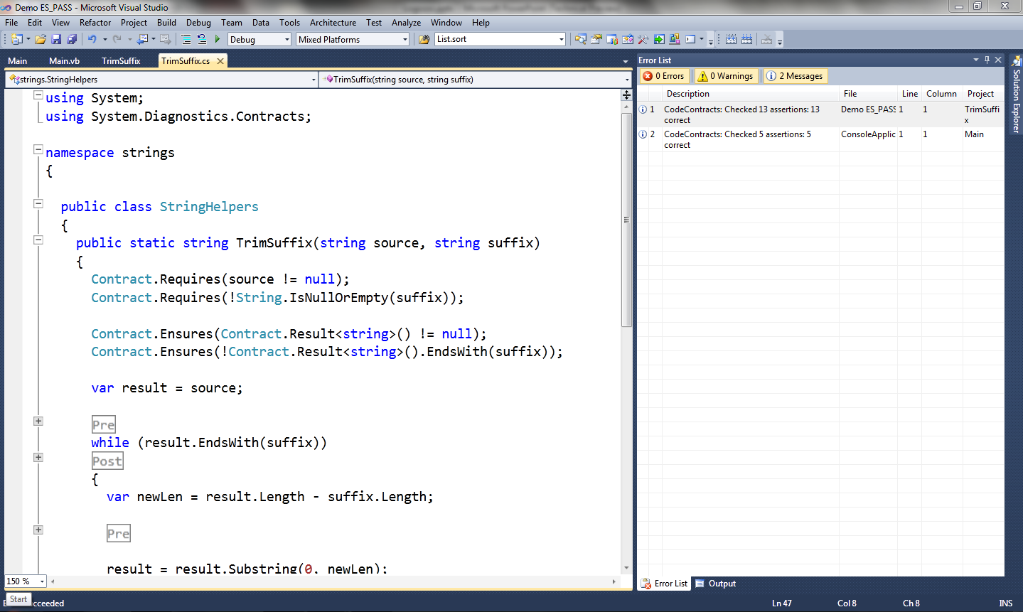
Demo!

Slide 3
.NET
Safe execution environment
Managed execution, GC …
Object-oriented
Shared type system
C#
VB
F#
…
Managed C++
Common Intermediate Language (CIL)
Libraries (mscorlib, System.dll …)
Virtual Machine
Operating System (Windows …)

Slide 4
Contracts
Specify
Preconditions
Postcondition
Object Invariants
Advantages
Documentation
Amplified runtime testing
Modular static checking

Slide 5
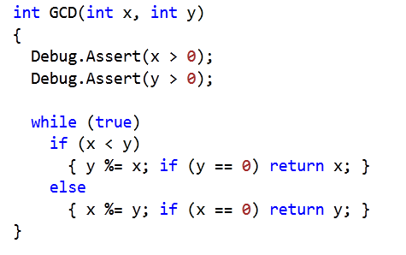
But we have Assert!
Hidden to the caller
Debug.Assert(Result > 0) ?

Slide 6
Contracts today
First class citizens in the language
Ex. Eiffel, D , Spec#…
Non-standard languages, new compiler, …
Inside comments or as code annotation
Ex. JML, Eclipse for non-null …
Persistence?
Need for serialization, parsing…
Separate type checking, name resolution…

Slide 7
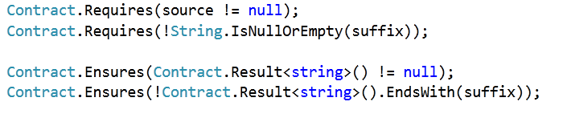

Code Contracts
Idea: Use the IL as contract representation
Use static methods to a contract library
Language agnostic: same for C#, VB, F# …

Slide 8
Code Contracts tools
Documentation generation (ccdoc)
Automatic generation of documentation
Runtime checking (ccrewrite)
Binary rewriting
Static checking (Clousot)

Slide 9
Clousot
Based on Abstract Interpretation
≠ Usual approaches based on theorem prover
Advantages
Automatic
Inference of loop invariants, pre, post, invariants
Predictable
No quantifier instantiation
No easy proofs by contradictory axioms
Scalable
Tune-up for the properties of interest

Slide 10
Clousot: The big picture
Assertion Checking
Analysis
Inference
Call Graph Construction
Contract Extraction
A.dll
B.dll
C.dll
…
Z.dll

Slide 11
Method Analysis
Analyze the method
Collect the proof obligations
Explicit: Pre/Post, assertions
Implicit: Array bounds, non-null …
Discharge proof obligations
If not, emit warning message
Propagate inferred contracts

Slide 12
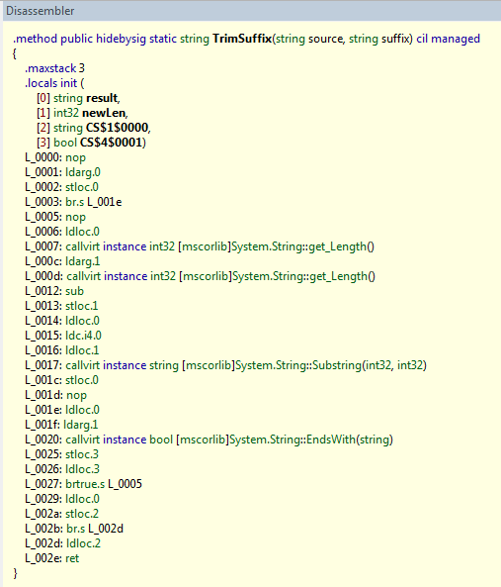
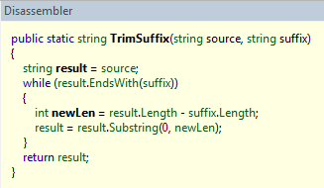
Bytecode
Stack language

Slide 13
Why the bytecode???
More faithful
Closer to what get executed
Clear semantics of the instructions
Exploit the work of the compiler
Name resolution, type inference, generics, LINQ…
Language agnostic
Bytecode does not change!
Languages yes : C# 2.0 → C# 3.0 → C# 4.0

Slide 14
Drawbacks
Explicit stack
Program structure lost
Expressions chunked out
…
Need a program normalization!

Slide 15



Clousot: Analysis structure
Expression analysis
Heap analysis
Stack analysis
Analyses
Bounds, nonnull, arrays…
Source: z = x + y

Slide 16
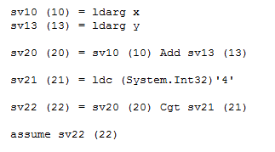
Expression recovery
Assume x + y ≤ 4
High level: ok with Octagons
Low level: problem!

Slide 17
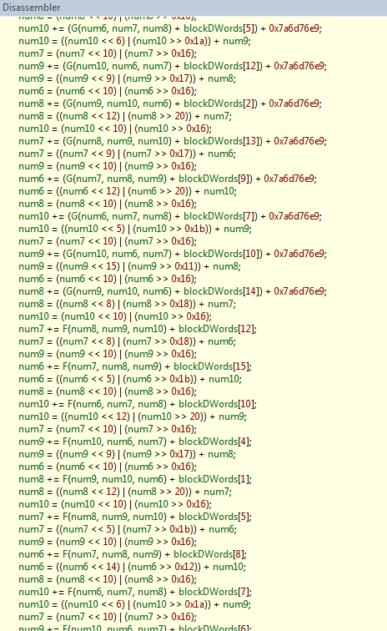
Eager expression reconstruction?
MDTransform
9000 straight line instructions

Slide 18
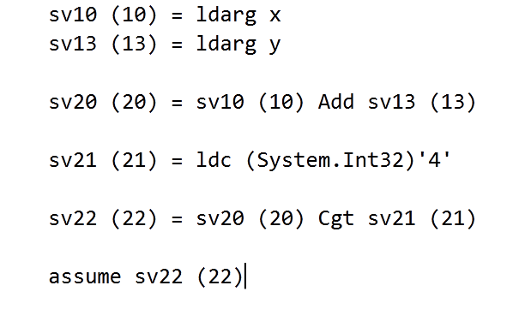
Lazy expression recovery

Slide 19
Value Analyses
Nonnull
Is a reference null?
Bounds
Array bounds, numerical values …
Arithmetic
Division by zero, negation of MinInt …
Unsafe
Buffer overrun

Slide 20
Array content
(with P. & R. Cousot)
Strings
Object Invariants
(M. Monereau)
Iterators
(S. Xia)
Pietro Ferrara, Francesco Logozzo and Manuel Fahndrich Safer Unsafe Code in .NET, in OOPSLA 2008

Slide 21
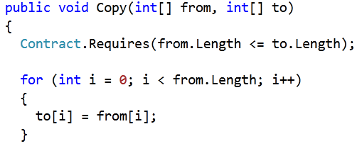
Bounds Analysis
Infer numerical relations over locations
Prove array accesses
Prove contracts with linear expressions
Which numerical domain?
Intervals?
We need relational information

Slide 22
Global analysis?
Unrealistic in OOP
Interfaces, Abstract classes …
Thousands of libraries
Whole program (maybe) available only at (during?) the execution
Which version of the framework?
Native code
In Java: JNI pervasive
In .NET: calls to Windows APIs

Slide 23
Relational numerical domains
Polyhedra?
Even modular, easily hundreds of variables
Octagons?
Sometimes we need more complex invariants
Not fast enough for us
Buckets and heap analysis?

Slide 24
Numerical domains in Clousot
Basic
Intervals, Pentagons, Leq, Karr, Octagons, Simple Disequalities, Stripes, Subpolyhedra …
Combination of thereof
Tree of domains
Incremental analysis
First analyze with “cheap” domains
Move to more expensive if fails to prove
Domain D1
Domain D2
Domain D3

Slide 25
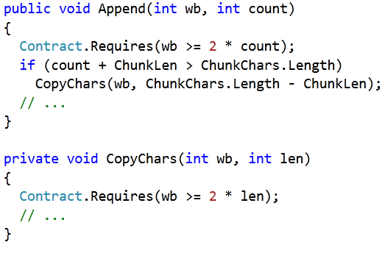
Why Subpolyhedra?
Often proving a “easy” precondition requires a complex reasoning
From StringBuilder:

Slide 26
Principle of Subpolyhedra
∑a_{i} x_{i} ≤ k ⇔ ∑a_{i} x_{i} = β ⋀ β ≤ k
Reduced product of
Intervals
Scalable, fast…
Linear Equalities
Precise join, fast …
Challenge: Have a precise Join
Vincent Laviron and Francesco Logozzo, Subpolyhedra: A (more) scalable approach to the inference of linear inequalities, in APLAS 2009

Slide 27
Naif Join
assume x <= y
x = 0; y = 1
〈x - y == β, β ∈ [-∞, 0]〉
〈T, x ∈ [0,0] ⋀ y ∈ [1,1]〉
〈T, T〉
assert x <= y

Slide 28
Join algorithm : SubPolyhedra
Uniform slack variables
Reduce the states
Do the pair-wise join
Recover precision using deleted equalities
Recover precision using hints
Templates, 2D Convex Hull, Annotations …
Vincent Laviron and Francesco Logozzo, Refining Abstract Interpretation-based Static Analyses with Hints, in APLAS 2009

Slide 29
Example : Join Step 1
Entry State:
s₀ : 〈x - y == β, β ∈ [-∞, 0]〉
s₁ : 〈T, x ∈ [0,0] ⋀ y ∈ [1,1]〉
Step 1 (uniform slack variables)
s’₀ : 〈x - y == β, β ∈ [-∞, 0]〉
s’₁ : 〈x - y == β, x ∈ [0,0] ⋀ y ∈ [1,1]〉

Slide 30
Example: Join steps 2-3
Step 2 (Reduction)
s’’₀ : 〈x - y == β, β ∈ [-∞, 0]〉
s’’₁ : 〈x - y == β, x ∈ [0,0] ⋀ y ∈ [1,1] ⋀ β ∈ [-1,-1]〉
Step 3 (Pair-wise join)
s₂ : 〈x - y == β, β ∈ [-∞, 0]〉

Slide 31
Example: Join Step 4
Recover lost relations
assume x == y
x = 0; y = 1
〈x - y == 0, T〉
〈T, x ∈ [0,0] ⋀ y ∈ [1,1]〉
〈T, T〉
〈x - y == β, β ∈ [-1, 0]〉
assert x<= y

Slide 32
Example : Join Step 5
assume y >= 0 ;
x = 0;
〈T, x ∈ [0,0] ⋀ y ∈ [0,+∞]〉
〈T, x ∈ [1,1] ⋀ y ∈ [1,+∞]〉
〈x – y == β’, x ∈ [0,1] ⋀ y ∈ [0,+∞] ⋀ β’ ∈ [-∞,0]〉
〈T, x ∈ [0,1] ⋀ y ∈ [0,+∞]〉
〈T, x ∈ [0,0] ⋀ y ∈ [0,+∞]〉
while x < y
〈 x – y == β, x ∈ [0,1] ⋀ y ∈ [0,1] ⋀ β ∈ [0,+∞]〉
〈T, x ∈ [0,0] ⋀ y ∈ [1,+∞]〉
〈 x – y == β’, x ∈ [0,1] ⋀ y ∈ [0,1] ⋀ β’ ∈ [0,0]〉
〈T, x ∈ [0,0] ⋀ y ∈ [0,0]〉
assert x == y ;
x++;

Slide 33
Critical operation: Reduction
Infer tightest bounds
Instance of a Linear programming problem
Solution in polynomial time
Drawbacks:
Numerical instability, Rounding errors
Simplex too slow for our purposes
Basis exploration (new)
Based on static basis exploration
Less concerned about numerical instability
Abstract when an error is detected
E.g. In a row operation, delete the row

Slide 34
To sum up on Subpolyhedra
Infer arbitrary linear inequalities
Scales to hundreds of variables
Precisely propagate linear inequalities
Give up some of the inference power
Family of abstract domains
Two precision axes
Hints
Tune the inference power at join points
Reduction
Infer the tightest intervals

Slide 35
Other…
Intra-modular Inference
Pre/Post/Object invariants
Reduce annotation burden
Can make the analysis bridle
Serialize to C#
Backward analysis for disjunctions
Safe floating points in parameters
Selective verification
Ranking of warnings
…

Slide 36
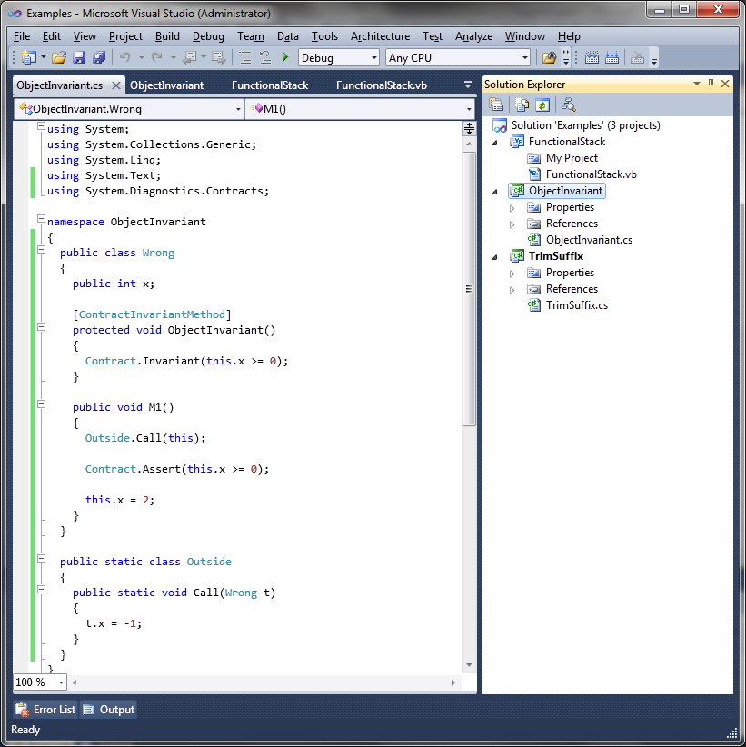
Soundness??
In general, sound handling of object invariants is a problem
Demo:
Solution: Restrict the programs or unsoundness

Slide 37
TODO
Collections
Experimenting handling of arrays
Extend to iterators, List<T> …
Strings
Need good domains to approximate strings
Modular overflow checking
Combine with automatic test generation
PEX
Make Clousot parallel
…

Slide 38
Conclusions
Programmers are willing to write annotations
SAL, ESP … at Microsoft,
CodeContracts Forum, PDC …
We should provide valuable tools
Automatic, predictable, fast!!!!
Clousot is a step in that direction
Download it today at:
http://msdn.microsoft.com/en-us/devlabs/
(Academic and Commercial license)

