Slide 1
EMBEDDED CONTRACT LANGUAGES
Manuel Fähndrich, Michael Barnett, Francesco Logozzo
Microsoft Research, Redmond, USA
SAC2010 OOPS track, Sierre, Switzerland
http://research.microsoft.com/contracts

Slide 2
Motivation
Enable Programmers to write Specifications
Preconditions, postconditions, object invariants
Document design decisions
Facilitate code reuse and evolution
Enable Tool Writers to mine Specifications
Documentation generation
Runtime checking of contracts
Static verification

Slide 3
Problems with Existing Approaches
Attributes/Annotations [NotNull], @NonNull
Very limited expressiveness
Semantics
Comment syntax (e.g., JML for Java)
Comments are text
Duplication of effort (parser, type checker, …)
Specialized Languages (Eiffel, Spec#)
They are specialized.
Lack of tool support or integration

Slide 4
Embedded Contract Languages
Specifications as Code in existing languages
Compile normally
Extract Contracts from target code
public virtual int Add(object value) { Contract.Requires( value != null ); Contract.Ensures( Count == Contract.OldValue(Count) + 1 ); Contract.Ensures( Contract.Result<int>() == Contract.OldValue(Count) ); if (count == items.Length) EnsureCapacity(count + 1); items[count] = value; return count++; }

Slide 5
Embedded CL Advantages
No new language, compilers, IDEs
Boolean expression in language used
No a-priori restrictions what can be expressed
Intellisense, refactoring, error checking, debugging, …
Compiled contract format is .NET CIL
Compiler translates to CIL
Semantics provided by ECMA CIL standard
Uniform format for tools
Same contracts used for
Documentation generation
Runtime checking
Static checking

Slide 6
Specifications = API Calls
namespace System.Diagnostics.Contracts {
public static class Contract
{
[Conditional(“CONTRACTS_FULL”)]
public static void Requires(bool condition) {}
[Conditional(“CONTRACTS_FULL”)]
public static void Ensures(bool condition) {}
[Conditional(“CONTRACTS_FULL”)]
public static void Invariant(bool condition) {}
public static T Result<T>() {…}
public static T OldValue<T>(T expression) {…}
…
}
}
Library reusable from C#, VisualBasic, F#, …

Slide 7
Interface Contracts
[ContractClass(typeof(IListContract<>))]
public interface IList<T> : ICollection<T>
{
…
void RemoveAt(int index);
}
[ContractClassFor(typeof(IList<>))]
public class IListContract<T> : IList<T>
{
…
public void RemoveAt(int index)
{
Contract.Requires(index >= 0);
Contract.Requires(index < this.Count);
Contract.Ensures(this.Count == Contract.OldValue(this.Count) - 1);
}
}

Slide 8
Interface Contracts
[ContractClass(typeof(IListContract<>))]
public interface IList<T> : ICollection<T>
{
…
void RemoveAt(int index);
}
[ContractClassFor(typeof(IList<>))]
public class IListContract<T> : IList<T>
{
…
public void RemoveAt(int index)
{
Contract.Requires(index >= 0);
Contract.Requires(index < this.Count);
Contract.Ensures(this.Count == Contract.OldValue(this.Count) - 1);
}
}

Slide 9
Interface Contracts
[ContractClass(typeof(IListContract<>))]
public interface IList<T> : ICollection<T>
{
…
void RemoveAt(int index);
}
[ContractClassFor(typeof(IList<>))]
public class IListContract<T> : IList<T>
{
…
public void RemoveAt(int index)
{
Contract.Requires(index >= 0);
Contract.Requires(index < this.Count);
Contract.Ensures(this.Count == Contract.OldValue(this.Count) - 1);
}
}

Slide 10
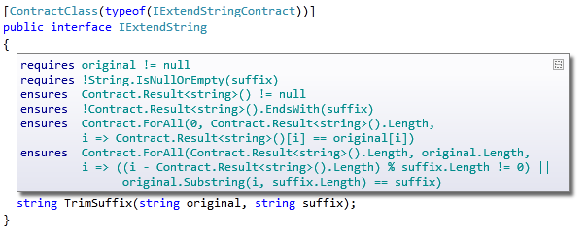
Contract Adornments (VS2010)
Shows inherited contracts
Shows interface contracts on interface
Shows contracts on metadata

Slide 11
Object Invariants
public class MyCollection
{
///<summary>data is never null<summary>
int[] data;
///<summary>count is non-negative and less equal data.Length<summary>
int count;
[ContractInvariantMethod]
void DataCountInvariants() {
Contract.Invariant( data != null );
Contract.Invariant( count >= 0 );
Contract.Invariant( count <= data.Length );
}
}

Slide 12
Object Invariants
public class MyCollection
{
///<summary>data is never null<summary>
int[] data;
///<summary>count is non-negative and less equal data.Length<summary>
int count;
[ContractInvariantMethod]
void DataCountInvariants() {
Contract.Invariant( data != null );
Contract.Invariant( count >= 0 );
Contract.Invariant( count <= data.Length );
}
}

Slide 13
Expressiveness: Quantifiers
public void Summarize(ICollection<string> data)
{
Contract.Requires( Contract.ForAll(data, s => s != null) );
…
}

Slide 14

Runtime Contract Checking
public virtual int Add(object value)
{
Contract.Requires(object != null);
Contract.Ensures( Count == Contract.Old(Count) + 1 );
Contract.Ensures( Contract.Result<int>() == Contract.OldValue(Count) );
if (_size == _items.Length) EnsuresCapacity(_size + 1);
_items[_size] = value;
return _size++;
}
public virtual int Add(object value)
{
Contract.Requires(object != null);
Contract.Ensures( Count == Contract.Old(Count) + 1 );
Contract.Ensures( Contract.Result<int>() == Contract.OldValue(Count) );
if (_size == _items.Length) EnsuresCapacity(_size + 1);
_items[_size] = value;
return _size++;
}
Executable runtime
Contract checking
csc
/d:CONTRACTS_FULL
.method public hidebysig newslot virtual instance int32 Add(object 'value') cil managed
{
.locals init (int32 'Contract.Old(Count)',
int32 'Contract.Result<int>()')
ldarg.1
ldnull
ceq
ldc.i4.0
ceq
ldstr "value != null"
call void __RewriterMethods::RewriterRequires$PST06000009(bool, string)ldarg.0
ldarg.0
call instance int32 TabDemo.BaseList::get_Count()
stloc.3
ldarg.0
ldfld int32 TabDemo.BaseList::count
ldarg.0
ldfld object[] TabDemo.BaseList::items
ldlen
conv.i4
ceq
ldc.i4.0
ceq
stloc.1
ldloc.1
brtrue IL_004d
nop
ldarg.0
ldarg.0
ldfld int32 TabDemo.BaseList::count
ldc.i4.1
add
call instance void TabDemo.BaseList::EnsureCapacity(int32)
nop
nop
ldarg.0
ldfld object[] TabDemo.BaseList::items
ldarg.0
ldfld int32 TabDemo.BaseList::count
ldarg.1
stelem.ref
ldarg.0
dup
ldfld int32 TabDemo.BaseList::count
dup
stloc.2
ldc.i4.1
add
stfld int32 TabDemo.BaseList::count
ldloc.2
stloc.0
br IL_0072
ldloc.0
stloc.s 'Contract.Result<int>()'
br IL_007a
ldarg.0
call instance int32 TabDemo.BaseList::get_Count()
ldloc.3
ldc.i4.1
add
ceq
ldstr "Count == Contract.Old(Count) + 1"
call void __RewriterMethods::RewriterEnsures$PST0600000B(bool, string)
ldloc.s 'Contract.Result<int>()'
ldloc.s V_4
ceq
ldstr "Contract.Result<int>() == Contract.Old(Count)"
call void __RewriterMethods::RewriterEnsures$PST0600000B(bool, string)
ldloc.s 'Contract.Result<int>()'
ret
}
.method public hidebysig newslot virtual instance int32 Add(object 'value') cil managed
{
ldarg.1
ldnull
ceq
ldc.i4.0
ceq
call void [Microsoft.Contracts]Microsoft.Contracts.Contract::Requires(bool)
ldarg.0
call instance int32 TabDemo.BaseList::get_Count()
ldarg.0
call instance int32 TabDemo.BaseList::get_Count()
call !!0 [Microsoft.Contracts]Microsoft.Contracts.Contract::Old<int32>(!!0)
ldc.i4.1
add
ceq
call void [Microsoft.Contracts]Microsoft.Contracts.Contract::Ensures(bool)
call !!0 [Microsoft.Contracts]Microsoft.Contracts.Contract::Result<int32>()
ldarg.0
call instance int32 TabDemo.BaseList::get_Count()
call !!0 [Microsoft.Contracts]Microsoft.Contracts.Contract::Old<int32>(!!0)
ceq
call void [Microsoft.Contracts]Microsoft.Contracts.Contract::Ensures(bool)
ldarg.0
ldfld int32 TabDemo.BaseList::count
ldarg.0
ldfld object[] TabDemo.BaseList::items
ldlen
conv.i4
ceq
ldc.i4.0
ceq
stloc.1
ldloc.1
brtrue.s IL_0069
ldarg.0
ldarg.0
ldfld int32 TabDemo.BaseList::count
ldc.i4.1
add
call instance void TabDemo.BaseList::EnsureCapacity(int32)
ldarg.0
ldfld object[] TabDemo.BaseList::items
ldarg.0
ldfld int32 TabDemo.BaseList::count
ldarg.1
stelem.ref
ldarg.0
dup
ldfld int32 TabDemo.BaseList::count
dup
stloc.2
ldc.i4.1
add
stfld int32 TabDemo.BaseList::count
ldloc.2
stloc.0
br.s IL_008b
ldloc.0
ret
} // end of method BaseList::Add
csc normal compile
.method public hidebysig newslot virtual instance int32 Add(object 'value') cil managed
{
ldarg.0
ldfld int32 TabDemo.BaseList::count
ldarg.0
ldfld object[] TabDemo.BaseList::items
ldlen
conv.i4
ceq
ldc.i4.0
ceq
stloc.1
ldloc.1
brtrue.s IL_0029
ldarg.0
ldarg.0
ldfld int32 TabDemo.BaseList::count
ldc.i4.1
add
call instance void TabDemo.BaseList::EnsureCapacity(int32)
ldarg.0
ldfld object[] TabDemo.BaseList::items
ldarg.0
ldfld int32 TabDemo.BaseList::count
ldarg.1
stelem.ref
ldarg.0
dup
ldfld int32 TabDemo.BaseList::count
dup
stloc.2
ldc.i4.1
add
stfld int32 TabDemo.BaseList::count
ldloc.2
stloc.0
br.s IL_004b
ldloc.0
ret
}
ccrewrite
WF checks
Inheritance
Invariants
Source text

Slide 15

Contract Reference Assemblies
public virtual int Add(object value)
{
Contract.Requires(object != null);
Contract.Ensures( Count == Contract.Old(Count) + 1 );
Contract.Ensures( Contract.Result<int>() == Contract.OldValue(Count) );
if (_size == _items.Length) EnsuresCapacity(_size + 1);
_items[_size] = value;
return _size++;
}
public virtual int Add(object value)
{
Contract.Requires(object != null);
Contract.Ensures( Count == Contract.Old(Count) + 1 );
Contract.Ensures( Contract.Result<int>() == Contract.OldValue(Count) );
if (_size == _items.Length) EnsuresCapacity(_size + 1);
_items[_size] = value;
return _size++;
}
Compile
/d:CONTRACTS_FULL
Contract Reference Assembly
.method public hidebysig newslot virtual instance int32 Add(object 'value') cil managed
{
ldarg.1
ldnull
ceq
ldc.i4.0
ceq
call void [Microsoft.Contracts]Microsoft.Contracts.Contract::Requires(bool)
ldarg.0
call instance int32 TabDemo.BaseList::get_Count()
ldarg.0
call instance int32 TabDemo.BaseList::get_Count()
call !!0 [Microsoft.Contracts]Microsoft.Contracts.Contract::Old<int32>(!!0)
ldc.i4.1
add
ceq
call void [Microsoft.Contracts]Microsoft.Contracts.Contract::Ensures(bool)
call !!0 [Microsoft.Contracts]Microsoft.Contracts.Contract::Result<int32>()
ldarg.0
call instance int32 TabDemo.BaseList::get_Count()
call !!0 [Microsoft.Contracts]Microsoft.Contracts.Contract::Old<int32>(!!0)
ceq
call void [Microsoft.Contracts]Microsoft.Contracts.Contract::Ensures(bool)
ldarg.0
ldfld int32 TabDemo.BaseList::count
ldarg.0
ldfld object[] TabDemo.BaseList::items
ldlen
conv.i4
ceq
ldc.i4.0
ceq
stloc.1
ldloc.1
brtrue.s IL_0069
ldarg.0
ldarg.0
ldfld int32 TabDemo.BaseList::count
ldc.i4.1
add
call instance void TabDemo.BaseList::EnsureCapacity(int32)
ldarg.0
ldfld object[] TabDemo.BaseList::items
ldarg.0
ldfld int32 TabDemo.BaseList::count
ldarg.1
stelem.ref
ldarg.0
dup
ldfld int32 TabDemo.BaseList::count
dup
stloc.2
ldc.i4.1
add
stfld int32 TabDemo.BaseList::count
ldloc.2
stloc.0
br.s IL_008b
ldloc.0
ret
} // end of method BaseList::Add
.method public hidebysig newslot virtual instance int32 Add(object 'value') cil managed
{
ldarg.1
ldnull
ceq
ldc.i4.0
ceq
call void [Microsoft.Contracts]Microsoft.Contracts.Contract::Requires(bool)
ldarg.0
call instance int32 TabDemo.BaseList::get_Count()
ldarg.0
call instance int32 TabDemo.BaseList::get_Count()
call !!0 [Microsoft.Contracts]Microsoft.Contracts.Contract::Old<int32>(!!0)
ldc.i4.1
add
ceq
call void [Microsoft.Contracts]Microsoft.Contracts.Contract::Ensures(bool)
call !!0 [Microsoft.Contracts]Microsoft.Contracts.Contract::Result<int32>()
ldarg.0
call instance int32 TabDemo.BaseList::get_Count()
call !!0 [Microsoft.Contracts]Microsoft.Contracts.Contract::Old<int32>(!!0)
ceq
call void [Microsoft.Contracts]Microsoft.Contracts.Contract::Ensures(bool)
} // end of method BaseList::Add
ccrefgen
Language-agnostic, persisted contract format
Free: produced by all compilers
Semantics given by MSIL encoding conditions
Uniform format to down-stream tools
Library for extracting contracts from MSIL

Slide 16
Contract Reference Assemblies
Contract Reference Assemblies
.method public hidebysig newslot virtual instance int32 Add(object 'value') cil managed
{
ldarg.1
ldnull
ceq
ldc.i4.0
ceq
call void [Microsoft.Contracts]Microsoft.Contracts.Contract::Requires(bool)
ldarg.0
call instance int32 TabDemo.BaseList::get_Count()
ldarg.0
call instance int32 TabDemo.BaseList::get_Count()
call !!0 [Microsoft.Contracts]Microsoft.Contracts.Contract::Old<int32>(!!0)
ldc.i4.1
add
ceq
call void [Microsoft.Contracts]Microsoft.Contracts.Contract::Ensures(bool)
call !!0 [Microsoft.Contracts]Microsoft.Contracts.Contract::Result<int32>()
ldarg.0
call instance int32 TabDemo.BaseList::get_Count()
call !!0 [Microsoft.Contracts]Microsoft.Contracts.Contract::Old<int32>(!!0)
ceq
call void [Microsoft.Contracts]Microsoft.Contracts.Contract::Ensures(bool)
ldarg.0
ldfld int32 TabDemo.BaseList::count
ldarg.0
ldfld object[] TabDemo.BaseList::items
ldlen
conv.i4
ceq
ldc.i4.0
ceq
stloc.1
ldloc.1
brtrue.s IL_0069
ldarg.0
ldarg.0
ldfld int32 TabDemo.BaseList::count
ldc.i4.1
add
call instance void TabDemo.BaseList::EnsureCapacity(int32)
ldarg.0
ldfld object[] TabDemo.BaseList::items
ldarg.0
ldfld int32 TabDemo.BaseList::count
ldarg.1
stelem.ref
ldarg.0
dup
ldfld int32 TabDemo.BaseList::count
dup
stloc.2
ldc.i4.1
add
stfld int32 TabDemo.BaseList::count
ldloc.2
stloc.0
br.s IL_008b
ldloc.0
ret
} // end of method BaseList::Add
ccrewrite
Runtime checks
cccheck
Compile-time warnings
ccdocgen
Augmented Xml doc

Slide 17
Providing Contracts for your Lib
src
src
src
src
Release Assemblies
Contract Reference Assemblies
PowerLib.dll
PowerLib.Contracts.dll
+
(minimal runtime checks)
All contracts, no code

Slide 18
Developing against 3rd Party Lib
can check Requires of PowerLib at call-sites
inherits contracts
src
src
src
MyApp.exe
MyApp.exe
src
ccrewrite
PowerLib.Contracts.dll
PowerLib.dll
(no runtime checks)

Slide 19
Drawbacks of Approach
Encodings necessary for missing constructs
Result, OldValue, ValueAtReturn
Interface contract classes
Contract extraction / decompilation from IL
Closures + closure instantiation
Field initialization in constructors
Language specific idioms (C#, VB, F#)
… Yet, advantages greatly outweigh these.

Slide 20
Purity
Contract expression should have no observable side effects
Current practice with Asserts
Pure Methods
Purity of methods is declared [Pure]
Calls to pure methods allowed in contracts

Slide 21
Proof of Concept: CodeContracts
ccrewrite
cccheck
ccdocgen
ccrefgen
Tools
Contracts
BCL 4.0
Authoring
VS2010
Sandcastle
Presentation

Slide 22
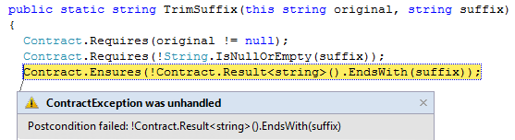
Runtime Checking Experience
Stepping, breakpoints work naturally
Runtime failure behavior fully configurable
Failing condition string available at runtime

Slide 23
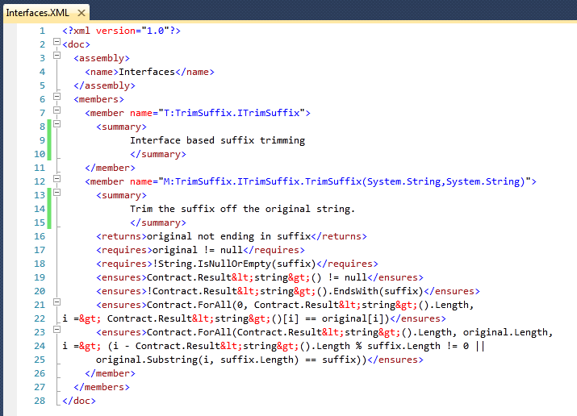
Documentation Generation
ccdocgen augments XML doc file with contract elements
Enables any other tool to read them
XSLT patches for Sandcastle prototyped

Slide 24
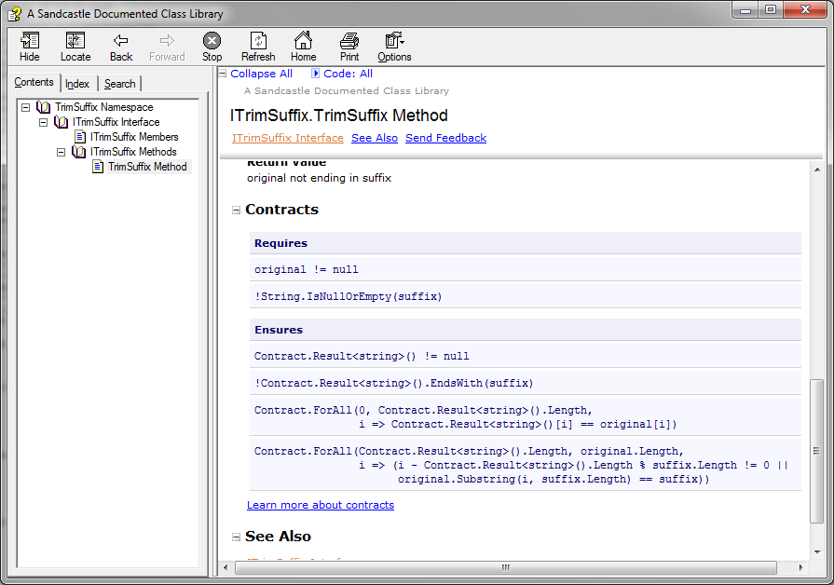
Documentation Generation

Slide 25
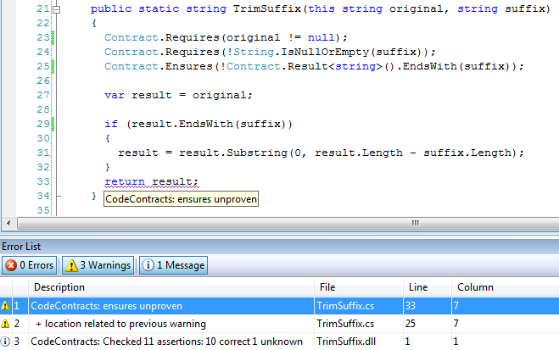
Static Contract Verification

Slide 26
Conclusion
Code as Contracts is a viable approach
Many advantages over attributes, comment syntax, or custom language
Standard representation not tied to tools
Executable contracts are important
Find errors in specifications
Immediate value to programmer
More Information
See paper for modularity, extraction, and instrumentation details
http://research.microsoft.com/contracts

Slide 27
Backups

Slide 28
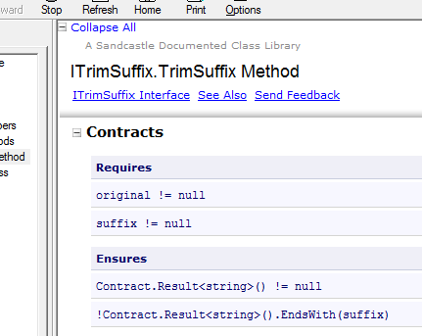
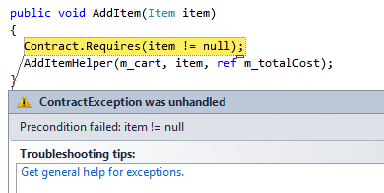
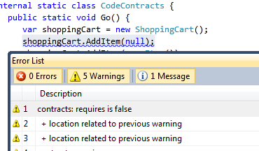
Code Contracts: Tools
Documentation
XML Based
Sandcastle Integration
Runtime Checking
Amplifies Test Runs
Keeps Code and Contracts in Sync
Static Checking
Earliest Bug Feedback
Customizable Checks

Slide 29
Runtime Checking Functionality
Inheritance
Base and interfaces
Granularity knobs
Which checks are inserted
Closures and Iterators
Call-site checking
Recursion guards
Source text extraction
Debug experience / stepping / breakpoints

Slide 30
Challenges
Instrumentation in presence of generics/closures
Copying of contracts
Concurrency
Contracts specify non-interleaved behavior
Contracts on shared state may produce races
Inheritance may cause unexpected races
Notion of “thread-safe” is simplistic as it changes contracts
Caller side locking works better

Slide 31
Contracts for Existing Libraries
Mscorlib
System
System.Data
System.Xml
System.Windows
System.Core
System.Configuration
System.Web
System.Windows.Browser
System.Windows.Forms
WindowsBase
System.Drawing
System.Security
Microsoft.VisualBasic.Compatibility
System.Xml.Linq
Microsoft.VisualBasic

Slide 32
Static Checker Design
Abstract interpretation (rather than WP theorem proving)
More automation (loop invariants, post-conditions)
More control over precision/speed tradeoff
Research in Abstract Domains
Sub-polyhedra
Array partitions (with P. Cousot)

Slide 33
Static Checker Architecture
Requires and Ensures Inference
Abstract Interpreters
Backward
analysis
Proof-obligations
Non-null
Contracts
Non-null
Arrays
Pointers
Arrays
Pointers
Abstract Domains
Strings
Numeric
Symbolic
Fix-point Engine
String
Expression refinement
Used in conditionals and transfer functions
Expression IL (expression recovery)
Similar to SSA form
Suitable for Abstract Interpretation
Old eliminated
Scalar program (heap eliminated)
Temp IL (stack eliminated)
requires/ensures/invariant are subroutines
spliced in where needed
Subroutines (method, finally, contracts)
MSIL+ (assert, assume, old, ldstack, …)
Turns calls into primitives
Contract Extractor + CFG Builder
.NET Assembly Reader

Slide 34
Pros and Cons of IL Verification
Pros
Relatively small language of instructions
Well-specified semantics
Type/name/overloading resolution done by compiler
Targeted by multiple languages (C#,VB,F#,…)
Cons
Some expression recovery needed
or abstract domains get too complicated (CC’08)
Source context not precise enough (from pdb’s)
Abstractions are lost / some need to be recovered
Closures, Iterators, etc…

Slide 35
Abstract Interpretation (on 1 slide)
Abstract states
Abstract step
x++
x < y
x <= y
Abstraction
Concretization
Soundness
Concrete states
x = 1
y = 10
Concrete step
x = 2
y = 10
x = 0
y = 1
x = 1
y = 1
x++
x = 100
y = 200
x = 101
y = 200
…
…

Slide 36
Scalar Programs
Control-flow graphs
Passive form (SSA) assumptions
sv2 == sv0 + sv1
Composed of tree fragments
Assignments at tree boundaries (renaming)
Suitable for
Abstract Interpretation
Weakest Preconditions

Slide 37
MSIL+
Analyzed code is MSIL+
Stack machine
All requires/ensures/invariant calls turn into
assume
assert
Extra synthetic instructions
begin_old
end_old
ldstack.i
ldresult
scall subroutine

Slide 38
Contract Subroutines
int Increment(int i) {
Contract.Requires(i > 0);
Contract.Ensures(Contract.Result<int>() == i+1);
return i+1;
}
Subroutine : Increment.requires
ldarg.1 // i
ldc 0
cgt
assume
Subroutine : Increment.ensures
ldresult
begin_old
ldarg.1 // i
end_old
ldc 1
add
ceq
assert

Slide 39
Subroutines and Inheritance
B.Inc.Req
B.Inv
B.Inc
B.Inc.Ens
D.Inv
D.Inc
D.Inc.Ens

Slide 40
Contract Subroutines at Call Sites
B.Inc.Req
B.Inv
B.Inc.Ens
call D.Inc
D.Inv
D.Inc.Ens

Slide 41
Dealing with Disjunctions
M(int y) {
Contract.Ensures( y < 0 && result <= 0 ||
y >= 0 && result >= 0);
int x = 0;
int oldy = y;
while (y != 0) {
Contract.Assert( oldy < 0 && x <= 0 ||
oldy > 0 && x >= 0 );
if (y < 0) { if (*) x--; y++; }
else { if (*) x++; y--; }
}
return x;
}

Slide 42
Dealing with Disjunctions (2)
No disjunctions in abstract invariants
Prove assertions via (weakest) precondition backward path
assert y0 < 0 ⇒ x0 <= 0 √
assert y0 < 0 ⇒ x4 <= 0
assert x4 <= 0
assert b0

Slide 43
Dealing with Disjunctions (2)
No disjunctions in abstract invariants
Prove assertions via weakest precondition backward path
assert y0 < 0 /\ x4 <= 0 ⇒ x4 - 1 <= 0 √
assert y0 < 0 ⇒ x5 - 1 <= 0
assert y0 < 0 ⇒ x3 <= 0
assert y0 < 0 ⇒ x4 <= 0
assert x4 <= 0
assert b0

Slide 44
Contract Format: Future Proof
Contracts as MSIL
Provides extension point
bool ProtectedBy<T>(ref T data, object lock);
No lock-in to particular tools
Language integration
C#, VB may provide syntax in the future, emit same format
CCrewrite
FxCop
CCCheck
Boogie
Coq, Isabelle
Prove Correct
Find Bugs

Slide 45
Experience
Downloads
>15000, 12 months
Active Forum
Useful feedback
Testing effort
Contexts
C#, VB, ASP.NET, Silverlight, Azure, Mobile 7
Internal adoption slow but increasing
Main stumbling block:
Migration from current argument validation practice

Slide 46
Conclusion
Code as Contracts is a viable approach
Many advantages over attributes, comment syntax, or custom language
Standard representation not tied to tools
Executable contracts important
Finds errors in specifications
Immediate value to programmer
http://research.microsoft.com/contracts

Slide 47
Moving Forward
Contract Authoring/API stable
Need to write contracts for existing libraries
Runtime Checking
Complete a few functionality loose ends (abbrevs)
Support language specific idioms
Stability testing
Build integration (standard, CoreXT done)
Documentation Generation
Prototyped
Need decompiler into multiple languages
VS2010 Adornments being prototyped
Interface contracts
Intellisense
Static Verifier needs work
Re-architecting for Z3 integration

Slide 48
Questions?
Internal
http://codebox/contracts
External
http://msdn.microsoft.com/devlabs/dd491992.aspx
Mail
mailto:maf mailto:mbarnett mailto:logozzo

