Slide 1
Code Contracts Status and Roadmap Discussion
maf, logozzo, mbarnett
March 30, 2011

Slide 2
Goals for today
Get everyone on the same page
What’s the status of the project ?
What are the next steps ?
Possible road maps for devdiv
Questions

Slide 3
What are Code Contracts?
Standardized way to express correct, intended program state
Preconditions for a method’s call state
Postconditions for a method’s return state
Invariants for objects
Specifications live in code
Same programming language, IDE, semantics
Contracts helps in three ways:
Documents design decisions – Discoverable via intellisense
Runtime checking – Asserts on steroids
Static checking – Finds bugs at build time
Notes:
Revisit first line
Monetization?
Next slides: What we shipped in Dev10
Backup slides for most of the details

Slide 4
Code Contracts in a Nutshell
Library-based specification approach for .NET
Tools to take advantage of specifications
Runtime checking via rewriting
Intellisense
Documentation generation
Static checking
Coding assistant
public string Join(string[] args)
{
Contract.Requires(args != null);
Contract.Requires(args.Length > 0);
Contract.Ensures(Contract.Result<string>() != null);
… code body …
}

Slide 5
Code Contracts Parts
Contract reference assembly generation
Contract Authoring
dummy
Rewriter runtime checks
dummy
Visualization
Intellisense
F12
ships in mscorlib
msbuild
scripts
VS
Property
Pane
Contracts for
referenced
assemblies
A.Contracts.dll
Static
checker
Doc
Generation
Sandcastle
Contract reference assemblies
mscorlib
Core
Data
Drawing
Numerics
Web

Slide 6
Project Status
Dev10: shipped Contract class for authoring
Tools available via DevLabs (2 years)
More than 35K downloads, active forum
4 book chapters, numerous blogs
Used for teaching at some Universities
Some external production use
Dev11: no change (a few extra attributes in BCL)
Feedback pain points:
License: “… for evaluation purposes …”
Lack of roadmap
Missing Contracts for Libraries

Slide 7
Competition
Java
Design by Contracts is THE top Request for Enhancement
Java Modeling Language (JML) – Design by Contracts ESC/Java2
Google’s contracts for Java
jContractor, AspectJ, Contract4J, iContract, KJC, IntelliJ
FindBugs tool (similar to FxCop >700K users)
Eclipse supports @NonNull annotations for static warnings
.NET
Validation Aspects – Uses attributes & aspects for runtime checks
Resharper – Uses attributes for simple static non-null warnings
Our Advantage
Most general approach (tool independent, syntax, semantics, reuse)
Expertise in static analysis (depth, automation)
Integration (IDE, warnings, testing, metrics)

Slide 8
MSR’s next steps
Working on Roslyn integration
Cleaning up loose ends
Improve static checker precision
Provide tooling for missing contracts problem
Talk to Cameron Skinner
Talk to Scott Wiltamuth

Slide 9
Possible Roadmaps
Package as Power Tool
VS branded with commercial license
In the VS box
Provide a subset of features in VS Pro Dev12
Runtime checking rewriter
Intellisense
Provide “value-add” in VS Ultimate Dev12
Coding Assistant based on static engine
Still need the other parts in this case
Open Source the tools on CodePlex.com

Slide 10
Dev12 VS Ultimate Proposal
Smart filtering for static warnings
Warning level slider
From “Find Bugs” to “Verification”
Based on changelist
Focus on changes/new problems
Smart assistant
Points out problems while typing
Suggests quick-fix refactorings
Smart quality metrics
Static assertion density and warning density
Dynamic assertion density and error density
Historical trends
Take away: single engine useful for many scenarios

Slide 11

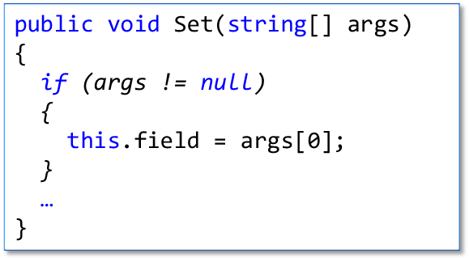
Smart Coding Assistant
public string field;
public void Set(string[] args)
{
this.field = args[0];
}

Slide 12
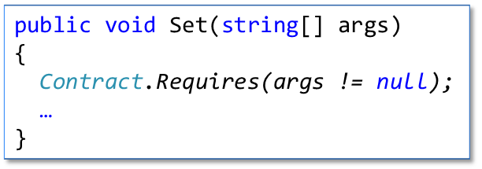
Smart Coding Assistant
public string field;
public void Set(string[] args)
{
this.field = args[0];
}

Slide 13
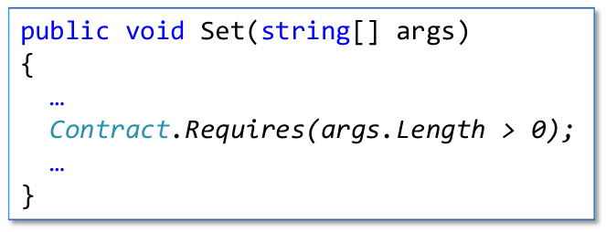
Smart Coding Assistant
public string field;
public void Set(string[] args)
{
Contract.Requires(args != null);
this.field = args[0];
}

Slide 14
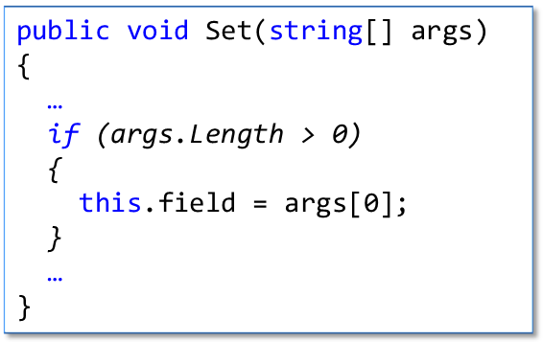
Smart Coding Assistant
public string field;
public void Set(string[] args)
{
Contract.Requires(args != null);
this.field = args[0];
}

Slide 15
Smart Coding Assistant
public string field;
public void Set(string[] args)
{
Contract.Requires(args != null);
if (args.Length > 0)
{
this.field = args[0];
}
}
Similar re-factorings for
post-conditions and
invariants

