Slide 1
Code Contracts Vision for Dev12 time frame
maf, logozzo, mbarnett
March 30, 2011

Slide 2
Code Contracts Dev12 Vision
Smart filtering for static warnings
Warning level slider
From “Find Bugs” to “Verification”
Based on changelist
Focus on changes/new problems
Smart assistant
Points out problems while typing
Suggests quick-fix refactorings
Smart quality metrics
Static assertion density and warning density
Dynamic assertion density and error density
Historical trends
Take away: single engine useful for many scenarios

Slide 3

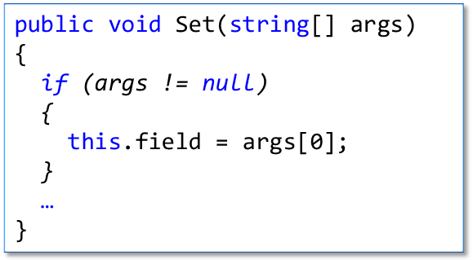
Smart Coding Assistant
public string field;
public void Set(string[] args)
{
this.field = args[0];
}

Slide 4
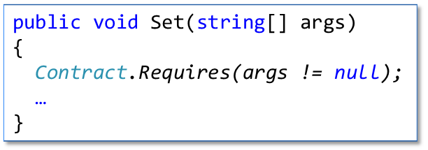
Smart Coding Assistant
public string field;
public void Set(string[] args)
{
this.field = args[0];
}

Slide 5
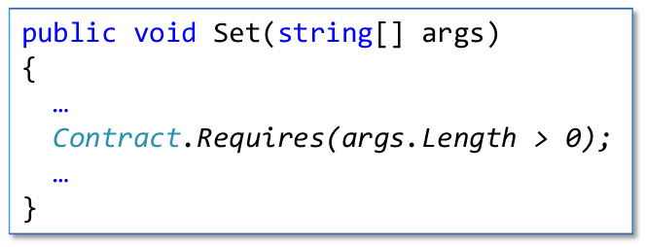
Smart Coding Assistant
public string field;
public void Set(string[] args)
{
Contract.Requires(args != null);
this.field = args[0];
}

Slide 6
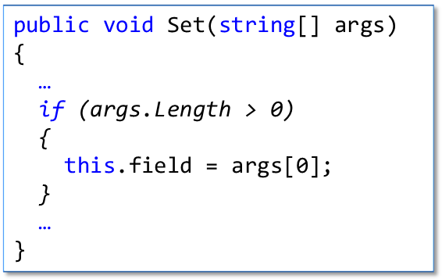
Smart Coding Assistant
public string field;
public void Set(string[] args)
{
Contract.Requires(args != null);
this.field = args[0];
}

Slide 7
Smart Coding Assistant
public string field;
public void Set(string[] args)
{
Contract.Requires(args != null);
if (args.Length > 0)
{
this.field = args[0];
}
}
Similar re-factorings for
post-conditions and
invariants

Slide 8

Smart Filtering
A spectrum from bug finding to verification
Possibly slider per project/type/method
Find bugs
Verify
no specifications/ annotations
some pre/post
some invariants
modifies clauses
loop invariants

Slide 9
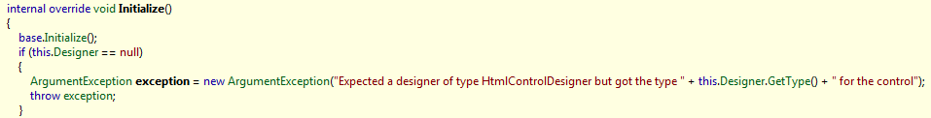

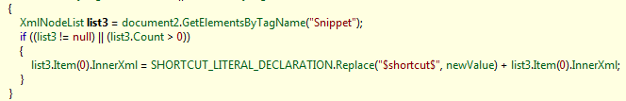
Running CCCheck on all VS assemblies
Assembly: Microsoft.Web.Design.Client, Version=10.0.0.0 Declaring Type: Microsoft.Web.Design.ElementDesigner Assembly: Microsoft.VisualStudio.Web, Version=10.0.0.0 Declaring Type: Microsoft.VisualStudio.Web.Snippets.SnippetListManager Assembly: Microsoft.SqlServer.Management.SqlWizardFramework, Version=10.0.0.0 Declaring Type: Microsoft.SqlServer.Management.SqlWizardFramework.CommandService
…
…
…

Slide 10
Quality Metrics
Per solution, project, type, method (like CodeCoverage)
Trends over time
DataStructures.dll
Contract Density

Slide 11
Code Contracts Parts
Contract reference assembly generation
Contract Authoring
dummy
Rewriter runtime checks
dummy
Visualization
Intellisense
F12
ships in mscorlib
msbuild
scripts
VS
Property
Pane
Contracts for
referenced
assemblies
A.Contracts.dll
Static
checker
Doc
Generation
Sandcastle
Contract reference assemblies
mscorlib
Core
Data
Drawing
Numerics
Web

Slide 12
Original
public void Set(string[] args)
{
Contract.Requires(args != null);
Contract.Requires(args.Length > 0);
…
}
public void Set(string[] args)
{
Contract.Requires(args != null);
…
}

Slide 13
Original
public void Set(string[] args)
{
…
Contract.Requires(args.Length > 0);
…
}
public void Set(string[] args)
{
…
if (args.Length > 0)
{
this.field = args[0];
}
…
}

Slide 14
Original
public void Set(string[] args)
{
if (args != null)
{
this.field = args[0];
}
…
}
public void Set(string[] args)
{
Contract.Requires(args != null);
…
}

Slide 15
public string field;
public void Set(string[] args)
{
Contract.Requires(args != null);
Contract.Requires(args.Length > 0);
this.field = args[0];
}
public string field;
public void Set(string[] args)
{
this.field = args[0];
}
public string field;
public void Set(string[] args)
{
Contract.Requires(args != null);
if (args.Length == 1)
{
this.field = args[0];
}
}
public string field;
public void Set(string[] args)
{
Contract.Requires(args != null);
Contract.Requires(args.Length > 0);
this.field = args[0];
}

