Slide 1

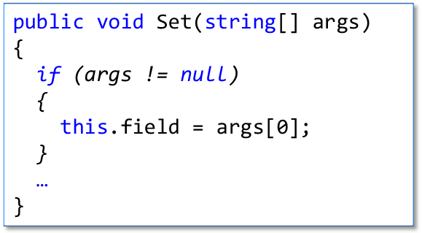
public string field;
public void Set(string[] args)
{
this.field = args[0];
}

Slide 2
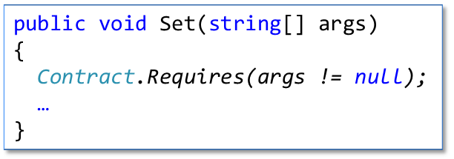
public string field;
public void Set(string[] args)
{
this.field = args[0];
}

Slide 3
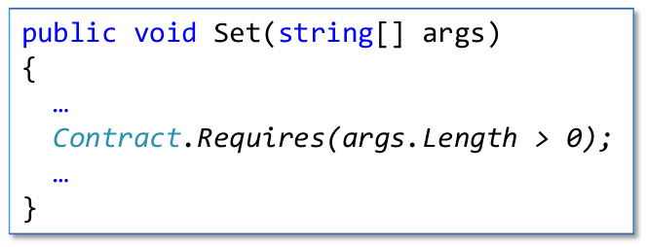
public string field;
public void Set(string[] args)
{
Contract.Requires(args != null);
this.field = args[0];
}

Slide 4
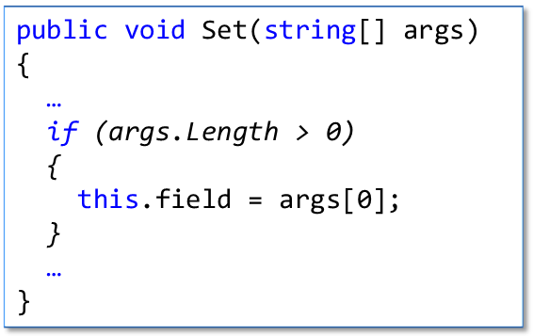
public string field;
public void Set(string[] args)
{
Contract.Requires(args != null);
this.field = args[0];
}

Slide 5
public string field;
public void Set(string[] args)
{
Contract.Requires(args != null);
if (args.Length > 0)
{
this.field = args[0];
}
}

Slide 7
Original
public void Set(string[] args)
{
Contract.Requires(args != null);
Contract.Requires(args.Length > 0);
…
}
public void Set(string[] args)
{
Contract.Requires(args != null);
…
}

Slide 8
Original
public void Set(string[] args)
{
…
Contract.Requires(args.Length > 0);
…
}
public void Set(string[] args)
{
…
if (args.Length > 0)
{
this.field = args[0];
}
…
}

Slide 9
Original
public void Set(string[] args)
{
if (args != null)
{
this.field = args[0];
}
…
}
public void Set(string[] args)
{
Contract.Requires(args != null);
…
}

Slide 10
public string field;
public void Set(string[] args)
{
Contract.Requires(args != null);
Contract.Requires(args.Length > 0);
this.field = args[0];
}
public string field;
public void Set(string[] args)
{
this.field = args[0];
}
public string field;
public void Set(string[] args)
{
Contract.Requires(args != null);
if (args.Length == 1)
{
this.field = args[0];
}
}
public string field;
public void Set(string[] args)
{
Contract.Requires(args != null);
Contract.Requires(args.Length > 0);
this.field = args[0];
}

