Slide 1
CodeContracts: Specification & Verification
Francesco Logozzo
joint work with
M. Barnett and M. Fahndrich

Slide 2
Demo!!!

Slide 3
In these 5 lectures
How to build a real-life static analyzer
Research
Theory
Engineering
Trade-offs
Experience
Try it online at
http://www.rise4fun.com
Download it at
http://msdn.microsoft.com/en-us/devlabs/dd491992.aspx

Slide 4
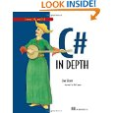

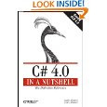
CodeContracts Impact
API in .NET 4.0
Externally available ~20 months
>40,000 downloads, very active forum
3 book chapters on CodeContracts
Many dozens of blog articles
Publications, talks, lectures
POPL, ECOOP, OOPSLA, VMCAI, APLAS, SAS, SAC, FoVeOOS …
Internal usage
Integrated into CLR build

Slide 5
Program verification
“The program does not go wrong”
What does it means?
It does not crash
Division by zero
Dereference of null (or 0 or nil)
No exception is thrown
…
It meets its specification
Specification???
What’s that?

Slide 6

Verification 101

Slide 7
Specification
Informally: “What the program should do”
“It should sort all the elements of the array”
Computers do not like English
(or Spanish or Italian for what it matters ;-)
Which formal language?
How close to the computer?
How close to the human?
How close to the programmer?
How close to the verification tool?

Slide 8
A plethora of specification lang.
Implementation
Temporal Logic?
Z (B) notation?
UML?
TLA+ ?
Abstract state machines (ASM)?
JML? Code Contracts?
SAL?
…
Many many
...

Slide 9
The programmer…
Only limit imagination…
… and the programmer
The final user of all our tools
Specification must be
Programmer friendly!
Tool friendly!
The programmer will use your language only if she has advantage from it

Slide 10
Real world: SAL
SAL = Simple Annotation Language
Windows API annotation
Easy to understand (for a C programmer)
Mainly buffer annotations
void fill_string(
__out_ecount(cchBuf) TCHAR* buf,
size_t cchBuf,
char ch) {
for (size_t i = 0; i < cchBuf; i++) {
buf[i] = ch;
}
}

Slide 11


SAL
Compilation time analysis
Visual C++ /analyze switch
Early bug detection
Better code documentation
MSDN (Microsoft Developer network)
Programmers willing to add them ☺
Why?
Because they have great bang for bucks
Drawbacks?
Limited extensibility (expressivity)

Slide 12
Potato
Specification
The program behavior is included in the behaviors admissible from the specification:
Program is correct ☺
Program

Slide 13
Potato
Specification
The program behavior is not included in the behaviors admissible from the specification:
Program is incorrect ☹
(Some behavior may not meet the specification)
Program

Slide 14
How do we check potato?
The problem is undecidable
Need to perform abstraction
In the concrete:
Is the program correct? Yes/No
In the abstract:
Is the program correct? Yes/No/I do not know
Which abstraction?
Upper-approximate the program semantics
Under-approximate the specification semantics

Slide 15
Potato (when lucky)
n
Add behaviors
Specification
Program
Remove specification
The over-approximation of the program behavior is included in the under-approximation of the admissible specification:
Program is correct! ☺

Slide 16
Potato (when lucky)
n
Add behaviors
Specification
Program
Remove specification
The over-approximation of the program behavior is included in the under-approximation of the admissible specification:
Program is correct! ☺

Slide 17
Potato (when unlucky)
n
Add behaviors
In this case, too many!
Specification
Program
Remove specification
The over-approximation of the program behavior is not included in the under-approximation of the admissible specification:
Program may be correct or it may not ☹

Slide 18
To sum up…
Specification
How do we specify the intent?
We should not over-specify
Verification
How do we check the program is doing the right thing?
Runtime (testing)
Static time (verification)
These lectures will all be about that!

Slide 19
Specification with Contracts

Slide 20
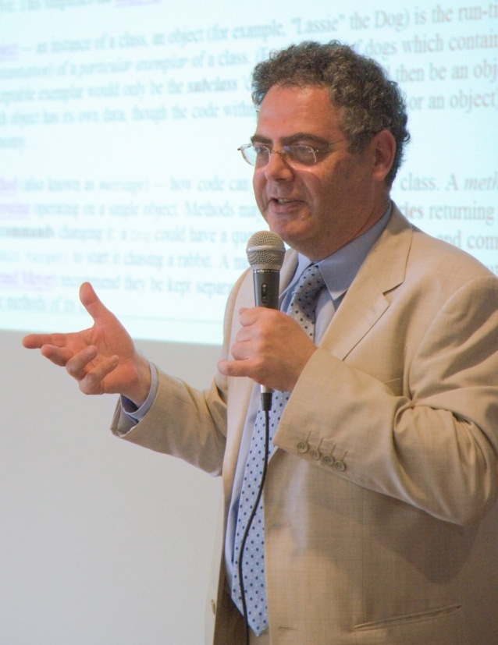
Contracts?
Each program module specifies
What it expects from its users
Precondition
What it ensures to its users
Postcondition
What holds in a stable state
Object invariants

Slide 21
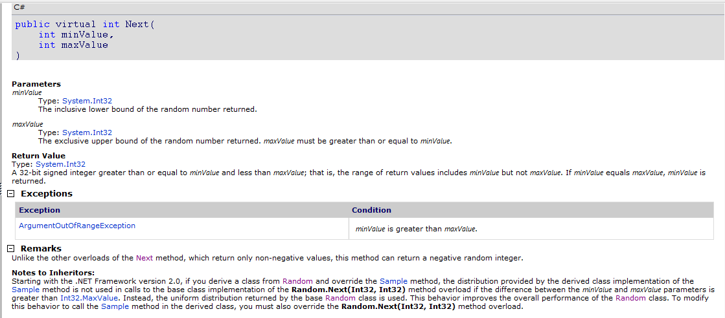
Contracts: What for?
Document design decisions
Precondition
Postcondition

Slide 22

Contracts: What for?
Amplify runtime checking (debugging)
More assertions in the code
More stable the code
Assertions can be disabled
in release builds
Enable modular static analysis
Improved precision
Analysis should not assume worst case
More scalability
A little bit as a type-checker (but more refined!)

Slide 23
Assume/guarantee reasoning
Have methods M, N
M with precondition P, postcondition Q
N call M
If P is true,
then M guarantees Q
When N calls M then
N should establish P
N can rely on Q

Slide 24
But we already have assertions!
All languages have an assert
assert(exp) macro in C/C++
assert exp keyword in Java
Debug.Assert(exp) static method in .NET
Assert is not visible from the caller!
static public int GCD(int x, int y)
{
Debug.Assert(x > 0);
Debug.Assert(y > 0);
}

Slide 25
Exceptions
Use exceptions for parameter validation:
At library surface
To protect from unwanted values
To early detect API misuses
Again, not visible to callers
static public int GCD(int x, int y)
{
if (x < 0)
throw new ArgumentException("Error");
… }

Slide 26
But we have Debug.Assert!
Cannot (easily) specify a postcondition
static public int GCD(int x, int y)
{
Debug.Assert(x > 0);
Debug.Assert(y > 0);
while (true)
if (x < y) { y %= x; if (y == 0) return x; }
else { x %= y; if (x == 0) return y; }
}
Debug.Assert(Result > 0) ?

Slide 27
Assert & OOP : ☹
Inheritance
Precondition: Should be weaker
Postcondition: Should be stronger
How do I enforce it?
Object invariants
Valid in steady states
Ex: this.x != null
Should I add it at every method??
Interfaces, abstract methods
Where I put my assert?

Slide 28
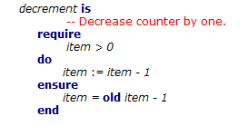
Contracts today
First class citizens in the language
Provide syntax to express contracts
Examples: Eiffel, D, Spec# …
Why not everyone is using it?
New language (start from scratch, or almost)
New compiler (do you trust it?)

Slide 29
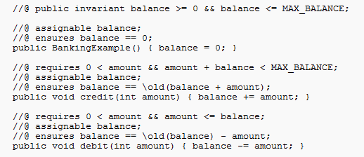
Contracts today
Inside comments or as code annotation
Ex. JML, Eclipse for non-null …
Why not everyone is using it?
Persistence?
Need for serialization, parsing…
Separate type checking, name resolution…

Slide 30
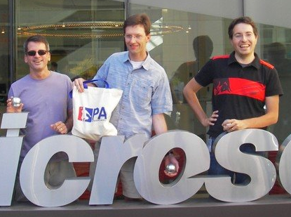
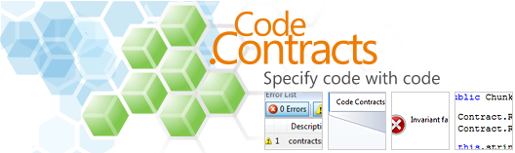
Code contracts

Slide 31
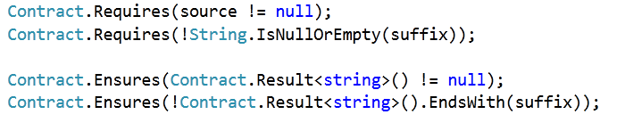

Code Contracts
Idea: Use the IL as contract representation
Use static methods to a contract library
Language agnostic: same for C#, VB, F# …

Slide 32
What are they?
Plain code for contracts
Static methods to a contract library
Language agnostic: same for C#, VB, F# …
Standard from .NET 4.0
No need for a new compiler/language
Precondition: Contract.Requires(...)
Postcondition: Contract.Ensures(…)
Invariant: Contract.Invariant(…)

Slide 33
Preconditions
Contract.Requires(exp)
int foo(String s, int y)
{
Contract.Requires(s != null);
Contract.Requires(y > 0);
// ...
}
C# expressions

Slide 34
Preconditions
Which is the underlying language specification?
Your programming language!!!
Public Function foo(ByVal s As String, ByVal y As Integer)
As Integer
Contract.Requires(s IsNot Nothing)
Contract.Requires(y > 0)
‘ …
End Function
VB expressions
Int32 __gc* foo(String __gc* s, Int32 __gc* y)
{
Contract::Requires(s != 0);
Contract::Requires(y > 0);
C++ expressions

Slide 35
Hmmm…

Slide 36
Side effects?
public class SideEffect
{
int x;
public void foo(SideEffect se)
{
Contract.Requires(XPositive());
//…
}
public bool XPositive()
{
return this.x > 0;
}
public bool XPositive()
{
int oldx = this.x;
this.x = -this.x;
return oldx > 0;
}
Change the state

Slide 37
Purity…
We require the user to add the attribute “Pure”
The user takes the responsibility
No dynamic checking
it will be too expensive
Static checking enforced by a separate tool
I will not talk about it here
Ask Diego if interested!

Slide 38
Postconditions
Contract.Ensures(exp)
Class Field
{
int x;
int Set(int y)
{
Contract.Ensures(this.x == y);
this.x = y;
}
}

Slide 39
Result value?
In C#/VB/… no name for the returned value
Use a dummy method
public int Fact(int x)
{
Contract.Ensures(Contract.Result<int>() >= 0); …
}

Slide 40
Question
Why <int> ?
Why <bool[]> ?
public int Fact(int x)
{
Contract.Ensures(Contract.Result<int>() >= 0); …
}
public bool[] ArrayFactory(int x)
{
Contract.Ensures(Contract.Result<bool[]>() != null); return new bool[x];
}
T Contract.Result<T>()

Slide 41
Old value?
No name for the old value
Class Account
{
int balance;
int Add(int k)
{
Contract.Ensures(this.balance == Contract.Old(this.balance) + k);
this.balance += k;
}
}
T Contract.Old<T>(T value)

Slide 42
Quantifiers
Limited form:
Contract.ForAll(0, A.Length, i => A[i] > 0);
Contract.Exists(0, A.Length, i => A[i] > 0);
Exploit higher order functions

Slide 43
Class Invariant
Class Account
{
int balance;
[ContractInvariantMethod]
protected void ObjectInvariant()
{
Contract.Invariant(balance >= 0);
}
}

Slide 44
Interfaces
[ContractClass(typeof(WithdrawContracts))]
interface IWithdraw
{
long Balance { get; }
void Withdraw(long money);
}
[ContractClassFor(typeof(IWithdraw))]
public class WithdrawContracts : IWithdraw {
public long Balance { get { Contract.Ensures(Contract.Result<long>() >= 0); return -111; } }
public void Withdraw(long money) {
Contract.Requires(money < this.Balance);}}

Slide 45
Other
Abstract classes
Similar to interfaces
Out/ref parameters
Use dummy method
Legacy code: “if !exp throw exception”
Use Contract.EndContract()

Slide 46
Why not simply attributes?
(Eclipse does it)
Need Expression serialization
No free type checking
No (almost) free dynamic checking
[ContractPre(“x ≥ 0”)]
protected void foo(int x) { … }

Slide 47
Advantages
Produced by all the compilers
Free:
Types
Intellisense
Name resolution…
Cross language
Precise semantics
Uniform format understood by our tools

Slide 48
Runtime checking (aka Testing)

Slide 49
Potato & testing
Specification
One execution is outside the specification
The program is incorrect!

Slide 50
Potato & testing
Specification
A sample of the program behavior is included in the behaviors admissible from the specification
Is the program correct?

Slide 51
Testing
Prove the existence of specification violations
i.e. the existence of bugs
If a test fails, then there is a bug
Cannot verify the program
i.e. the existence of no bug!
Can try only finitely main inputs
100% code coverage do not imply 100% data coverage
Yet, very useful!!!

Slide 52
Runtime checking of contracts
C# compiler does not know about contracts
Achieved via binary rewriting
Handle old, result …
Inherit contracts
Stick contracts to interface implementations

Slide 53
Binary rewriting
public virtual int Add(object value){
Contract.Requires( value != null );
Contract.Ensures( Count == Contract.OldValue(Count) + 1 );
Contract.Ensures( Contract.Result<int>() == Contract.OldValue(Count) );
if (_size == _items.Length) EnsureCapacity(_size+1);
_items[_size] = value;
return _size++;
}
Executable Runtime
Contract Checking
.method public hidebysig newslot virtual instance int32 Add(object 'value') cil managed
{
.locals init (int32 'Contract.Old(Count)',
int32 'Contract.Result<int>()')
ldarg.0
call instance int32 TabDemo.BaseList::get_Count()
stloc.3
ldarg.1
ldnull
ceq
ldc.i4.0
ceq
ldstr "value != null"
call void __RewriterMethods::RewriterRequires$PST06000009(bool, string)
ldarg.0
ldfld int32 TabDemo.BaseList::count
ldarg.0
ldfld object[] TabDemo.BaseList::items
ldlen
conv.i4
ceq
ldc.i4.0
ceq
stloc.1
ldloc.1
brtrue IL_004d
nop
ldarg.0
ldarg.0
ldfld int32 TabDemo.BaseList::count
ldc.i4.1
add
call instance void TabDemo.BaseList::EnsureCapacity(int32)
nop
nop
ldarg.0
ldfld object[] TabDemo.BaseList::items
ldarg.0
ldfld int32 TabDemo.BaseList::count
ldarg.1
stelem.ref
ldarg.0
dup
ldfld int32 TabDemo.BaseList::count
dup
stloc.2
ldc.i4.1
add
stfld int32 TabDemo.BaseList::count
ldloc.2
stloc.0
br IL_0072
ldloc.0
stloc.s 'Contract.Result<int>()'
br IL_007a
ldarg.0
call instance int32 TabDemo.BaseList::get_Count()
ldloc.3
ldc.i4.1
add
ceq
ldstr "Count == Contract.Old(Count) + 1"
call void __RewriterMethods::RewriterEnsures$PST0600000B(bool, string)
ldloc.s 'Contract.Result<int>()'
ldloc.s V_4
ceq
ldstr "Contract.Result<int>() == Contract.Old(Count)"
call void __RewriterMethods::RewriterEnsures$PST0600000B(bool, string)
ldloc.s 'Contract.Result<int>()'
ret
}
csc/vbc/…
Release Compile
/d:CONTRACTS_FULL
.method public hidebysig newslot virtual instance int32 Add(object 'value') cil managed
{
ldarg.1
ldnull
ceq
ldc.i4.0
ceq
call void [Microsoft.Contracts]Microsoft.Contracts.Contract::Requires(bool)
ldarg.0
call instance int32 TabDemo.BaseList::get_Count()
ldarg.0
call instance int32 TabDemo.BaseList::get_Count()
call !!0 [Microsoft.Contracts]Microsoft.Contracts.Contract::Old<int32>(!!0)
ldc.i4.1
add
ceq
call void [Microsoft.Contracts]Microsoft.Contracts.Contract::Ensures(bool)
call !!0 [Microsoft.Contracts]Microsoft.Contracts.Contract::Result<int32>()
ldarg.0
call instance int32 TabDemo.BaseList::get_Count()
call !!0 [Microsoft.Contracts]Microsoft.Contracts.Contract::Old<int32>(!!0)
ceq
call void [Microsoft.Contracts]Microsoft.Contracts.Contract::Ensures(bool)
ldarg.0
ldfld int32 TabDemo.BaseList::count
ldarg.0
ldfld object[] TabDemo.BaseList::items
ldlen
conv.i4
ceq
ldc.i4.0
ceq
stloc.1
ldloc.1
brtrue.s IL_0069
ldarg.0
ldarg.0
ldfld int32 TabDemo.BaseList::count
ldc.i4.1
add
call instance void TabDemo.BaseList::EnsureCapacity(int32)
ldarg.0
ldfld object[] TabDemo.BaseList::items
ldarg.0
ldfld int32 TabDemo.BaseList::count
ldarg.1
stelem.ref
ldarg.0
dup
ldfld int32 TabDemo.BaseList::count
dup
stloc.2
ldc.i4.1
add
stfld int32 TabDemo.BaseList::count
ldloc.2
stloc.0
br.s IL_008b
ldloc.0
ret
} // end of method BaseList::Add
csc/vbc/…
ccrewrite
.method public hidebysig newslot virtual instance int32 Add(object 'value') cil managed
{
ldarg.0
ldfld int32 TabDemo.BaseList::count
ldarg.0
ldfld object[] TabDemo.BaseList::items
ldlen
conv.i4
ceq
ldc.i4.0
ceq
stloc.1
ldloc.1
brtrue.s IL_0029
ldarg.0
ldarg.0
ldfld int32 TabDemo.BaseList::count
ldc.i4.1
add
call instance void TabDemo.BaseList::EnsureCapacity(int32)
ldarg.0
ldfld object[] TabDemo.BaseList::items
ldarg.0
ldfld int32 TabDemo.BaseList::count
ldarg.1
stelem.ref
ldarg.0
dup
ldfld int32 TabDemo.BaseList::count
dup
stloc.2
ldc.i4.1
add
stfld int32 TabDemo.BaseList::count
ldloc.2
stloc.0
br.s IL_004b
ldloc.0
ret
}

Slide 54
Static verification

Slide 55
Static verification with potatos
n
Add behaviors
Specification
Program
Remove specification
The over-approximation of the program behavior is included in the under-approximation of the admissible specification:
Program is correct! ☺

Slide 56
Static verification
Any static verification method is incomplete
Verification is not decidable
public static bool NotDecidable()
{
if (SolvableDiophantineEquation)
return 1;
else
Contract.Assert(false);
}
Not decidable (Hilbert’s 10th problem)

Slide 57
Verification techniques
Many, many out there…
Model Checking
Theorem proving
Automatic
SMT solvers, resolution based, …
Semi-automatic
2nd order
All those instances of Abstract interpretation!

Slide 58
Abstract interpretation

Slide 59


Abstract Interpretation
Theory of approximations
Semantics are order according to the precision
The more the precise the semantics
The more the properties captured
A static analysis is a semantics
Precise enough to capture the properties of interest
Rough enough to be computable

Slide 60
Basic Concepts
Concrete domain
A mathematical structure describing the most precise information on the program
Usually the program semantics
Traces, operational, denotational …
Abstract domain
A mathematical structure describing the property of interests
Ex.: range of a variable

Slide 61
Which is the structure?
In general a partial order
Often a complete lattice
Order
The order is the implication
Least element: bottom (⊥)
Greatest element: top (⊤)
Join
The least element larger than given twos
Meet
The greatest element smaller than given twos

Slide 62
Example: Sets of integers ℤ
Elements: Sets of integers
Least element: {}
Largest element: ℤ
Order subset inclusion
Join: set union
Meet: set intersection

Slide 63
Example: Signs
Elements: {⊥, pos, neg, zero, ⊤}
Least element: ⊥
Greatest element: ⊤
Order, join, meet : At the whiteboard!

Slide 64
Example: Intervals
Elements: { [a, b] | a, b ∈ 𝕫 ∪ { +∞, -∞} }
Least element: [a, b] such that a > b
Largest element: [+∞, -∞]
Order: Interval inclusion
Join: Interval union
Meet: Interval intersection

Slide 65
Concrete & Abstract
There should exists a relation between them
Often a Galois Connection
Concrete
Abstract
Concretization γ
Abstraction α

Slide 66
Example
Concrete: Sets of integers
Abstract: Intervals
Abstraction α
α( S ) = [inf S, sup S]
Concretization γ
γ([a, b]) = { x | a ≤ x ≤ b }
Can prove they form a Galois Connection
α, γ be monotonic
x ⊑ γ(α (x))
α(γ(x)) ⊑ x

Slide 67
Example
Concrete: Intervals
Abstract: Signs
Abstraction α is
α([a, b]) = …
Concretization γ
γ(pos) = [0, +∞]
γ(zero) = [0, 0]
….
They form a Galois Connection too

Slide 68
Some properties
Galois Connections compose
Example: Sets of ℤ → Intervals → Signs
Exercise: prove it!!!
The set of abstractions is a complete lattice
Proof harder… Talk to me if interested
Least precise abstraction : {⊤}
Most precise abstraction : Concrete domain
Many equivalent definitions
Moore families, ideals, upper closure operators…

Slide 69
Ok, so what?
How is all of this related to program verification?
The execution of a program is on a concrete domain
A static analysis/verification executes the program on an abstract domain

Slide 70
Rule of signs (1 of 3)
Have language with only expressions
e ::= k | x | e + e | e * e
Concrete semantics is over ℘(𝕫)
Sets because of non-determinism
c⟦ k⟧ρ | = | k
c⟦ x ⟧ρ | = | ρ( x )
c⟦e1 + e2 ⟧ρ | = | c⟦ e1 ⟧ρ + c⟦ e2 ⟧ρ
c⟦e1 * e2 ⟧ρ | = | c⟦ e1 ⟧ρ * c⟦ e2 ⟧ρ

Slide 71
Rule of signs (2 of 3)
Abstract semantics is over signs
a⟦ k ⟧ρ | = | sign(k)
a⟦ x ⟧ρ | = | ρ( x )
a⟦e1 + e2 ⟧ρ | = | a⟦ e1 ⟧ρ + a⟦ e2 ⟧ρ
a⟦e1 * e2 ⟧ρ | = | a⟦ e1 ⟧ρ * a⟦ e2 ⟧ρ
+ | ⊥ | neg | zero | pos | ⊤
⊥ | ⊥ | ⊥ | ⊥ | ⊥ | ⊥
neg | ⊥ | neg | neg | ⊤ | ⊤
zero | ⊥ | neg | zero | pos | ⊤
pos | ⊥ | ⊤ | pos | Pos | ⊤
⊤ | ⊥ | ⊤ | ⊤ | ⊤ | ⊤

Slide 72
Rule of signs (3 of 3) - Example
(12345565 * 13456) + (-9873 * -1344678)
Sign of the result?
Do the computation: 179 397 928 534
Then take the sign : pos
Do the abstract computation:
(pos * pos) + (neg * neg)
= pos + pos

Slide 73
How does it apply to programs?
Execute the program in the abstract
Interpret concrete operations in the abstract
Assume a simple imperative language
Just to make it easy
The program is
C::= x = exp; | skip; |
if (exp) C else C; | C C
while (exp) C;

Slide 74
Assignment
a⟦x = exp ⟧ρ = ρ[x ↦ ⟦x = exp ⟧ ]
Example (with intervals)
ρ = [y ↦ [2, 4]]
a⟦x = y * y ⟧ρ = [x ↦ [4, 16], y ↦ [2, 4]]
Note that we lost precision
On purpose for the example
Intervals do not capture relations
Can be refined!
All static analyses are incomplete!!!!

Slide 75
The other commands…
Skip does nothing
a⟦ skip ⟧ρ = ρ
Sequence is function composition
a⟦ C₁ C₂ ⟧ρ = a⟦ C₂ ⟧ ( a⟦ C₁ ⟧ρ )
Conditional more complex
a⟦ if(b) C₁ else C₂ ⟧ρ
= a⟦ C₁ ⟧(ρ ⊓ ⟦b⟧) ⊔ a⟦ C₂ ⟧(ρ ⊓ ⟦!b⟧)
Loops have a fixpoint formulation
a⟦ while(b) C ⟧ρ = lfp λX. ρ ⊔ a⟦ C ⟧(X⊓⟦b⟧)

Slide 76
Fixpoint computation
In general it may not terminate
Depends on the lattice
If the lattice is of finite height: ok
Not so expressive
Ex: constant propagation, signs, predicate abstraction
If the lattice of ∞ height, needs widening
“extrapolate the fixpoint”
Recover precision by narrowing
Don’t worry: example follows!

Slide 77
Example of fixpoint iterations with widening
x = 0;
while (x < 100)
{
x ++;
}
x ∈ [0, 0]
x ∈ [0, 1]
x ∈ [0, 2]
x ∈ [0, ∞]
x ∈ [0, 0]
x ∈ [0, 1]
…
x ∈ [0, 99]
x ∈ [1, 1]
x ∈ [1, 2]
x ∈ [1, 100]

Slide 78
Example of fixpoint iterations with narrowing
x = 0;
while (x < 100)
{
x ++;
}
x ∈ [0, ∞]
x ∈ [0, 0] ⊔ [1, 100]
x ∈ [0, 100]
x ∈ [0, 99]
x ∈ [0, 99]
x ∈ [0, 99]
x ∈ [1, 100]
x ∈ [1, 100]
x ∈ [1, 100]

Slide 79
Static Checking of Contracts

Slide 80
Potato are nice, but…
How should I prove a program?
Model checking
SLAM, SPIN, BLAST …
Theorem proving
Automatic (Esc/Java, Spec# …)
Interactive (Isabelle, Coq …)
Abstract interpretation
Astree, ESP/X, Polyspace, Julia, Clousot …

Slide 81
Model checkers
P ⊨ M
Explore a finite model
May not be enough
Predicate abstraction
Needs user-provided predicates
No way
Try to get them from the source code
Limited from the syntax
Very costly in practice
May not terminate
int x = 0, y = 2;
while (…)
{
x++; y++;
}
assert(y - x == 2);

Slide 82
Theorem provers
{Pre} C {Post}
Try to prove that Pre ⇒ wp(C, Post)
Nice in theory…
Practice
Limited inference abilities
E.g. Loop invariants
Need a lot of extra-annotations
More of what a programmer
is willing to pay
assume (N >= 0)
int i = 0, a = 0, b = 0;
while (i < N)
{
a++; b += 2; i++;
}
assert(a + b == 3 * N);

Slide 83

CodeContracts Static checker aka Clousot

Slide 84
Clousot
Based on Abstract Interpretation
≠ Usual approaches based on theorem prover
Advantages
Automatic
Inference of loop invariants, pre, post, invariants
Predictable
No quantifier instantiation
No easy proofs by contradictory axioms
Scalable
Tune-up for the properties of interest

Slide 85
Algorithm: High level
For each assembly A
For each class C
For each method M
Extract the proof obligations
What should I prove?
Run the analyses
Discover facts on the program
Use the facts to prove the proof obligations
If not, do something else…

Slide 86
Proof obligations
Two kinds: Implicit and explicit
Implicit
NonNull checking
Bounds checking
Divisions by zero, overflow
…
Explicit
Assertions
When calling a method, its precondition
When returning from a method, its postcondition

Slide 87
NonNull dereference
public bool IsCiao(string s)
{
return s.Contains("ciao!");
}
The string s should not be null
Otherwise, exception at run time
Clousot scans the program and records the proof obligation:
s != null

Slide 88
Array bounds
public int[] RandomArray(int len)
{
var random = new Random(len);
var arr = new int[len];
for (var i=0; i < len; i++)
{
arr[i] = random.Next();
}
return arr;
}
len >= 0
i < arr.Length
i >= 0

Slide 89
Overflows
public int Abs(int x)
{
if (x < 0)
return -x;
return x;
}
public int Div(int x, int y)
{
return x / y;
}
y != 0
x != MinValue
x != MinValue || y != -1

Slide 90
Explicit obligation: Assertions
public string Concat(string p, string q)
{
Contract.Requires(p != null);
Contract.Requires(q != null);
var concat = p + q;
Contract.Assert(concat != null);
Contract.Assert(concat.Length > 0);
return concat;
}
concat != null
concat.Length > 0

Slide 91
Assume/guarantee reasoning
Have methods M, N
M with precondition P, postcondition Q
If P is true, then M guarantees Q
If N calls M then
N should establish P
N can rely on Q

Slide 92
Preconditions
public string Concat(string p, string q)
{
Contract.Requires(p != null);
Contract.Requires(q != null);
// …
}
public string MyConcat()
{
return Concat("Ciao", null);
}
Concat “believes”
(assumes)
those preconditions
“Ciao” != null
null != null

Slide 93
Postconditions
public double Abs(double x)
{
Contract.Ensures(
Contract.Result<double>() >= 0);
if (x < 0)
return -x;
return x;
}
public double Sqrt(double z)
{
return Math.Sqrt(Abs(z));
}
-x >= 0
x >= 0
Sqrt “believes”
(assumes)
Abs(z) >= 0

Slide 94
Read the bytecode

Slide 95
Phase 1
Read the program from the disk
Bytecode format
Bytecode is stack based
Get rid of the stack
Program in 3 addresses form
Build the control flow graph
Get rid of Heap
Scalar program

Slide 96
On the disk…
.Dll or .Exe
Metadata
(attributes?)
Metadata
(bitmaps?)
Code
Class
Method 1 (constructor?)
Method 2
Method 3

Slide 97
.NET
Safe execution environment
Managed execution, GC …
Object-oriented
Shared type system
C#
VB
F#
…
Managed C++
Common Intermediate Language (CIL)
Libraries (mscorlib, System.dll …)
Virtual Machine
Operating System (Windows …)

Slide 98
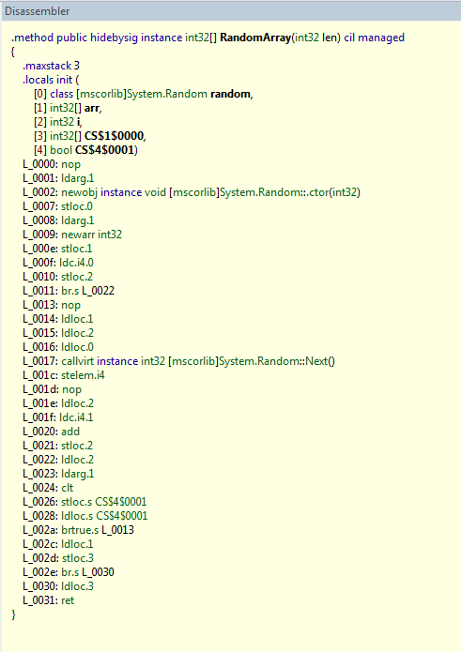
Bytecode
public int[] RandomArray(int len)
{
var random = new Random(len);
var arr = new int[len];
for (var i=0; i < len; i++)
{
arr[i] = random.Next();
}
return arr;
}
C# compiler

Slide 99
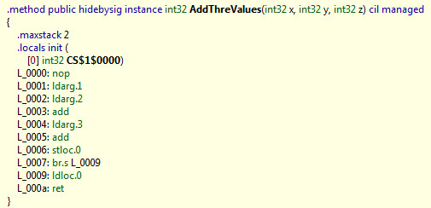
Bytecode is ugly to analyze
public int AddThreValues(int x, int y, int z)
{
return x + y + z;
}

Slide 100
So why we analyze it?
It’s common
Output of C#, F#, VB … compilers
i.e. millions of programmers…
Languages change, bytecode not
C# 2.0 → C# 3.0 → C# 4.0
Semantics of bytecode is fix
Closest thing we have to a formal specification
Do not need the source code to analyze

Slide 101
De-stack
Make the stack locations explicit
public int DeStack(int x, int y, int z)
{
int stack; // Stack
int CS_1_0000; // CS$1$0000 is an invalid C# name
stack = x + y;
stack = stack + z;
CS_1_0000 = stack;
return CS_1_0000;
}

Slide 102
De-stack
Syntactic transformation
Input
Stream of instructions for a method
Output
Stream of instructions in one of the forms
R = R1 binop R2
where binop ∈ { +, -, *, /, %, ≥, ≤ > , … }
R = unop R1
Where unop ∈ { -, (int32), (int64) …}
Jump label, ret value
Where jump is { jz, jnz, … }
Call method

Slide 103
Control flow graph construction
Method entry
assume Pre(f)
entry
entry

Slide 104
Control flow graph construction
Method exit
assert Post(f)
ret v
ret v

Slide 105
Control flow graph construction
Method call
assert Pre(f)
Call f()
Call f()
assume Post(f)

Slide 106

Control flow graph construction
Jumps
jump l
istr 1
…
istr n
jump j
l:
istr n+1
…
istr k
j:
istr 1
…
istr n
l:
istr n+1
…
istr k
j: …
A sequence of non-jump instructions is a block

Slide 107
De-heap
Variables can alias
public class Alias
{
int x;
public void Foo(bool b)
{
Alias tmp = new Alias();
tmp.x = -11;
Alias alias = tmp;
if(b)
{
alias.x = 10;
}
Contract.Assert(tmp.x == -11);
}
}
alias and tmp alias!
Is it true?

Slide 108
De-heap
Goal:
Remove the heap
Assign a name to each heap location
Input:
A program in 3 addresses form
Output:
A program without explicit heap locations
All variables are assigned at least once (SSA)
Idea:
Track equalities

Slide 109
An example
public class Alias
{
int x;
public void Foo(bool b)
{
Alias tmp = new Alias();
tmp.x = -11;
Alias alias = tmp;
if(b)
{
alias.x = 10;
}
Contract.Assert(tmp.x == -11);
}
}
public class AliasScalar
{
public void Foo(bool b)
{
int svX = -11;
if (b)
{
svX = 10;
}
Contract.Assert(svX == -11);
}
}
Use e-graph
At the blackboard

Slide 110
Let’s recap
We’ve seen:
Contracts
Documentation
Better debugging
Assume/guarantee reasoning on the code
Clousot
Collect proof obligations
Implicit/explicit
Bytecode analysis
De-Stack
CFG construction
De-Heap

Slide 111
Next
Expression recovery
Numerical abstract domains in Clousot
Pentagons
Combination of domains
Subpolyhedra
Hints
Floating points
Backward analysis
Inter-method inference
Message prioritization and filtering

Slide 112



Clousot: Analysis structure
Expression analysis
Heap analysis
Stack analysis
Analyses
Bounds, nonnull, arrays…
Source: z = x + y
From here

Slide 113
Compilation
In general loses information
The program is decomposed in smaller chunks
The static analysis should recover it
Loops are no more explicit
No if statements
No explicit guards
No Boolean connectives
…

Slide 114
Wanted:(Relative) completeness
P
⟦P⟧
⊑
C(P)
⟦C(P)⟧
Consequences:
No imprecision introduced by the compilation
Bytecode analysis as precise as the source one
It can be more precise
It relates abstract semantics
The abstract semantics for the source can be incomplete w.r.t. concrete
Is it always the case??

Slide 115
Exercise
Suppose x ∈ [0,1]
public double DivCompiled(double x)
{
double t1 = 1 + x;
double t2 = x / t1;
return t2;
}
public double Div(double x)
{
return x / (1 + x);
}
Which is the interval for the value returned by the two methods?

Slide 116
Where is the problem?
Lost the relation between the two x
But they are the same variable!
Compilation put the program in normal form
Advantages:
Type checking, name resolution, fewer cases
Disadvantages:
Smaller window on the program
Solution?
Rebuild the expressions

Slide 117
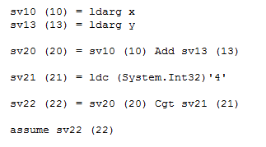
Example
At high level: x + y ≤ 4
Compiled:
(and de-stack, de-heap, …)

Slide 118
Brainstorm: How to recover info?

Slide 119
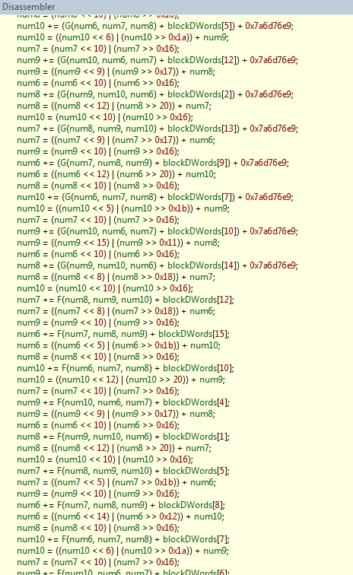
Eager expression reconstruction?
MDTransform
9000 straight line instructions

Slide 120
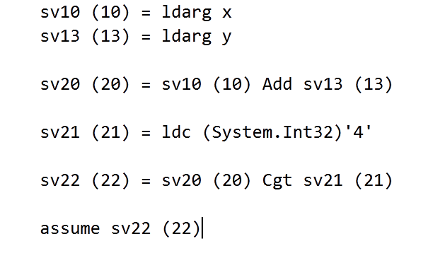
Lazy expression recovery

Slide 121
Essentially a domain refinement
Given
Abstract domains 〈 D+, ⊑+ 〉 ←γ ← 〈 D, ⊑ 〉
Abstract semantics
ℍ⟦⋅⟧ ∈ D → D , 𝕃⟦⋅⟧ ∈ D+ → D+
(… some more hypotheses …)
∀ d ∈ D:
P
γ(ℍ ⟦P⟧(d))
⊑
C(P)
π (𝕃 ⟦C(P)⟧(γ(d)))

Slide 122
Non-Null analysis

Slide 123
“Null references: The billion dollar mistake”
“I call it my billion-dollar mistake.
It was the invention of the null reference in 1965.
At that time, I was designing the first comprehensive type system for references in an object oriented language (ALGOL W). My goal was to ensure that all use of references should be absolutely safe, with checking performed automatically by the compiler.
But I couldn't resist the temptation to put in a null reference, simply because it was so easy to implement. This has led to innumerable errors, vulnerabilities, and system crashes, which have probably caused a billion dollars of pain and damage in the last forty years.”

Slide 124
Example
public string TrimSuffix(string s, string suffix)
{
Contract.Requires(s != null);
Contract.Requires(suffix != null);
string res = s;
while (res.EndsWith(suffix))
{
int len = res.Length - suffix.Length;
res = res.Substring(0, len);
}
Contract.Assert(res != null);
return res;
}

Slide 125
Analysis steps (recall)
Read the bytecode
Program transformations
De-Stack
CFG Construction
De-heap
Expression recovery
Collect proof obligations
Analysis
Check
…

Slide 126
With proof obligations explicit
public string TrimSuffixWPO(string s, string suffix)
{
Contract.Requires(s != null);
Contract.Requires(suffix != null);
string res = s;
Contract.Assert(res != null);
while (res.EndsWith(suffix))
{
Contract.Assert(res != null);
Contract.Assert(suffix != null);
int len = res.Length - suffix.Length;
Contract.Assert(res != null);
res = res.Substring(0, len);
Contract.Assume(res != null); // Postcondition of res
}
Contract.Assert(res != null);
return res;
}

Slide 127
Analysis steps (recall)
Read the bytecode
Program transformations
De-Stack
CFG Construction
De-heap
Expression recovery
Collect proof obligations
Analysis
Check
…

Slide 128
Abstract domain for the analysis
⊤
Null
NotNull
⊥
Point-wise extension for environments
Point-wise?
Simple and finite domain
Fast convergence

Slide 129
Assume & Assert
During the analysis assert are turned into assume
Why?
If an assert does not hold, the program crashes
If we reach the point after the assert, then it holds
So we can trust it holds
(we delay the check to the next phase)

Slide 130
Analysis
public string TrimSuffixWPO(string s, string suffix)
{
Contract.Requires(s != null);
Contract.Requires(suffix != null);
string res = s;
Contract.Assume(res != null);
while (res.EndsWith(suffix))
{
Contract.Assume(res != null);
Contract.Assume(suffix != null);
int len = res.Length - suffix.Length;
Contract.Assume(res != null);
res = res.Substring(0, len);
Contract.Assume(res != null); // Postcondition of res
}
Contract.Assume(res != null);
return res;
}
s, suffix, res: NotNull
s, suffix, res: NotNull
s, suffix : NotNull, res: ⊤
s, suffix, res: NotNull

Slide 131
Checking
public string TrimSuffixWPO(string s, string suffix)
{
Contract.Requires(s != null);
Contract.Requires(suffix != null);
string res = s;
Contract.Assert(res != null);
while (res.EndsWith(suffix))
{
Contract.Assert(res != null);
Contract.Asert(suffix != null);
int len = res.Length - suffix.Length;
Contract.Assert(res != null);
res = res.Substring(0, len);
Contract.Assume(res != null); // Postcondition of res
}
Contract.Assert(res != null);
return res;
}
s, suffix: NotNull, res : Null
s, suffix, res: NotNull
s, suffix, res: NotNull
s, suffix : NotNull, res: ⊤
s, suffix, res: NotNull
Ok!

Slide 132
What we did?
We over-approximated the semantics
We kept the concrete specification
Specification
Program

Slide 133
Limits?
No relations
Can say
“a variable is null/is not null”
Cannot say
“a variable is null if another var is not null”

Slide 134
Numerical Analysis

Slide 135
GCD
static public int GCD(int x, int y)
{
Contract.Requires(x > 0);
Contract.Requires(y > 0);
Contract.Ensures(Contract.Result<int>() > 0);
while (true)
{
if (x < y)
{
y %= x;
if (y == 0)
return x;
}
else
{
x %= y;
if (x == 0)
return y;
}
}
}
We need numerical reasoning

Slide 136
Intervals (recall)
Approximate each variable with a range
[a, b] where a, b ∈ Z ∪ { +∞, -∞ }
More complex in reality because of
Overflows
Different Int types (16, 32, 64 bits, signed/unsigned)
Order: interval inclusion
Join: interval union
Meet: interval intersection
Widening: drops unstable bounds

Slide 137
Example
static public int GCD(int x, int y)
{
Contract.Requires(x > 0);
Contract.Requires(y > 0);
Contract.Ensures(Contract.Result<int>() > 0);
while (true)
{
if (x < y)
{
y %= x;
if (y == 0)
return x;
}
else
{
x %= y;
if (x == 0)
return y;
}
}
}
x :[1,+∞] y :[1,+∞]
x :[1,+∞] y :[1,+∞]
Loop invariant!
x :[1,+∞], y:[2, +∞]
x :[1,+∞], y:[0, +∞]
x :[1,+∞], y:[1, +∞]
x :[1,+∞], y:[1, +∞]
Ok!
x :[0,+∞], y:[1, +∞]
x :[1,+∞], y:[1, +∞]

Slide 138
Exercise (home?)
Does the GCD terminate?
How can we leverage intervals to prove it?

Slide 139
Bounds checking example
public void AllToZero(int[] a)
{
for (int i = 0; i < a.Length; i++)
{
Contract.Assert(i >= 0);
Contract.Assert(i < a.Length);
a[i] = 0;
}
}
a.Length :[0. +∞] i :[0,+∞]
Not Ok!

Slide 140
What are we missing?
Intervals keep only numerical information
No symbolic information
Ex. i < a.Length
No relations
Intervals are an example of a non-relational domain
Non-null is non-relational too

Slide 141
Relational numerical abstract domains

Slide 142
Abstract domains
0 ≤ index < array.Length?
Intervals
O(n)
a ≤ x ≤ b
No ☹
Pentagons
O(n)
a≤ x ≤ b & x <y
Yes ☺
Octagons
O(n³)
± x ± y ≤ a
Yes ☺
Polyhedra
O(2^{n})
Σ a_{i}x_{i} ≤ b
Yes ☺

Slide 143


Polyhedra
Discover invariants in the form of
x variables, a, b constants
Dual representation for elements
Set of inequalities
Set of points and generators
Some operations better in one some in the other
Meet: Intersection of equations
Join: Convex hull of points

Slide 144
Everything done in the 70s?
Conversion is expensive ☹
Constraints → Generators is exponential (worst case)
It cannot be done better:
Khachiyan, Boros, Borys, Elbassioni, Gurvich (2006): Generating all vertices of a polyhedron is hard
In practice scales to few variables:
~30 variables for the Parma Polyhedra Library
Very optimized C++ implementation
Up to date algorithms

Slide 145

Octagons
Discover invariants in the form of
x, y are variables
a ∈ {+1, -1, 0}
b is a constant
Elements are represented by a
direct graph: x – y ≤ b is
Efficient representation with sparse matrixes
Order, join, meet, … are defined point-wise

Slide 146
Closure
Inference rule
Propagated by Floyd-Marshall algorithm
Used everywhere
Constraint propagation is expensive ☹
“Bad” cubic algorithm
The multiplicative constant is 30
Constants are quickly propagated
Matrixes tends to be saturated
Many relations between unrelated variables

Slide 147
Pentagons: Main ideas
Intervals are efficient ☺
Compact representation of elements
Linear time operations
Intervals are good for numerical computations ☺
Pentagons: Refine Intervals with symbolic reasoning
In particular: strict upper bounds

Slide 148

Pentagons
Capture properties in the form of
x, y variables
a, b constants
Elements are pairs of maps
(Var → Intv) x (Var → ℘(Var))
Information is propagated
“reduction”

Slide 149
LessThan domain
Elements:
Var → ℘ (Var)
Efficient representation with hash tables
Order
“The less constraints the less the information”
A ⊑ B iff ∀ x ∈ B. B(x) ⊆ A(x)
Bottom
A such that ∃ x, y. y ∈ A(x) ∧ x ∈ A(y)
Checking it may require a transitive closure
Top
λx. ∅

Slide 150
LessThan domain
Join
A ⊔ B = λx. A(x) ∩ B(x)
Meet
A ⊓ B = λx. A ∪ B
Widening
Lattice has finite height ⇒ Join suffices
Transfer functions:
⟦ y := x - 1 ⟧(A) = (π_{y} A) [ y → { x } ∪ A(x) ]
⟦ y == x ⟧(A) = A[ x, y → A(x) ∪ A(y) ]
⟦ y < x ⟧(A) = A[ y → A(y) ∪ A(x) ∪ {x} ]

Slide 151
Pentagons
Reduced product of Intervals and LT
Not just pairs: information flows from one element to the other
(x → [1, 4], y → [3, 3], { x < y } ) ⇒ (x → [1, 2], y → [3, 3], {x < y} )
May introduce significant slowdown
For each (x, y) in Intv check if x < y and add to LT
For each x < y in LT, assume it in Intv
Reduction is applied
In precise points of the analysis
Ex. When checking assertions, on demand on transfer functions, …
Lazily at join points

Slide 152
Example: Cartesian join
Pair-wise Cartesian join is too imprecise
Lost all the information
Why? No propagation of information
(x →[0,0] ,y→[1,1], ∅)
(∅, { x < y })
⊔
(∅, ∅)

Slide 153
Join with reduction
Left_{P} = (left_{intv}, left_{lt})
Right_{P} = (right_{intv}, right_{lt})
⊔*
Join with reduction
Reduce Left_{P} and Right_{P}
Apply the join pair-wise
Brute force solution…

Slide 154
Example: Reduced Join ⊔*
Reduced Join is precise
Reduction on the left branch materializes the constraint x<y
Problem: Reduction introduces a quadratic slowdown
Even cubic if we saturate the LT part
(x →[0,0] ,y→[1,1], ∅)
(∅, { x < y })
(x →[0,0] ,y→[1,1], {x<y})
(∅, { x < y })
⊔*
(∅, {x < y})

Slide 155
The smarter join on Pentagons
Idea:
Apply the pair-wise join
If a symbolic constraint x < y is dropped, check if the other branch implies it
If it does, then keep the constraint
(x →[0,0] ,y→[1,1], ∅)
(∅, { x < y })
⊔
(∅, ∅)
(∅, {x < y})

Slide 156
⊔* and ⊔
(x →[0,0] ,y→[3,3], ∅)
(x→[-2,-2], y→[0,0], ∅)
⊔*
(x →[-2,0] ,y→[0,3], {x < y})
(x →[0,0] ,y→[3,3], ∅)
(x→[-2,-2], y→[0,0], ∅)
⊔
(x →[-2,0] ,y→[0,3], ∅ )

Slide 157
⊔* and ⊔
In theory :
⊔* is strictly more precise ⊔
In practice :
For mscorlib.dll we moved from > 1h to a couple of minutes
No access is lost!

Slide 158
Reminder & reduction
Reminder: u % d
Important for array accesses (e.g. hash)
Informal semantics
|u % d | < |d|
Hence, d ≥ 0 ⇒ u % d < d
In the analysis
Intervals alone do not infer useful bounds when d unbounded
LT alone do not infer lower bounds
Pentagons have the necessary information
Use Intervals to determine if d ≥ 0
Use LT to track the relation y < d

Slide 159
Are Pentagons enough?
Pentagons work well to discharge simple array obligations
Life is more complicated
Need to track
Inequalities
Relations between several variables
Non unary coefficients
…
So should we go back to Polyhedra?
Well, no

Slide 160
Life is more complex…
Proving simple properties complex reasoning
public void CopyTo(object[] from, object[] to, int start)
{
Contract.Requires(start >= 0);
Contract.Requires(start < to.Length);
Contract.Requires(from.Length <= to.Length - start);
for (int i = 0; i < from.Length; i++)
to[start + i] = from[i];
}
Cannot prove with Pentagons

Slide 161
Linear equalities
Discover relations in the form of
xi variables, ai and bi constants
Elements are sets of linear equations
Canonical representation as Upper matrixes
Order is space inclusion, Meet is intersection, …
Nice join algorithm (polynomial ☺)
Drawback: not really useful by their own
Few programs handle with equalities

Slide 162
Karr by example
public void Loop()
{
int x = 0, y = 2;
while (NonDet())
{
x++; y++;
}
Contract.Assert(y - x == 2);
}

Slide 163
So far
We have seen several numerical domains
Intervals
Very fast, non-relational
Pentagons
Very fast, very weakly relational
Octagons
Fast, weakly relational
Linear equalities
Fast, only equalities
Next: Tree domain
Combination of those above and more…

Slide 164
Tree domain
The higher in the hierarchy
The most precise the domain
The fewer variables it tracks
Domains reduction via message passing
Ex. Formalize it
B₁
B₂
B₃
B_{n-2}
B_{n-1}
B_{n}

Slide 165
Example
x < z ?
x < y ?
LinEq
y = z
x < y || x < t ?
LessEq
Intervals
t ≤ y
x == 2, t == 3
Ok! ☺

Slide 166
Still we need some more…
We need the expressive power of Polyhedra
Without giving up performance
void Append(int wb, int count)
{
Contract.Requires(wb >= 2 * count);
if (count + ChunkLen > ChunkChars.Length)
CopyChars(wb, ChunkChars.Length - ChunkLen);
}
private void CopyChars(int wb, int len)
{
Contract.Requires(wb >= 2 * len);
}
Cannot represent

Slide 167

Subpolyhedra
∑a_{i} x_{i} ≤ k ⇔ ∑a_{i} x_{i} = β ⋀ β ≤ k
Introduce a slack variable β
Reduced product of
Intervals
Scalable, fast…
Linear Equalities
Precise join, fast …
Challenge: Have a precise Join

Slide 168
Naif Join
assume x <= y
x = 0; y = 1
〈x - y == β, β ∈ [-∞, 0]〉
〈T, x ∈ [0,0] ⋀ y ∈ [1,1]〉
〈T, T〉
assert x <= y

Slide 169
Join algorithm : SubPolyhedra
Uniform slack variables
Reduce the states
Do the pair-wise join
Recover precision using deleted equalities
Recover precision using hints
Templates, 2D Convex Hull, Annotations …

Slide 170
Example : Join Step 1
Entry State:
s₀ : 〈x - y == β, β ∈ [-∞, 0]〉
s₁ : 〈T, x ∈ [0,0] ⋀ y ∈ [1,1]〉
Step 1 (uniform slack variables)
s’₀ : 〈x - y == β, β ∈ [-∞, 0]〉
s’₁ : 〈x - y == β, x ∈ [0,0] ⋀ y ∈ [1,1]〉

Slide 171
Example: Join steps 2-3
Step 2 (Reduction)
s’’₀ : 〈x - y == β, β ∈ [-∞, 0]〉
s’’₁ : 〈x - y == β, x ∈ [0,0] ⋀ y ∈ [1,1] ⋀ β ∈ [-1,-1]〉
Step 3 (Pair-wise join)
s₂ : 〈x - y == β, β ∈ [-∞, 0]〉

Slide 172
Example: Join Step 4
Recover lost relations
assume x == y
x = 0; y = 1
〈x - y == 0, T〉
〈T, x ∈ [0,0] ⋀ y ∈ [1,1]〉
〈T, T〉
〈x - y == β, β ∈ [-1, 0]〉
assert x<= y

Slide 173
Example : Join Step 5
assume y >= 0 ;
x = 0;
〈T, x ∈ [0,0] ⋀ y ∈ [0,+∞]〉
〈T, x ∈ [1,1] ⋀ y ∈ [1,+∞]〉
〈x – y == β’, x ∈ [0,1] ⋀ y ∈ [0,+∞] ⋀ β’ ∈ [-∞,0]〉
〈T, x ∈ [0,1] ⋀ y ∈ [0,+∞]〉
〈T, x ∈ [0,0] ⋀ y ∈ [0,+∞]〉
while x < y
〈 x – y == β, x ∈ [0,1] ⋀ y ∈ [0,1] ⋀ β ∈ [0,+∞]〉
〈T, x ∈ [0,0] ⋀ y ∈ [1,+∞]〉
〈 x – y == β’, x ∈ [0,1] ⋀ y ∈ [0,1] ⋀ β’ ∈ [0,0]〉
〈T, x ∈ [0,0] ⋀ y ∈ [0,0]〉
assert x == y ;
x++;

Slide 174
Widening
Similar to join
Keep only the constraints stable over iterations

Slide 175
Critical operation: Reduction
Infer tightest bounds
Instance of a Linear programming problem
Solution in polynomial time
Drawbacks:
Numerical instability, Rounding errors
Simplex too slow for our purposes
Basis exploration (new)
Based on static basis exploration
Less concerned about numerical instability
Abstract when an error is detected
E.g. In a row operation, delete the row

Slide 176
To sum up on Subpolyhedra
Infer arbitrary linear inequalities
Scales to hundreds of variables
Precisely propagate linear inequalities
Give up some of the inference power
Family of abstract domains
Two precision axes
Hints
Tune the inference power at join points
Reduction
Infer the tightest intervals

Slide 177

Checking

Slide 178
Proving things
We inferred many facts on the program
We use those to prove assertions
Algorithm:
For each assertion a at program point p
For each analysis A
Check if A(p) implies a:
True: It is always ok
False: It is always not ok
Bottom: The assertion is never reached
Top: We do not know

Slide 179
Why do we get top?
The analysis is not precise enough
Abstract domain not precise
Widening loses too many constraints
Algorithmic properties
Implementation bug
Some contract is missing
Precondition or Postcondition
Object-invariant
The assertion is sometimes wrong

Slide 180
Incremental analysis in Clousot
First analyze with “cheap” domains
If check != Top
Done!
If check == Top
Try a more precise domain
On the average great performance gains
Persist analysis options in different runs
Domain D1
Domain D2
Domain D3

Slide 181
Disjunctions
(So far) Join approximates disjunction
Compact representation
Sometimes not enough:
public string Simple2(bool b)
{
Contract.Ensures(
Contract.Result<string>() == null
|| Contract.Result<string>().Length > 0);
if (b)
return null;
else
return "Ciao!";
}
public int Simple(bool b)
{
int z;
if (b)
z = 12;
else
z = -12;
return 1 / z;
}

Slide 182
Different solutions
Do not join
Used by ESP/X, ESC/Java, Model checkers …
Huge scalability issues
Trace partitioning
How do you chose the partition automatically?
PowerSets
Weaker, but better performances
How do you limit the max # of elements in a set?
Use smart encodings, Sat solvers …
Sloppy ….

Slide 183
The solution in Clousot
Backward analysis
The failing assertion is pushed back to the program
public int Simple(bool b)
{
int z;
if (b)
z = 12;
else
z = -12;
return 1 / z;
}
z : [12, 12]
z != 0
z : [-12, -12]
z != 0
z :[- ∞,+∞]
z != 0

Slide 184
More complex example
public string Simple2(bool b)
{
Contract.Ensures(
Contract.Result<string>() == null
|| Contract.Result<string>().Length > 0);
if (b)
return null;
else
return "Ciao!";
}

Slide 185
Example with loop
public void NonNull()
{
string foo = null;
for (int i = 0; i < 5; i++)
{
foo += "foo";
}
Contract.Assert(foo != null);
}
foo: Null
foo != null
foo: T
foo: NotNull
foo != null
foo: T
foo != null

Slide 186
Key points
Precise backward propagation
Arbitrary Boolean structures
Intersect with forward analysis
E.g. for loops
Enable combination of analysis
Non-null & numerical
Enable splitting the proof in lemmas
On-demand only
When we fail in the forward step

Slide 187
To sum up

Slide 188
Clousot phases
Infer facts on the method
Non-nullness
Numerical values
Use facts to prove assertions
True: ok
False: ok (report warning to the user)
Bottom: ok (report warning to the user)
Top
Change the abstract domain
Perform backward analysis
Infer (next)
Report warning to the user

Slide 189
Next
Advanced topics
Inference
Precondition
Postcondition
Object invariants
Floating point
Array content inference

Slide 190
Let’s recap
Analyze a method
Prove assertions
True
False
Bottom (unreached)
Top
Refine the analysis on Top
More refined abstract domain
Backward analysis
And if it fails???

Slide 191
Why are we getting Top?
Missing information
The analysis is modular
The program is sometimes wrong
Examples…

Slide 192
Example
public void IsOutOfBounds(int[] a)
{
int sum = 0;
for (int i = 0; i <= a.Length; i++)
{
sum += a[i];
}
}
Is it correct?
Is it always wrong?

Slide 193
Trace-based vs state-based
Clousot analysis is state-based
Over-approximate the set of states reaching a program point
Suppose a.Length == 5
public void IsOutOfBounds(int[] a)
{
int sum = 0;
for (int i = 0; i <= a.Length; i++)
{
sum += a[i];
}
}
{ i: 0, i: 1, i: 2, i: 3, i: 4, i:5 }
i : [0, 5]

Slide 194
More on state abstraction
Execution reaches the assertion5 times
Only one is definitely wrong
The abstraction does not distinguish it
Question: How can we refine it?
Why should we refine it?
Better error messages

Slide 195
Concrete trace semantics
Semantics of a program:
Sets of traces
Concrete states
Σ : [ Vars → Values ]
(assume de-heap)
Program counter pc ∈ Vars
Concrete semantics
Transition t
t ∈ [Σ → ℘(Σ)]
Ex. Why sets?

Slide 196
Partial traces semantics
Let Σ₀ set of initial states
Partial trace semantics
X = Σ₀ ∪ { τ σ_{i+1} |
τ = σ₀ σ₁ … σ_{i} ∈ X ∧ (σ_{i}, σ_{i+1}) ∈ t}
Semantics : Least fix point

Slide 197
For-loop unrolling
public void IsOutOfBoundsUnroll(int[] a)
{
int sum = 0;
for (int i = 0; i <= a.Length; i++)
{
if (i < a.Length)
{
sum += a[i];
}
else
{
sum += a[i];
}
}
}

Slide 198
Example
Fixpoint iterations
Suppose a = [1, 2, 3, 4]
At the whiteboard!

Slide 199
State based abstraction
Idea: group states by program point
It’s an abstraction!
α ∈ [Σ* → (PC → Σ)]
γ ?
In the example:
α (F)(2) = { (i:0, s:0), (i:1, s: 1), (i: 2, s: 3), (i: 3, s: 6), (i:4, s: 10) }
Strongest postcondition for a program point
Can be too strong!
Not computable ;-)

Slide 200
Inter-method Inference

Slide 201

Precondition inference
public int ZeroValues(int[] a)
{
int count = 0;
for (int i = 0; i < a.Length; i++)
{
if (a[i] == 0)
count++;
}
return count;
}

Slide 202
Precondition inference
Let assume we cannot prove:
assert exp
It may be that exp depends on the entry state
Th (?) : if exp
contains only variables of the prestate
fields, parameters
not modified in any path from the entry point to the assertion
Then exp is a precondition of the method

Slide 203
Hmmmm…?

Slide 204
Counter-example to “Theorem”
public int NotAPrecondition(object x)
{
if (x is string)
{
Contract.Assert(((string)x).Length > 10);
}
if (x is int[])
{
Contract.Assert(((int[])x).Length > 10);
}
return 0;
}

Slide 205
Pre-condition inference
Sufficient pre-conditions?
“If the precondition holds the program is correct”
Precise inference requires WP calculus
Loops?
Necessary pre-conditions?
“If the precondition does not hold the program is wrong”
Makes more sense

Slide 206
Post-condition inference

Slide 207
In theory
Have a method m
For each program point
Abstract state a
Approximate the concrete states at that point
Take the abstract state at the exit point of the method
public int Sum(int x, int y)
{
Contract.Requires(x >= 0);
Contract.Requires(y >= 0);
return x + (y - x) / 2;
}

Slide 208
In practice: Locals
Make no sense outside the method body
tmp+x is not a postcondition
tmp is not visible outside Local
public int Local(int x)
{
int tmp = … ; // some strange computation
return tmp + x;
}

Slide 209
In practice: Redundant info
int z;
public void Redundant(int x, int y)
{
Contract.Requires(x >= 0);
Contract.Requires(y >= 0);
z = x + y;
}
z >= 0
x >= 0
y >= 0
z = x + y
z <= x + y
z >= x +y
x <= z
y <= z
…
Infinitely many
equivalent expressions

Slide 210
In practice: Information split
public int Square(int x, int y)
{
return (x * x) - (y * y);
}
Quadratic postcondition
Need non-linear domain?
Info from the expression refinement domain

Slide 211
In practice: duplicated
public int Dup(int x, int y)
{
Contract.Requires(x >= 0);
Contract.Requires(y >= 0);
Contract.Ensures(Contract.Result<int>() >= 0);
return x + (y - x) / 2;
}
Postcondition is already there
No need to suggest/infer it again

Slide 212
The inference algorithm
For each abstract domain
Get a list of all the facts
Order the facts according an heuristic
Equalities > inequalities > ranges
Create the oracle O
α( “user-provided method postconditions “)
For each fact f
If O ⇒ f continue
Info already there
Else O = O ⊓ { f }
Emit O

Slide 213
Pre from post
Aka abductive inference
public int PreFromPost(int x)
{
if (x >= 0)
{
return -x;
}
throw new Exception();
}
x >= 0
Precondition or postcondition?

Slide 214

Object invariant inference

Slide 215
Class semantics
Execute the static constructor
Execute the object constructor
Forever
Execute one of the methods
Can be given a trace semantics
Th. Sound & Complete

Slide 216
Analysis
C1
C2
Cn
⊔
M1
M2
Mk
⊔

Slide 217
Example
public class Counter
{
private int c;
readonly int Max;
public Counter(int start)
{
this.c = 0;
this.Max = Int32.MaxValue;
}
public Counter(int c, int MaxValue)
{
Contract.Requires(MaxValue > 0);
this.c = 0;
this.Max = MaxValue;
}
public int Add()
{
c = c < Max ? c + 1 : 0;
return c;
}
}
0 <= c <= Max
0 <= Max <= Int32.MaxValue
c <= Max

Slide 218
Aliasing?
C1
C2
Cn
Context
⊔
M1
M2
Mk
Context
⊔

Slide 219
Can we do better?
Heuristic: If a field reference escape
Report a warning to the user
Assume it is not modified
Optimistic
Unsound!
Refine with contracts
Better: Approximate the context
Lose some modularity
(not today…)

Slide 220
Message prioritization

Slide 221
So we have a Top…
We should report it to the programmer
It can be:
a real bug?
a false positive?
In general impossible to tell
Undecidability of the analysis
Should sort all the messages
The one most likely to be bugs at the top

Slide 222
1. Warning partitioning
Partition warnings in classes
Contract violation
Non-null
Arrays
Overflows
…
Assign a fixed reward R to each class
R ∈ [ C → N ]
The highest the reward the more important

Slide 223
2. Scale rewards with outcome
False = 1.0 * R(c)
Important
Always wrong…
Bottom = 0.75 * R(c)
Unreached, we wanted it?
Top = 0.50 * R(c)
So many …
True = 0 * R(c)
Don’t care

Slide 224
3. Scale rewards with info
Proof obligation p contains
Variables from parameters
Variables result of a method call
…
The scale the reward
public foo(int z)
{
// ...
Contract.Assert(z + x > 0);
var f = Add();
Contract.Assert(f != null);
// ...
}

Slide 225
Heuristic…
Yep, it’s an heuristic
Is it the best one?
I do not know….
Can we do something more formal?
Assign a reward to each
Transfer function
Domain operation

Slide 226
Floating points…

Slide 227
Computers & numbers
Computers crunch numbers
But computer numbers are not mathematical ones!
Plethora of Int*
Int8, Int16, Int32, Int64, BigInt
UInt8, UInt16, UInt32, UInt64
And even more fun:
Floating points

Slide 228
Y > 0 ⇒ X + Y > X?
True: Epsilon != 0
Contract.Assert(Double.Epsilon != Double.Epsilon * Double.Epsilon);
Contract.Assert(1.0d == 1.0d + Double.Epsilon);
Contract.Assert(1000000000d == 1000000000d + Double.Epsilon);
True!

Slide 229
(x + k) – (x – k) == 2 k ?
double x, y, z, r;
x = 1.000000019e+38d;
y = x + 1.0e21d;
z = x - 1.0e21d;
r = y - z;
Contract.Assert(r == 2.0e21d);
Assert is false!

Slide 230
K ≠ 0 ⇒ (x + k) – (x – k) ≠ 0
double x, y, z, r;
x = 1.000000019e+38d;
y = x + 1.0e21d;
z = x - 1.0e21d;
r = y - z;
Contract.Assert(r == 0.0d);
Assert is true!

Slide 231
Solution? Static analysis
Error
Have intervals of doubles
For each operation
X op Y = [ inf(X op Y), sup (X op Y)]
Symbolic reasoning?
More complex
Done for some abstract domains
Octagons
Polyhedra
Linear Equalities

Slide 232
X == X ?
Assert is true!
Contract.Assert(0.0 == 0.0);
Contract.Assert(Double.NegativeInfinity == Double.NegativeInfinity);
Contract.Assert(Double.NaN == Double.NaN);
Assert is false!!!!!!!
1/0 is NaN
Sqrt(-1) is NaN

Slide 233
X == X ?
public class Point
{
public double X, Y;
Point(double x, double y)
{
this.X = x;
this.Y = y;
}
}
public CreatePoint(double x)
{
var p = new Point(x, x);
Contract.Assert(x == p.X);
}
Assert is false!!!!!!!

Slide 234
Why?
A double is a synonym for Float64
A Float64 is represented
in RAM with 64 bits
in the CPU with 80 bits!!!
RAM
32 bits
32 bits
32 bits
32 bits
CPU
80 bits

Slide 235
Cod-gen matters…
Compiler chose where to put variables
In the registers => Extra precision
Why? Additional precision matters for
Scientific computations
Games
…
A mess for static analyses!
In C/C++, depends on compiler/platform
In Java “strictfp” keyword
In .NET?

Slide 236
.NET ECMA standard
Allows
Locals
parameters
return value
To have the maximum precision
Requires
Fields
Globals
To be stored in memory
Ex: why?

Slide 237
Exercise: Static analysis?
public class Point
{
public double X, Y;
Point(double x, double y)
{
this.X = x;
this.Y = y;
}
}
public CreatePoint(double x)
{
var p = new Point(x, x);
Contract.Assert(x == p.X);
}

Slide 238
Arrays

Slide 239
Inferring array contents…
public void Init(int N)
{
Contract.Requires(N > 0);
int[] a = new int[N];
int i = 0;
while (i < N)
{
a[i] = 222;
i = i + 1;
}
Contract.Assert(∀ k ∈ [0, N). a[k] == 222);
}
Challenge 1:
Effective handling of disjunction
If i == 0 then
a not initialized
else if i > 0
a[0] == … a[i] == 222
else
impossible
Challenge 2:
No overapproximation (can be unsound)
(no hole, all the elements are initialized)

Slide 240
Not the first …
Many approaches using:
Human help
Under- and over-approximations
Templates
Theorem provers
…
We tried some in Clousot but not practical
Many hidden hypotheses
Scalability is an issue

Slide 241

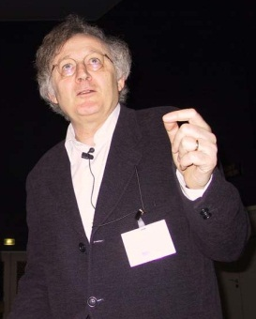

Our idea
Precise and very very fast!
Basis: Array segments
Segment bounds
Disjunction
Uniform content abstraction
0
[222, 222]
i, k
?
[0, 0]
N
0 ≤ i, 0 ≤ k
i == k
i < N, k < N

Slide 242
Example
Contract.Requires(N > 0);
int[] a = new int[N];
0
0
N
int i = 0;
0,i
0
N
0
222
1,i
0
N
?
assume i ≥ N
assume i < N
i -> _
j -> i
N -> N
0,i
0
N
a[i] = 222;
0,i
222
1,i+1
0
N
?
j = i+1;
0,i
222
1,i+1,j
0
N
?

Slide 243
Segment unification
0,i
0
N
0
222
1,i
0
N
?
0
⊥
i
?
0
N
0
222
1,i
0
N
?
0
⊥
i
?
0
N
0
222
i
0
N
?
Join
Can be empty segments! (Disjunction)
0
222
i
?
0
N
?

Slide 244
Example
Contract.Requires(N > 0);
int[] a = new int[N];
int i = 0;
0
222
i
?
0
N
?
Remove doubts
(i == N && N > 0)
assume i ≥ N
assume i < N
0
222
i
?
0
N
0
222
i, N
a[i] = 222;
i -> _
j -> i
N -> N
And so on up to a fixpoint …
We visited all the elements in [0, N)
j = i+1;

Slide 245
Status…
Fast and precise array analysis
Implemented in Clousot
On mscorlib.dll:
Inferred 2429 non-trivial array properties
5 seconds slow down
Less than 1%

Slide 246
Conclusions…

Slide 247
CodeContracts
Specify code with code
No change to the build environment
Part of .NET v4
Documentation generation
Runtime checking
Static checking
Based on abstract interpretation
Predicatable, tunable, scalable, automatic!!!!
Try it today!!!!!

