Slide 1
Code Contracts
Sep 2011

Slide 2
What are Code Contracts?
Standard, language-agnostic way to express
Preconditions
Postconditions
Object invariants
Tools for
Runtime checking of contracts
Documentation generation
Static verification

Slide 3
Goals for Code Contracts
Specify design decisions once Use many times…
Code documentation (in sync with code)
Documentation generation
Runtime checking
Static verification
Don’t change existing .NET dev environment
Languages, IDE, compilers, etc.
Provide a standard specification format
Enable tool eco-system around contracts

Slide 4
Example
/// <summary> Removes suffix from original </summary>
///
public string TrimSuffix(string original, string suffix)
{
Contract.Requires(original != null);
Contract.Requires(!String.IsEmptyOrNull(suffix));
Contract.Ensures(!Contract.Result<string>().EndsWith(suffix));
var result = original
while (result.EndsWith(suffix))
{
result = result.Substring(0, result.Length – suffix.Length);
}
return result;
}

Slide 5
Example
/// <summary> Removes suffix from original </summary>
///
public string TrimSuffix(string original, string suffix)
{
Contract.Requires(original != null);
Contract.Requires(!String.IsEmptyOrNull(suffix));
Contract.Ensures(!Contract.Result<string>().EndsWith(suffix));
var result = original;
if (result.EndsWith(suffix))
{
result = result.Substring(0, result.Length – suffix.Length);
}
return result;
}

Slide 6
Example
/// <summary> Removes suffix from original </summary>
///
public string TrimSuffix(string original, string suffix)
{
Contract.Requires(original != null);
Contract.Requires(!String.IsEmptyOrNull(suffix));
Contract.Ensures(!Contract.Result<string>().EndsWith(suffix));
var result = original;
if (result.EndsWith(suffix))
{
result = result.Substring(0, result.Length – suffix.Length);
}
return result;
}

Slide 7
Example
/// <summary> Removes suffix from original </summary>
///
public string TrimSuffix(string original, string suffix)
{
Contract.Requires(original != null);
Contract.Requires(suffix != null);
Contract.Ensures(!Contract.Result<string>().EndsWith(suffix));
var result = original;
if (result.EndsWith(suffix))
{
result = result.Substring(0, result.Length – suffix.Length);
}
return result;
}

Slide 8
Example
/// <summary> Removes suffix from original </summary>
///
public string TrimSuffix(string original, string suffix)
{
Contract.Requires(original != null);
Contract.Requires(suffix != null);
Contract.Ensures(!Contract.Result<string>().EndsWith(suffix));
var result = original;
if (result.EndsWith(suffix))
{
result = result.Substring(0, result.Length – suffix.Length);
}
return result;
}

Slide 9
Code Contracts Overview
ccrewrite
cccheck
ccdocgen
ccrefgen
Tools
Contracts
BCL 4.0
Authoring
VS2010
Sandcastle
Presentation

Slide 10
Example
/// <summary> Removes suffix from original </summary>
///
public string TrimSuffix(string original, string suffix)
{
Contract.Requires(original != null);
Contract.Requires(suffix != null);
Contract.Ensures(!Contract.Result<string>().EndsWith(suffix));
var result = original;
if (result.EndsWith(suffix))
{
result = result.Substring(0, result.Length – suffix.Length);
}
return result;
}
2 Bugs

Slide 11
Example
/// <summary> Removes suffix from original </summary>
///
public string TrimSuffix(string original, string suffix)
{
Contract.Requires(original != null);
Contract.Requires(suffix != null);
Contract.Ensures(!Contract.Result<string>().EndsWith(suffix));
var result = original;
if (result.EndsWith(suffix))
{
result = result.Substring(0, result.Length – suffix.Length);
}
return result;
}
Bug 1
original = “foo” suffix = “”
result = “foo”

Slide 12
Example
/// <summary> Removes suffix from original </summary>
///
public string TrimSuffix(string original, string suffix)
{
Contract.Requires(original != null);
Contract.Requires(!String.IsEmptyOrNull(suffix));
Contract.Ensures(!Contract.Result<string>().EndsWith(suffix));
var result = original;
if (result.EndsWith(suffix))
{
result = result.Substring(0, result.Length – suffix.Length);
}
return result;
}
Strengthened
Precondition

Slide 13
Example
/// <summary> Removes suffix from original </summary>
///
public string TrimSuffix(string original, string suffix)
{
Contract.Requires(original != null);
Contract.Requires(!String.IsEmptyOrNull(suffix));
Contract.Ensures(!Contract.Result<string>().EndsWith(suffix));
var result = original;
if (result.EndsWith(suffix))
{
result = result.Substring(0, result.Length – suffix.Length);
}
return result;
}
Bug 2
original = “foo” suffix = “o”
result = “fo”

Slide 14
Example
/// <summary> Removes suffix from original </summary>
///
public string TrimSuffix(string original, string suffix)
{
Contract.Requires(original != null);
Contract.Requires(!String.IsEmptyOrNull(suffix));
Contract.Ensures(!Contract.Result<string>().EndsWith(suffix));
var result = original;
while (result.EndsWith(suffix))
{
result = result.Substring(0, result.Length – suffix.Length);
}
return result;
}
Handle repeated
suffixes

Slide 15
Contracts Authored as Code
Boolean expression in source language
No new language
Full expressiveness
No new IDE, compiler, or parser
Full IDE support (intellisense, refactoring, errors)
Semantics of boolean expressions
Given by compiler translation to ECMA MSIL
Persisted compiled contract format
Metadata + IL

Slide 16
Contract API in BCL 4.0
namespace System.Diagnostics.Contracts {
public static class Contract
{
[Conditional(“CONTRACTS_FULL”)]
public static void Requires(bool condition) {}
[Conditional(“CONTRACTS_FULL”)]
public static void Ensures(bool condition) {}
[Conditional(“CONTRACTS_FULL”)]
public static void Invariant(bool condition) {}
…
}
}

Slide 17
Expressiveness: Quantifiers
/// <summary> Removes suffix from original </summary>
///
public string TrimSuffix(string original, string suffix)
{
Contract.Requires(original != null);
Contract.Requires(!String.IsEmptyOrNull(suffix));
Contract.Ensures(!Contract.Result<string>().EndsWith(suffix));
Contract.Ensures(Contract.ForAll(0,
Contract.Result<string>().Length,
i => Contract.Result<string>()[i] == original[i]));
}

Slide 18
Interface Contracts
[ContractClass(typeof(IListContract<>))]
public interface IList<T> : ICollection<T>
{
…
void RemoveAt(int index);
}
[ContractClassFor(typeof(IList<>))]
public class IListContract<T> : IList<T>
{
…
public void RemoveAt(int index)
{
Contract.Requires(index >= 0);
Contract.Requires(index < this.Count);
Contract.Ensures(this.Count == Contract.OldValue(this.Count) - 1);
}
}

Slide 19
Interface Contracts
[ContractClass(typeof(IListContract<>))]
public interface IList<T> : ICollection<T>
{
…
void RemoveAt(int index);
}
[ContractClassFor(typeof(IList<>))]
public class IListContract<T> : IList<T>
{
…
public void RemoveAt(int index)
{
Contract.Requires(index >= 0);
Contract.Requires(index < this.Count);
Contract.Ensures(this.Count == Contract.OldValue(this.Count) - 1);
}
}

Slide 20
Interface Contracts
[ContractClass(typeof(IListContract<>))]
public interface IList<T> : ICollection<T>
{
…
void RemoveAt(int index);
}
[ContractClassFor(typeof(IList<>))]
public class IListContract<T> : IList<T>
{
…
public void RemoveAt(int index)
{
Contract.Requires(index >= 0);
Contract.Requires(index < this.Count);
Contract.Ensures(this.Count == Contract.OldValue(this.Count) - 1);
}
}

Slide 21
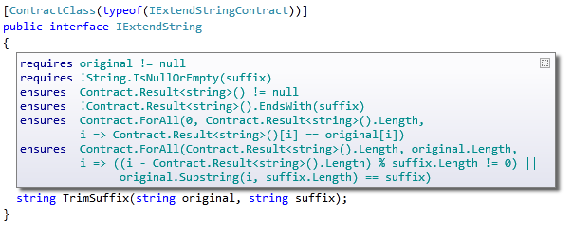
Contract Adornments (VS2010)
Shows inherited contracts
Shows interface contracts on interface

Slide 22
Object Invariants
public class MyCollection
{
///<summary>data is never null<summary>
int[] data;
///<summary>count is non-negative and less equal data.Length<summary>
int count;
[ContractInvariantMethod]
void DataCountInvariants() {
Contract.Invariant( data != null );
Contract.Invariant( count >= 0 );
Contract.Invariant( count <= data.Length );
}
}

Slide 23
Object Invariants
public class MyCollection
{
///<summary>data is never null<summary>
int[] data;
///<summary>count is non-negative and less equal data.Length<summary>
int count;
[ContractInvariantMethod]
void DataCountInvariants() {
Contract.Invariant( data != null );
Contract.Invariant( count >= 0 );
Contract.Invariant( count <= data.Length );
}
}

Slide 24
Code Contracts Overview
ccrewrite
cccheck
ccdocgen
ccrefgen
Tools
Contracts
BCL 4.0
Authoring
VS2010
Sandcastle
Presentation

Slide 25

Runtime Contract Checking
public virtual int Add(object value)
{
Contract.Requires(object != null);
Contract.Ensures( Count == Contract.Old(Count) + 1 );
Contract.Ensures( Contract.Result<int>() == Contract.OldValue(Count) );
if (_size == _items.Length) EnsuresCapacity(_size + 1);
_items[_size] = value;
return _size++;
}
public virtual int Add(object value)
{
Contract.Requires(object != null);
Contract.Ensures( Count == Contract.Old(Count) + 1 );
Contract.Ensures( Contract.Result<int>() == Contract.OldValue(Count) );
if (_size == _items.Length) EnsuresCapacity(_size + 1);
_items[_size] = value;
return _size++;
}
Executable runtime
Contract checking
csc
/d:CONTRACTS_FULL
.method public hidebysig newslot virtual instance int32 Add(object 'value') cil managed
{
.locals init (int32 'Contract.Old(Count)',
int32 'Contract.Result<int>()')
ldarg.1
ldnull
ceq
ldc.i4.0
ceq
ldstr "value != null"
call void __RewriterMethods::RewriterRequires$PST06000009(bool, string)ldarg.0
ldarg.0
call instance int32 TabDemo.BaseList::get_Count()
stloc.3
ldarg.0
ldfld int32 TabDemo.BaseList::count
ldarg.0
ldfld object[] TabDemo.BaseList::items
ldlen
conv.i4
ceq
ldc.i4.0
ceq
stloc.1
ldloc.1
brtrue IL_004d
nop
ldarg.0
ldarg.0
ldfld int32 TabDemo.BaseList::count
ldc.i4.1
add
call instance void TabDemo.BaseList::EnsureCapacity(int32)
nop
nop
ldarg.0
ldfld object[] TabDemo.BaseList::items
ldarg.0
ldfld int32 TabDemo.BaseList::count
ldarg.1
stelem.ref
ldarg.0
dup
ldfld int32 TabDemo.BaseList::count
dup
stloc.2
ldc.i4.1
add
stfld int32 TabDemo.BaseList::count
ldloc.2
stloc.0
br IL_0072
ldloc.0
stloc.s 'Contract.Result<int>()'
br IL_007a
ldarg.0
call instance int32 TabDemo.BaseList::get_Count()
ldloc.3
ldc.i4.1
add
ceq
ldstr "Count == Contract.Old(Count) + 1"
call void __RewriterMethods::RewriterEnsures$PST0600000B(bool, string)
ldloc.s 'Contract.Result<int>()'
ldloc.s V_4
ceq
ldstr "Contract.Result<int>() == Contract.Old(Count)"
call void __RewriterMethods::RewriterEnsures$PST0600000B(bool, string)
ldloc.s 'Contract.Result<int>()'
ret
}
.method public hidebysig newslot virtual instance int32 Add(object 'value') cil managed
{
ldarg.1
ldnull
ceq
ldc.i4.0
ceq
call void [Microsoft.Contracts]Microsoft.Contracts.Contract::Requires(bool)
ldarg.0
call instance int32 TabDemo.BaseList::get_Count()
ldarg.0
call instance int32 TabDemo.BaseList::get_Count()
call !!0 [Microsoft.Contracts]Microsoft.Contracts.Contract::Old<int32>(!!0)
ldc.i4.1
add
ceq
call void [Microsoft.Contracts]Microsoft.Contracts.Contract::Ensures(bool)
call !!0 [Microsoft.Contracts]Microsoft.Contracts.Contract::Result<int32>()
ldarg.0
call instance int32 TabDemo.BaseList::get_Count()
call !!0 [Microsoft.Contracts]Microsoft.Contracts.Contract::Old<int32>(!!0)
ceq
call void [Microsoft.Contracts]Microsoft.Contracts.Contract::Ensures(bool)
ldarg.0
ldfld int32 TabDemo.BaseList::count
ldarg.0
ldfld object[] TabDemo.BaseList::items
ldlen
conv.i4
ceq
ldc.i4.0
ceq
stloc.1
ldloc.1
brtrue.s IL_0069
ldarg.0
ldarg.0
ldfld int32 TabDemo.BaseList::count
ldc.i4.1
add
call instance void TabDemo.BaseList::EnsureCapacity(int32)
ldarg.0
ldfld object[] TabDemo.BaseList::items
ldarg.0
ldfld int32 TabDemo.BaseList::count
ldarg.1
stelem.ref
ldarg.0
dup
ldfld int32 TabDemo.BaseList::count
dup
stloc.2
ldc.i4.1
add
stfld int32 TabDemo.BaseList::count
ldloc.2
stloc.0
br.s IL_008b
ldloc.0
ret
} // end of method BaseList::Add
csc normal compile
.method public hidebysig newslot virtual instance int32 Add(object 'value') cil managed
{
ldarg.0
ldfld int32 TabDemo.BaseList::count
ldarg.0
ldfld object[] TabDemo.BaseList::items
ldlen
conv.i4
ceq
ldc.i4.0
ceq
stloc.1
ldloc.1
brtrue.s IL_0029
ldarg.0
ldarg.0
ldfld int32 TabDemo.BaseList::count
ldc.i4.1
add
call instance void TabDemo.BaseList::EnsureCapacity(int32)
ldarg.0
ldfld object[] TabDemo.BaseList::items
ldarg.0
ldfld int32 TabDemo.BaseList::count
ldarg.1
stelem.ref
ldarg.0
dup
ldfld int32 TabDemo.BaseList::count
dup
stloc.2
ldc.i4.1
add
stfld int32 TabDemo.BaseList::count
ldloc.2
stloc.0
br.s IL_004b
ldloc.0
ret
}
ccrewrite
WF checks
Inheritance
Invariants
Source text

Slide 26
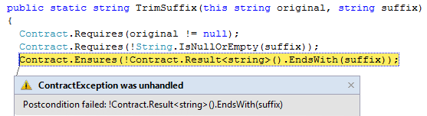
Runtime Checking Experience
Stepping, breakpoints work naturally
Runtime failure behavior fully configurable
Failing condition string available at runtime

Slide 27
Runtime Checking Functionality
Inheritance
Base and interfaces
Granularity knobs
Which checks are inserted
Closures and Iterators
Call-site checking
Recursion guards
Source text extraction
Debug experience/stepping/breakpoints

Slide 28

Contract Reference Assemblies
public virtual int Add(object value)
{
Contract.Requires(object != null);
Contract.Ensures( Count == Contract.Old(Count) + 1 );
Contract.Ensures( Contract.Result<int>() == Contract.OldValue(Count) );
if (_size == _items.Length) EnsuresCapacity(_size + 1);
_items[_size] = value;
return _size++;
}
public virtual int Add(object value)
{
Contract.Requires(object != null);
Contract.Ensures( Count == Contract.Old(Count) + 1 );
Contract.Ensures( Contract.Result<int>() == Contract.OldValue(Count) );
if (_size == _items.Length) EnsuresCapacity(_size + 1);
_items[_size] = value;
return _size++;
}
Compile
/d:CONTRACTS_FULL
Contract Reference Assembly
.method public hidebysig newslot virtual instance int32 Add(object 'value') cil managed
{
ldarg.1
ldnull
ceq
ldc.i4.0
ceq
call void [Microsoft.Contracts]Microsoft.Contracts.Contract::Requires(bool)
ldarg.0
call instance int32 TabDemo.BaseList::get_Count()
ldarg.0
call instance int32 TabDemo.BaseList::get_Count()
call !!0 [Microsoft.Contracts]Microsoft.Contracts.Contract::Old<int32>(!!0)
ldc.i4.1
add
ceq
call void [Microsoft.Contracts]Microsoft.Contracts.Contract::Ensures(bool)
call !!0 [Microsoft.Contracts]Microsoft.Contracts.Contract::Result<int32>()
ldarg.0
call instance int32 TabDemo.BaseList::get_Count()
call !!0 [Microsoft.Contracts]Microsoft.Contracts.Contract::Old<int32>(!!0)
ceq
call void [Microsoft.Contracts]Microsoft.Contracts.Contract::Ensures(bool)
ldarg.0
ldfld int32 TabDemo.BaseList::count
ldarg.0
ldfld object[] TabDemo.BaseList::items
ldlen
conv.i4
ceq
ldc.i4.0
ceq
stloc.1
ldloc.1
brtrue.s IL_0069
ldarg.0
ldarg.0
ldfld int32 TabDemo.BaseList::count
ldc.i4.1
add
call instance void TabDemo.BaseList::EnsureCapacity(int32)
ldarg.0
ldfld object[] TabDemo.BaseList::items
ldarg.0
ldfld int32 TabDemo.BaseList::count
ldarg.1
stelem.ref
ldarg.0
dup
ldfld int32 TabDemo.BaseList::count
dup
stloc.2
ldc.i4.1
add
stfld int32 TabDemo.BaseList::count
ldloc.2
stloc.0
br.s IL_008b
ldloc.0
ret
} // end of method BaseList::Add
.method public hidebysig newslot virtual instance int32 Add(object 'value') cil managed
{
ldarg.1
ldnull
ceq
ldc.i4.0
ceq
call void [Microsoft.Contracts]Microsoft.Contracts.Contract::Requires(bool)
ldarg.0
call instance int32 TabDemo.BaseList::get_Count()
ldarg.0
call instance int32 TabDemo.BaseList::get_Count()
call !!0 [Microsoft.Contracts]Microsoft.Contracts.Contract::Old<int32>(!!0)
ldc.i4.1
add
ceq
call void [Microsoft.Contracts]Microsoft.Contracts.Contract::Ensures(bool)
call !!0 [Microsoft.Contracts]Microsoft.Contracts.Contract::Result<int32>()
ldarg.0
call instance int32 TabDemo.BaseList::get_Count()
call !!0 [Microsoft.Contracts]Microsoft.Contracts.Contract::Old<int32>(!!0)
ceq
call void [Microsoft.Contracts]Microsoft.Contracts.Contract::Ensures(bool)
} // end of method BaseList::Add
ccrefgen
Language-agnostic, persisted contract format
Free: produced by all compilers
Semantics given by MSIL encoding conditions
Uniform format to down-stream tools
Library for extracting contracts from MSIL

Slide 29
Contract Reference Assemblies
Contract Reference Assemblies
.method public hidebysig newslot virtual instance int32 Add(object 'value') cil managed
{
ldarg.1
ldnull
ceq
ldc.i4.0
ceq
call void [Microsoft.Contracts]Microsoft.Contracts.Contract::Requires(bool)
ldarg.0
call instance int32 TabDemo.BaseList::get_Count()
ldarg.0
call instance int32 TabDemo.BaseList::get_Count()
call !!0 [Microsoft.Contracts]Microsoft.Contracts.Contract::Old<int32>(!!0)
ldc.i4.1
add
ceq
call void [Microsoft.Contracts]Microsoft.Contracts.Contract::Ensures(bool)
call !!0 [Microsoft.Contracts]Microsoft.Contracts.Contract::Result<int32>()
ldarg.0
call instance int32 TabDemo.BaseList::get_Count()
call !!0 [Microsoft.Contracts]Microsoft.Contracts.Contract::Old<int32>(!!0)
ceq
call void [Microsoft.Contracts]Microsoft.Contracts.Contract::Ensures(bool)
ldarg.0
ldfld int32 TabDemo.BaseList::count
ldarg.0
ldfld object[] TabDemo.BaseList::items
ldlen
conv.i4
ceq
ldc.i4.0
ceq
stloc.1
ldloc.1
brtrue.s IL_0069
ldarg.0
ldarg.0
ldfld int32 TabDemo.BaseList::count
ldc.i4.1
add
call instance void TabDemo.BaseList::EnsureCapacity(int32)
ldarg.0
ldfld object[] TabDemo.BaseList::items
ldarg.0
ldfld int32 TabDemo.BaseList::count
ldarg.1
stelem.ref
ldarg.0
dup
ldfld int32 TabDemo.BaseList::count
dup
stloc.2
ldc.i4.1
add
stfld int32 TabDemo.BaseList::count
ldloc.2
stloc.0
br.s IL_008b
ldloc.0
ret
} // end of method BaseList::Add
ccrewrite
Runtime checks
cccheck
Compile-time warnings
ccdocgen
Augmented Xml doc

Slide 30
Providing Contracts for your Lib
src
src
src
src
Release Assemblies
Contract Reference Assemblies
PowerLib.dll
PowerLib.Contracts.dll
+
(minimal runtime checks)
All contracts, no code

Slide 31
Developing against 3rd Party Lib
can check Requires of PowerLib at call-sites
inherits contracts
src
src
src
MyApp.exe
MyApp.exe
src
ccrewrite
PowerLib.Contracts.dll
PowerLib.dll
(no runtime checks)

Slide 32
Runtime Checking Scenario
ACME
ACME.dll
ACME.Contracts.dll
PowerLib
PowerLib.dll
PowerLib.Contracts.dll
Developing MyApp against libraries ACME and PowerLib
Libraries come with contract reference assemblies
ACME.Contracts.dll
PowerLib.Contracts.dll
When developing MyApp with runtime checked contracts
Checks contracts within MyApp
Inherits contracts from ACME and PowerLib
Instruments preconditions at call-sites to ACME and PowerLib
MyApp

Slide 33
Contracts for Existing Libraries
Mscorlib
System
System.Data
System.Xml
System.Windows
System.Core
System.Configuration
System.Web
System.Windows.Browser
System.Windows.Forms
WindowsBase
System.Drawing
System.Security
Microsoft.VisualBasic.Compatibility
System.Xml.Linq
Microsoft.VisualBasic

Slide 34
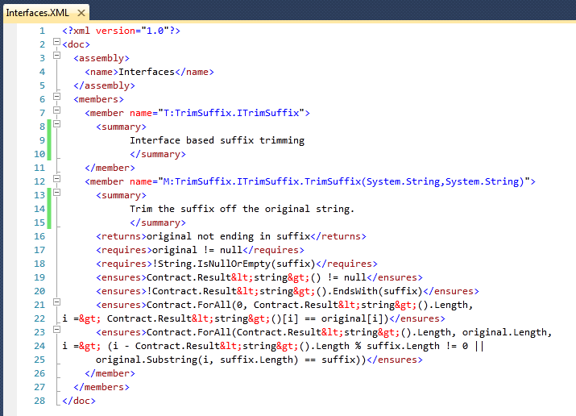
Documentation Generation
ccdocgen augments XML doc file with contract elements
Enables any other tool to read them
XSLT patches for Sandcastle prototyped

Slide 35
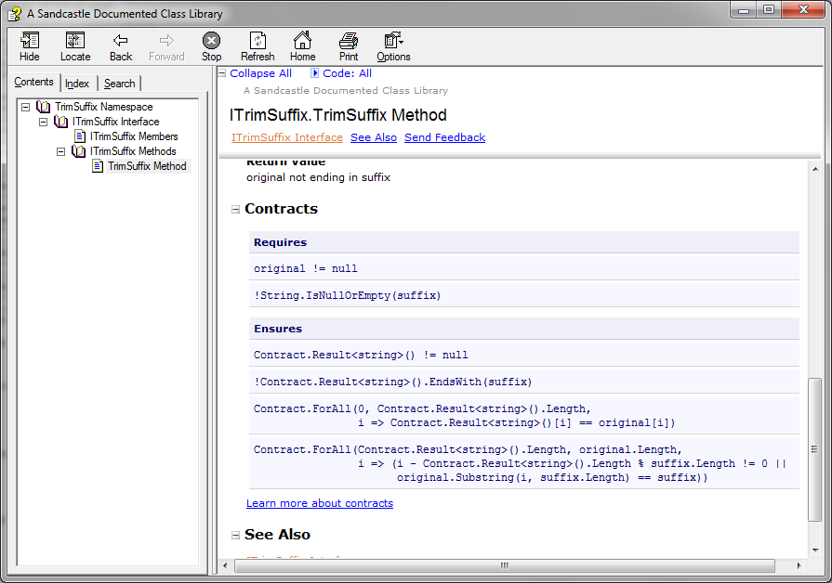
Doc Generation with Sandcastle

Slide 36
Static Contract Checking
No silver bullet
False warnings
Prefast/FxCop
Masking
SAL
Annotate
Contracts
More expressive annotations
Runtime checked
Start small (1 method, 1 class)
Annotation Overhead
Precision
Performance
Noise
Notes:
We feel we have a better handle.

Slide 37
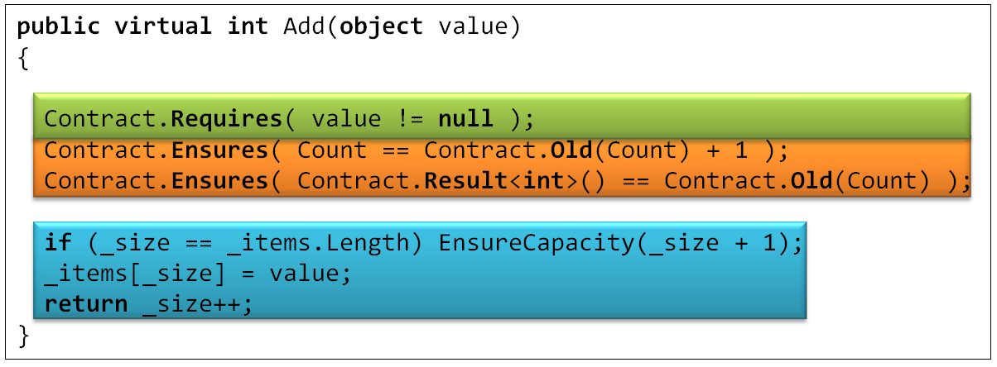
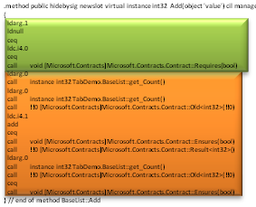
Static Checking
Contract Reference Assemblies
Compile
/d:CONTRACTS
.method public hidebysig newslot virtual instance int32 Add(object 'value') cil managed
{
ldarg.1
ldnull
ceq
ldc.i4.0
ceq
call void [Microsoft.Contracts]Microsoft.Contracts.Contract::Requires(bool)
ldarg.0
call instance int32 TabDemo.BaseList::get_Count()
ldarg.0
call instance int32 TabDemo.BaseList::get_Count()
call !!0 [Microsoft.Contracts]Microsoft.Contracts.Contract::Old<int32>(!!0)
ldc.i4.1
add
ceq
call void [Microsoft.Contracts]Microsoft.Contracts.Contract::Ensures(bool)
call !!0 [Microsoft.Contracts]Microsoft.Contracts.Contract::Result<int32>()
ldarg.0
call instance int32 TabDemo.BaseList::get_Count()
call !!0 [Microsoft.Contracts]Microsoft.Contracts.Contract::Old<int32>(!!0)
ceq
call void [Microsoft.Contracts]Microsoft.Contracts.Contract::Ensures(bool)
ldarg.0
ldfld int32 TabDemo.BaseList::count
ldarg.0
ldfld object[] TabDemo.BaseList::items
ldlen
conv.i4
ceq
ldc.i4.0
ceq
stloc.1
ldloc.1
brtrue.s IL_0069
ldarg.0
ldarg.0
ldfld int32 TabDemo.BaseList::count
ldc.i4.1
add
call instance void TabDemo.BaseList::EnsureCapacity(int32)
ldarg.0
ldfld object[] TabDemo.BaseList::items
ldarg.0
ldfld int32 TabDemo.BaseList::count
ldarg.1
stelem.ref
ldarg.0
dup
ldfld int32 TabDemo.BaseList::count
dup
stloc.2
ldc.i4.1
add
stfld int32 TabDemo.BaseList::count
ldloc.2
stloc.0
br.s IL_008b
ldloc.0
ret
} // end of method BaseList::Add
Static Contract Checking with Clousot
Compile-time warnings

Slide 38
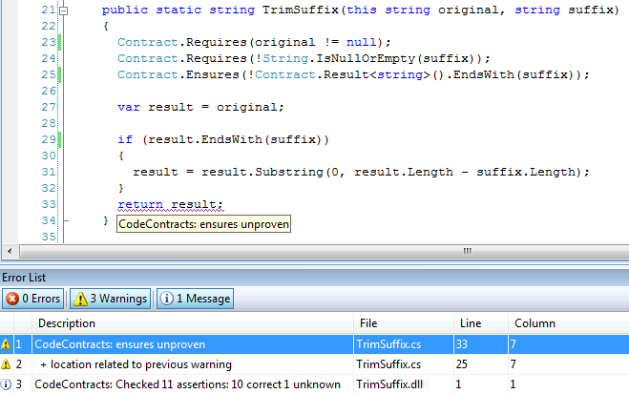
Static Contract Verification

Slide 39
More Info
External
http://msdn.microsoft.com/devlabs/dd491992.aspx
Mail
mailto:conconfb@microsoft.com

