Slide 1
Integrating a Set of Contract Checking Tools into Visual Studio
Manuel Fähndrich Microsoft Research
TOPI Workshop 2012

Slide 2
The Researcher Dilemma
How do you provide new programming language features?
How do you provide tool support for this extension?

Slide 3







Tension!
Crazy Scientist
Professional Programmer
Wants adoption of ideas, but
wants to focus on research
wants to minimize engineering
Needs tools, but requires
easy adoption
immediate benefit
low risk

Slide 4
Easy Adoption
Existing practices impacted minimally
Same programming language and IDE

Slide 5
Provide a Mixed Set of Benefits
Some Immediate benefits at low cost
Intermediate and long-term benefits
The more programmers invest, the more benefit

Slide 6

Risks
Tool bugs, maintenance
Critical path to building product
Fall behind underlying language and IDE

Slide 7











Approaches to Language Extensions
Comment syntax (e.g. JML for Java)
Comments are text
Duplication of effort (parser, type checker, …)
IDE support difficult
Attributes/Annotations (e.g. [NotNull], @NonNull)
Very limited expressiveness
Semantics
Specialized Languages (e.g. Spec#, Eiffel)
Not easy to adopt
Large development effort
Lots of inessential distractions

Slide 8





Our Preferred Approach
Source Embedded Language Extensions
Express new features as statements in existing language
Leverage existing compilers, IDEs
Extract new features from compiled code
Target Rewriting and Analysis
Work around expressiveness
For semantics and re-use
Generic Plug-ins
For version isolation and re-use

Slide 9
A Study: CodeContract Tools
Enable Programmers to write Specifications
Preconditions, postconditions, object invariants
Document design decisions
Facilitate code reuse and evolution
Same contracts used for many tools
Documentation generation
Runtime checking of contracts
Static verification

Slide 10
Source Embedded Contract Language
Specifications as Code in existing languages
Compile normally
Extract Contracts from target code
public virtual int Add(object value) { Contract.Requires( value != null ); Contract.Ensures( Count == Contract.OldValue(Count) + 1 ); Contract.Ensures( Contract.Result<int>() == Contract.OldValue(Count) ); if (count == items.Length) EnsureCapacity(count + 1); items[count] = value; return count++; }

Slide 11
Specifications = API Calls
namespace System.Diagnostics.Contracts {
public static class Contract
{
[Conditional(“CONTRACTS_FULL”)]
public static void Requires(bool condition) {}
[Conditional(“CONTRACTS_FULL”)]
public static void Ensures(bool condition) {}
[Conditional(“CONTRACTS_FULL”)]
public static void Invariant(bool condition) {}
public static T Result<T>() {…}
public static T OldValue<T>(T expression) {…}
…
}
}
Library reusable from C#, VisualBasic, F#, …

Slide 12
Source Embedded Advantages
No new language, compilers, IDEs
Boolean expression from source language used
No a-priori restrictions what can be expressed
Intellisense, refactoring, error checking, …
Compiled contract format is .NET CIL
Compiler translates to CIL
Semantics provided by ECMA CIL standard
Uniform format for tools

Slide 13
Object Invariants
public class MyCollection
{
///<summary>data is never null<summary>
int[] data;
///<summary>count is non-negative and less equal data.Length<summary>
int count;
[ContractInvariantMethod]
void DataCountInvariants() {
Contract.Invariant( data != null );
Contract.Invariant( count >= 0 );
Contract.Invariant( count <= data.Length );
}
}

Slide 14
Object Invariants
public class MyCollection
{
///<summary>data is never null<summary>
int[] data;
///<summary>count is non-negative and less equal data.Length<summary>
int count;
[ContractInvariantMethod]
void DataCountInvariants() {
Contract.Invariant( data != null );
Contract.Invariant( count >= 0 );
Contract.Invariant( count <= data.Length );
}
}

Slide 15
Expressiveness: Quantifiers
public void Summarize(ICollection<string> data)
{
Contract.Requires( Contract.ForAll(data, s => s != null) );
…
}

Slide 16
Interface Contracts
[ContractClass(typeof(IListContract<>))]
public interface IList<T> : ICollection<T>
{
…
void RemoveAt(int index);
}
[ContractClassFor(typeof(IList<>))]
public class IListContract<T> : IList<T>
{
…
public void RemoveAt(int index)
{
Contract.Requires(index >= 0);
Contract.Requires(index < this.Count);
Contract.Ensures(this.Count == Contract.OldValue(this.Count) - 1);
}
}

Slide 17
Interface Contracts
[ContractClass(typeof(IListContract<>))]
public interface IList<T> : ICollection<T>
{
…
void RemoveAt(int index);
}
[ContractClassFor(typeof(IList<>))]
public class IListContract<T> : IList<T>
{
…
public void RemoveAt(int index)
{
Contract.Requires(index >= 0);
Contract.Requires(index < this.Count);
Contract.Ensures(this.Count == Contract.OldValue(this.Count) - 1);
}
}

Slide 18
Interface Contracts
[ContractClass(typeof(IListContract<>))]
public interface IList<T> : ICollection<T>
{
…
void RemoveAt(int index);
}
[ContractClassFor(typeof(IList<>))]
public class IListContract<T> : IList<T>
{
…
public void RemoveAt(int index)
{
Contract.Requires(index >= 0);
Contract.Requires(index < this.Count);
Contract.Ensures(this.Count == Contract.OldValue(this.Count) - 1);
}
}

Slide 19
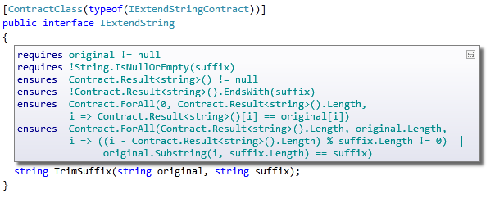
Mitigating the Encoding: Adornments
Shows inherited contracts
Shows interface contracts on interface
Shows contracts on metadata

Slide 20
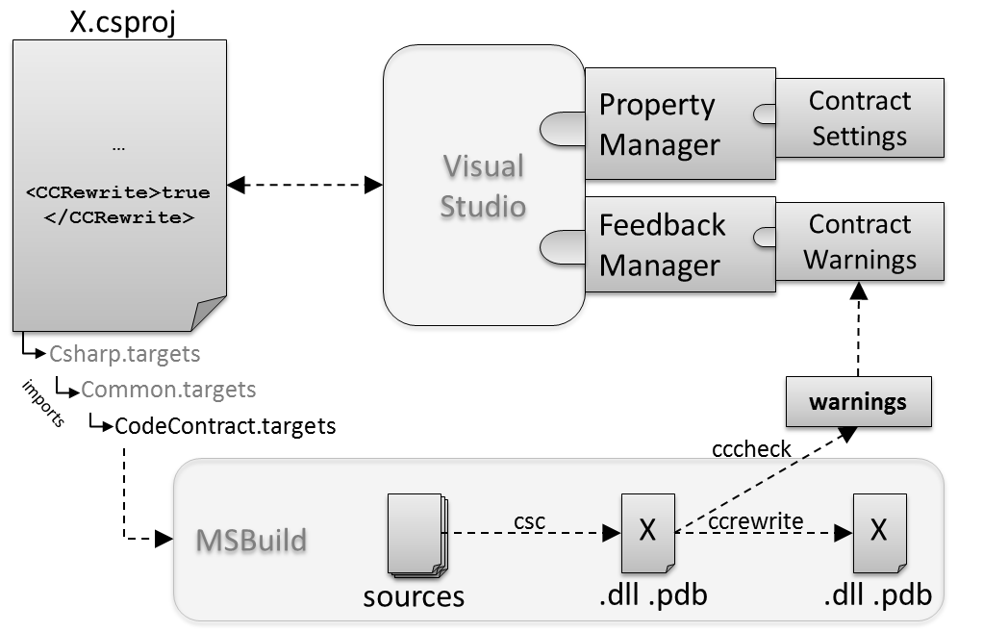
Integration Architecture

Slide 21
MSBuild Integration
Build settings
Property file
Build rules
Included based on project type
Has hooks for extra build files
Build rules have hooks for extra steps/dependencies
Command-line and IDE
Same build description
Complications
Re-signing
Bin-placing / packaging into .xaps

Slide 22

Target Rewriting : Runtime Contract Checking
public virtual int Add(object value)
{
Contract.Requires(object != null);
Contract.Ensures( Count == Contract.Old(Count) + 1 );
Contract.Ensures( Contract.Result<int>() == Contract.OldValue(Count) );
if (_size == _items.Length) EnsuresCapacity(_size + 1);
_items[_size] = value;
return _size++;
}
public virtual int Add(object value)
{
Contract.Requires(value != null);
Contract.Ensures( Count == Contract.Old(Count) + 1 );
Contract.Ensures( Contract.Result<int>() == Contract.OldValue(Count) );
if (_size == _items.Length) EnsuresCapacity(_size + 1);
_items[_size] = value;
return _size++;
}
Executable runtime
Contract checking
csc
/d:CONTRACTS_FULL
.method public hidebysig newslot virtual instance int32 Add(object 'value') cil managed
{
.locals init (int32 'Contract.Old(Count)',
int32 'Contract.Result<int>()')
ldarg.1
ldnull
ceq
ldc.i4.0
ceq
ldstr "value != null"
call void __RewriterMethods::RewriterRequires$PST06000009(bool, string)ldarg.0
ldarg.0
call instance int32 TabDemo.BaseList::get_Count()
stloc.3
ldarg.0
ldfld int32 TabDemo.BaseList::count
ldarg.0
ldfld object[] TabDemo.BaseList::items
ldlen
conv.i4
ceq
ldc.i4.0
ceq
stloc.1
ldloc.1
brtrue IL_004d
nop
ldarg.0
ldarg.0
ldfld int32 TabDemo.BaseList::count
ldc.i4.1
add
call instance void TabDemo.BaseList::EnsureCapacity(int32)
nop
nop
ldarg.0
ldfld object[] TabDemo.BaseList::items
ldarg.0
ldfld int32 TabDemo.BaseList::count
ldarg.1
stelem.ref
ldarg.0
dup
ldfld int32 TabDemo.BaseList::count
dup
stloc.2
ldc.i4.1
add
stfld int32 TabDemo.BaseList::count
ldloc.2
stloc.0
br IL_0072
ldloc.0
stloc.s 'Contract.Result<int>()'
br IL_007a
ldarg.0
call instance int32 TabDemo.BaseList::get_Count()
ldloc.3
ldc.i4.1
add
ceq
ldstr "Count == Contract.Old(Count) + 1"
call void __RewriterMethods::RewriterEnsures$PST0600000B(bool, string)
ldloc.s 'Contract.Result<int>()'
ldloc.s V_4
ceq
ldstr "Contract.Result<int>() == Contract.Old(Count)"
call void __RewriterMethods::RewriterEnsures$PST0600000B(bool, string)
ldloc.s 'Contract.Result<int>()'
ret
}
.method public hidebysig newslot virtual instance int32 Add(object 'value') cil managed
{
ldarg.1
ldnull
ceq
ldc.i4.0
ceq
call void [Microsoft.Contracts]Microsoft.Contracts.Contract::Requires(bool)
ldarg.0
call instance int32 TabDemo.BaseList::get_Count()
ldarg.0
call instance int32 TabDemo.BaseList::get_Count()
call !!0 [Microsoft.Contracts]Microsoft.Contracts.Contract::Old<int32>(!!0)
ldc.i4.1
add
ceq
call void [Microsoft.Contracts]Microsoft.Contracts.Contract::Ensures(bool)
call !!0 [Microsoft.Contracts]Microsoft.Contracts.Contract::Result<int32>()
ldarg.0
call instance int32 TabDemo.BaseList::get_Count()
call !!0 [Microsoft.Contracts]Microsoft.Contracts.Contract::Old<int32>(!!0)
ceq
call void [Microsoft.Contracts]Microsoft.Contracts.Contract::Ensures(bool)
ldarg.0
ldfld int32 TabDemo.BaseList::count
ldarg.0
ldfld object[] TabDemo.BaseList::items
ldlen
conv.i4
ceq
ldc.i4.0
ceq
stloc.1
ldloc.1
brtrue.s IL_0069
ldarg.0
ldarg.0
ldfld int32 TabDemo.BaseList::count
ldc.i4.1
add
call instance void TabDemo.BaseList::EnsureCapacity(int32)
ldarg.0
ldfld object[] TabDemo.BaseList::items
ldarg.0
ldfld int32 TabDemo.BaseList::count
ldarg.1
stelem.ref
ldarg.0
dup
ldfld int32 TabDemo.BaseList::count
dup
stloc.2
ldc.i4.1
add
stfld int32 TabDemo.BaseList::count
ldloc.2
stloc.0
br.s IL_008b
ldloc.0
ret
} // end of method BaseList::Add
csc normal compile
.method public hidebysig newslot virtual instance int32 Add(object 'value') cil managed
{
ldarg.0
ldfld int32 TabDemo.BaseList::count
ldarg.0
ldfld object[] TabDemo.BaseList::items
ldlen
conv.i4
ceq
ldc.i4.0
ceq
stloc.1
ldloc.1
brtrue.s IL_0029
ldarg.0
ldarg.0
ldfld int32 TabDemo.BaseList::count
ldc.i4.1
add
call instance void TabDemo.BaseList::EnsureCapacity(int32)
ldarg.0
ldfld object[] TabDemo.BaseList::items
ldarg.0
ldfld int32 TabDemo.BaseList::count
ldarg.1
stelem.ref
ldarg.0
dup
ldfld int32 TabDemo.BaseList::count
dup
stloc.2
ldc.i4.1
add
stfld int32 TabDemo.BaseList::count
ldloc.2
stloc.0
br.s IL_004b
ldloc.0
ret
}
ccrewrite
WF checks
Inheritance
Invariants
Source text

Slide 23
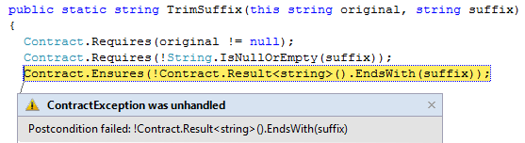
Runtime Checking Experience
Stepping, breakpoints work naturally
Runtime failure behavior fully configurable
Failing condition string available at runtime

Slide 24
Target Rewriting Provides Expressiveness
Can work around language limitations
Constructor base call evaluation
public class C : B {
public C(object value)
: base(value)
{
Contract.Requires(value != null);
...
}
}
Delayed evaluation due to thunks
public IEnumerable<T> GetItems(object value)
{
Contract.Requires(value != null);
...
yield return element;
}
}

Slide 25
Target Analysis
Contract Reference Assemblies
Simplification
Complexity of source vs. target
Semantic clarity
Resolution
Overloading
Drawbacks:
Encodings
.method public hidebysig newslot virtual instance int32 Add(object 'value') cil managed
{
ldarg.1
ldnull
ceq
ldc.i4.0
ceq
call void [Microsoft.Contracts]Microsoft.Contracts.Contract::Requires(bool)
ldarg.0
call instance int32 TabDemo.BaseList::get_Count()
ldarg.0
call instance int32 TabDemo.BaseList::get_Count()
call !!0 [Microsoft.Contracts]Microsoft.Contracts.Contract::Old<int32>(!!0)
ldc.i4.1
add
ceq
call void [Microsoft.Contracts]Microsoft.Contracts.Contract::Ensures(bool)
call !!0 [Microsoft.Contracts]Microsoft.Contracts.Contract::Result<int32>()
ldarg.0
call instance int32 TabDemo.BaseList::get_Count()
call !!0 [Microsoft.Contracts]Microsoft.Contracts.Contract::Old<int32>(!!0)
ceq
call void [Microsoft.Contracts]Microsoft.Contracts.Contract::Ensures(bool)
ldarg.0
ldfld int32 TabDemo.BaseList::count
ldarg.0
ldfld object[] TabDemo.BaseList::items
ldlen
conv.i4
ceq
ldc.i4.0
ceq
stloc.1
ldloc.1
brtrue.s IL_0069
ldarg.0
ldarg.0
ldfld int32 TabDemo.BaseList::count
ldc.i4.1
add
call instance void TabDemo.BaseList::EnsureCapacity(int32)
ldarg.0
ldfld object[] TabDemo.BaseList::items
ldarg.0
ldfld int32 TabDemo.BaseList::count
ldarg.1
stelem.ref
ldarg.0
dup
ldfld int32 TabDemo.BaseList::count
dup
stloc.2
ldc.i4.1
add
stfld int32 TabDemo.BaseList::count
ldloc.2
stloc.0
br.s IL_008b
ldloc.0
ret
} // end of method BaseList::Add
cccheck
Compile-time warnings

Slide 26




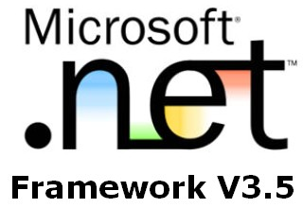





Target Rewriting and Analysis Provides Stability and Reach
Between .NET 2.0 and 4.5, IL instruction set did not change
Variance was added
C# and VB added dozens of new language constructs and features
CodeContracts work on multiple languages and platforms w/o change*
Notes:
Contract reference assemblies are framework specific, complicates things

Slide 27
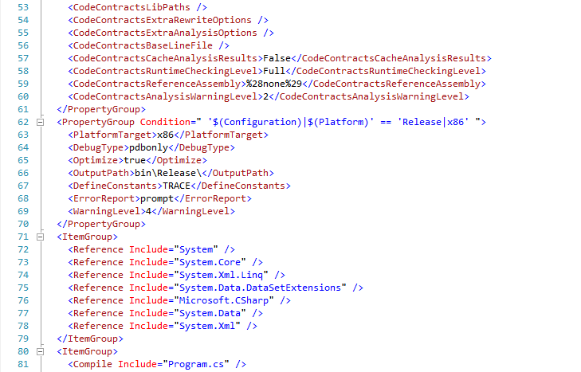
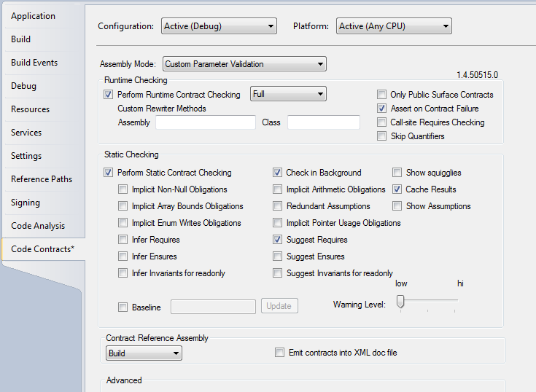
Tool Specific Plug-ins improve adoption
Property and Settings Manager provides UI support to view and edit compilation unit settings

Slide 28
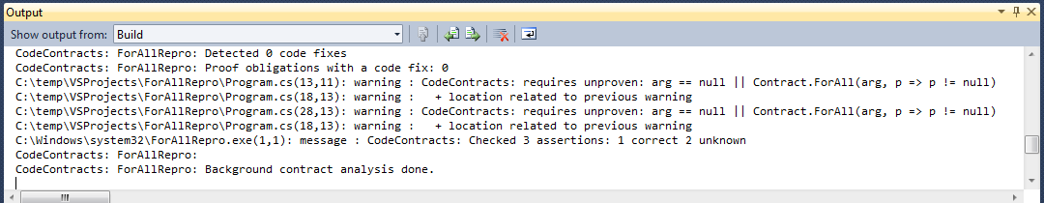
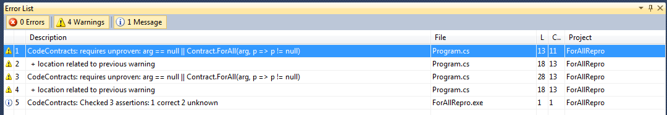
Tool Specific Plug-ins improve adoption
Task Manager: translates tool output to IDE warnings , squigglies, and context sensitive actions

Slide 29
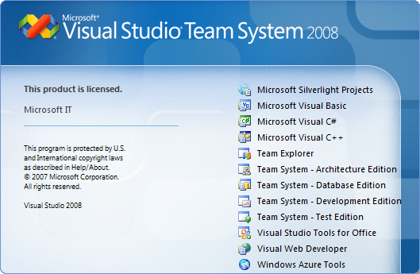
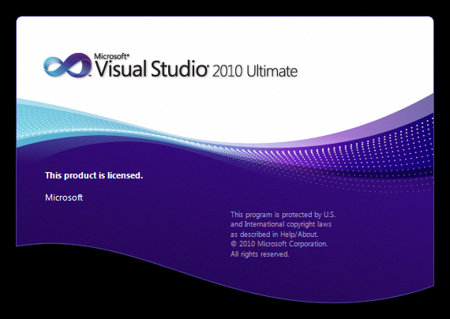
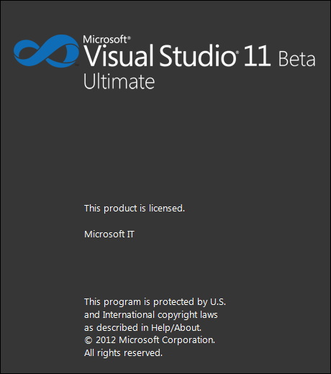
Generic Plug-ins Provide Stability and Reuse
Task Manager and Property Pane Generic Plugins
Had to be adapted from VS2008 to VS2010 to VS2012
Tool specific plugins worked without change afterwards
Task Manager used in Spec#, CodeContracts, and Revisions
Property Pane used in CodeContracts, Revisions, and internal tools

Slide 30
Porting Tools Forward

Slide 31





Lessons Learned
Source Embedded Language Extensions
Reuse of compiler, IDE, intellisense, syntax, type checking, etc.
Target Rewriting and Analysis
Simpler language, clarity of semantics, stability and reach
Generic Plug-ins
Isolation from IDE changes and re-use: settings + feedback manager
Very liberal build system helps (msbuild)
Drawbacks
Heavy syntax for some constructs
Contract Extractor is most brittle part
Advantages heavily outweigh drawbacks

Slide 33
Backups

Slide 34




Target Rewriting Provides Reach

Slide 35

Contract Reference Assemblies
public virtual int Add(object value)
{
Contract.Requires(object != null);
Contract.Ensures( Count == Contract.Old(Count) + 1 );
Contract.Ensures( Contract.Result<int>() == Contract.OldValue(Count) );
if (_size == _items.Length) EnsuresCapacity(_size + 1);
_items[_size] = value;
return _size++;
}
public virtual int Add(object value)
{
Contract.Requires(value != null);
Contract.Ensures( Count == Contract.Old(Count) + 1 );
Contract.Ensures( Contract.Result<int>() == Contract.OldValue(Count) );
if (_size == _items.Length) EnsuresCapacity(_size + 1);
_items[_size] = value;
return _size++;
}
Compile
/d:CONTRACTS_FULL
Contract Reference Assembly
.method public hidebysig newslot virtual instance int32 Add(object 'value') cil managed
{
ldarg.1
ldnull
ceq
ldc.i4.0
ceq
call void [Microsoft.Contracts]Microsoft.Contracts.Contract::Requires(bool)
ldarg.0
call instance int32 TabDemo.BaseList::get_Count()
ldarg.0
call instance int32 TabDemo.BaseList::get_Count()
call !!0 [Microsoft.Contracts]Microsoft.Contracts.Contract::Old<int32>(!!0)
ldc.i4.1
add
ceq
call void [Microsoft.Contracts]Microsoft.Contracts.Contract::Ensures(bool)
call !!0 [Microsoft.Contracts]Microsoft.Contracts.Contract::Result<int32>()
ldarg.0
call instance int32 TabDemo.BaseList::get_Count()
call !!0 [Microsoft.Contracts]Microsoft.Contracts.Contract::Old<int32>(!!0)
ceq
call void [Microsoft.Contracts]Microsoft.Contracts.Contract::Ensures(bool)
ldarg.0
ldfld int32 TabDemo.BaseList::count
ldarg.0
ldfld object[] TabDemo.BaseList::items
ldlen
conv.i4
ceq
ldc.i4.0
ceq
stloc.1
ldloc.1
brtrue.s IL_0069
ldarg.0
ldarg.0
ldfld int32 TabDemo.BaseList::count
ldc.i4.1
add
call instance void TabDemo.BaseList::EnsureCapacity(int32)
ldarg.0
ldfld object[] TabDemo.BaseList::items
ldarg.0
ldfld int32 TabDemo.BaseList::count
ldarg.1
stelem.ref
ldarg.0
dup
ldfld int32 TabDemo.BaseList::count
dup
stloc.2
ldc.i4.1
add
stfld int32 TabDemo.BaseList::count
ldloc.2
stloc.0
br.s IL_008b
ldloc.0
ret
} // end of method BaseList::Add
.method public hidebysig newslot virtual instance int32 Add(object 'value') cil managed
{
ldarg.1
ldnull
ceq
ldc.i4.0
ceq
call void [Microsoft.Contracts]Microsoft.Contracts.Contract::Requires(bool)
ldarg.0
call instance int32 TabDemo.BaseList::get_Count()
ldarg.0
call instance int32 TabDemo.BaseList::get_Count()
call !!0 [Microsoft.Contracts]Microsoft.Contracts.Contract::Old<int32>(!!0)
ldc.i4.1
add
ceq
call void [Microsoft.Contracts]Microsoft.Contracts.Contract::Ensures(bool)
call !!0 [Microsoft.Contracts]Microsoft.Contracts.Contract::Result<int32>()
ldarg.0
call instance int32 TabDemo.BaseList::get_Count()
call !!0 [Microsoft.Contracts]Microsoft.Contracts.Contract::Old<int32>(!!0)
ceq
call void [Microsoft.Contracts]Microsoft.Contracts.Contract::Ensures(bool)
} // end of method BaseList::Add
ccrefgen
Language-agnostic, persisted contract format
Free: produced by all compilers
Semantics given by MSIL encoding conditions
Uniform format to down-stream tools
Library for extracting contracts from MSIL

Slide 36
Contract Reference Assemblies
Contract Reference Assemblies
.method public hidebysig newslot virtual instance int32 Add(object 'value') cil managed
{
ldarg.1
ldnull
ceq
ldc.i4.0
ceq
call void [Microsoft.Contracts]Microsoft.Contracts.Contract::Requires(bool)
ldarg.0
call instance int32 TabDemo.BaseList::get_Count()
ldarg.0
call instance int32 TabDemo.BaseList::get_Count()
call !!0 [Microsoft.Contracts]Microsoft.Contracts.Contract::Old<int32>(!!0)
ldc.i4.1
add
ceq
call void [Microsoft.Contracts]Microsoft.Contracts.Contract::Ensures(bool)
call !!0 [Microsoft.Contracts]Microsoft.Contracts.Contract::Result<int32>()
ldarg.0
call instance int32 TabDemo.BaseList::get_Count()
call !!0 [Microsoft.Contracts]Microsoft.Contracts.Contract::Old<int32>(!!0)
ceq
call void [Microsoft.Contracts]Microsoft.Contracts.Contract::Ensures(bool)
ldarg.0
ldfld int32 TabDemo.BaseList::count
ldarg.0
ldfld object[] TabDemo.BaseList::items
ldlen
conv.i4
ceq
ldc.i4.0
ceq
stloc.1
ldloc.1
brtrue.s IL_0069
ldarg.0
ldarg.0
ldfld int32 TabDemo.BaseList::count
ldc.i4.1
add
call instance void TabDemo.BaseList::EnsureCapacity(int32)
ldarg.0
ldfld object[] TabDemo.BaseList::items
ldarg.0
ldfld int32 TabDemo.BaseList::count
ldarg.1
stelem.ref
ldarg.0
dup
ldfld int32 TabDemo.BaseList::count
dup
stloc.2
ldc.i4.1
add
stfld int32 TabDemo.BaseList::count
ldloc.2
stloc.0
br.s IL_008b
ldloc.0
ret
} // end of method BaseList::Add
ccrewrite
Runtime checks
cccheck
cccheck
Compile-time warnings
Compile-time warnings
ccdocgen
Augmented Xml doc

Slide 37
Providing Contracts for your Lib
src
src
src
src
Release Assemblies
Contract Reference Assemblies
PowerLib.dll
PowerLib.Contracts.dll
+
(minimal runtime checks)
All contracts, no code

Slide 38
Developing against 3rd Party Lib
can check Requires of PowerLib at call-sites
inherits contracts
src
src
src
MyApp.exe
MyApp.exe
src
ccrewrite
PowerLib.Contracts.dll
PowerLib.dll
(no runtime checks)

Slide 39
Drawbacks of Approach
Encodings necessary for missing constructs
Result, OldValue, ValueAtReturn
Interface contract classes
Contract extraction / decompilation from IL
Closures + closure instantiation
Field initialization in constructors
Language specific idioms (C#, VB, F#)
… Yet, advantages greatly outweigh these.

Slide 40
Purity
Contract expression should have no observable side effects
Current practice with Asserts
Pure Methods
Purity of methods is declared [Pure]
Calls to pure methods allowed in contracts

Slide 41
Proof of Concept: CodeContracts
ccrewrite
cccheck
ccdocgen
ccrefgen
Tools
Contracts
BCL 4.0
Authoring
VS2010
Sandcastle
Presentation

Slide 42
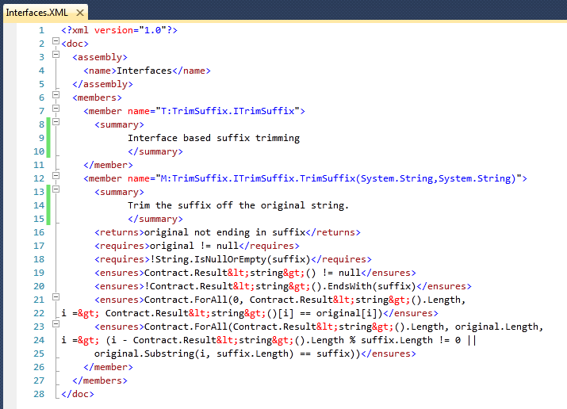
Documentation Generation
ccdocgen augments XML doc file with contract elements
Enables any other tool to read them
XSLT patches for Sandcastle prototyped

Slide 43
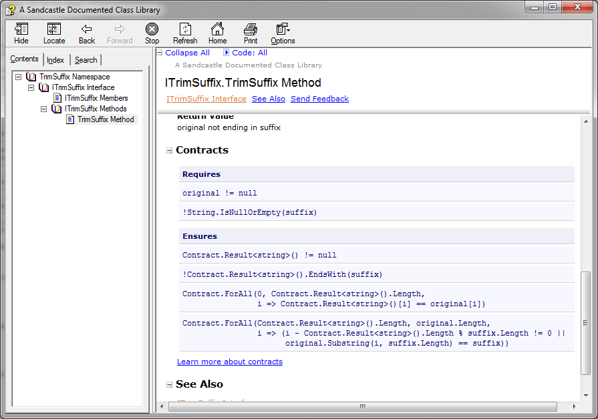
Documentation Generation

Slide 44
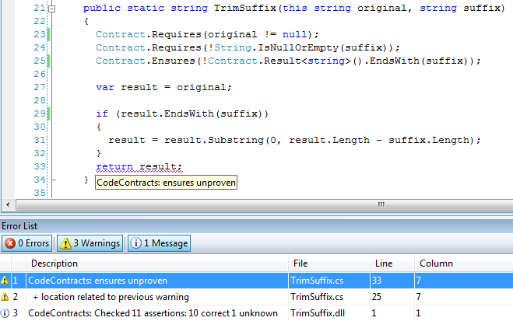
Static Contract Verification

