Slide 1
Clousot

Slide 2
Static contract checking for .net
CodeContracts: Express Contracts as method calls
Ex. Contract.Requires(x != null), Contract.Ensures(Contract.Result<int>() > 0)
Advantages:
No need for a new language, compiler etc.
Leverage IDE, existing compiler, etc.
Runtime checking via binary rewriting
Static checking via abstract interpretation
Infer loop invariants, pre/post, obj. invariants
Use them to discharge proof obligations

Slide 3
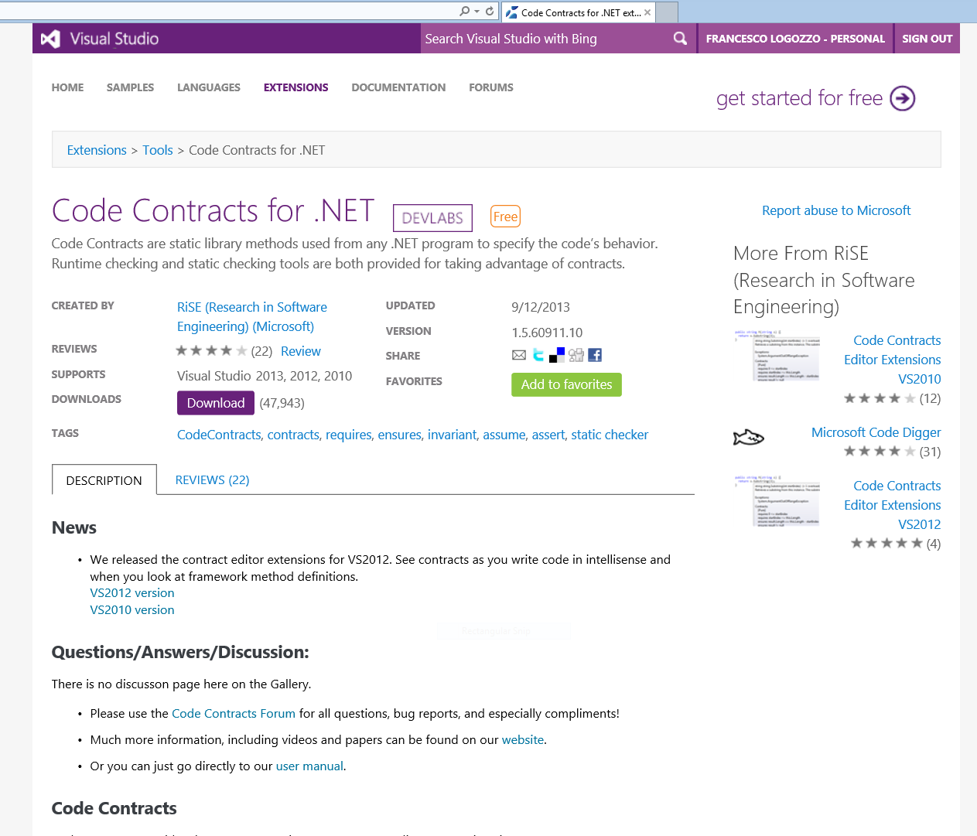
Usable verification
Externally available for external users
More than 130K downloads
Active user forum
Book chapters, blogs, magazines

Slide 4
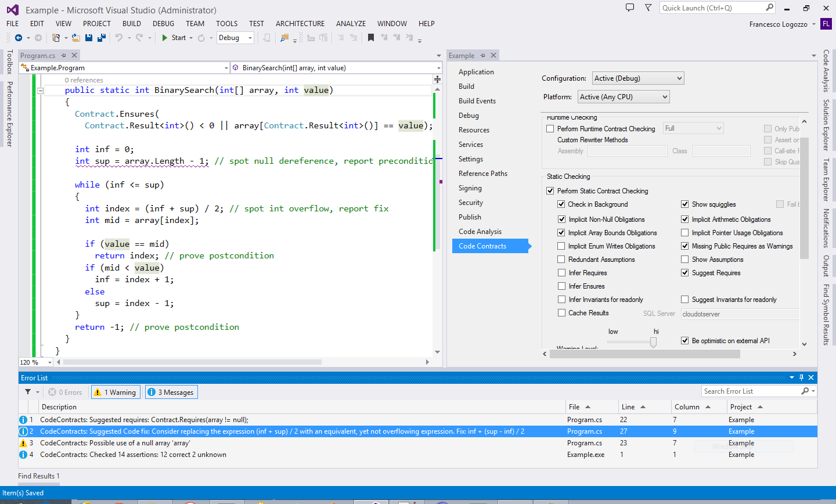
Prove
non-trivial conditions
Integrate in VS
Infer loop invariants
Find defects
Infer preconditions
Suggest code fixes

Slide 5
But also…
Cloudot
Run the analysis on a server, share cache among team members
Smart Programming Assistant
Errors and fixes as you type, refactoring with contracts
Verification Modulo Versions
Static verification made version-aware
Relative verification, and regression finding
ReviewBot
Automatic review generation (annotations, comments, regressions …)

